Slide 1
Multicultural Education Professional Learning

Slide 2
Full Session Outline
Introduction
Your Perspective
Terms
Multicultural Education
Cultural Responsiveness
Closing Reflection
Handouts
Notes:
Facilitator - Follow these steps when presenting this slide: (Note: You will need the handouts prepared in advance. Most of them come from (as cited from Paul Gorski –; http://www.edchange.org/multicultural/curriculum/steps.html – Stages of Multicultural Curriculum Transformation).
Explain:
The overview PowerPoint provided the following information regarding the professional learning session:
Introduction
Purpose
Benefits
WV Code, WVDE Policies, & WVDE Evaluation Standards
Terms
Why Culture Matters
Closing Reflections
As a review, the next several slides provide key information about the multicultural education professional learning session.
The review includes:
The Purpose
WV Code, Policies, and Evaluation Standards
A list of 16 Cultural Groups, which provides insight into what is being defined when discussing multicultural education throughout the learning session.

Slide 3
Introduction

Slide 4

Purpose
Increase awareness and respect for ALL differences, through multicultural education.
Notes:
Facilitator - Follow these steps when presenting this slide:
Read the slide aloud or allow participants an opportunity to silently read the slide.
Explain that a more comprehensive list of differences will be provided.

Slide 5
WV Code and Policy
WV State Code
  §18-5-5a: Study of Multicultural Education for School Personnel
WV Board of Education Policies
  Policy 2315: Comprehensive School Counseling Model
  Policy 2322: West Virginia System of Support and Accountability
  Policy 2510: Assuring the Quality of Education: Regulations for Educational Programs
  Policy 2520.19: WV College- and Career- Readiness Dispositions and Standards for Student Success Grades K-12
  Policy 4373: Expected Behavior in Safe and Supportive Schools
Notes:
Facilitator - Follow these steps when presenting this slide:
Explain The additional purpose of multicultural education professional learning is to fulfill WV Code, Policy, and Evaluation Standards. Then, complete one of the following options:
Option 1: Allow participants to read through the slide. OR
Option 2: Read through and explain the policies in more detail, using the information below as a reference.
The WV Code & WVDE Policies Section Includes:
The relevancy of the initiative as pertaining to specific WV Code, WVDE Policies, and WVDE Evaluation Standards.
These policies reflect that Diversity Professional Learning is embedded in the vision of WVDE.
Specific Policy Support is as follows:
Policy 2322: 1.1; 3.2.1; 3.2.1c; 3.2.3; 3.2.3a; 3.2.3d
Policy 2510: Assuring the Quality of Education: Regulation for Education Programs: pages 7, 10, 12 Prek-5; 6-8; 9-12

Slide 6
WV Code and Policy
WV Board of Education Strategic Plan : Core Values
Evaluation Standards
Teacher:
  Standard 2 - The Learner and the learning Environment; Element 2.1, Element 2.2
  Standard 3 - Teaching; Element 3.3
  Standard 4 Professional Responsibilities for Self-Renewal; element 4.1
Counselor:
  Standard 2 - Program Delivery; Element 2.1, Element 2.3, Element 2.4, Element 2.5
  Standard 4 - Leadership and Advocacy; Element 4.1
  Standard 5 Professional Growth and Responsibilities; Element 5.1, Element 5.2
Administrator:
  Standard 4 - Positive Learning Climate and Cohesive Culture; Element 4
  Standard 5 - Professional Growth and Retention of Quality Staff; Element 5
  Standard 6 - Support Systems for Student Success; Element 6
Notes:
Facilitator - Follow these steps when presenting this slide:
Explain The additional purpose of multicultural education professional learning is to fulfill WV Code, Policy, and Evaluation Standards. Then, complete one of the following options:
Option 1: Allow participants to read through the slide. OR
Option 2: Read through and explain the policies in more detail, using the information below as a reference.
The WV Code & WVDE Policies Section Includes:
The relevancy of the initiative as pertaining to specific WV Code, WVDE Policies, and WVDE Evaluation Standards.
These policies reflect that Diversity Professional Learning is embedded in the vision of WVDE.
Specific Policy Support is as follows:
Policy 2322: 1.1; 3.2.1; 3.2.1c; 3.2.3; 3.2.3a; 3.2.3d
Policy 2510: Assuring the Quality of Education: Regulation for Education Programs: pages 7, 10, 12 Prek-5; 6-8; 9-12

Slide 7
Student Success Standards
Global Citizenship
  DSS.K-2.14-15:
    Understand and describe the interactive roles and relationships among family members and classroom community.
    Identify self as a member of groups within a community.
    Understand similarities and respect differences among people, such as gender, race, disability, culture, language, and family structure.
  DSS.3-5.14-15:
    Investigate and respect aspects of various communities and discuss how these contribute to each person’s perspective of local, state, and world events.
    Identify themselves as members of varied groups within the local, state, national, and international community.
    Interact respectfully with all individuals regardless of gender, race, disability, culture, language, and family structure
Notes:
Explain:
Policy 2520.19: WV College- and Career- Readiness Dispositions and Standards for Student Success are required to be implemented K-12 in all schools.

Slide 8
Student Success Standards
Global Citizenship
  DSS.6-8.14-15:
    Compare and contrast aspects of various communities and describe how these contribute to each person’s perspective and world view.
    Analyze factors that contribute to different social and world views (e.g., ethnicity, race, culture, gender, sexual orientation, family composition, lifestyle, religion, economic status and nationality).
    Apply an inter-culturally sensitive perspective to social interactions.
    Describe global issues and events from perspectives of various individuals and groups to understand viewpoints other than one’s own.
    Investigate methods for enhancing language proficiency and the ability to communicate effectively across cultural and linguistic boundaries.
    Describe how stereotyping and prejudices impact interpersonal relationships.
Notes:
Explain:
Policy 2520.19: WV College- and Career- Readiness Dispositions and Standards for Student Success are required to be implemented K-12 in all schools.

Slide 9
Student Success Standards
Global Citizenship
  DSS.9-12.14-15:
    Describe how the characteristics of diverse world regions and individual communities contribute to varying world views.
    Investigate and explain how factors such as ethnicity, gender, religion, sexuality, and economic conditions contribute to different social and world views.
    Analyze global issues and events to gain an understanding of others’ viewpoints.
    Analyze language, behavior, and non-verbal communication cues to interact respectfully with diverse cultures.
    Examine the influence of stereotyping and prejudice and how they impact relationships.
Notes:
Explain:
Policy 2520.19: WV College- and Career- Readiness Dispositions and Standards for Student Success are required to be implemented K-12 in all schools.

Slide 10
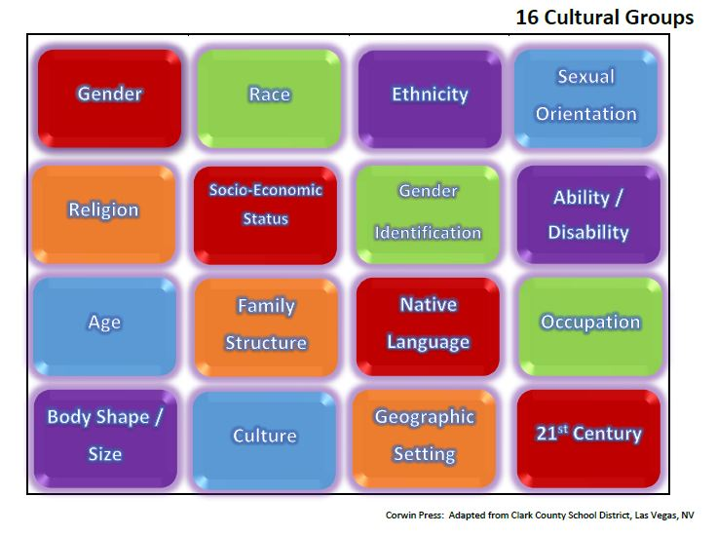
Notes:
Facilitator - Follow these steps when presenting this slide:
Explain:
Diversity is vast.
It’s important to understand that multiculturalism and diversity includes more than race, gender, religion, and socio-economic status.
The 16 Cultural Groups listed on the slide provide a scope of what multiculturalism and diversity include.
Each of the 16 cultural groups have subcultures.
There are other cultural groups not listed.
The cultural group of 21st Century reflects a new century. Refers to differences in society including technology.
Optional Activity:
Stand Up – Use this activity to show the level of diversity that exists within the room. Stand Up Activity
Directions:
Explain to participants that you are going to read a series of statements.
Ask participants to stand up when they meet the criteria for each statement.
Have everyone look around at those standing in the room.
Ask standing participants to sit down in between each statement.
Excuse anyone from standing who feels the questions may violate their privacy.
Purpose: To show the diversity within the room. Relate the activity to the 16 cultural groups.
Statements:
Please stand up if you:
Were raised in County, WV. (Please Note: Regarding the blank - use the county in which the activity is being used).
Were raised in the State of WV, outside of County. (Please Note: Regarding the blank - use the county stated in #1).
Were raised in a state outside of WV.
Were raised in another country outside of the US or one of its territories.
Have had a professional career outside of the educational system.
Have spent 1-5 years working in the educational system.
Have spent 6-10 years working in the educational system.
Have spent 10-20 years working in the educational system.
Have spent more than at least 20 years working within the educational system.
Consider yourself to be tech savvy.
Were born between 1927 – 1945 (Mature / Silent Generation). Have them share something unique about their generation – from their perspective.
Were born between 1946 – 1964 (Baby Boomers). Have them share something unique about their generation – from their perspective.
Were born between 1965 – 1980 (Generation X). Have them share something unique about their generation – from their perspective.
Were born between 1981 – 1996 (Generation Y - Millennials). Have them share something unique about their generation – from their perspective.
Were both between 1997 - 2012 (Generation Z). Have them share something unique about their generation – from their perspective.
Speak more than one language.
Debriefing Questions:
What did you notice as you were sitting and standing?
What surprised you?
What questions do you have for group members?
What other questions might have been asked?
What was the purpose of this activity?

Slide 11
Diversity Makes Us Different
Primary Dimensions of Diversity
Secondary Dimensions of Diversity
Age
Race
Ethnicity
Heritage
Gender
Physical abilities/qualities
Sexual/affection orientation
Mental abilities/characteristics
Education
Communication style
Work background
Work style
Income: Wealth/Poverty
Marital status
Military experience
Religious beliefs
Geographic location
Parental status
Notes:
Facilitator - Follow these steps when presenting this slide:
Explain that this slide further details cultural groups, aka Dimensions of Diversity.
Optional Activities:
Have participants list other types of diversity not listed in these two slides.
Have participants provide examples of advantages and stereotypes of each category of diversity.
Ask participants to silently think about their own reactions to the 16 cultural groups listed.
Ask participants to share personal experiences they have encountered because of being a part of one or more of the cultural groups.

Slide 12
Activity: Name Five Things
List 5 things about you,
that if taken from you,
you would not be the same person you are today.
Notes:
Facilitator - Follow these steps when presenting this slide:
Ask participants to have a writing utensil and sheet of paper available.
Ask participants to write 1, 2, 3, 4, 5 vertically on their papers.
Read Slide. Explain to participants that the types of things they would list include family, friends, faith, job – etc.
Give participants three minutes to list five items.
After three minutes, tell participants to place a line through the first item they listed.
Then have participants place a line through the seconds item they listed.
Then have participants place a line through the fourth item they listed.
Ask participants to answer the following questions, either aloud or reflectively:
What did you notice as you wrote your list?
What did it feel like to have to cross items off your list?
What did you learn about yourself?
Ask participants to reflect upon the following statement as you read the statement aloud:
Consider the last two remaining items on your list. Would you, as an adult, be able to function day to day if three of the most important aspects of your life were taken away from you and you were left to function with the two remaining items?
Pause for 10 seconds and then progress to the next slide.

Slide 13
Consider the Students
When we ask students to remove aspects of themselves to accommodate our teaching, or our schools, we are disabling their ability to learn and achieve at full capacity.
Notes:
Facilitator - Follow these steps when presenting this slide:
Read the slide aloud.
Ask for any thoughts or reflections.

Slide 14
Terms
Notes:
The next activity allows participants to discuss definitions and to clarify their understanding of such so that the same vocabulary may be used throughout the session.
Facilitator - Follow these steps when presenting this slide:
Explain that the Terms Section includes commonly used terms when referring to Multicultural Education.

Slide 15
Activity: Defining Terms Used in Multicultural Education
Culture​
Diversity​
Ethnicity​
Race​
Multicultural Education​
Cultural Responsiveness​
Cultural Proficiency​
Global Competence​
Tolerance​
Bias​
Stereotype​
Equity​
Equality​
Handout
Notes:
The terms on this slide are commonly used and misused when discussing Multicultural Education. The activity provides an opportunity for participants to discuss definitions and to clarify their understanding of such so that the same vocabulary may be used throughout the session.
Facilitator:
1.Explain the purpose of the activity, which is to allow participants to discuss definitions and to clarify their understanding of such so that the same vocabulary may be used throughout the session.
2.Distribute the Definitions Handout. The handout may be accessed by clicking on the icon on the PPT slide. Access the document prior to placing the PPT in presentation mode.
3.Organize the participants into groups of three to five people.
4.Give each group one or two words to discuss.
5.Ask the participants to:
a.read the definitions for these commonly used and misused terms;
b.reflect on the definition, comparting it to how they use the term(s); and
c.note whether the definition affirms, helps to clarify, or challenges their thinking.
6.Ask each group to share the highlights of their discussion.

Slide 16
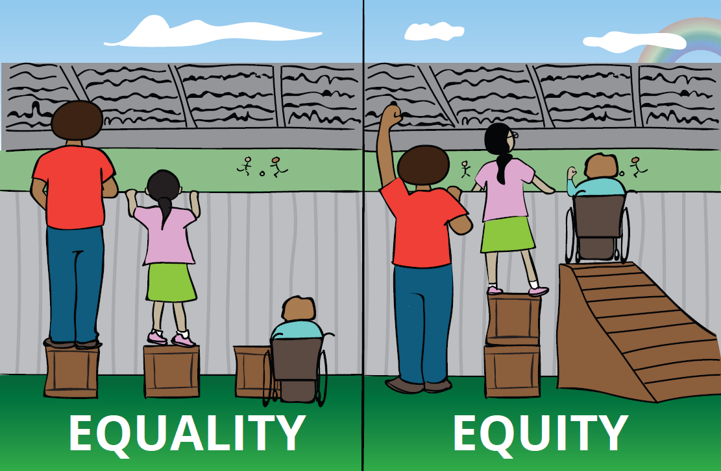
Equality vs. Equity
Equality means giving each student the same resource.​
Educational equity means that every student has access to the resources and educational rigor they need at the right moment in their education, despite race, gender, ethnicity, language, family income, family background, or disability.​
Notes:
Equality is about SAMENESS, it promotes fairness and justice by giving everyone the same thing. BUT, it can only work IF everyone starts from the same place. In this example, equality only works if everyone is the same height.
Equity is about FAIRNESS, it’s about making sure people get access to the same opportunities. Sometimes, our differences and/or history, can create barriers to participation, so we must FIRST ensure EQUITY before we can enjoy equality. Sometimes, our students of diverse populations- especially those with disabilities- do not get appropriate access to their education. A student‘s disability should not determine his/her educational environment nor define them, which leads me to person-first language.

Slide 17
Your Perspective
Notes:
Facilitator - Follow these steps when presenting this slide:
Explain the Your Perspective section provides an opportunity for participants to look inwardly at their own thoughts, beliefs, and perspectives.

Slide 18
The Culture of Schooling
20th Century​
21st Century​
Tolerance ​
Factory Model ​
Top Down​
Silos ​
Gatekeepers​
Intervention Programs​
Deficits ​
“Old School” ​
Diversity Training ​
Transformation ​
Inclusive Systems ​
Collaborative/Co-Creative ​
Leadership Teams ​
Agents of Change ​
School-Wide Support/Prevention ​
Assets ​
Multiple Perspectives ​
Cultural Proficiency Practices ​
Notes:
This slides compares and contrasts how school systems operate(d) in the 20th and 21st centuries.
Facilitator - Follow these steps when presenting this slide:
1.Read aloud and compare the following types of schooling which occurred in 20th and 21st Century Schooling
a.Tolerance vs. Transformation
i.20th Century Tolerance: The concept of tolerance gives the notion that we “put up with” or “stomach” or “endure” someone or something. It’s like you really don’t want to have to deal with something or someone, but we “endure” the effort. Tolerance is least effective when attempting to build strong student relationships. WHEREAS
ii.21st Century Transformation: The concept of transformation refers to adapting our school, classroom and professional offices to ensure a culture and climate of safety, acceptance and student learning is established. Transformation is most effective when attempting to build strong student relationships.
b.Silos vs. Leadership Teams
i.20th Century Silos: Where administrators, teachers and other school personnel work in isolation. Least effective way of operating when attempting to strengthen and enhance district / school culture. WHEREAS
ii.21st Century Leadership Teams: Teams collaborate and formalize plans based upon input from key persons in a district / school building. Most effective way of operating when attempting to strengthen and enhance district / school culture.

Slide 19
Activity: The Culture of Schooling
1. Compare and contrast one of the following 20th and 21st century culture of schooling aspects:
    Factory Model vs. Inclusive System
    Top Down vs. Collaborative/Co-Creative
    Gatekeepers vs. Agents of Change
    Intervention Programs vs. School Wide Support/Prevention
    Deficits vs. Assets
    “Old School” vs. Multiple Perspectives
2. Identify the pros and cons of the 20th and 21st century culture of schooling aspects they have chosen.
3. Determine if your building (administrator), classroom (teacher/others) or office (counselors, nurses, etc.) represents 20th or 21st century culture of schooling.
Notes:
This slide represents a “Think-Pair-Share” activity.
Facilitator - Follow these steps when presenting this slide:
Think-Pair-Share Activity: Provide a three-minute opportunity for participants to pair with another individual to compare/contrast other aspects of 20th and 21st Century Schooling.
Read the following instructions to the staff development participants. In their groups they will:
Compare and contrast one of the following 20th and 21st century culture of schooling aspects:
Factory Model vs. Inclusive System
Top Down vs. Collaborative/Co-Creative
Gatekeepers vs. Agents of Change
Intervention Programs vs. School Wide Support/Prevention
Deficits vs. Assets
“Old School” vs. Multiple Perspectives
Identify and write down on a sheet of paper the pros and cons of the 20th and 21st century culture of schooling aspects they have chosen. For example, if they chose #4 - Intervention Programs vs. School Wide Support/Prevention, then they would list the pros and cons of Intervention Programs and the pros and cons of School Wide Support/Prevention
Have the participants determine if their building (if they are an administrator), classroom (if they are a teacher or another individual with a classroom) or office (if they are a counselor, nurse, etc.) represents 20th or 21st century culture of schooling.

Slide 20


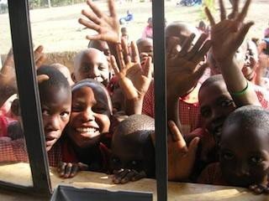
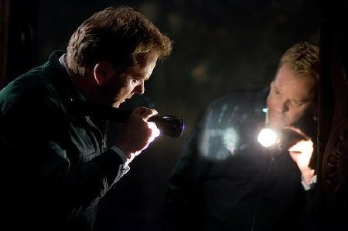


Multicultural Perspectives
  Windows Mirrors
Notes:
Facilitator - Follow these steps when presenting this slide:
Explain to participants that there are essentially two perspectives regarding multicultural education:
Window Perspective – The “Window” perspective of multicultural education and culturally responsive teaching is looking outwardly to try to determine what’s “wrong” with “someone who is different”
Mirror Perspective – The “Mirror” perspective of multicultural education and culturally responsive teaching is looking inwardly and to self-reflect… an inside-out approach to improve one’s responses and interactions with others.
The most effective educators look inwardly to determine impressions they may have about others, which influences how instruction is taught in the classroom.
The next activity, First Impressions, provides insights on how our initial thoughts of others – based upon beliefs and assumptions – impact our impressions of others. The activity is key in relating our experiences to the classroom and school environment as well.

Slide 21

Activity: First Impressions: Who Are They?
Write down your thoughts and impressions regarding the individual or groups of individuals on the next eight slides.
Notes:
Facilitator - Follow these steps when presenting this slide:
Ask participants to consider their first thoughts and impression about the identity of the individuals or group of individuals on the next several slides – simply by looking at them.
Ask participants to use pencil/pen and paper to document their thoughts / first impressions.

Slide 22
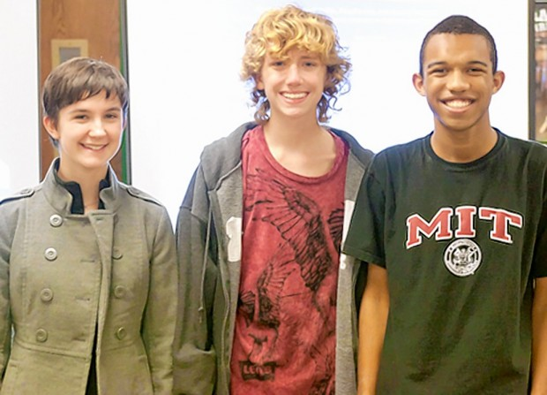
Activity
Notes:
Facilitator - Follow these steps when presenting this slide:
Allow 30-45 seconds for participants to write down or ponder their thoughts about the individuals on the slide.
Move to the next slide.

Slide 23
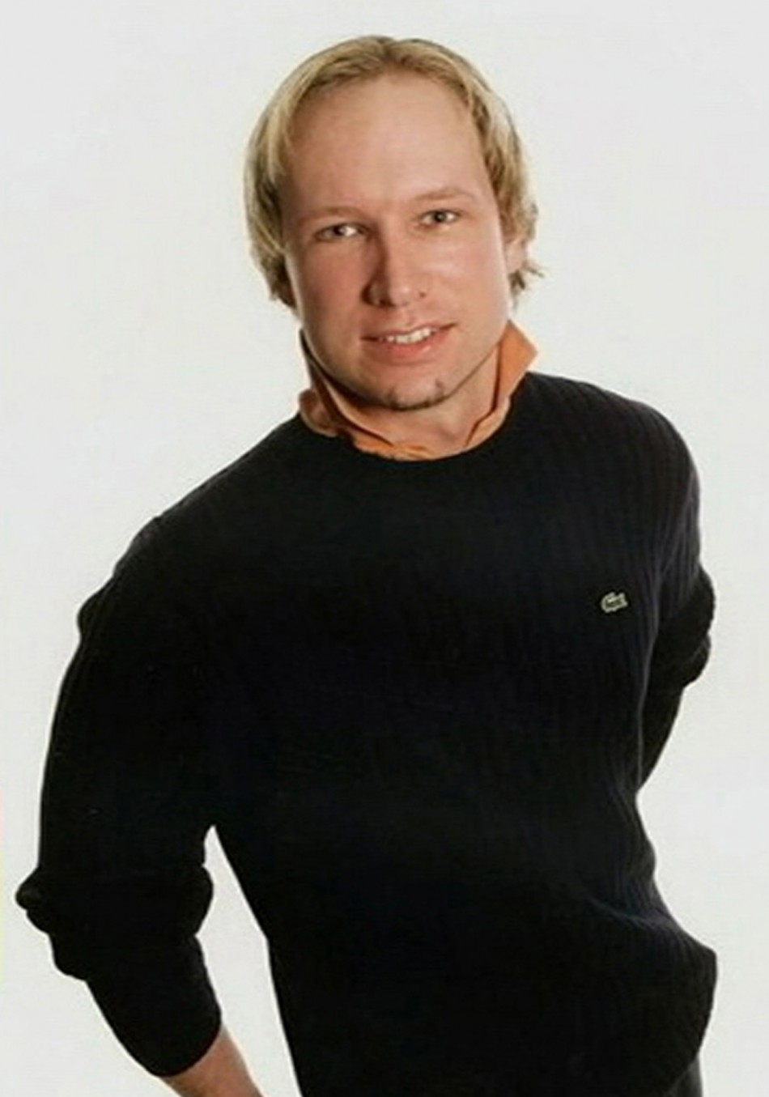
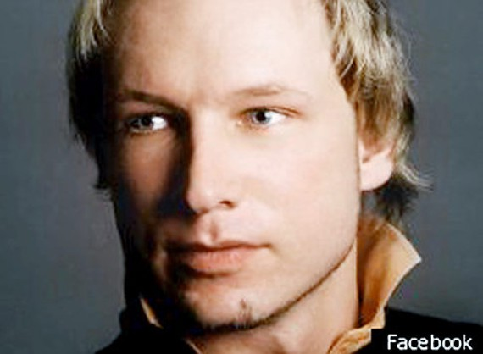
Activity
Notes:
Facilitator - Follow these steps when presenting this slide:
Allow 30-45 seconds for participants to write down or ponder their thoughts about the individuals on the slide.
Move to the next slide.

Slide 24
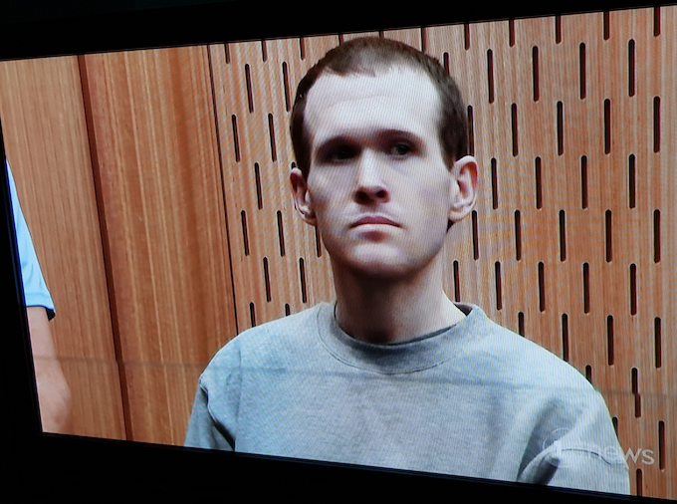
Activity
Notes:
Facilitator - Follow these steps when presenting this slide:
Allow 30-45 seconds for participants to write down or ponder their thoughts about the individuals on the slide.
Please Note: This is the last slide that requires individuals to write their first impressions. The next several slides provide the identities of each of the individuals or groups of individuals.

Slide 25
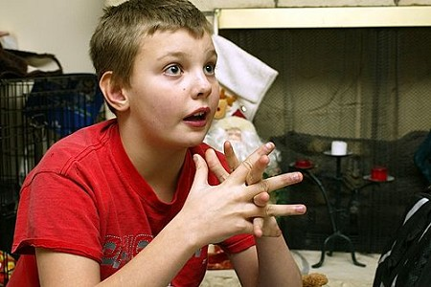
Activity
Notes:
Facilitator - Follow these steps when presenting this slide:
Allow 30-45 seconds for participants to write down or ponder their thoughts about the individuals on the slide.
Move to the next slide.

Slide 26
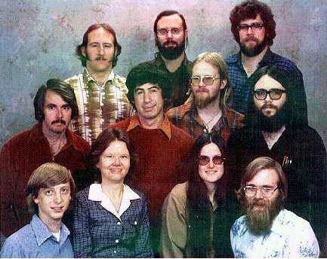
Activity
Notes:
Facilitator - Follow these steps when presenting this slide:
Allow 30-45 seconds for participants to write down or ponder their thoughts about the individuals on the slide.
Move to the next slide.

Slide 27
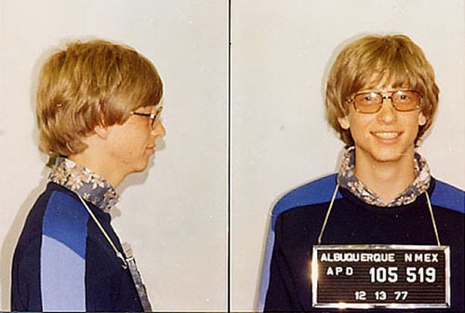
Activity
Notes:
Facilitator - Follow these steps when presenting this slide:
Allow 30-45 seconds for participants to write down or ponder their thoughts about the individuals on the slide.
Move to the next slide.

Slide 28
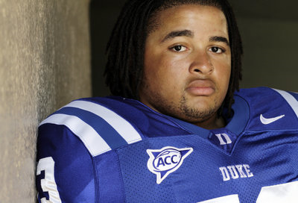
Activity
Notes:
Facilitator - Follow these steps when presenting this slide:
Allow 30-45 seconds for participants to write down or ponder their thoughts about the individuals on the slide.
Move to the next slide.

Slide 29
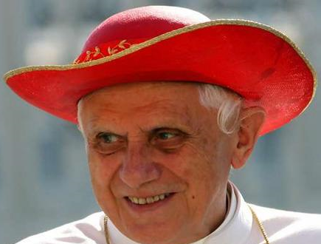
Activity
Notes:
Facilitator - Follow these steps when presenting this slide:
Allow 30-45 seconds for participants to write down or ponder their thoughts about the individuals on the slide.
Move to the next slide.

Slide 30
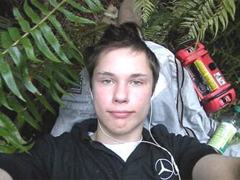
Activity
Notes:
Facilitator - Follow these steps when presenting this slide:
Allow 30-45 seconds for participants to write down or ponder their thoughts about the individuals on the slide.
Please Note: This is the last slide that requires individuals to write their first impressions. The next several slides provide the identities of each of the individuals or groups of individuals.

Slide 31
Activity
National Merit Scholar Winners, 2011
National Merit Finalists from Pattonville High School are (from left)
Erica Ream, Jordi Mendard and Khalil Griffin.
Notes:
Facilitator - Follow these steps when presenting this slide:
Read the slide aloud or allow participants an opportunity to silently read the slide.
After reading the slide, ask participants to share who they thought the individual or group of individuals were on the slide.
Ask participants to explain how their impressions matched or did not match the true identities of the individual or groups of individuals on the slide.

Slide 32
Activity
Who is Anders Behring Breivik?
A Norwegian extremist who was behind the Oslo shootings and bombing in Norway, killing up to 98 on July 23, 2011.
Notes:
Facilitator - Follow these steps when presenting this slide:
Read the slide aloud or allow participants an opportunity to silently read the slide.
After reading the slide, ask participants to share who they thought the individual or group of individuals were on the slide.
Ask participants to explain how their impressions matched or did not match the true identities of the individual or groups of individuals on the slide.

Slide 33
Activity
Who is Brenton Tarrant?
Tarrant is a white supremacist who killed 51 people at two mosques in New Zealand in March 2019.
Notes:
Facilitator - Follow these steps when presenting this slide:
Read the slide aloud or allow participants an opportunity to silently read the slide.
After reading the slide, ask participants to share who they thought the individual or group of individuals were on the slide.
Ask participants to explain how their impressions matched or did not match the true identities of the individual or groups of individuals on the slide.

Slide 34
Activity
Shawn Samic, age 11, helped a fellow student of the same age, Asha Mohamed, when she was accidently run over by her mother after school on Monday.
Samic ran home to get a car jack, which was used to help free the girl, who was pinned under the car.
Notes:
Facilitator - Follow these steps when presenting this slide:
Read the slide aloud or allow participants an opportunity to silently read the slide.
After reading the slide, ask participants to share who they thought the individual or group of individuals were on the slide.
Ask participants to explain how their impressions matched or did not match the true identities of the individual or groups of individuals on the slide.

Slide 35
Activity
Would you have invested?
Microsoft Corporation, 1978 Bill Gates
Notes:
Facilitator - Follow these steps when presenting this slide:
Read the slide aloud or allow participants an opportunity to silently read the slide.
After reading the slide, ask participants to share who they thought the individual or group of individuals were on the slide.
Ask participants to explain how their impressions matched or did not match the true identities of the individual or groups of individuals on the slide.

Slide 36
Activity
Tevin Hood was a walk-on freshman defensive lineman for
Duke University. He is a National Merit Scholar .
(September 2010)
Notes:
Facilitator - Follow these steps when presenting this slide:
Read the slide aloud or allow participants an opportunity to silently read the slide.
After reading the slide, ask participants to share who they thought the individual or group of individuals were on the slide.
Ask participants to explain how their impressions matched or did not match the true identities of the individual or groups of individuals on the slide.

Slide 37
Activity
Former Pope Benedict XVI
Notes:
Facilitator - Follow these steps when presenting this slide:
Read the slide aloud or allow participants an opportunity to silently read the slide.
After reading the slide, ask participants to share who they thought the individual or group of individuals were on the slide.
Ask participants to explain how their impressions matched or did not match the true identities of the individual or groups of individuals on the slide.

Slide 38
Activity
Colton Harris-Moore (born March 22, 1991) is an American criminal and former fugitive from Camano Island, Washington. He was charged with the thefts of small aircraft, a boat, and two cars and in the burglaries of at least 100 private residences in various locations around the Pacific Northwest of the United States and Canada. He fled to the Bahamas on July 4, 2010, allegedly in a plane stolen from Bloomington, Indiana. Harris-Moore was arrested in Harbour Island, Bahamas, on July 11, 2010, after police shot out the engine of the boat in which he was attempting to flee. On January 27, 2012, he was sentenced to six and a half years for related federal crimes. He became known as the "Barefoot Bandit" by reportedly committing some of his crimes barefoot, once leaving behind 39 chalk footprints and the word "c'ya!".
Notes:
Facilitator - Follow these steps when presenting this slide:
Read the slide aloud or allow participants an opportunity to silently read the slide.
After reading the slide, ask participants to share who they thought the individual or group of individuals were on the slide.
Ask participants to explain how their impressions matched or did not match the true identities of the individual or groups of individuals on the slide.

Slide 39
Looking Inward
As highlighted in the Overview Session, each person sees the world through his/her cultural lens.
Each person’s experience impacts the way he/she interacts with others, including students, parents, guardians, and colleagues.
An individual’s experiences may create biases, whether consciously or unconsciously, that impact how he/she may function in a role within the school system.
Gaps in academics, access, opportunities, and services may exist within a school or school system based upon others’ first impressions of them.
Notes:
Facilitator - Follow these steps when presenting this slide:
Read the slide aloud or allow participants an opportunity to silently read the slide.
Ask participants if they have any additional thoughts or comments that they’d like to share.

Slide 40
Multicultural Education
Notes:
Facilitator - Follow these steps when presenting this slide:
1.Explain that the Multicultural Education section provides background information, including strategies, regarding multicultural education.

Slide 41
Notes:
Facilitator - Follow these steps when presenting this slide:
Remind participants about the 16 Cultural Groups regarding multiculturalism and diversity, which is the essence of fully understanding and incorporating a multicultural curriculum.
Optional Activity:
Reflection Questions (either as a group or silently to oneself):
What privileges or advantages are associated with a particular cultural group or group(s)?
What stereotypes or disadvantages are associated with a particular cultural group or groups(s)?
What experience have you had, either positive or negative, being a member of a particular cultural group.
What experiences have you witnessed in the school community, whether positive or negative, regarding students/parents/guardians/colleagues who are members of a particular cultural group.
What types of curricular and/or school programs are in place that presently meet the needs of the various cultural groups listed?

Slide 42

The Multicultural Curriculum
Teachers can help to overcome superficial differences to create a multicultural, democratic society.
Allow the curriculum to consist of a wide variety of teaching strategies that embrace the diverse cultures in the classroom.
Teachers will determine bias and carefully monitor all students in the classroom to assure that diversity is valued.
Notes:
Facilitator - Follow these steps when presenting this slide:
1.Read the slide aloud or allow participants an opportunity to silently read the slide.
2.Explain that having an effective Multicultural Curriculum is essential because of the differences in society, and the differences highlighted in the previous slides.

Slide 43
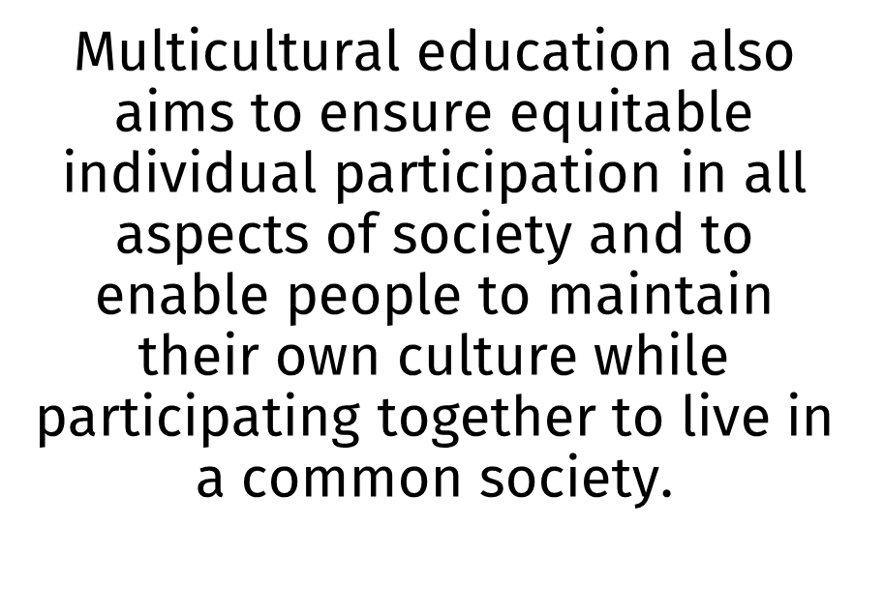


The Multicultural Curriculum
Notes:
Facilitator - Follow these steps when presenting this slide:
1.Read the slide aloud or allow participants an opportunity to silently read the slide.

Slide 44

The Multicultural Curriculum
Schools have a responsibility to teach students:
respect for self and others;
how to create relationships with a wide
range of people;
how to work toward eliminating
prejudice and discrimination.
Notes:
Facilitator - Follow these steps when presenting this slide:
1.Read the slide aloud or allow participants an opportunity to silently read the slide.
2.If there are other participants who serve in other roles (i.e. administrators, school counselors, school nurses, administrative assistants, etc.), ask volunteers to share how they ensure their programs or the school overall supports multicultural education and to create an inclusive, safe school environment.

Slide 45
The “Every Child” Statement
By “every child”, we mean every child – no exceptions. We emphasize that "every child" includes:
  learners of English as a second language and speakers of English as a first language;
  members of underrepresented ethnic groups and members of well-represented groups;
  students who are physically challenged and those who are not;
  all gender identifications
  students who live in poverty and those who do not;
  students who have or have not been successful in school.
Notes:
Facilitator - Follow these steps when presenting this slide:
1.Ask for volunteers to read each statement.
Optional Activity:
1.Divide the participants into groups.
2.Assign one or more of the statements to each group.
3.Ask participants to list how the school presently meets the needs of those students by identifying:
a.Strengths of meeting needs.
b.Areas in need of improving.
c.What new idea may be used during the upcoming school year to improve meeting the needs of students groups listed in the slide.
Have participants to share their responses.

Slide 46
Stages of Multicultural Curriculum Transformation
Curriculum of the Mainstream
Heroes and Holidays
Integration
Structural Reform
Multicultural, Social Action, and Awareness
Notes:
Facilitator - Follow these steps when presenting this slide: (see handout information below)
1.Review and discuss each bullet point based upon the following points (as cited from Paul Gorski –; http://www.edchange.org/multicultural/curriculum/steps.html – Stages of Multicultural Curriculum Transformation):
a. Curriculum of the Mainstream
•Policies, curricula, instructional materials, resources - including textbooks, learning tools and strategies – mainly represent the dominant culture: Eurocentric and male.
•Perspectives and resources from other cultures, nationalities, histories are not used or used limitedly.
b. Heroes and Holidays
•Teachers at this stage "celebrate" difference by integrating information or resources about famous people and the cultural artifacts of various groups into the mainstream curriculum. Bulletin boards might contain pictures of Martin Luther King, Jr., or Rosa Parks, and teachers might plan special celebrations for Black History Month or Women's History Month. Student learning about "other cultures" focuses on costumes, foods, music, and other tangible cultural items.
•The strengths of this stage are that the teacher is attempting to diversify the curriculum by providing materials and knowledge outside the dominant culture and that the Heroes and Holidays approach is fairly easy to implement. The weaknesses are as such:
By focusing celebratory attention on non-dominant groups outside the context of the rest of the curriculum, the teacher is further defining these groups as "the other.“
Curricula at this stage fail to address the real experiences of non-dominant groups, instead focusing on the accomplishments of a few heroic characters. Students may learn to consider the struggles of non-dominant groups as "extra" information instead of important knowledge in their overall understandings of the world.
The special celebrations at this stage often are used to justify the lack of effort at more authentic transformative measures.
The Heroes and Holidays approach trivializes the overall experiences, contributions, struggles, and voices of non-dominant groups, consistent with a Eurocentric, male-centric curriculum.
c. Integration
•At the Integration stage, teachers transcend heroes and holidays, adding substantial materials and knowledge about non-dominant groups to the curriculum. The teacher might add to her or his collection of books those by authors of color or by women.
•The strengths of the Integration stage are that it transcends special celebrations to deal with real issues and concepts and that it more closely ties diverse material into the rest of the curriculum. The weaknesses include:
a. New materials and units become secondary resources and knowledge as textbooks and the meat of the curriculum remain based on a Eurocentric, male-centric orientation (Banks, 1993).
b. New information is still delivered from a Eurocentric, male-centric perspective.
c. Structural Reform
•New materials, perspectives, and voices are woven seamlessly with current frameworks of knowledge to provide new levels of understanding from a more complete and accurate curriculum. The teacher dedicates her- or himself to continuously expanding her or his knowledge base through the exploration of various sources from various perspectives and sharing that knowledge with her or his students. Students learn to view events, concepts, and facts through various lenses. "American History" includes African American History, Women's History, Asian American History, Latino American History, and all other previously differentiated fields of knowledge.
d. Multicultural, Social Action, and Awareness
In addition to the changes made in the Structural Reform stage, important social issues are addressed explicitly as part of the curriculum. The voices, ideas, and perspectives of the students regarding these and all other topics are brought to the fore in the learning experience -- the students themselves becoming yet another multicultural classroom resource. The textbook is viewed as a single perspective among many, and the relevance of its limitations, along with those of other educational media, are explored and discussed.
Handouts in presentation link or online at the link above: Multicultural Education – Toward a Transformative Approach… and Five Paradigm Shifts.... Contains more detailed information.

Slide 47
Cultural Responsiveness
Notes:
Facilitator - Follow these steps when presenting this slide:
Explain that the Cultural Responsiveness Section in the handout highlights aspects of effective teachers. The video on the next slide provides an example of such.

Slide 48

Notes:
Facilitator - Follow these steps when presenting this slide:
1.Show the video.

Slide 49

An educator may use superior teaching strategies. The strategies are, however, only as effective as the educator’s ability to engage and relate to students.​
Notes:
Facilitator - Follow these steps when presenting this slide:
1.Read the slide aloud.

Slide 50
Six Types of Teachers
Repeat Offenders
  Use the same lessons year after year rather than updating lessons to meet students’ changing needs.
  Make derogatory comments to or about students.
2. Referral Agents
  20% of teachers make 80% of referrals.
3. Instructors
  Teach subjects not students.
Notes:
The next two review key concept slides highlight the six types of teachers who exist in school systems.
Facilitator - Follow these steps when presenting this slide:
1.State – “There are six types of teachers who exist in school systems.”
2.Encourage participants to determine where they exist within the spectrum of the defined six types of teachers.
3.Read aloud each type of teaching, pausing at least 5-7 seconds between each category of teacher.

Slide 51
Six Types of Teachers
4. Coaches
Same as teachers but creates bonds with all students.
5. Teachers
  Understand their subject content
  Realize all students are able to learn
  Teach students rather than just teaching subject
  Use differentiated instruction/strategies which reach all students
  Coaches
  Same as teachers but create bonds with all students.
6. Coaches
  Same as teachers but create bonds with all students.
Notes:
Continued review: Six types of teachers.
Facilitator - Follow these steps when presenting this slide:
1.Read the remaining three types of teachers
2.Encourage participants to determine where they exist within the spectrum of the defined six types of teachers.

Slide 52
What is Culturally Responsive Teaching?
Academic Standards + Relevance to Students Lives =
Culturally Responsive Teaching
Notes:
Facilitator - Follow these steps when presenting this slide:
1.Read the slide aloud or allow participants an opportunity to silently read the slide.
2.Ask for thoughts and feedback.

Slide 53
Culturally Responsive Teaching
Teachers who consistently get results with all groups of students:
  Have strong content knowledge;
  Have an array of effective strategies;
  Draw on prior knowledge of their students;
  See the range of student abilities and differentiate instruction; and
  Constantly examine their own attitudes about race, class, and culture. (Moir, 2002).
Notes:
Facilitator - Follow these steps when presenting this slide (handout- Culturally Responsive Standards-Based Teaching):
1. Read the slide aloud or allow participants an opportunity to silently read the slide.
2. Discuss the handout
3. Ask for thoughts and feedback.

Slide 54
Next Steps
Implement one new strategy as a springboard for change.
Notes:
Facilitator - Follow these steps when presenting this slide:
1.Explain that the Next Steps Section serves as a reminder to implement one new strategy regarding multicultural education for the upcoming school year.

Slide 55
Reflection/Action Steps
Reflect on how you have made all students welcome in your classroom, on the bus, in the cafeteria, or in the hallways.
Complete the Self-Assessment on Classroom Environment pages.
Implement one new strategy regarding multicultural education during the school year.
Notes:
Facilitator- Follow these steps when presenting this slide:
Read the slide to participants.
HANDOUTS- Self-Assessment and Classroom Environment
Discuss, have teachers reflect on how they may begin the shift in the classroom, adjourn.

