Slide 1
2020 ACA 1095C
Kim Harvey
knharvey@k12.wv.us
419-202-9898

Slide 2
Affordable Care Act
A 1095C form must be issued to each employee by the March 2.
Programs available include an edit program to make changes to exception employees and a print program. Formsprint will be used to print on a blank form. Form types are 1095cXXXX and 1095cfsXX for fold/seal. (XX= 2 digit year and XXXX = 4 digit year)
1095C and 1094C forms will be reported to the SSA by the end of March on your behalf.

Slide 3
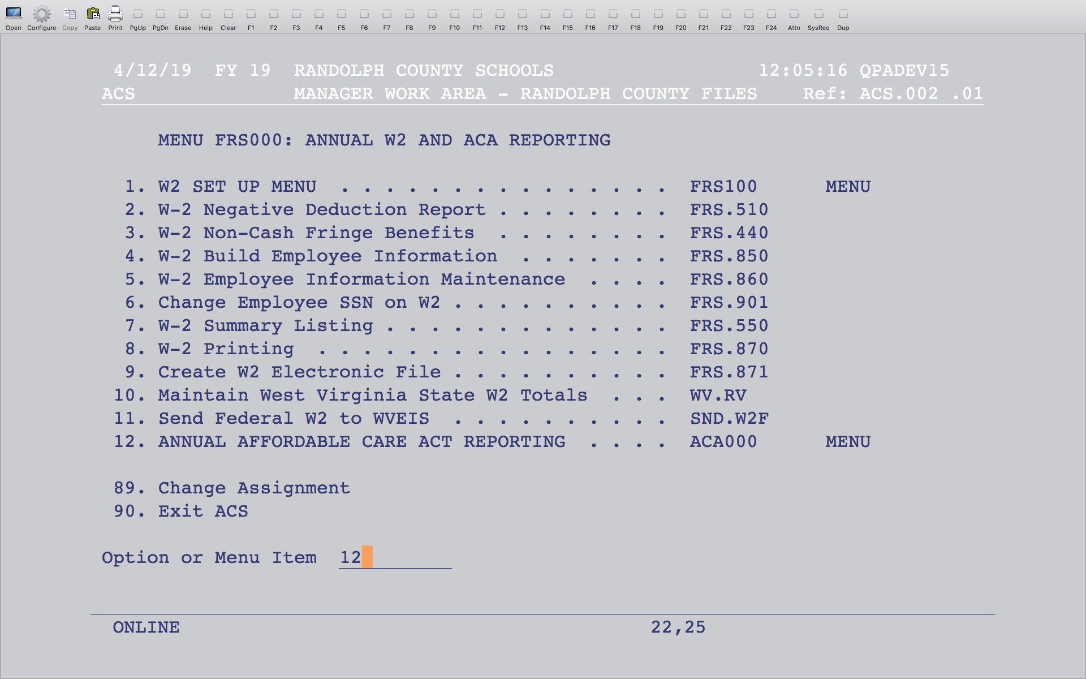
Affordable Care Act
Notes:
The menu is at the end of the W2 menu.

Slide 4
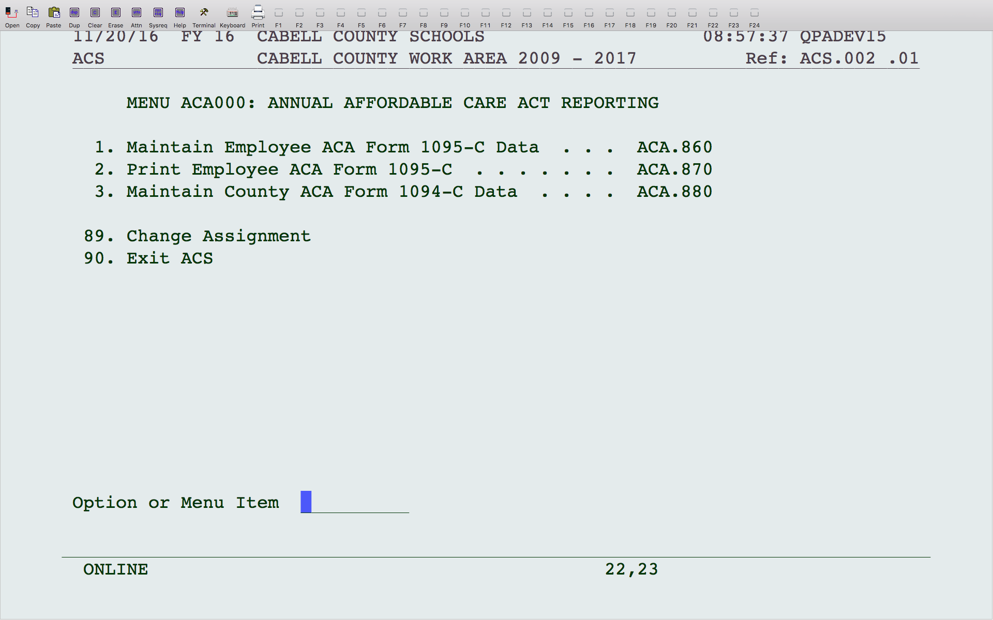
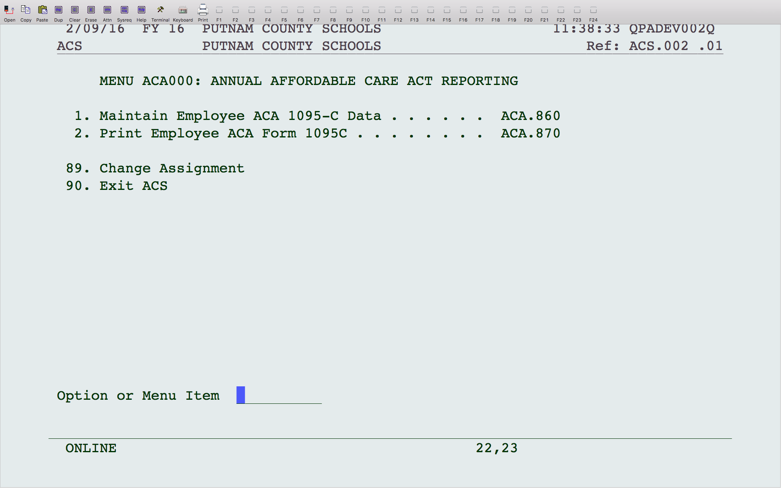
Affordable Care Act
Notes:
A build program will be done collectively for all the counties. Option 1 will allow changes to individual records, as well as additions and deletions. Option 2 will print the forms and an edit listing. Option 3 will allow changes to the 1094C.

Slide 5
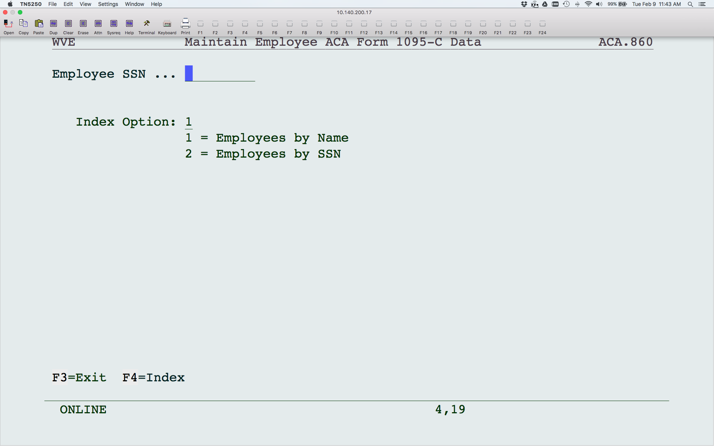
Affordable Care Act
Edit Program
Notes:
To edit an existing record, enter the SSN or hit F4 on any part of the screen to pull up a listing of employees. To add a new record, enter the SSN of the missing employee and hit enter.

Slide 6
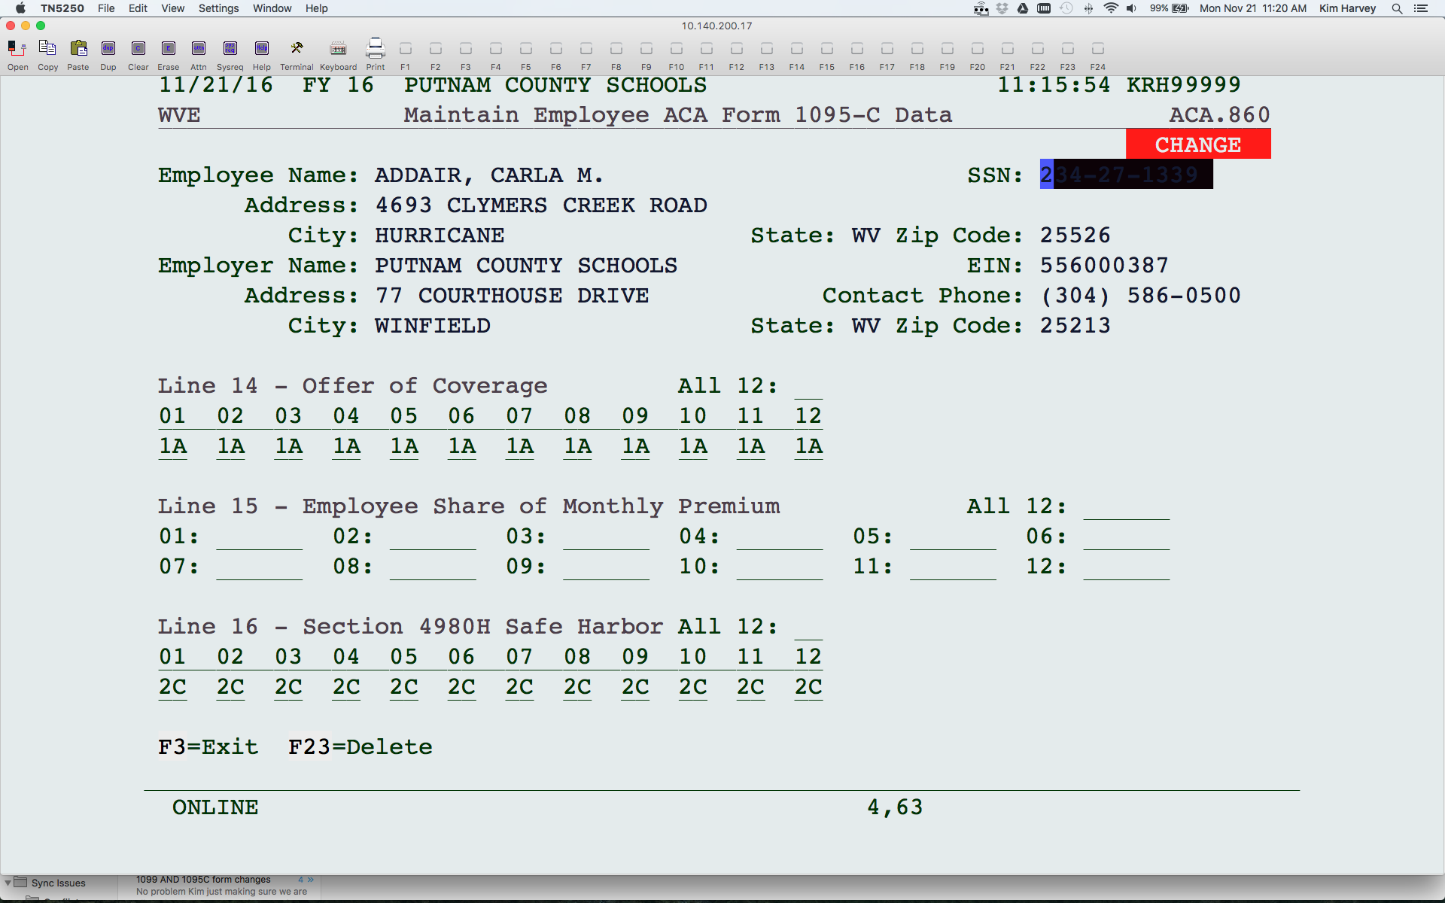
Affordable Care Act
Edit Program
Notes:
The program will create a record for any employee who had a P code withheld or was paid with a contracted job code some time during the year. The program cannot determine exactly which months the employee had coverage. If any record found during the year, the program assumes that they had the coverage all year, with the exception of any hire or term date within the calendar year. If you offered insurance to an employee that refused, you will need to make sure that a 1095C is issued with 1A for Line 14 and 2G for Line 16 for the months eligible. You are not responsible to report for an employee once they have been terminated, regardless if they took COBRA or bought insurance with their sick days.
To delete a record, hit F23 and answer ‘Y’ to delete.
Information for the employee and employer will default from payroll. These fields cannot be changed. Line 14 will default code 1A for 01-12. If a person was not employed all year, enter 1H for months not employed. If employed after 1/1/20, then 1A will default for the months following the hire date, otherwise, 1H for the months not employed. Also, if a person was terminated after 1/1/20, 1A defaults for each month, including the month terminated, and then 1H after.
Line 16 value of 2C in 01-12 blocks will default. If an employee was not employed all year, enter 2A for each month not employed, 2C for each month fully employed, with health insurance. If the employee was not full time, enter 2B for each month not full time. Enter 2G for any full time employee that did not take health insurance. A 2D will default for the month an employee was hired. For any month that a new employee had not accepted the offer of insurance yet, you will need to enter a 2D, then 2C for months with health insurance, 2G, if they did not accept health.
Nothing needs to be entered on Line 15.

Slide 7
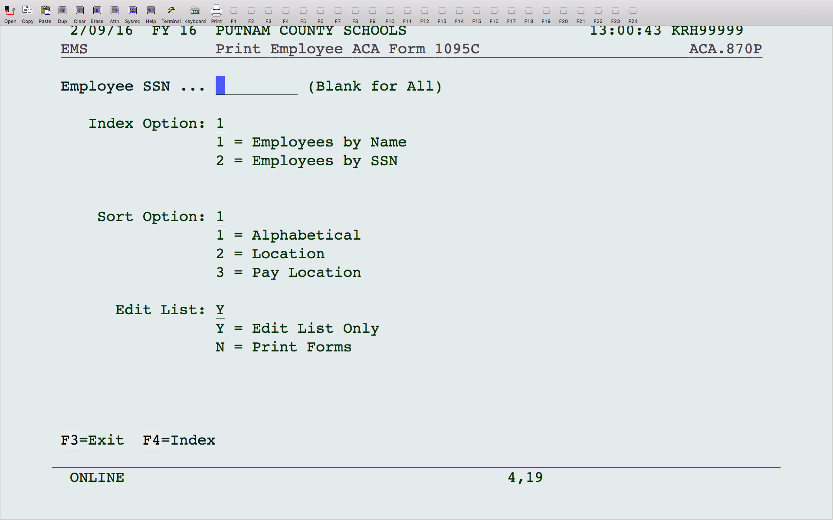
Affordable Care Act
Print program
Notes:
This program will print the 1095C forms or an edit listing. You can print for 1 SSN or leave blank for all. You can hit F4 on any part of the screen to pull up an index. You have 3 sort options, but keep in mind that the location codes do not print on the edit or form. To print just the edit listing, leave Edit List as ‘Y’. To print the forms, enter ‘N’. Use the appropriate form type (see page 1) when printing based on the form you are using. You enter the form type once the file is created, just like checks and W2s.

Slide 8
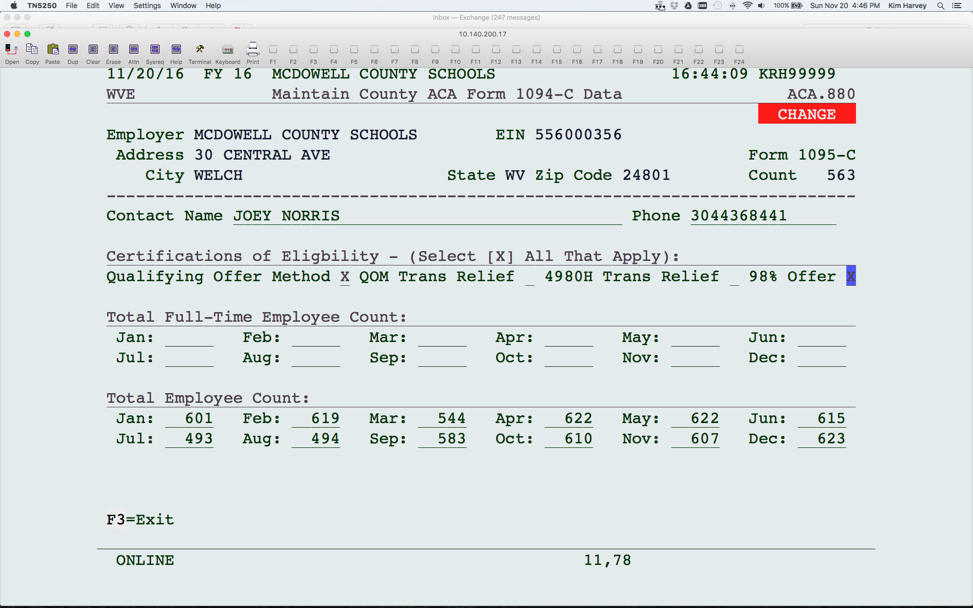
Affordable Care Act
1094 C
Notes:
The system will count the number of employees based on the pay file each month. Please review and make any changes to employee count, especially to the counts in the summer. You will also need to enter the Contact Name and Phone. You are not required to enter the Full-Time Employee Count unless you cannot mark that you offered insurance to 98% of eligible employees.

