Slide 1

Planning for the 2020 CEFPs
Comprehensive Educational Facilities Planning
Wednesday, October 28, 2020
sba.wv.gov

Slide 2
Comprehensive Educational Facilities Planning
Why are we doing this?
Need described Statutorily
Cornerstone of WVDE & SBA Policy
Eligible for SBA Funds
2010 Plan Expires

Slide 3
Comprehensive Educational Facilities Planning
What is the purpose?
Long-range Planning before Individual Projects
Relating to the Delivery of Education…
  Identify current & future facility needs
  Predict life-cycle costs of systems & equipment

Slide 4
Comprehensive Educational Facilities Planning
What will this do?
Becomes a “To-Do List” for facilities
Allows for an Ongoing Implementation & Review
Accommodate Educational Innovations
Build Community Support
New for 2020!
Tech-based platform – readily available data

Slide 5

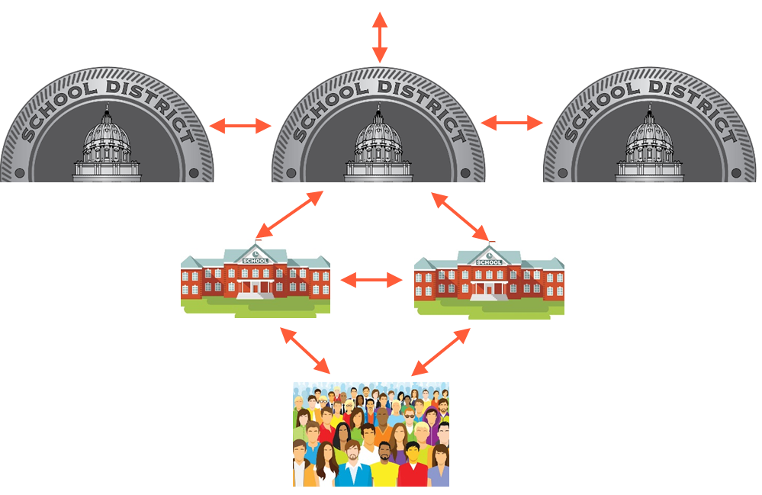
CEFP Engagement Platform
Collaboration

Slide 6
WVDE Policy 6200 – Chapter 1
Goals & Objectives
Community Analysis
Population & Enrollment Study
The Educational Plan
Evaluation & Inventory of Existing Facilities
Major Improvement Plan
Inter-County Feasibility Study
Translating Educational Needs into Facility Needs
Finance Plan & Project Priority List
Synopsis of Comments from Public Hearing(s)
Objective Evaluation of the Plan’s Implementation
Phase 1
Phase 2
Phase 3
Notes:
Eleven different steps
Four different phases
This is the Outline that the CEFP will follow.

Slide 7
The Old Process 1990-2019
LOCAL or SBA PROJECT
NOT WORKING
Phase 1:
ASSESS
Phase 2:
PRIORITIZE
Phase 3:
PLAN
Phase 4:
EXECUTE
RUN TO FAILURE
REACTIVE MAINTENANCE

Slide 8
The New Process – A Cycle of Success
Phase 1: ASSESS
  Create a Detailed Assessment for all parts of your building, equipment – Create ideal Education Plan
Phase 2: PRIORITIZE
  Translate Educational Needs into Facility Needs
Phase 3: PLAN
  Create a plan of action for all items on the list
Phase 4: EXECUTE
  Put the plan in motion – complete projects
Phase 5: MAINTAIN
  Keep your system up to date so you never start at zero again
And… Repeat!
Phase 1: ASSESS
Phase 4: EXECUTE
Phase 5: MAINTAIN
Phase 2: PRIORITIZE
Phase 3: PLAN

Slide 9
The New Process – A Cycle of Success
Phase 1: ASSESS
Phase 4: EXECUTE
Phase 5: MAINTAIN
Phase 2: PRIORITIZE
Phase 3: PLAN
SBA-Funded PM Program
Dude Solutions
- In Place -
This is the CEFP

Slide 10


Statewide Contractors
Program Oversight – QA/QC
  Mobilization
  A/E Firm Training
Information Gathering Instruments
Justification Capabilities
Predictive Analysis
Database to House Information - CEFPs

Slide 11
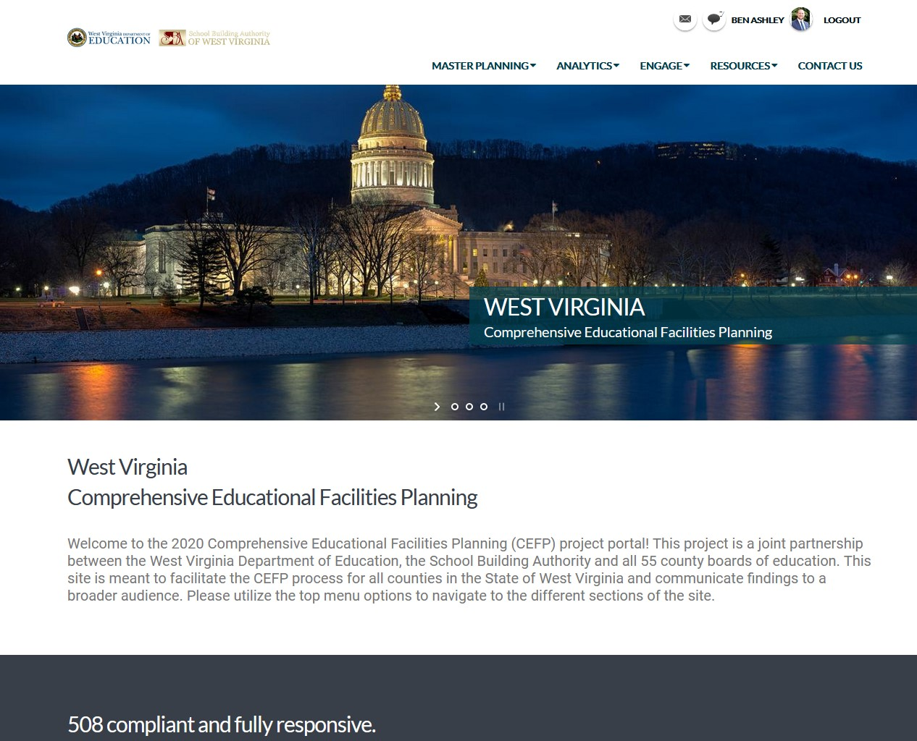
https://dudeconnect.dudesolutions.com/west-virginia/

Slide 12

Statewide Contractors
Facility Condition Assessment
  Program Oversight
  QA / QC
  A/E Firm Training
  Standardization & Quality
Reports directly into Dude Solutions Platform

Slide 13
Phase 1
Phase 2
Phase 3
Evaluation and Inventory of Existing Facilities
Resource / Consulting
Project Cost Estimating
Digital
2020 CEFP
A/E FIRM
Standardization & Quality
Community Analysis
Enrollment Projections
Information Database
“Dude Solutions 360”
Prediction Software
“Capital Forecast Direct”
STATEWIDE CONTRACTORS
Justification Capabilities
“Dude Intelligence”
Committees Meet
Evaluate Previous CEFP
Determine Goals
Create Educational Plan
Curriculum Plan
Instructional Plan
Operations Plan
Support Plan
Personnel Plan
Translating Educational Needs into Facility Needs
Project Priority List
Finance Plans
Community Meetings
LOCAL EDUCATION AGENCY
Notes:
I am mostly going to talk today in Phase 1… I’ll touch briefly on Phases 2 & 3 at the end.

Slide 14
WVDE Policy 6200 – Chapter 1
Phase 1
Evaluation and Inventory of Existing Facilities
Goals & Objectives
Community Analysis
Population & Enrollment Study
The Educational Plan
Evaluation & Inventory of Existing Facilities
A/E FIRM
Standardization & Quality
Community Analysis
Enrollment Projections
Information Database
STATEWIDE CONTRACTORS
Committees Meet
Evaluate Previous CEFP
Determine Goals
Create Educational Plan
Curriculum Plan
Instructional Plan
Operations Plan
Support Plan
Personnel Plan
LOCAL EDUCATION AGENCY
Notes:
Now I will show you how the SBA and WVDE have partnered with Statewide Contractors, Counties, and their Architects to Execute the 3 Phases of the CEFP

Slide 15

WVDE Policy 6200 – Chapter 1
Phase 1
Evaluation and Inventory of Existing Facilities
Goals & Objectives
Community Analysis
Population & Enrollment Study
The Educational Plan
Evaluation & Inventory of Existing Facilities
A/E FIRM
Standardization & Quality
Community Analysis
Enrollment Projections
Information Database
STATEWIDE CONTRACTORS
Committees Meet
Evaluate Previous CEFP
Determine Goals
Create Educational Plan
Curriculum Plan
Instructional Plan
Operations Plan
Support Plan
Personnel Plan
LOCAL EDUCATION AGENCY
Pre-Configured WVDE & SBA Templates
Notes:
Now I will show you how the SBA and WVDE have partnered with Statewide Contractors, Counties, and their Architects to Execute the 3 Phases of the CEFP

Slide 16
LEA Responsibilities – Phase 1
Evaluate Previous CEFP
Create 2020 CEFP Goals & Objectives
Create Education Plan
  System Plan
  Curriculum Plan
  Instructional Plan
Coordinate A/E Facility Condition Assessments (FCA)
  Operations Plan
  Support Plan
  Personnel Plan
Notes:
Outside of Procuring A/E Services, which are already ongoing, here are the counties’ responsibilities:

Slide 17
The Education Plan
Review Goals & Objectives
Think Ideally about all phases of Educational Delivery
How to boost student achievement, teacher success? - Architecturally
  Not about which school to renovate, close
  Decisions on the future of facilities in “Translating” Section
Applicable Ideas from Educational Forums?
Explore “what you DON’T know”
Notes:
Outside of Procuring A/E Services, which are already ongoing, here are the counties’ responsibilities:

Slide 18

WVDE Policy 6200 – Chapter 1
Phase 1
Evaluation and Inventory of Existing Facilities
Goals & Objectives
Community Analysis
Population & Enrollment Study
The Educational Plan
Evaluation & Inventory of Existing Facilities
A/E FIRM
Standardization & Quality
Community Analysis
Enrollment Projections
Information Database
STATEWIDE CONTRACTORS
Committees Meet
Evaluate Previous CEFP
Determine Goals
Create Educational Plan
Curriculum Plan
Instructional Plan
Operations Plan
Support Plan
Personnel Plan
Your A/E Firm
LOCAL EDUCATION AGENCY
Notes:
Now I will show you how the SBA and WVDE have partnered with Statewide Contractors, Counties, and their Architects to Execute the 3 Phases of the CEFP

Slide 19
Facility Condition Assessments
Completed by your A/E Firm
Gives an Idea of what needs to happen for your facility to meet:
  Current Building Codes & Standards
  Current WVDE Policy 6200 Standards
Establishes Key Indexes – Statewide Consistency
Feeds directly into Dude Solutions 360 Database

Slide 20
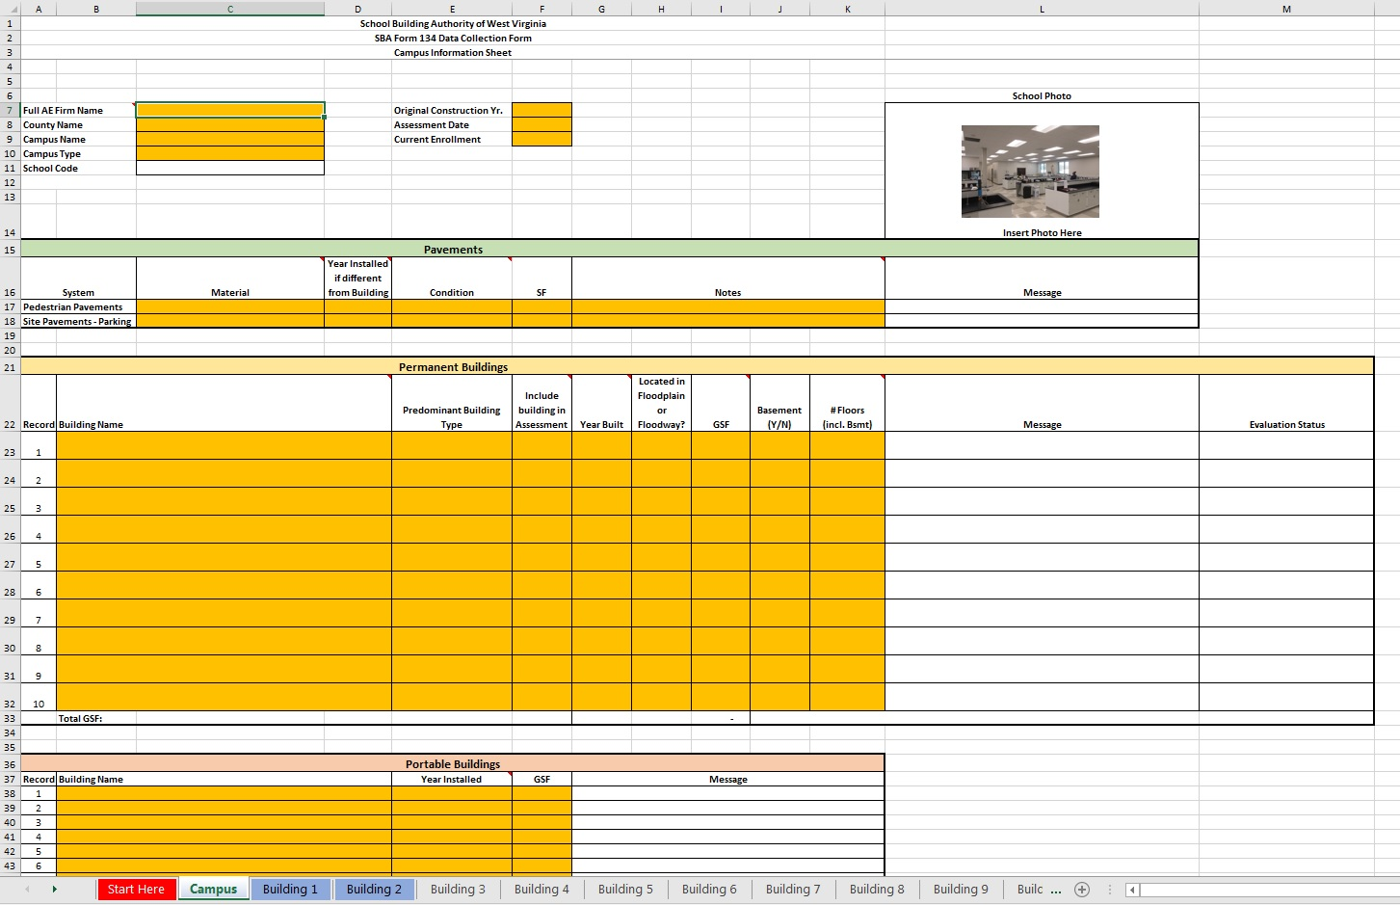

Slide 21
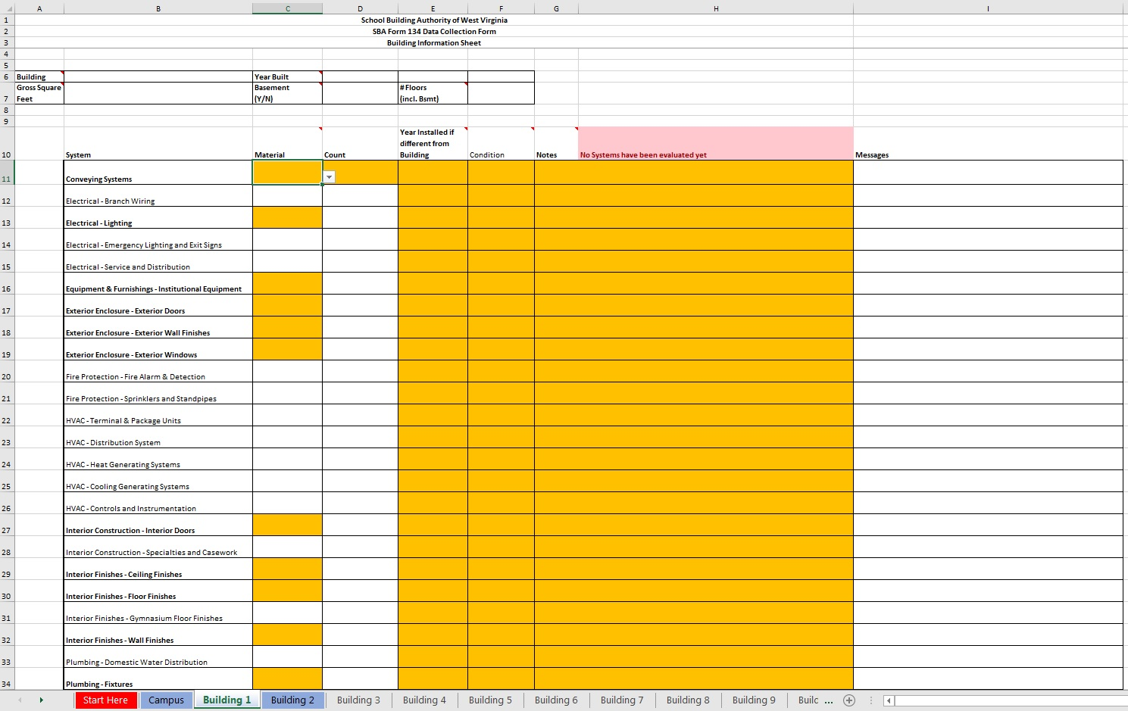

Slide 22
FCA Indexes – Facility Condition Index (FCI)
Cost of Facility Improvements
(to meet all Codes & Standards)
= 60
(Lower = Better)
Replacement Cost of Facility
(SBA Funding Formula)

Slide 23
FCA Indexes – Energy Usage Index (EUI)
Facility Energy Consumption per Year
(Converted to BTU)
= 45
(Lower = Better)
“Conditioned”
Building Square Footage

Slide 24
FCA Indexes – Building Program Utilization
Student Enrollment
(Current, Projected, or Design)
= 85%
(Desired Target)
Building Capacity
(Based on Educational Program)

Slide 25
Phase 1
Phase 2
Phase 3
Evaluation and Inventory of Existing Facilities
Resource / Consulting
Project Cost Estimating
Digital
2020 CEFP
A/E FIRM
Standardization & Quality
Community Analysis
Enrollment Projections
Information Database
“Dude Solutions 360”
Prediction Software
“Capital Forecast Direct”
STATEWIDE CONTRACTORS
Justification Capabilities
“Dude Intelligence”
Committees Meet
Evaluate Previous CEFP
Determine Goals
Create Educational Plan
Curriculum Plan
Instructional Plan
Operations Plan
Support Plan
Personnel Plan
Translating Educational Needs into Facility Needs
Project Priority List
Finance Plans
Community Meetings
LOCAL EDUCATION AGENCY
Notes:
I am mostly going to talk today in Phase 1… I’ll touch briefly on Phases 2 & 3 at the end.

Slide 26
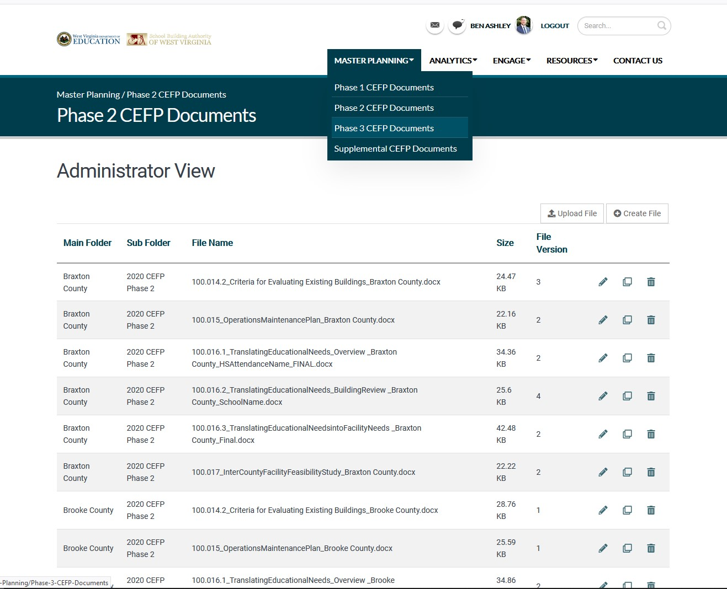

Slide 27
LEA Responsibilities – Phase 2
Review Data from Phase 1
Decide how to Translate Educational Needs into Facility Needs
  Individual School Level
  HS Attendance Area Level
  System-wide Level
Review Inter-County Feasibility
Create Operations & Maintenance Plan

Slide 28
Translating Educational Needs into Facility Needs
Using data collected in Phase 1, make decisions on future facility use/needs
What makes sense?
  Educationally
  Geographically
  Financially
How can we deliver the best education…. efficiently?
Are we in compliance with Building Codes, Policy 6200, Fire Marshal, etc.?
Is this our best chance at success?
Notes:
Outside of Procuring A/E Services, which are already ongoing, here are the counties’ responsibilities:

Slide 29
LEA Responsibilities – Phase 3
Create a Finance Plan to determine Funding Sources
Consider limitations of the SBA
Consider Local Contribution
Present to Public & Record Comments
Provide a method for Objective Evaluation of Implementation

Slide 30
Gather Data
Make Decisions
Execute Plan
Facility Condition Information
Translating
Educational Needs
into
Facility Needs
&
Implementation
Plan
Source Data
(Enrollment Projections, etc.)
2020 CEFP Projects
Ideal Educational Plan

Slide 31
CEFP Development Timelines
Phase I December 31, 2019
Goals & Objectives, Community Analysis, Population & Enrollment Study, Education Plan
Phase I September 30, 2019
Evaluation & Inventory of Existing Facilities, Facility Condition Assessments (FCA)
Phase II March 31, 2020
Operations & Maintenance Plan, Translating Educational Needs into Facility Needs, Intercounty Feasibility Study
Phase III July 1, 2020
Finance Plan, Public Hearing Comments, Objective Evaluation Criteria for Implementation
January 31, 2020
June 30, 2020
August 31, 2020
September 30, 2020

Slide 32
CEFP Approval Timelines
Local Board Approval August 1, 2020
Submission to WVDE October 31, 2020
Staff Review & WVBE Approval
Submission to SBA November 30, 2020
Staff Review & Authority Approval
SBA Needs Grant Apps. Due September 11, 2020
SBA Superintendent Interviews Nov. 16-17, 2020
SBA Needs Project Selection December 14, 2020
October 30, 2020
December 31, 2020
January 29, 2020
January 29, 2020
March 15-16, 2021
April 19, 2020

Slide 33
Questions?
Thank You!
Ben Ashley, MBA
Director of Architectural Services
Benjamin.S.Ashley@wv.gov
304-558-2541

