Slide 1
2020 W2’s
Kim Harvey
knharvey@k12.wv.us
419-202-9898

Slide 2
W2 Laser Forms
CIMSW2XXXX and CIMSW2EMXX (employer copy, 4 per page)
W2BLANKXX is an 8.5X11. This prints in the 4 corners. So there are 2 perfs that split the page horizontally and vertically.
W2BLANKXXM is an 8.5x14. It prints in the 4 corners but is a fold/seal form.
W2BLKXX is 8.5X14, form type is MW1288 and it is a fold and seal form. This prints 4 copies horizontally.
XX = 2 digit calendar year
XXXX = 4 digit calendar year

Slide 3
New this year
For those that took a COVID related absence, there will be a supplemental report that will need generated and included with the W2. This will print on a plain 8.5x11 piece of paper. There will be 3 lines of information based on the absence types used. The system will calculate the amounts based on absence history, but you will have the option to adjust or correct.

Slide 4
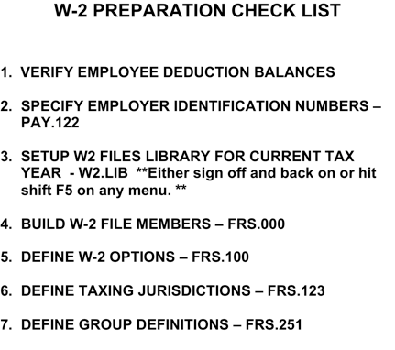

Slide 5
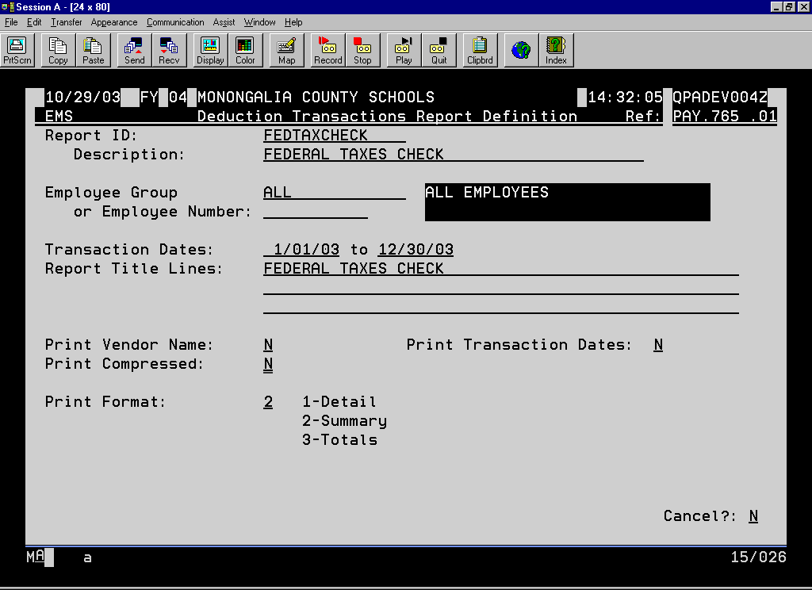
11/23/99 FY 98 JACKSON COUNTY FMS/EMS TEST LIBRARY 22:38:52 QPADEV0004
EMS Deduction Transactions Report Definition Ref: PAY.765 .01
Report ID: FEDTAXCHECK
Description: FEDERAL TAXES CHECK
Employee Group ALL ALL EMPLOYEES
or Employee Number:
Transaction Dates: 1/01/00 to 12/31/00
Report Title Lines: FEDERAL TAXES CHECK
Print Vendor Name: N Print Transaction Dates: N
Print Compressed: N
Print Format: 2 1-Detail
2-Summary
3-Totals
Cancel?: N
Notes:
The following report formats will allow you to verify your FICA and Federal Wages. They are entered in the Deduction Transaction Report Writer on the EMS Report Writers menu. If the fifth column of these reports has a value for an employee, then either the report is not setup right, or a person has a problem with their taxable wages. I would advise that you run this throughout the year, but at least before the last pay of the year to correct any problems in the current calendar year.

Slide 6
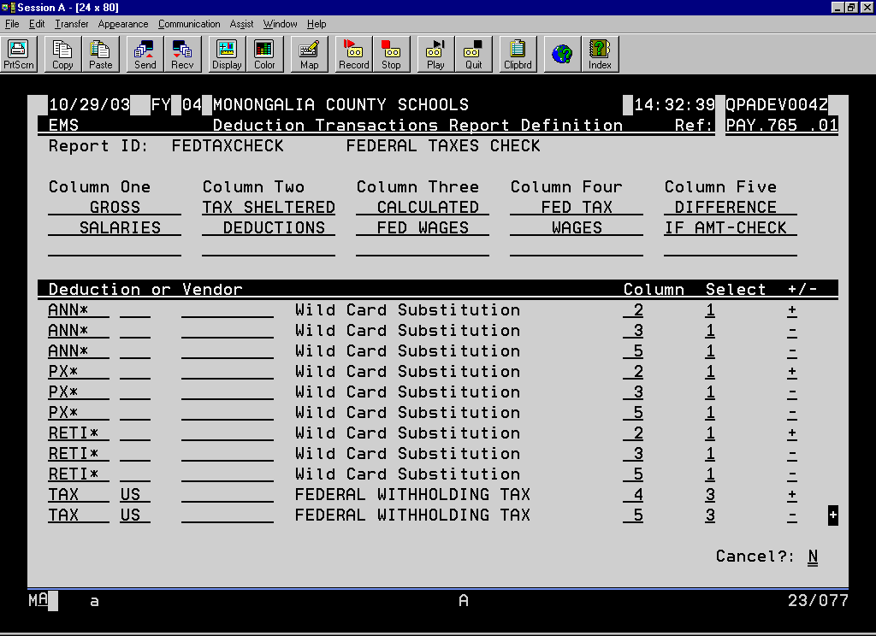
11/23/99 FY 98 JACKSON COUNTY FMS/EMS TEST LIBRARY 22:38:52 QPADEV0004
EMS Deduction Transactions Report Definition Ref: PAY.765 .01
Report ID: FEDTAXCHECK FEDERAL TAXES CHECK
Column One Column Two Column Three Column Four Column Five
GROSS TAX SHELTERED CALCULATED FED TAX DIFFERENCE
SALARIES DEDUCTIONS FED WAGES WAGES (IF AMT, CHK)
Deduction or Vendor Column Select +/-
ANN* Wild Card Substitution 2 1 +
ANN* Wild Card Substitution 3 1 -
ANN* Wild Card Substitution 5 1 -
PX* Wild Card Substitution 2 1 +
PX* Wild Card Substitution 3 1 -
PX* Wild Card Substitution 5 1 -
RET* Wild Card Substitution 2 1 +
RET* Wild Card Substitution 3 1 -
RET* Wild Card Substitution 5 1 -
TAX US FEDERAL WITHHOLDING TAX 4 3 +
TAX US FEDERAL WITHHOLDING TAX 5 3 - +
Cancel?: N

Slide 7
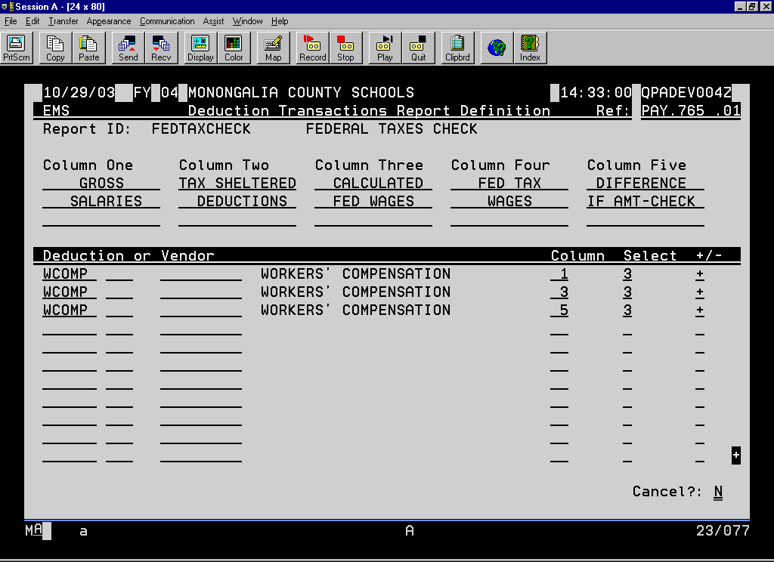
11/23/99 FY 98 JACKSON COUNTY FMS/EMS TEST LIBRARY 22:38:52 QPADEV0004
EMS Deduction Transactions Report Definition Ref: PAY.765 .01
Report ID: FEDTAXCHECK FEDERAL TAXES CHECK
Column One Column Two Column Three Column Four Column Five
GROSS TAX SHELTERED CALCULATED FED TAX DIFFERENCE
SALARIES DEDUCTIONS FED WAGES WAGES (IF AMT, CHK)
Deduction or Vendor Column Select +/-
WCOMP WORKERS' COMPENSATION 1 3 +
WCOMP WORKERS' COMPENSATION 3 3 +
WCOMP WORKERS' COMPENSATION 5 3 +
+
Cancel?: N

Slide 8
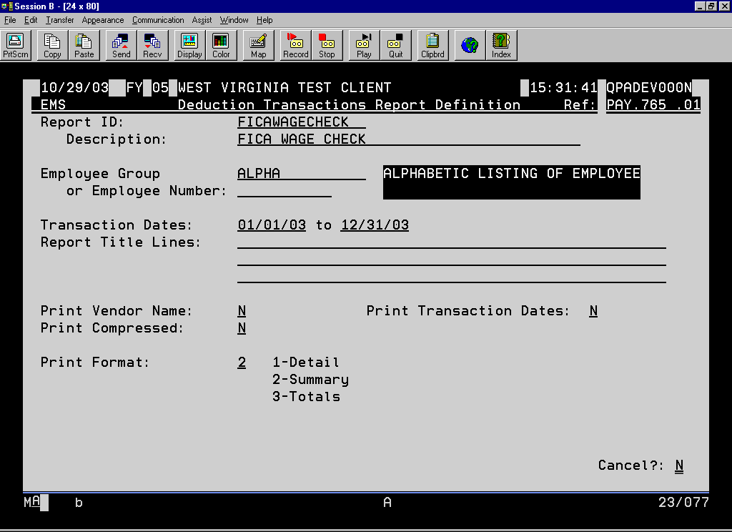
11/23/99 FY 98 JACKSON COUNTY FMS/EMS TEST LIBRARY 22:45:21 QPADEV0004
EMS Deduction Transactions Report Definition Ref: PAY.765 .01
Report ID: FICAWAGECK
Description: FICA WAGES
Employee Group ALL ALL EMPLOYEES
or Employee Number:
Transaction Dates: 1/01/00 to 12/31/00
Report Title Lines: FICA WAGES CHECK
Print Vendor Name: N Print Transaction Dates: N
Print Compressed: N
Print Format: 2 1-Detail
2-Summary
3-Totals
Cancel?: N

Slide 9
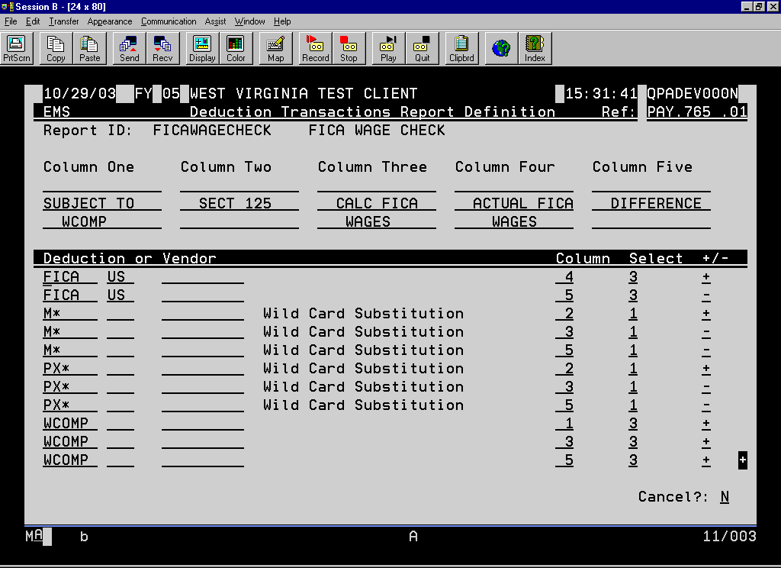
11/23/99 FY 98 JACKSON COUNTY FMS/EMS TEST LIBRARY 22:45:21 QPADEV0004
EMS Deduction Transactions Report Definition Ref: PAY.765 .01
Report ID: FICAWAGECK FICA WAGES
Column One Column Two Column Three Column Four Column Five
GROSS S125 CALCULATED FICA US DIFFERENCE
SALARIES TOTAL FICA WAGES WAGES (IF AMT, CHK)
Deduction or Vendor Column Select +/-
FICA US FICA-SOCIAL SECURITY 4 3 +
FICA US FICA-SOCIAL SECURITY 5 3 -
PX* Wild Card Substitution 2 1 +
PX* Wild Card Substitution 3 1 -
PX* Wild Card Substitution 5 1 -
WCOMP WORKERS' COMPENSATION 1 3 +
WCOMP WORKERS' COMPENSATION 3 3 +
WCOMP WORKERS' COMPENSATION 5 3 +
+
Cancel?: N

Slide 10
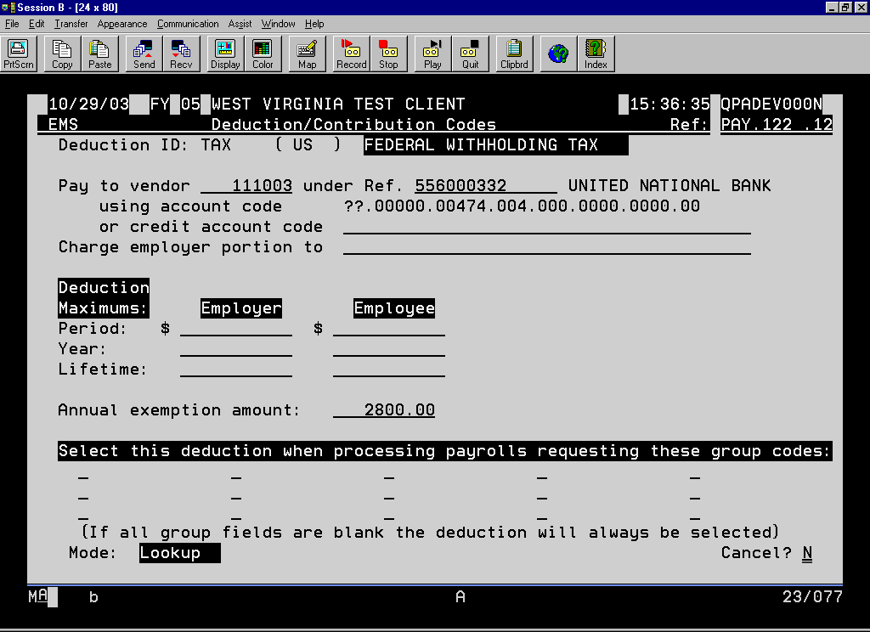
11/23/99 FY 00 WEST VIRGINIA TEST CLIENT 22:47:40 QPADEV0005
EMS Deduction/Contribution Codes Ref: PAY.122 .12
Deduction ID: TAX ( US ) FEDERAL WITHHOLDING TAX
Pay to vendor under Ref. 556000387
using account code
or credit account code 11.00000.00471.004.000.0000.0000.00
Charge employer portion to
Deduction
Maximums: Employer Employee
Period: $ $
Year:
Lifetime:
Annual exemption amount: 2749.92
Select this deduction when processing payrolls requesting these group codes:
(If all group fields are blank the deduction will always be selected)
Mode: Change Cancel? N
Notes:
Make sure that your tax deductions have your Tax ID number with no hyphens, slashes or spaces. Typically, the Tax WV should be the federal number with 001 at the end with no spaces or hyphens.

Slide 11
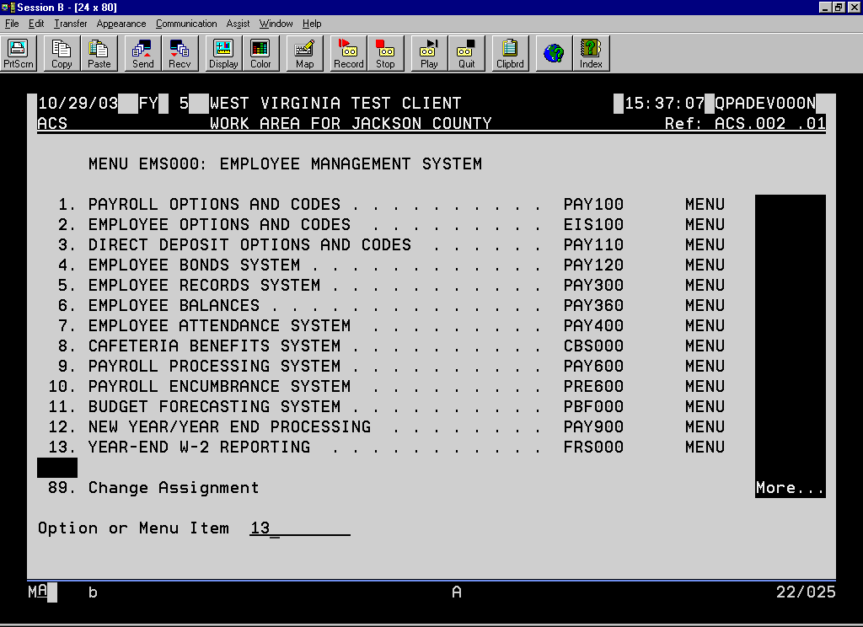
11/23/99 FY WEST VIRGINIA TEST CLIENT 22:48:46 QPADEV0005
ACS PRODUCTION WORK AREA FOR PUTNAM COUNTY DATA Ref: ACS.002 .01
MENU EMS000: EMPLOYEE MANAGEMENT SYSTEM
1. PAYROLL OPTIONS AND CODES . . . . . . . . . . PAY100 MENU
2. EMPLOYEE OPTIONS AND CODES . . . . . . . . EIS100 MENU
3. DIRECT DEPOSIT OPTIONS AND CODES . .. PAY110 MENU
4. EMPLOYEE BONDS SYSTEM . . . . . . . . . . . . . . PAY120 MENU
5. EMPLOYEE RECORDS SYSTEM . . . . . . . . . . . PAY300 MENU
6. EMPLOYEE BALANCES . . . . . . . . . . . . . . . . . . PAY360 MENU
7. EMPLOYEE ATTENDANCE SYSTEM . . . . . . PAY400 MENU
8. CAFETERIA BENEFITS SYSTEM . . . . . . . . . . CBS000 MENU
9. PAYROLL PROCESSING SYSTEM . . . . . . . . . PAY600 MENU
10. PAYROLL ENCUMBRANCE SYSTEM . . . . . PRE600 MENU
11. BUDGET FORECASTING SYSTEM . . . . . . . . PBF000 MENU
12. NEW YEAR/YEAR END PROCESSING . . . . PAY900 MENU
13. YEAR-END W-2 REPORTING . . . . . . . . . . . FRS000 MENU
89. Change Assignment More...
Option or Menu Item

Slide 12
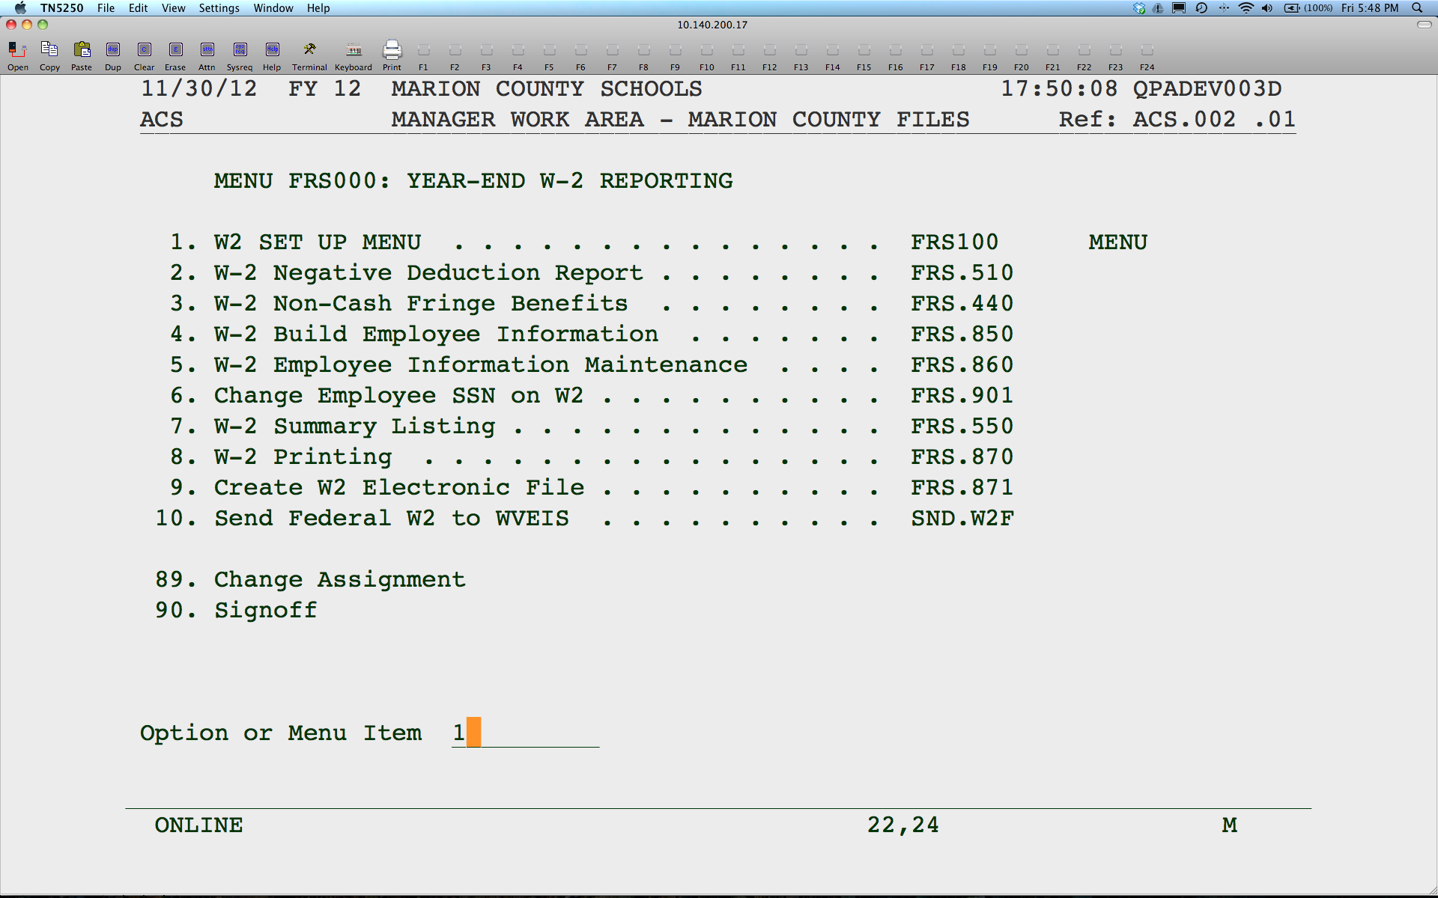

Slide 13
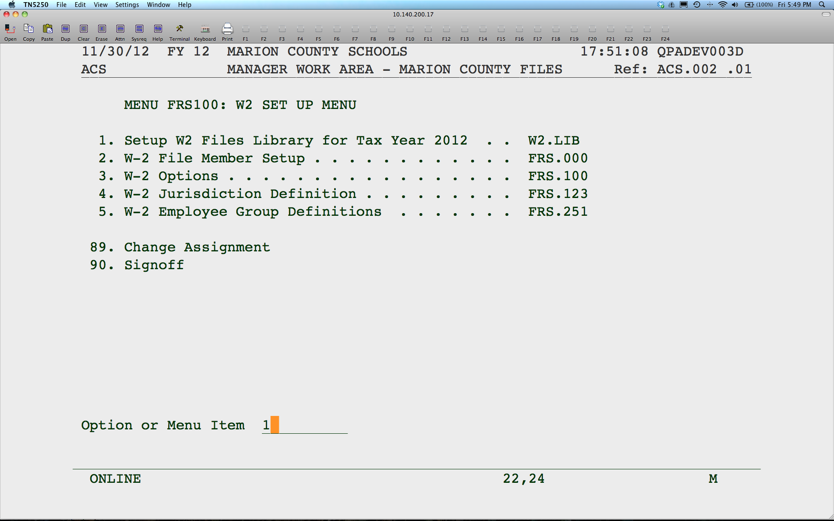
Notes:
You must run this program before you do anything else. You will not go to another screen. The system will just flash a message at the bottom. It will tie up your screen until it appears to be done. IMPORTANT: Please either sign off and back on to continue or hit Shift F5 from any menu before continuing

Slide 14

Notes:
Add 2021 member.

Slide 15
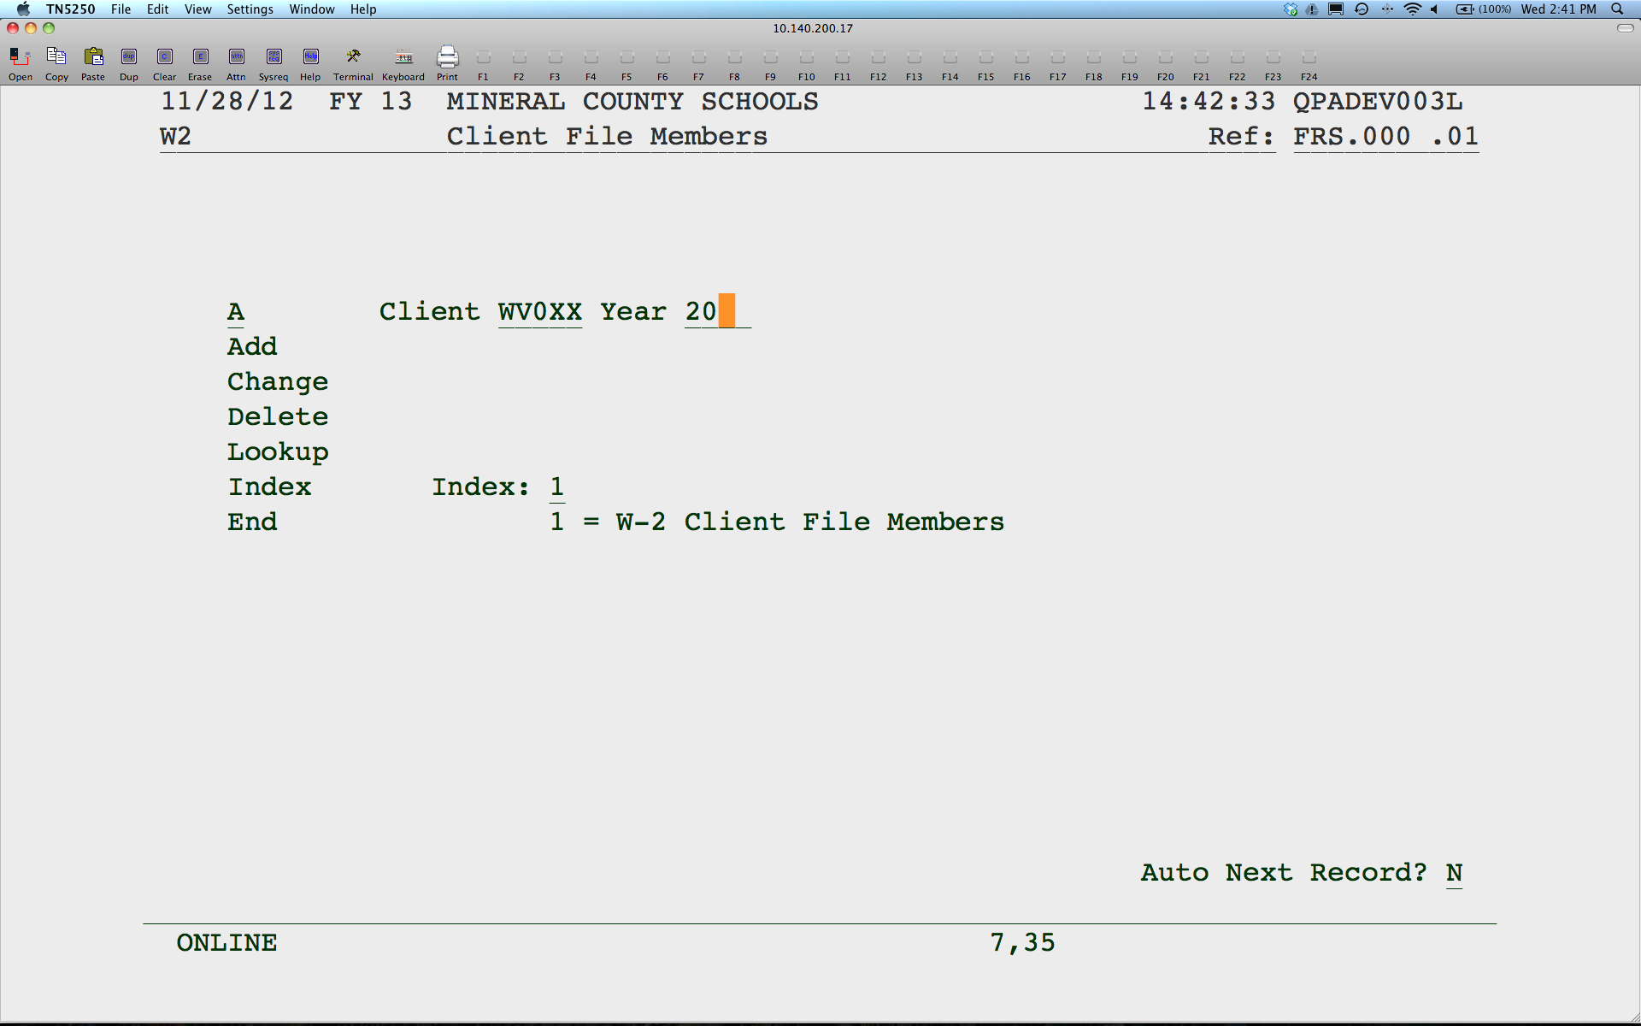
Notes:
Replace XX with your county number. Be sure you enter 2021 for the year.

Slide 16
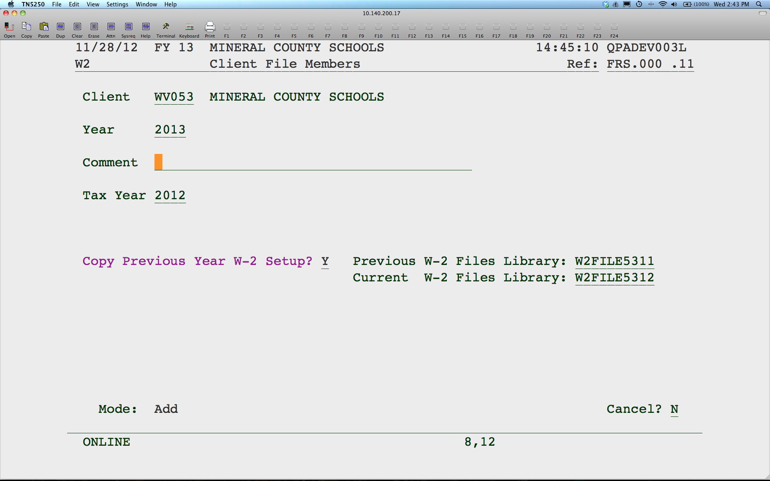
Notes:
You should just be able to hit enter here. It is not necessary to change anything.

Slide 17
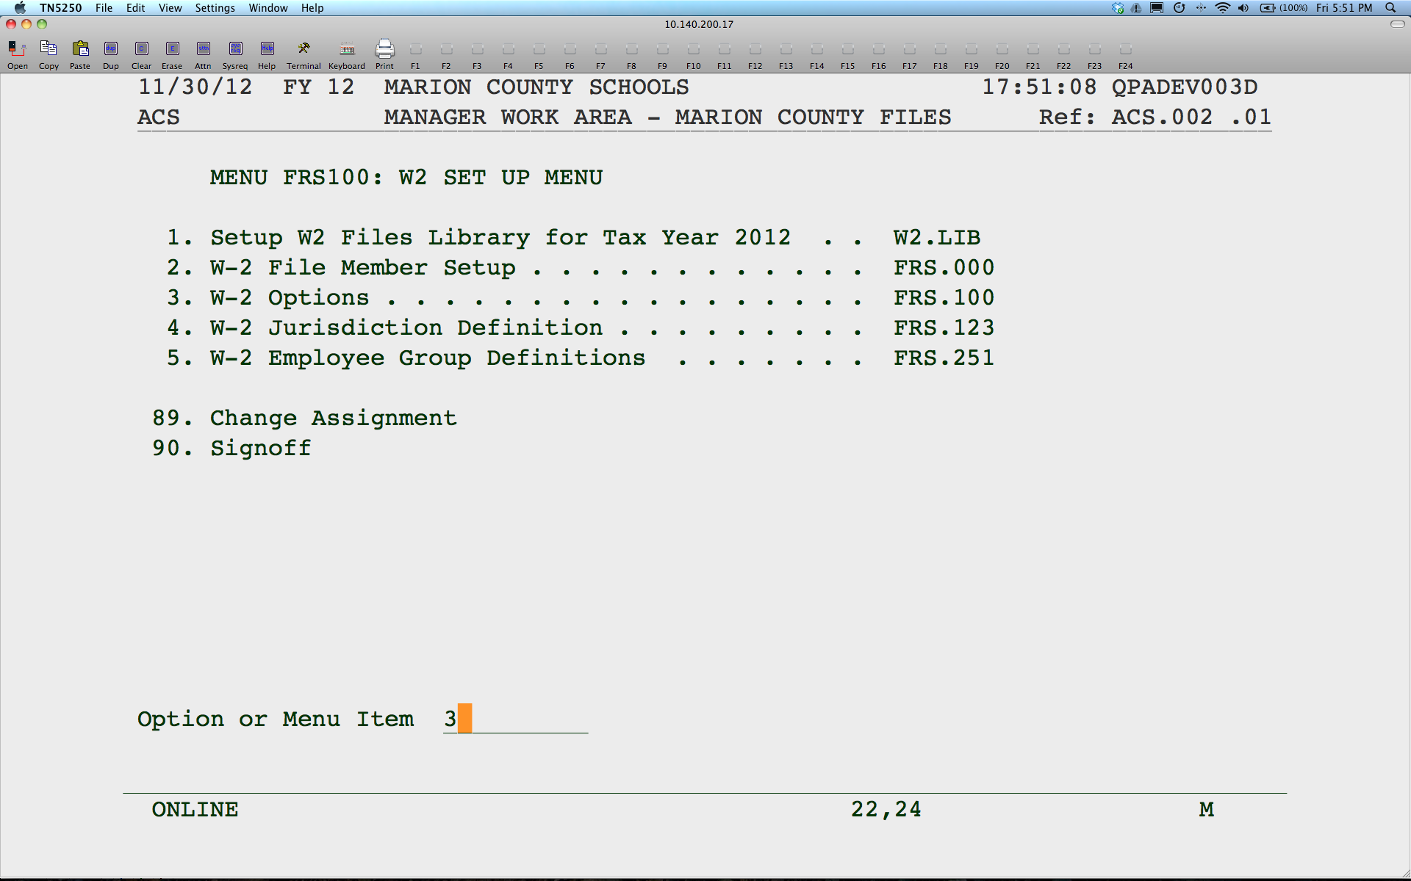

Slide 18
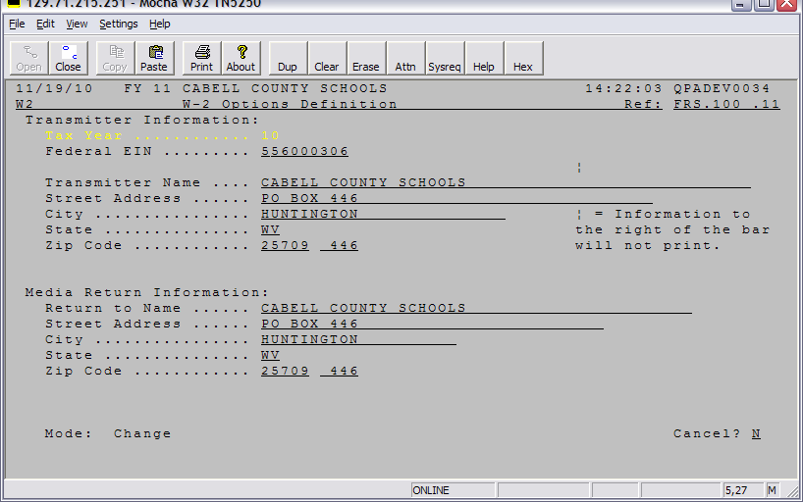
Notes:
Verify the information.

Slide 19
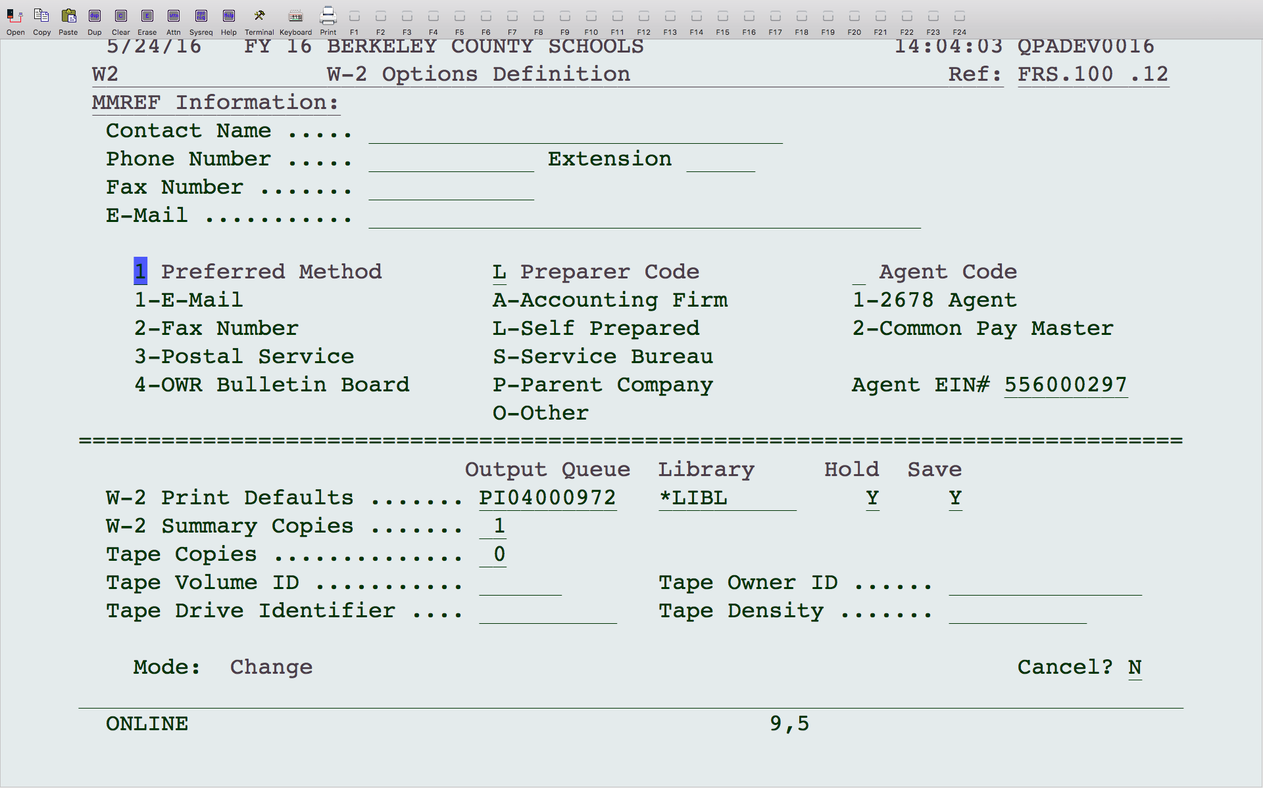
Notes:
Please enter your Contact Name, phone number and E-mail. This is very important in light of the legal agreement that the DOE will only be the issuer, not the transmitter.

Slide 20
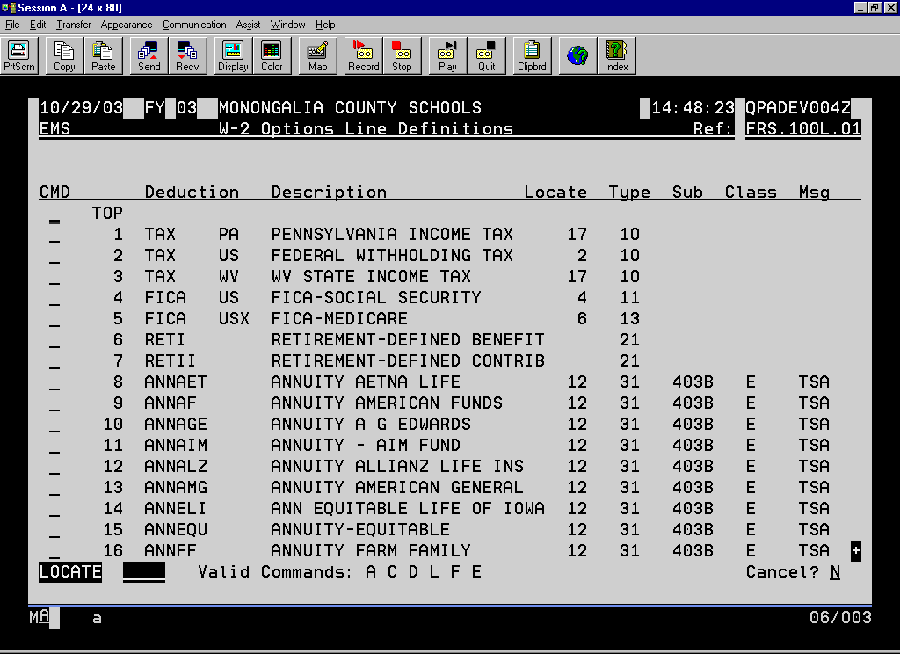
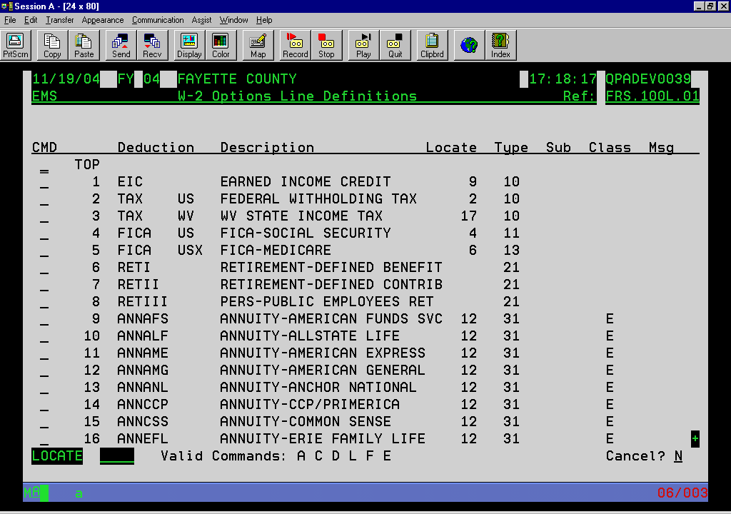
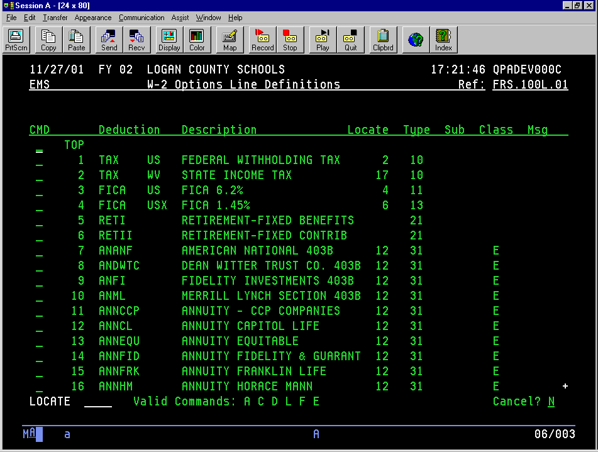
Notes:
The deduction information will default from last year. You just need to add any new deductions.

Slide 21
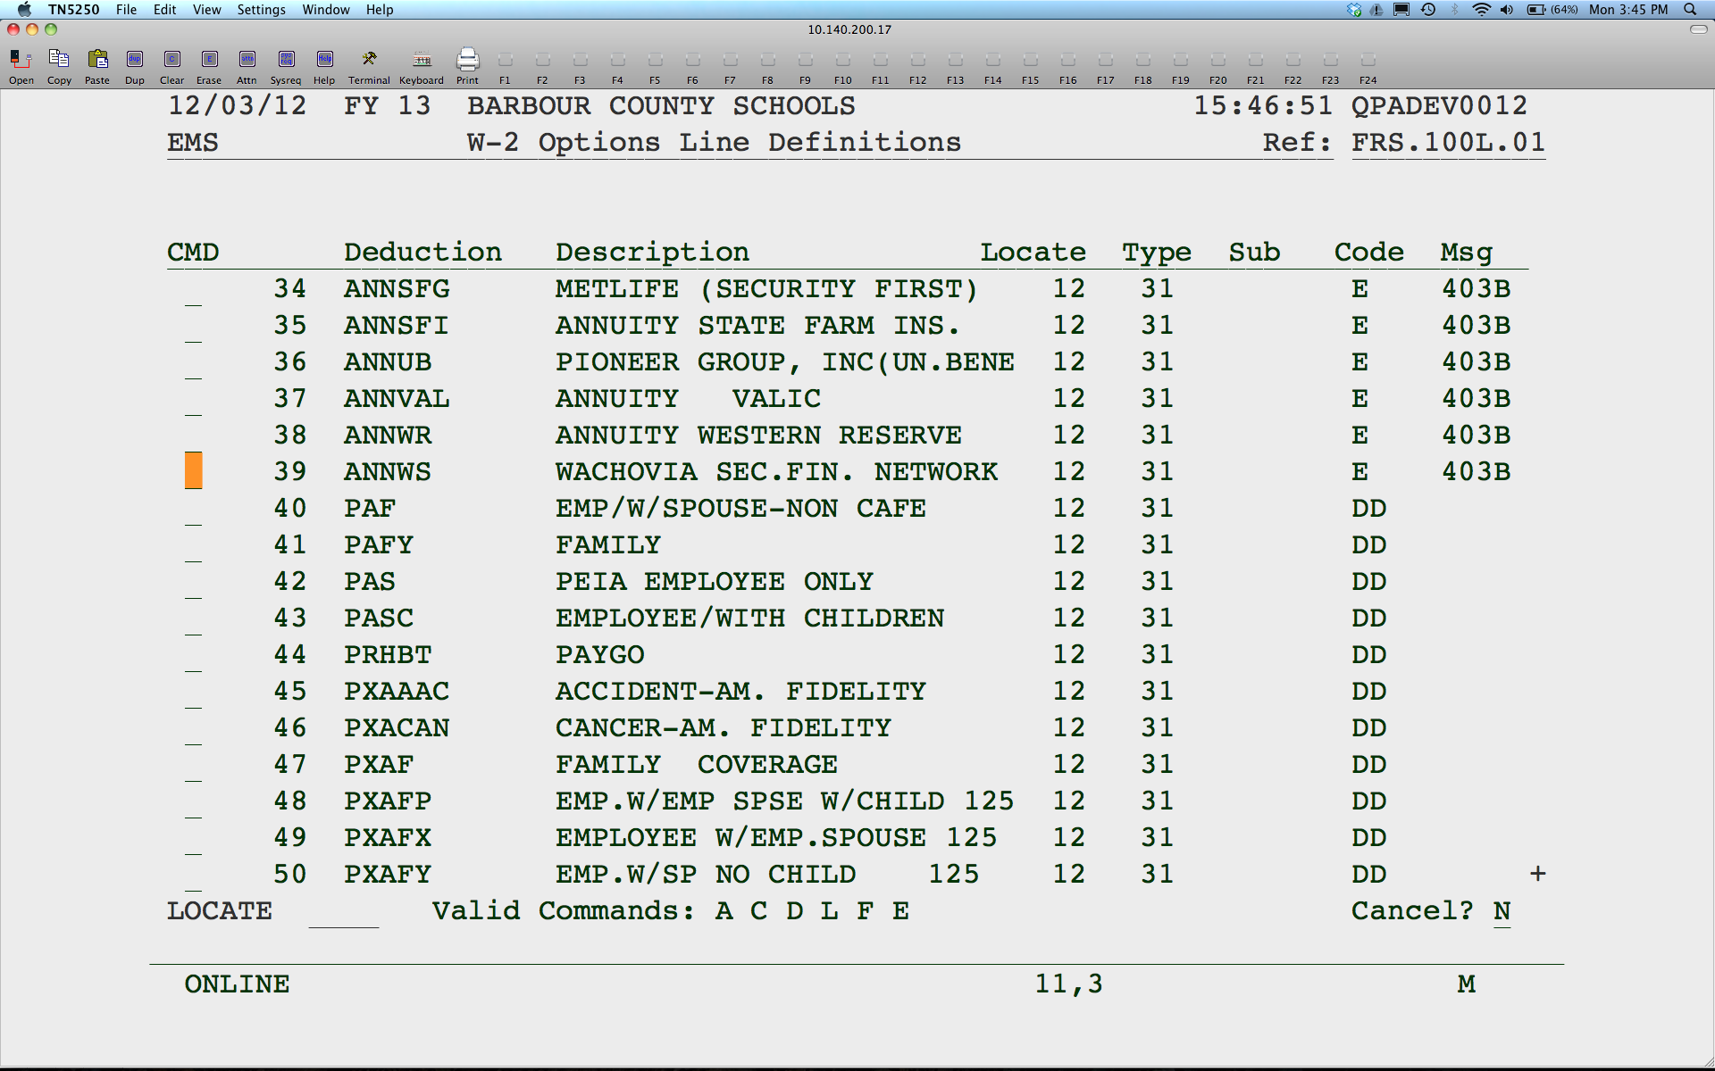
Notes:
If necessary, add other codes that need to be included on the W2.
If you have any ROTH deductions, be sure you add them to box 12 with code BB for 403b plan and EE for 457b plan.

Slide 22
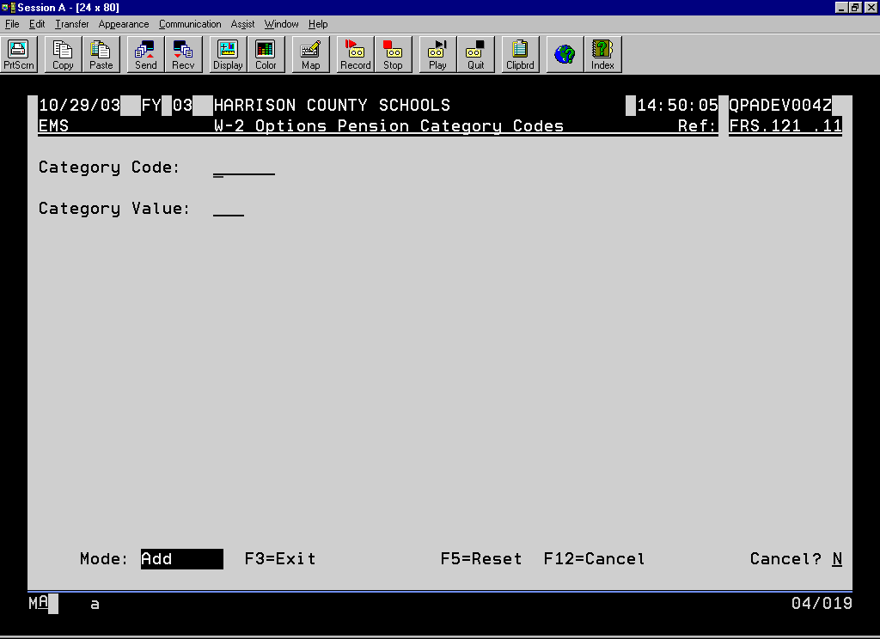
11/23/99 FY 99 PUTNAM COUNTY SCHOOLS 23:12:54 QPADEV0004
EMS W-2 Options Pension Category Codes Ref: FRS.121 .11
Category Code:
Category Value:
Mode: Add F3=Exit F5=Reset F12=Cancel Cancel? N
Notes:
Leave this screen blank and hit enter.

Slide 23
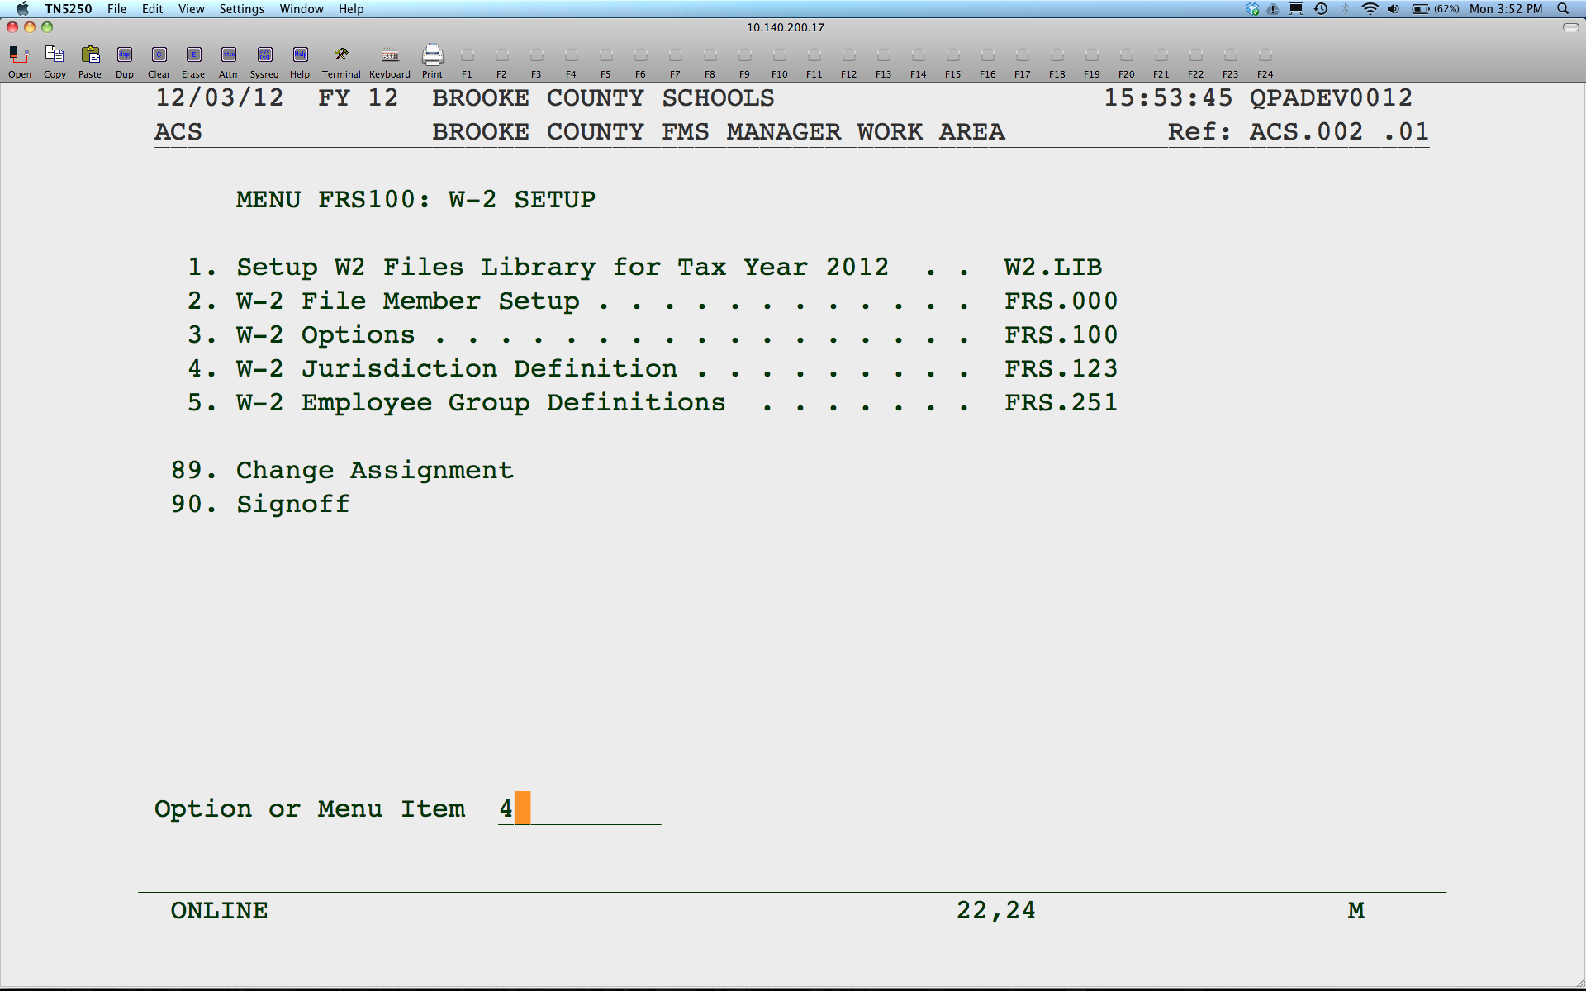

Slide 24
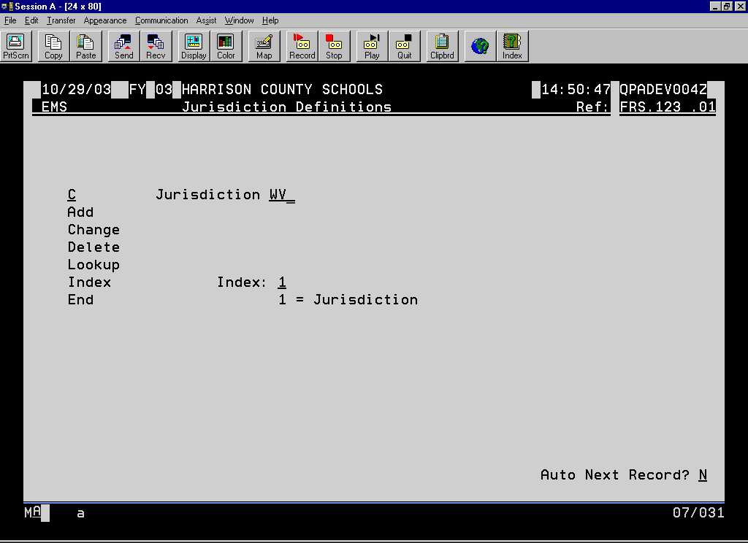
11/23/99 FY 99 PUTNAM COUNTY SCHOOLS 23:13:21 QPADEV0004
EMS Jurisdiction Definitions Ref: FRS.123 .01
C Jurisdiction WV
Add
Change
Delete
Lookup
Index Index: 1
End 1 = Jurisdiction
Auto Next Record? N
Notes:
Make sure you have a jurisdiction for all state taxes you will be printing on the W2’s.

Slide 25
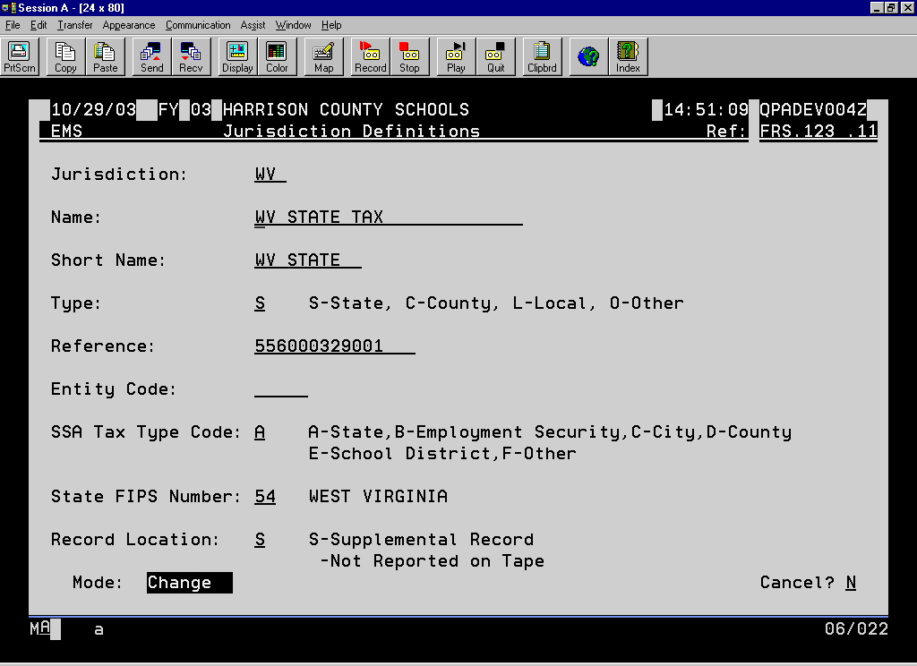
11/23/99 FY 99 PUTNAM COUNTY SCHOOLS 23:13:55 QPADEV0004
EMS Jurisdiction Definitions Ref: FRS.123 .11
Jurisdiction: WV
Name: WV STATE INCOME TAX
Short Name: WV STATE I
Type: S S-State, C-County, L-Local, O-Other
Reference: 556000387001
Entity Code:
SSA Tax Type Code: A A-State,B-Employment Security,C-City,D-County
E-School District,F-Other
State FIPS Number: 54 WEST VIRGINIA
Record Location: S S-Supplemental Record
-Not Reported on Tape
Mode: Change Cancel? N
Notes:
The description in the short name field is what prints on the W2 for the state wages. You can type anything you want here. Please verify that the reference is your federal ID number with 001 at the end or your state ID number with no hyphens or spaces. However, some counties have something other than 001 at the end of the federal ID #. Just be sure there are no spaces or hyphens.

Slide 26


Slide 27
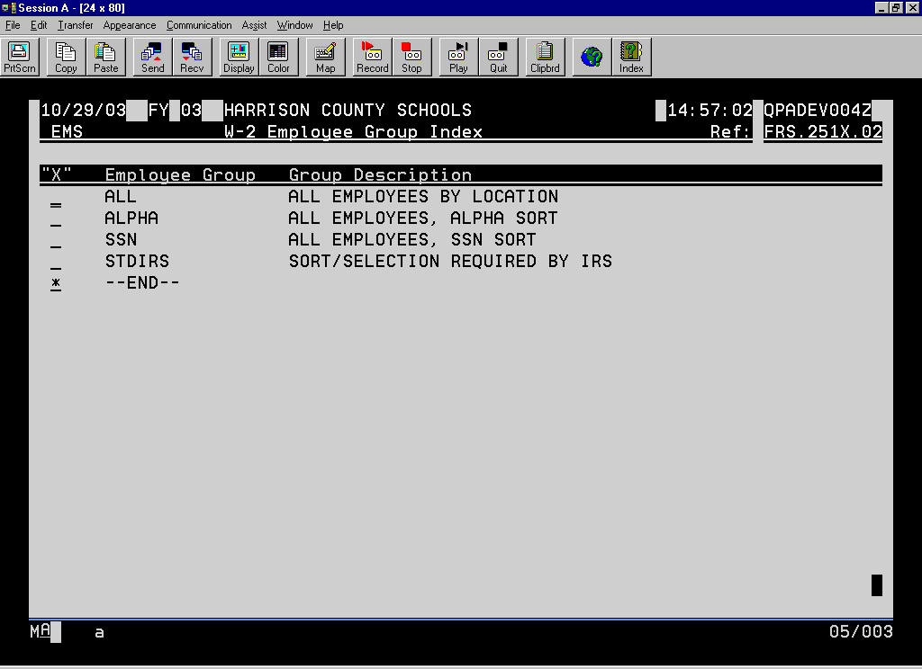
11/24/99 FY 99 PUTNAM COUNTY SCHOOLS 8:37:38 QPADEV0007
EMS W-2 Employee Group Index Ref: FRS.251X.02
"X" Employee Group Group Description
ALPHA ALL EMPLOYEES, ALPHA SORT
SSN ALL EMPLOYEES, SSN SORT
STDIRS SORT/SELECTION REQUIRED BY IRS
* --END--
Notes:
If you would like your W2’s sorted differently, you can setup your own group.

Slide 28
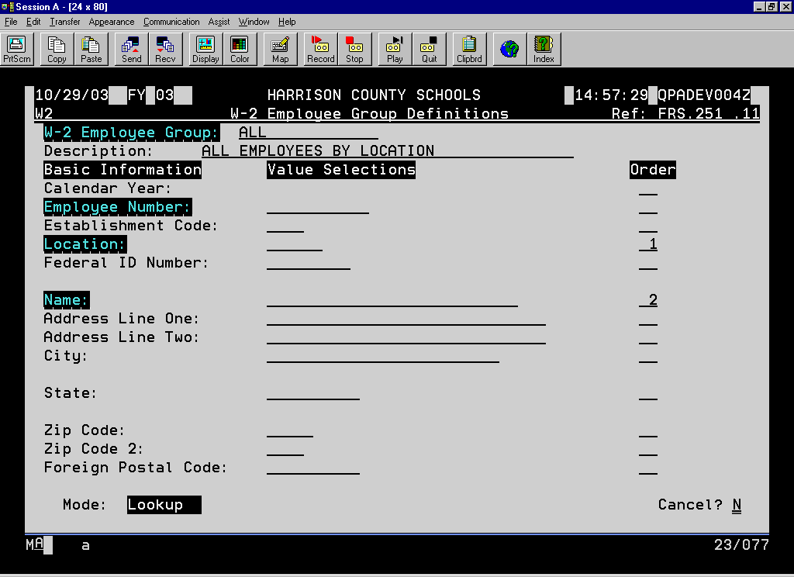
11/24/99 FY 99 PUTNAM COUNTY SCHOOLS 8:38:24 QPADEV0007
W2 W-2 Employee Group Definitions Ref: FRS.251 .11
W-2 Employee Group: ALPHA LOC
Description: ALPHA BY LOCATION
Basic Information Value Selections Order
Calendar Year:
Employee Number:
Establishment Code:
Location: 1
Federal ID Number:
Name: 2
Address Line One:
Address Line Two:
City:
State:
Zip Code:
Zip Code 2:
Foreign Postal Code:
Mode: Add F3=Exit F4=Index F5=Reset F12=Cancel Cancel? N

Slide 29
Notes:
This checklist is used after all payrolls have been run. Once option 5 is completed, you can proceed with your January payroll. Once the January payroll is run, you cannot run option 4 again without doing some backups and restores. Just make sure you run steps 12 and 13 before you run your January payroll. You can then come back to the W2’s and complete the steps.

Slide 30
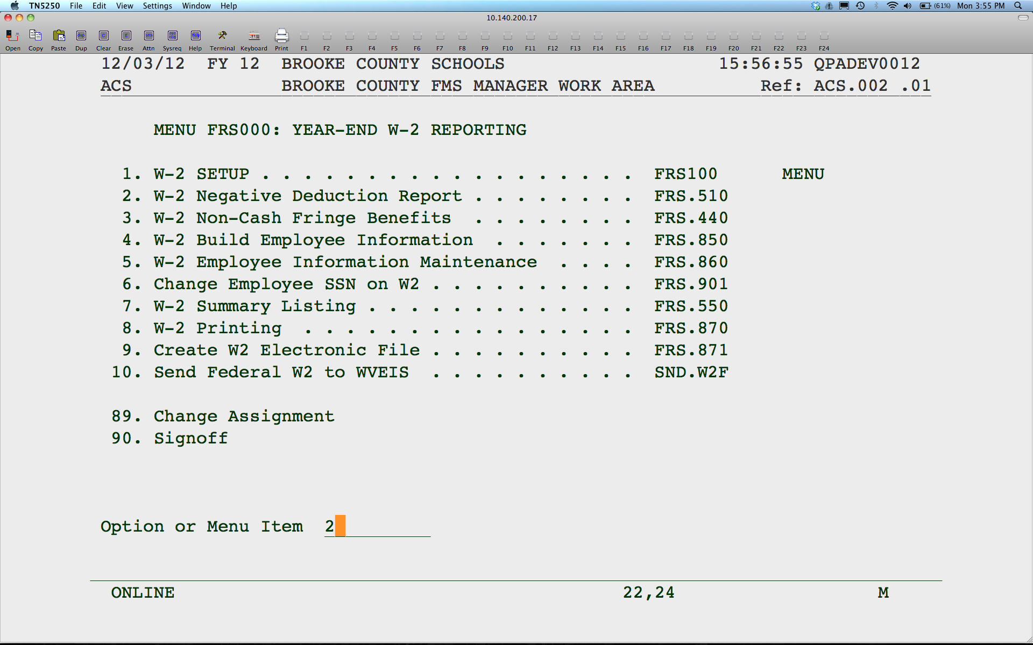
Notes:
Print this report to see if any person would have a negative amount on their W2. The W2 will not print an amount less than zero. This report will make you aware of any discrepancies between the W2 summary and your payroll reports. You do not need to correct or change anything that prints on this report.

Slide 31

Notes:
Use this program to enter fringe benefits, for example the use of the company car by an employee. This entry will increase the taxable wages on the W2 but will not affect the taxes withheld. You will need to withhold the extra FICA taxes through payroll before the last check of the year.

Slide 32
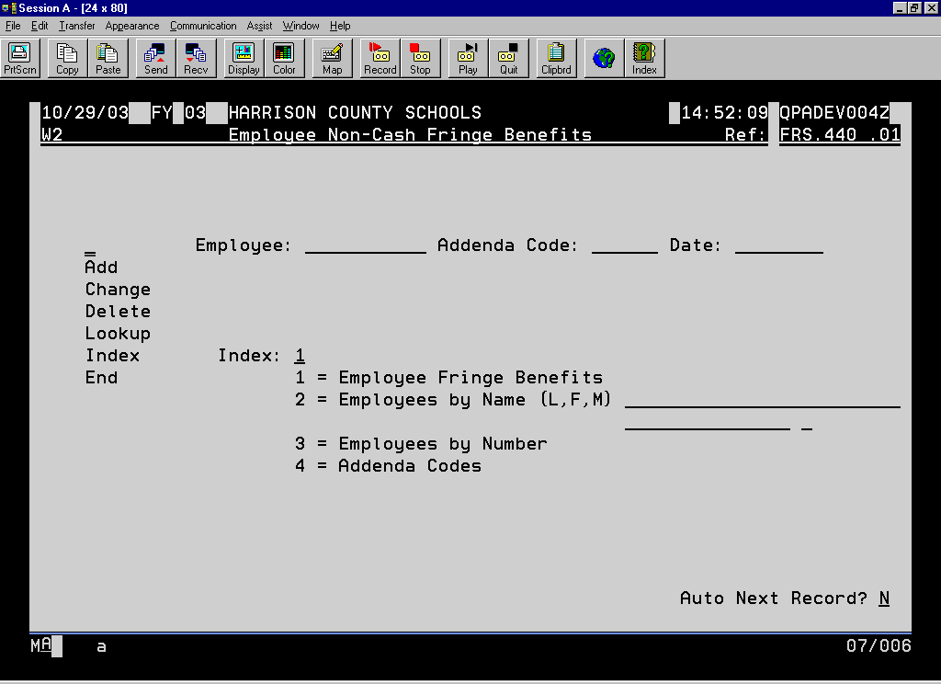
11/24/99 FY 99 PUTNAM COUNTY SCHOOLS 8:30:06 QPADEV0007
EMS Employee Non-Cash Fringe Benefits Ref: FRS.440 .01
Employee: Addenda Code: Date:
Add
Change
Delete
Lookup
Index Index: 1
End 1 = Employee Fringe Benefits
2 = Employees by Name (L,F,M)
3 = Employees by Number
4 = Addenda Codes
Auto Next Record? N
Notes:
You have to enter an addenda code. Any valid code can be used. The code is required, but what you call it is irrelevant. For each employee, do an A to add, enter their Employee number, the addenda code and date. 12/31 is sufficient.

Slide 33
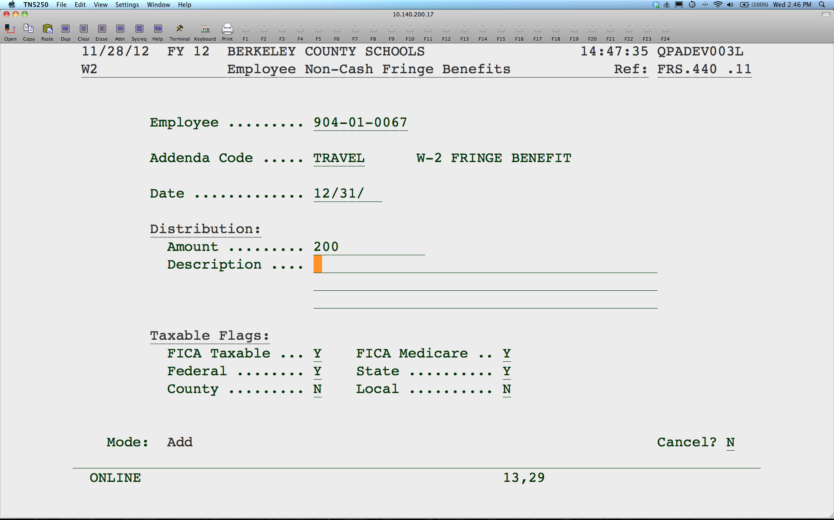
Notes:
Enter the amount of the benefit. You can enter a description for your own info. Be sure the taxable flags are set to tax FICA, Federal and State. Note that for any benefit entered here that is subject to FICA, you will need to calculate the employee and employer amount for FICA based on the benefit amount. You will then need to enter a one time voluntary deduction for FICA US and FICA USX for both the employee and employer amounts prior to the last payroll of the year. If the employee is no longer employed, the county will need to pay both the employee and employer amounts. Just calculate the amounts and add to your next FICA payment. You will also need to reflect these payments on your 941.

Slide 34


Slide 35
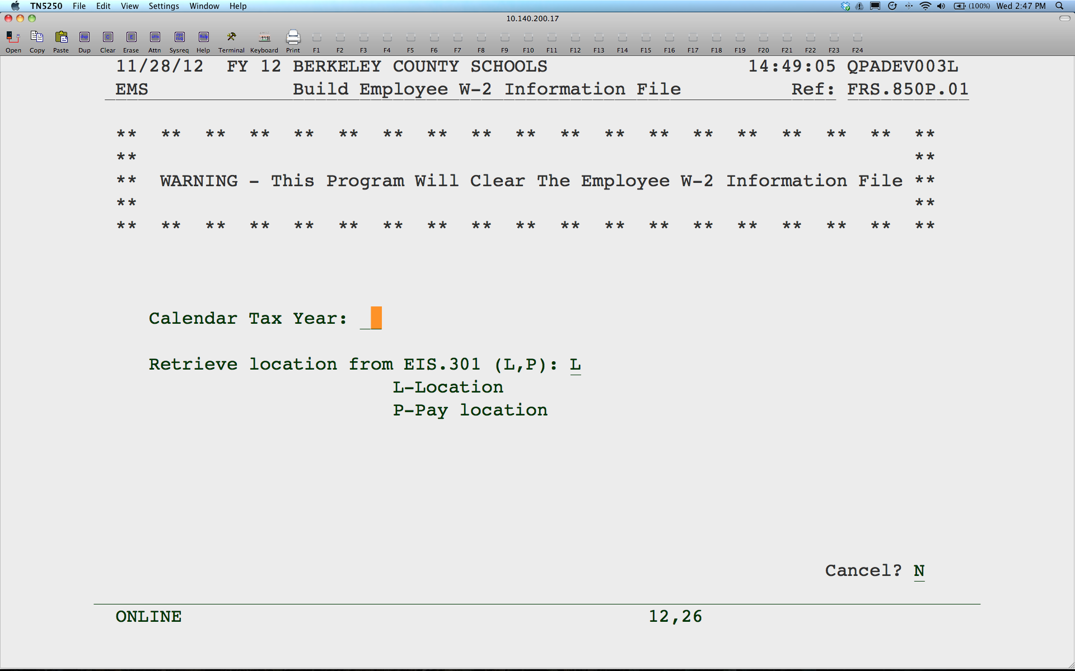
Notes:
This program will build the W2 totals using the payroll balances. If any manual adjustments have been entered on the employee’s W2, this program will wipe them out. If you make any changes to the W2 setup (for example, adding new deductions), you would need to build the employee file again. Once you have built this file, you may want to make a backup of your PPAY801. Select which location (work or pay) you want to sort your W2’s by. Calendar year will default to current calendar year.

Slide 36
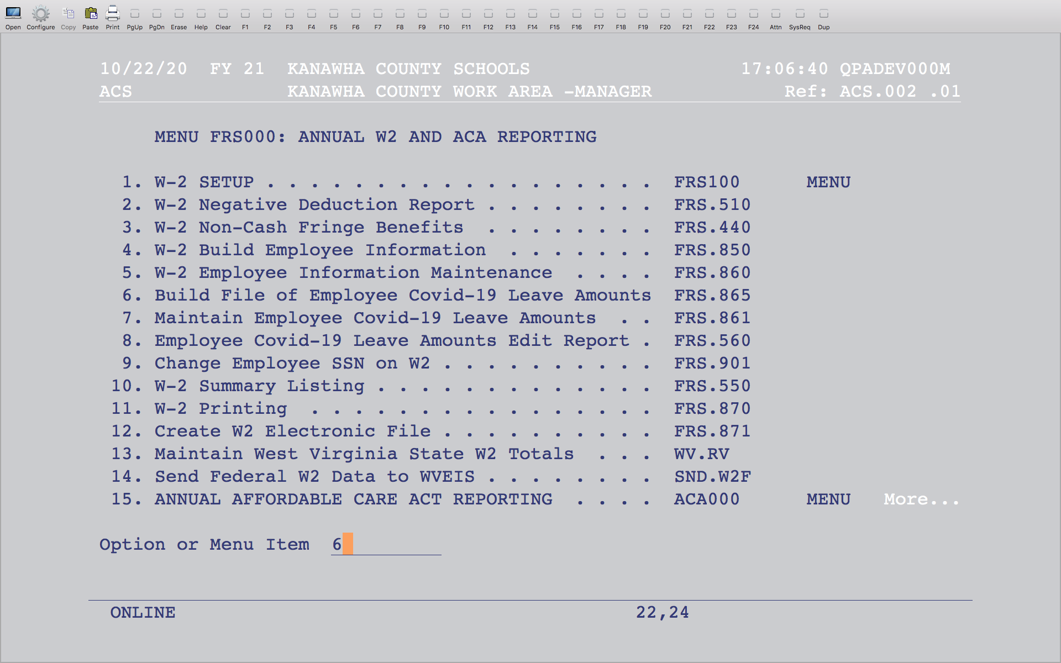
Notes:
Run option 6 to build the wages for COVID absences for the supplemental W2 form based on the payroll history files.

Slide 37


Slide 38
Notes:
This is the new program that will allow changes to the amounts on the supplemental form for those that took COVID absences this year. Hit F4 or index to find the employee. Once the SSN is entered, hit enter.

Slide 39
Notes:
You will be able to make changes to the 3 fields which contain wages based on the absences taken. The first field is for COVESF, which are the first 10 days taken with full pay. The second field is for COVESP, which are the first 10 days taken at 2/3 pay. The third field is for COVFMA, which is the remaining 10 weeks of FMLA paid at 2/3 daily rate. The W2 build program will not update or change these values.

Slide 40

Notes:
Use this program to print the W2 supplemental forms for those that took COVID absences this year. This will print on a plain 8.5x11 paper.

Slide 41


Slide 42
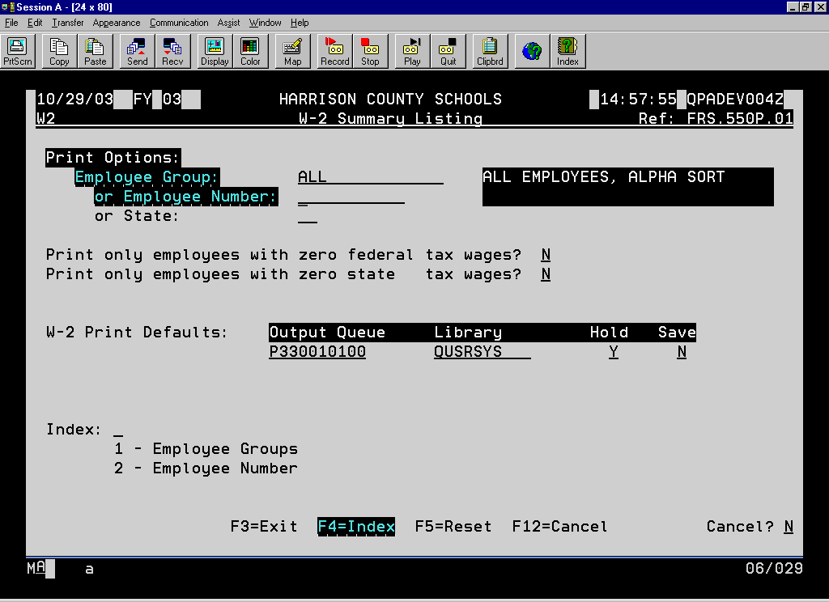
11/24/99 FY 99 PUTNAM COUNTY SCHOOLS 8:40:55 QPADEV0007
W2 W-2 Summary Listing Ref: FRS.550P.01
Print Options:
Employee Group: ALPHA ALL EMPLOYEES, ALPHA SORT
or Employee Number:
or State:
Print only employees with zero federal tax wages? N
Print only employees with zero state tax wages? N
W-2 Print Defaults: Output Queue Library Hold Save
PRT7200132 QUSRSYS Y Y
Index:
1 - Employee Groups
2 - Employee Number
F3=Exit F4=Index F5=Reset F12=Cancel Cancel? N
Notes:
This program will print a listing of the W2 information for each employee with grand totals at the end. Be sure you check the totals to make sure they agree with the payroll reports you ran. Any differences may be from negative amounts or fringe benefits entered. Refer to the Negative Deduction Report. IMPORTANT: Be sure to check your totals by taking your total gross wages for the calendar year and subtract the S125 totals to make sure it matches the FICA wage amounts and then subtract retirement and annuities to make sure it agrees with the federal and state wages. The FICA and Medicare wages should be the same. The only difference would be for those employees who maxed out on FICA US. Make sure your federal and state wages are the same also.

Slide 43
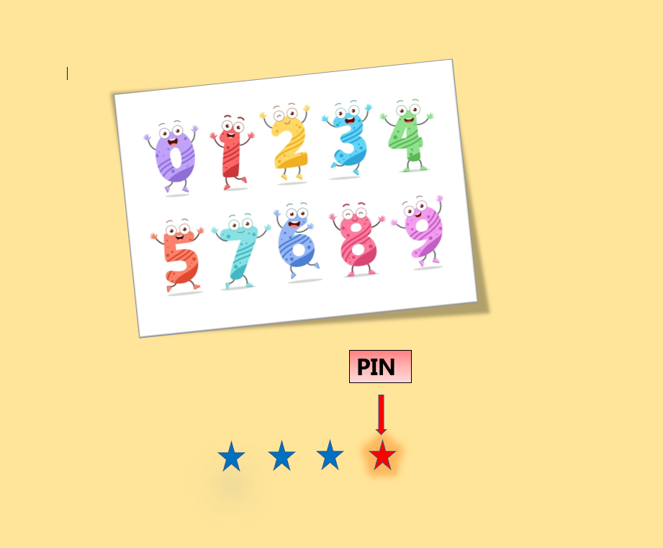
1

Slide 44

Notes:
Use this program to make any manual changes to an employee’s W2. Make these changes once you have built the W2 totals for the last time.

Slide 45

Notes:
Use this program to change an incorrect SSN on the W2.

Slide 46
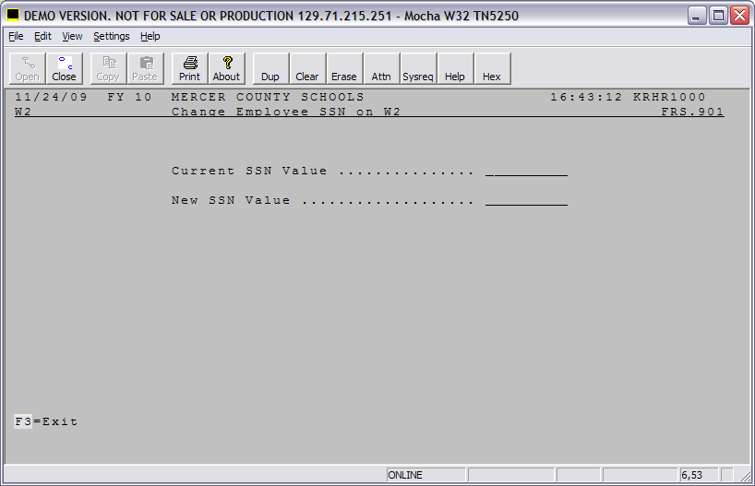
Notes:
Enter the wrong SSN, then the correct SSN.

Slide 47


Slide 48
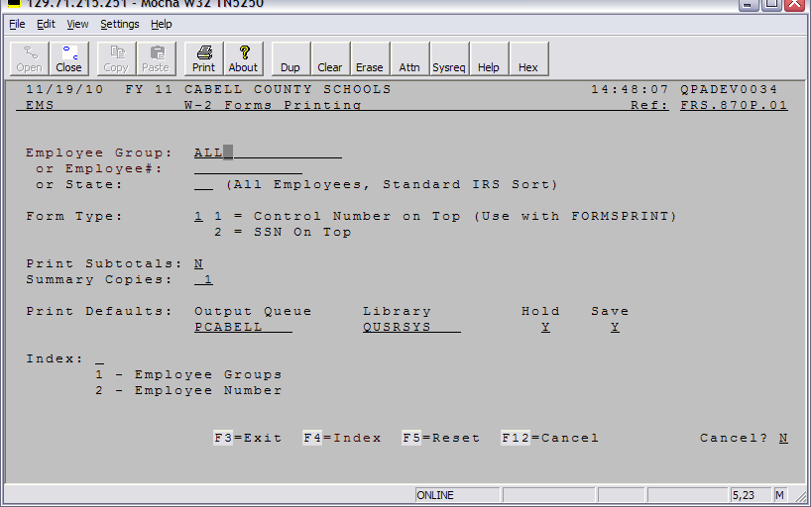
Notes:
You can run this program for all employees or just one. The employee number is actually the SSN, not the ID number. By entering a state code in the “or State” field, you can print a copy of the W-2’s subject to a particular state’s taxes, if you withhold for another state. This is the copy you can send to that state to report the W-2’s. If you withhold MD, VA, PA, OH or KY taxes, we can submit electronically for you. Just let Kim Harvey know to do that for you.
There are 2 formats to select from. Depending on your W2 forms, you will choose the first option to print the SSN in the middle or the second option to print the SSN at the top. If you are using FORMSPRINT (laser printing), use option 1.
Once you run your W2’s, you will want to save your W2 file. The file is W2FILEXXYY, where XX is your county number and YY is the calendar year. Contact the WVEIS helpdesk, if necessary.

Slide 49

11/23/99 FY WEST VIRGINIA TEST CLIENT 22:48:46 QPADEV0005
ACS PRODUCTION WORK AREA FOR PUTNAM COUNTY DATA Ref: ACS.002 .01
MENU EMS000: EMPLOYEE MANAGEMENT SYSTEM
1. PAYROLL OPTIONS AND CODES . . . . . . . . . . PAY100 MENU
2. EMPLOYEE OPTIONS AND CODES . . . . . . . . EIS100 MENU
3. DIRECT DEPOSIT OPTIONS AND CODES . .. PAY110 MENU
4. EMPLOYEE BONDS SYSTEM . . . . . . . . . . . . . . PAY120 MENU
5. EMPLOYEE RECORDS SYSTEM . . . . . . . . . . . PAY300 MENU
6. EMPLOYEE BALANCES . . . . . . . . . . . . . . . . . . PAY360 MENU
7. EMPLOYEE ATTENDANCE SYSTEM . . . . . . PAY400 MENU
8. CAFETERIA BENEFITS SYSTEM . . . . . . . . . . CBS000 MENU
9. PAYROLL PROCESSING SYSTEM . . . . . . . . . PAY600 MENU
10. PAYROLL ENCUMBRANCE SYSTEM . . . . . PRE600 MENU
11. BUDGET FORECASTING SYSTEM . . . . . . . . PBF000 MENU
12. NEW YEAR/YEAR END PROCESSING . . . . PAY900 MENU
13. YEAR-END W-2 REPORTING . . . . . . . . . . . FRS000 MENU
89. Change Assignment More...
Option or Menu Item
Notes:
Don’t forget to clear your balances before you run a payroll in January.

Slide 50
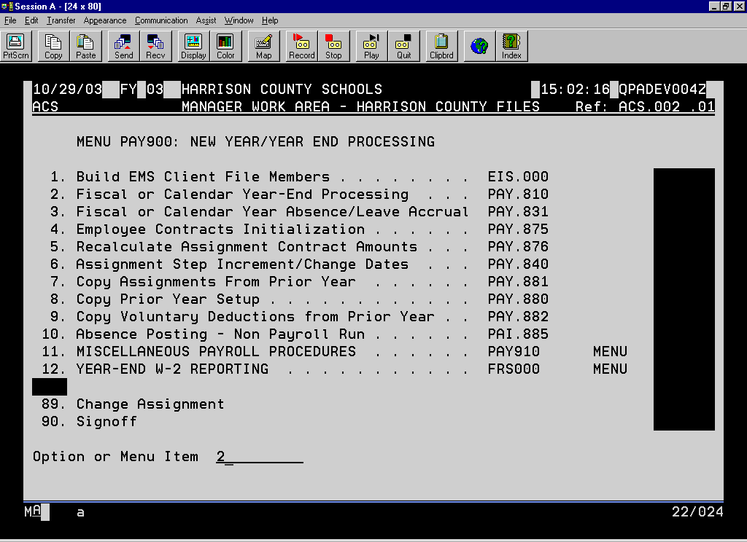
11/24/99 FY 99 PUTNAM COUNTY SCHOOLS 11:20:48 QPADEV0006
ACS PUTNAM COUNTY SCHOOLS Ref: ACS.002 .01
MENU PAY900: NEW YEAR/YEAR END PROCESSING
1. Build EMS Client File Members . . . . . . .. . . . . . . . . . . . . . EIS.000
2. Fiscal or Calendar Year-End Processing . . . . . . . . . . . .. . . PAY.810
3. Fiscal or Calendar Year Absence/Leave Accrual . . . . . . . . . PAY.831
4. Employee Contracts Initialization . . . . . . . . . . . . . . . . . . . .. PAY.875
5. Recalculate Assignment Contract Amounts . . . . . . . . . . . . . PAY.876
6. Assignment Step Increment/Change Dates . . . . . . . . . . . .. . PAY.840
7. Copy Assignments From Prior Year . . . . . . . . . . . . . . . . .. . PAY.881
8. Copy Prior Year Setup . . . . . . . . . . . . . . . . . . . . . . . . . . . . .. PAY.880
9. Copy Voluntary Deductions from Prior Year . .. . . . . . . . . . PAY.882
10. Absence Posting - Non Payroll Run . . . . . .. . . . . . . . . . . . . PAI.885
11. MISCELLANEOUS PAYROLL PROCEDURES . . . . . . PAY910 MENU
12. YEAR-END W-2 REPORTING . . . . . . . . . .. . . . . . . . . . . FRS000 MENU
89. Change Assignment More...
Option or Menu Item

Slide 51
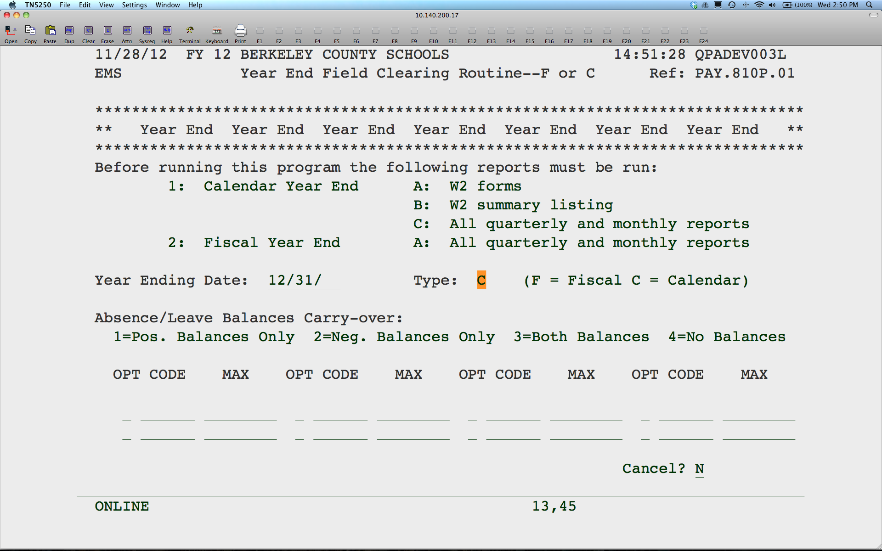
Notes:
Make sure you have run your monthly, quarterly (such as unemployment reports) and calendar year reports,. Enter the appropriate date (12/31/20). You do not need to enter anything at the bottom of the screen.
You must run this program before you run your first pay in January, regardless of where you are in the W2 process. If you have not completed the W2 steps, you may need to backup your PPAY801 balances before clearing them. WVEIS helpdesk can assist with any backups and restores. To make sure the balances cleared, go into PAY.801 – Employee Pay/Deduction Balances and check the calendar column. There should be numbers in the fiscal but not calendar.

Slide 52

Notes:
This program will create your federal file. When you are finished with W2’s, you can create the file that the state will send on your behalf. If you make any changes to W2’s, you will need to create the file and submit again.

Slide 53
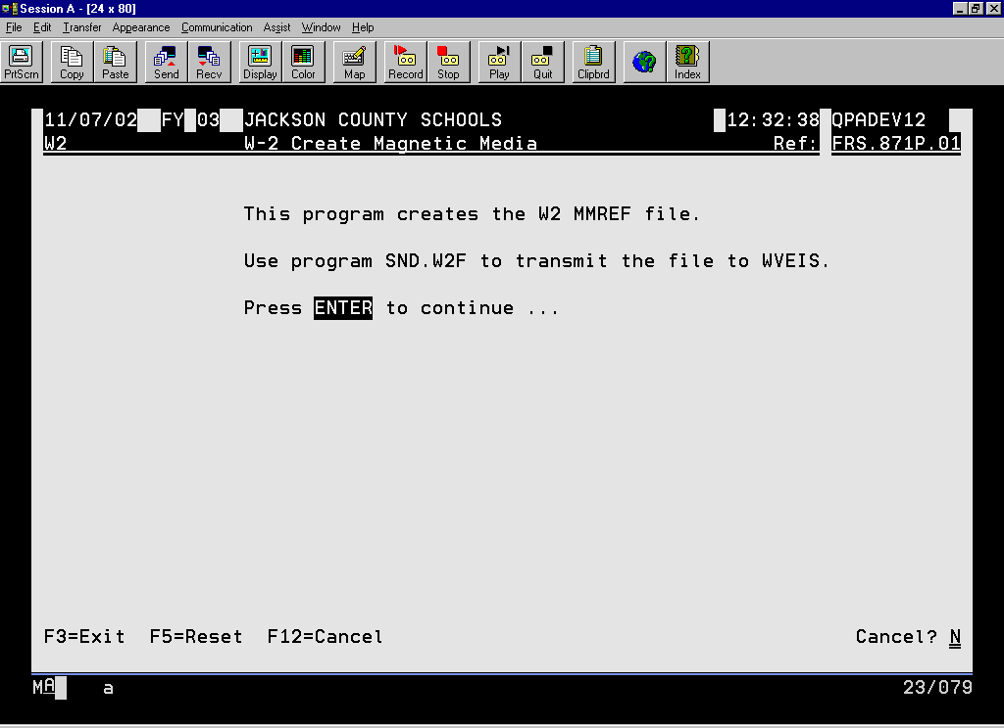

Slide 54

Notes:
This is the new program that replaces the WV-IT103. You will need to enter your quarterly totals as submitted to the state throughout the calendar year.

Slide 55
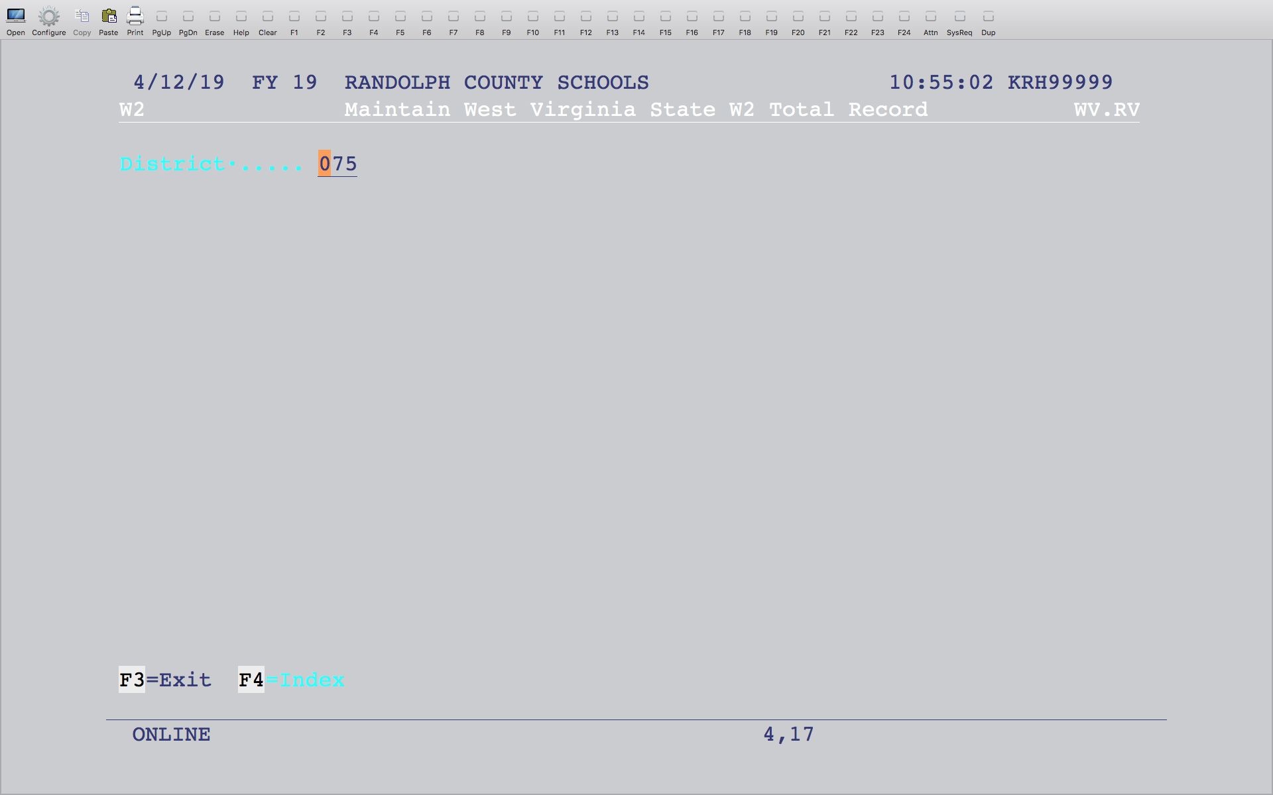
Notes:
Enter your county number with a leading zero. You can also hit F4 to select your county.

Slide 56
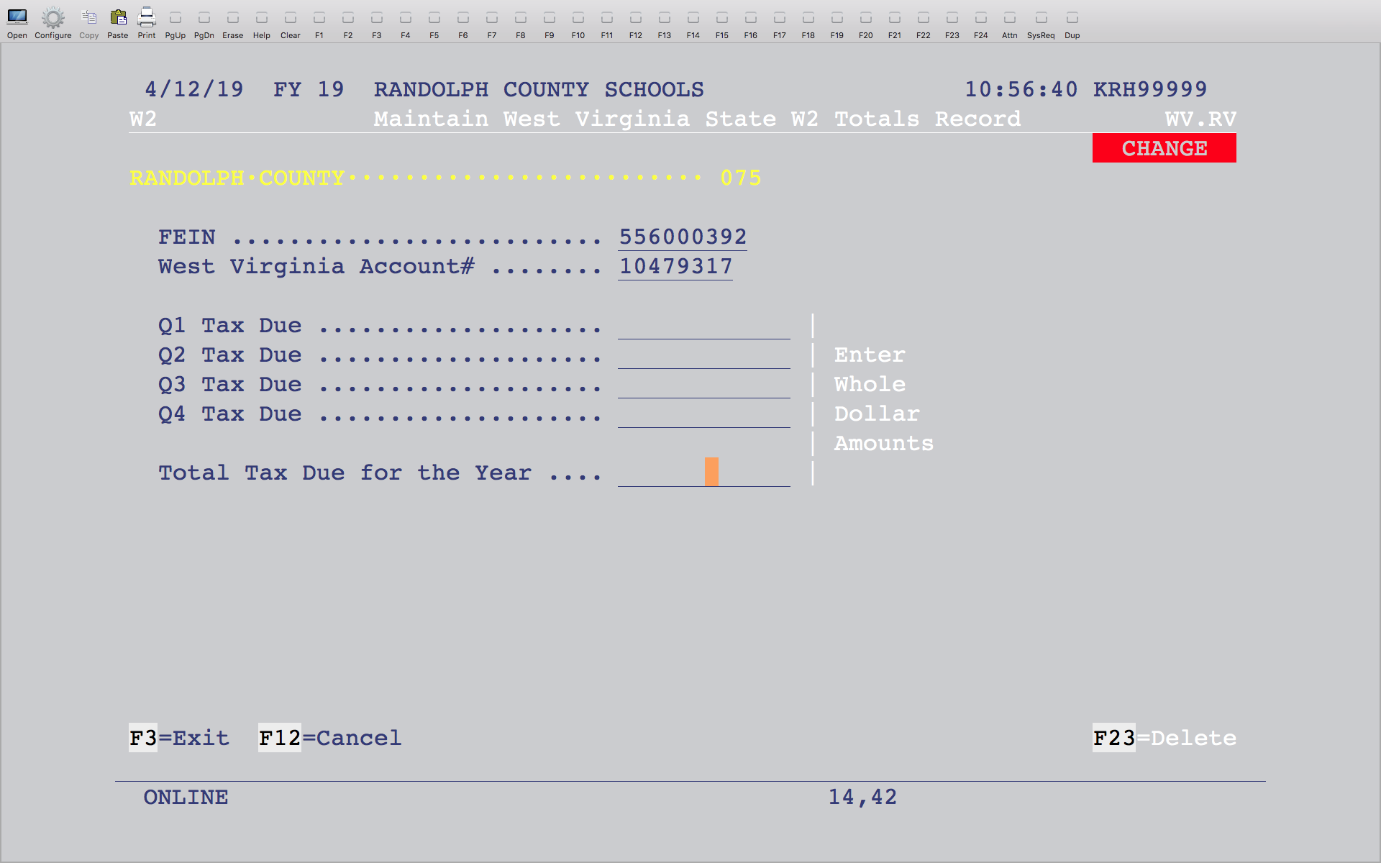
Notes:
Enter the withholding totals for each quarter and the total for the year. Be sure to only enter Whole Dollar Amounts.

Slide 57

Notes:
This will send the W2 file to WVEIS to be submitted to the SSA and all states. Each Friday, the CEO (County Employee Online) website will be updated with the county’s W2 information that has been submitted to us during the week. You will no longer need to send the WV/IT-103 annual reconciliation form. This information will be included in our electronic file that we send to them.

Slide 58
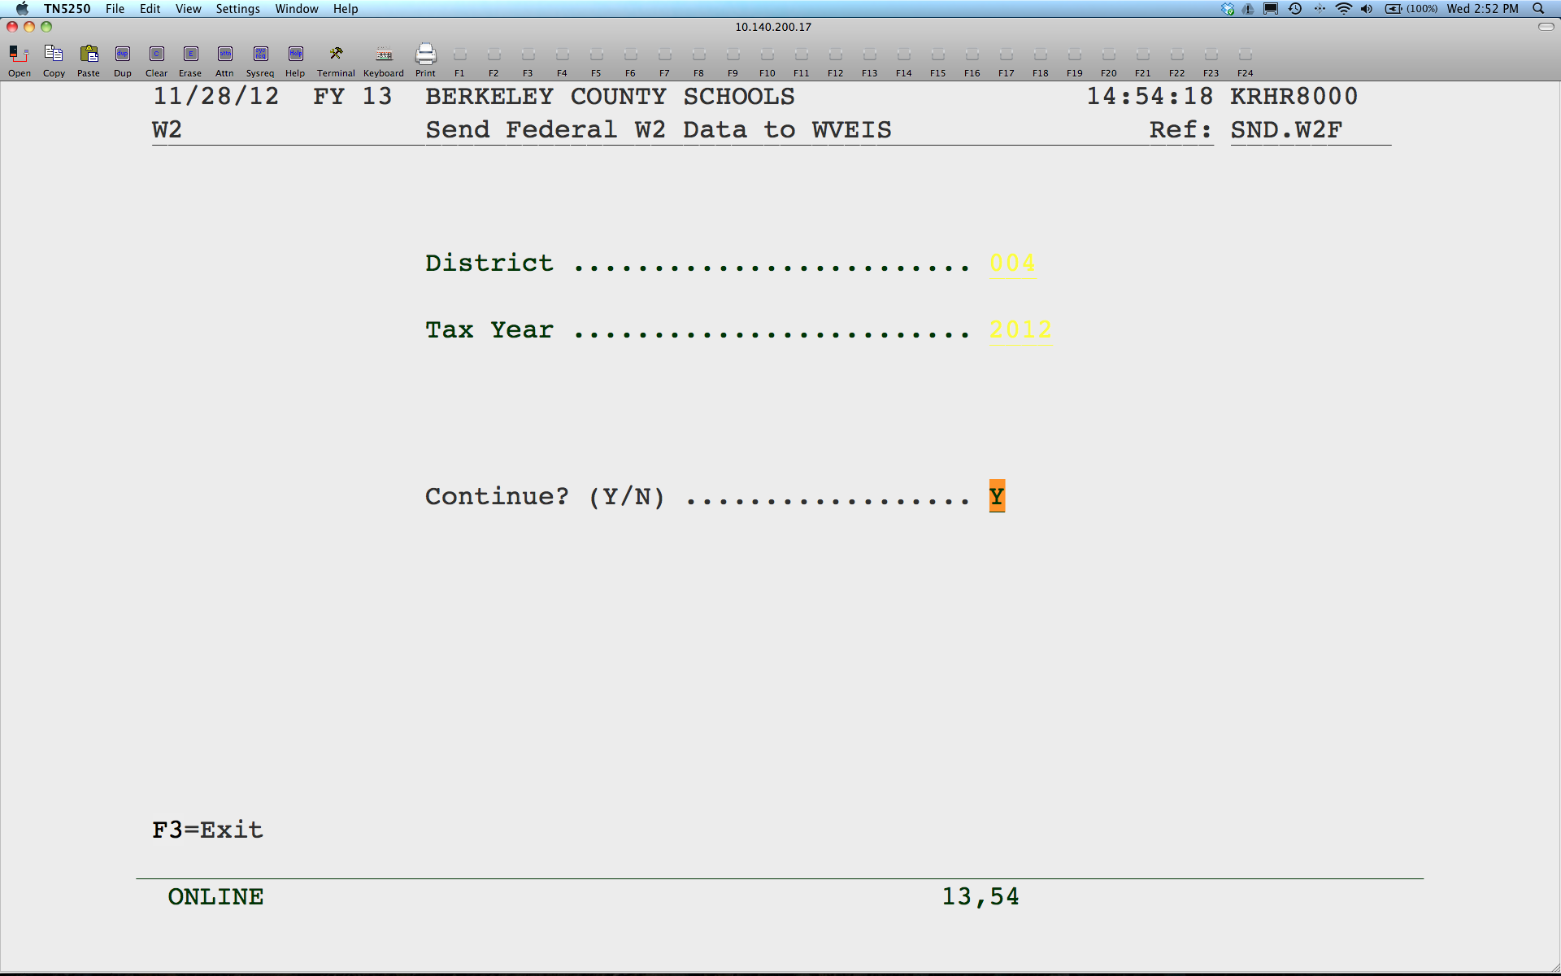
Notes:
Press enter to continue. This sends the file to us to submit to the federal and states. This is also the file used to update the County Employee Online (CEO). Please complete no later than January 24.

