Slide 1
Purchasing and policy 8200
Kristina Geiselhart
Purchasing director
Harrison county

Slide 2
Policy 8200
Purchasing policies and procedures for local educational agencies
  Establishes the minimum requirements for county boards of education by the State Board of Education
  To be used in conjunction with local LEA policies
According to WV Code §11-8-26, a local fiscal body, which includes county boards of education, shall not expend money or incur obligations:
  In an unauthorized manner
  For an unauthorized purpose
  In excess of the amount allocated to the fund in the levy order
  In excess of the funds available for current expenses

Slide 3
Planning purchases (acquisition planning)
Planning is key when trying to prepare for a purchase regardless of the size
  Define need
  Acquisition and delivery time frame
  Specifications
  Alternative sources
  Identify possible vendors
  Pre-bid meetings
  Preparing the requisition

Slide 4
When do I do…
RFI – Request for Information – this is used when there is not enough information to develop a full RFQ or RFP and/or to gauge interest in a project to ensure a high level of competition
RFQ – Request for Quotes – used to solicit competitive bids for commodities and has a scope of work and contractual terms and conditions.
RFP – Request for Proposals – used to solicit competitive bids for professional, technical or specialized services where the scope of work may not be comparable.
EOI – Expression of Interest – used only for the procurement of A and E services.

Slide 5
…and at what thresholds
Purchases costing:
  $5000 or less – competitive bids are encouraged but not required
  $5000 to $10,000 – competitive bids are required, minimum of three quotes, documentation must be maintained
  $10,000 to $25,000 – competitive bids are required, minimum of three written bids
  $25,000 to $50,000 – competitive bids are required and solicited from at least three known suppliers
  $50,000 or more – solicitation of bids must be in the form of sealed bids and publicly advertised

Slide 6
Construction projects
WV Code 5-22-1 requires bids be solicited for all construction projects in excess of $25,000
  Construction is defined in WV Code 21-5A-1as:
    Construction
    Reconstruction
    Improvement
    Enlargement
    Painting
    Decorating
    Repairs to public improvement
    Does NOT include temporary or emergency repairs
  Construction bids must be awarded to the lowest responsible bidder
WV Department of Labor requires all construction contracts that exceed $10,000 be in writing
Other required documentation
  Purchase affidavit (no debt affidavit), business license, contractors License, WV96 (agreement addendum)
    Regardless of the type of project or dollar threshold, if a contract is being issued, some of these forms are required.
    This is good practice for any type of contract where applicable
  Follow local LEA policy

Slide 7
Final payment releases
A final payment release is required for all contracts and construction related payments from:
  WV State Tax Department
    State taxes
  WV Workforce
    Unemployment
  WV Insurance Commissioner
    Worker’s Compensation
  City B&O Tax
    Some cities, who actively collect B&O tax, may require a final payment release during large construction projects.
      This is typically to ensure all sub-contractors have paid their B&O tax

Slide 8
State contracts
All state contracts published on the West Virginia State Purchasing website are available for use by political subdivisions including but not limited to BOE’s.
  School buses
  Custodial supplies
  Cellular services
  Shipping services
  Vehicles*
Contract Requirements
  Length with renewals
  PCard acceptance
  Insurance requirements
Website: http://www.state.wv.us/admin/purchase/swc/default.html

Slide 9
Purchasing cooperatives
An organization that has already completed the procurement process by obtaining competitive bids that meet the requirements of Policy 8200. Some examples include:
  Omnia
  E&I
  Sourcewell
  1GPA
  AEPA – Association of Educational Purchasing Agencies
  GSA – General Services Administration
Be careful with vendors trying to use other states purchasing alliances (Pennsylvania - CoStars) as some states do not allow other states to participate.

Slide 10
Benefits and fun facts about cooperatives
While already receiving cooperative pricing, some vendors via their cooperative offer rebates or additional incentives
  Growth rebates
  Free shipping
  Green spend rebates
  Purchasing platforms with built in approval processes
    E-commerce rebate
  K-12 enhanced discount program (percentage discount varies by category)
  Exclusive brands that net additional discounts

Slide 11
Cooperative / vendor rebates
Omnia – Home Depot – 1% rebate on all POS and online purchases with registered PCards
Omnia – School Specialty – 1% growth rebate year to year or free shipping on most orders
Omnia – Amazon – Free business prime membership if less than a certain amount of users; select products/Amazon shipping day could net a free business prime membership
E&I – Grainger – growth rebate, green rebate – rebate increases with increased spend
PCard – rebate based on specific program’s schedule.

Slide 12
Purchasing card (pcard)
PCard is great way to streamline your purchasing processes while having the benefits of:
  Prompt pay discounts
  Float time
  PCard rebate
Analyze your program
  Can we grow our program?
    Add cardholders or billing accounts?
  Do those with cards need them? Are the limits and restrictions appropriate to their job duties?
    Be careful to not be too restrictive with limits and purchasing power; be careful not to be too open with limits and purchasing power
  Vendor relations
While purchase orders are not required for PCard purchases, they do make it easier for AP when keying the expenditures

Slide 13
Purchasing card (pcard)
WVSAO – updated policies and procedures adopted in September 2020
  Please remember that the WVSAO policies and procedures are minimum requirements and it is up to each BOE to adopt and expand upon them.
    Travel policy
    Hospitality policy
    Reconciliation process
      When are receipts due and to whom?
      Who should sign statements?
    Failure to comply
      Loss of PCard privileges?
      Misuse, abuse or fraud?
  All employees should be trained on these policies and procedures every two years.

Slide 14
Purchasing platforms
Purchasing platforms can be an innovative way to streamline the procurement process
  ESchool Mall
    Multiple vendors
  Amazon
    Business platform
  Office Depot
    Business platform
  Grainger
    In ESM and business platform
    Keepstock program

Slide 15
amazon
Tax exempt certificate can be uploaded
  All vendors not honoring will automatically be blocked
Reconciliation module
  If you are a heavy Amazon user, if you set up a PCard just for Amazon, this module makes reconciling your PCard quick and easy
Free Prime membership
  Free membership for so many users
  If you exceed those users, there is a group of products and selection of a specific delivery day that will help reduce the memberhsip fee or even make it free!
Purchasing groups
  School (levy or in house), Special Ed, Technology, Title 1, etc.
Approval routes
  You can have as many or as few levels as you wish

Slide 16
Eschool mall
Fully integrated with WVEIS
Punch out system where your staff can browse and create a requisition from sites such as Staples, School Specialty, Kurtz Brothers, etc.
  Business pricing or Cooperative pricing built right in
Create your own catalogs
  Liberty Distributors (state contract)
  Nonintegrated sites
Once finished, cart is submitted as a requisition through the appropriate approval process. One approved, purchase order is created, and purchase order is automatically sent to the vendor on your behalf.
Warehouse management – can also create catalogs for items you store at a warehouse if applicable. This can also be used to order items stored at the warehouse and would have appropriate approval processes.
  Textbooks
  Child Nutrition items
  Custodial

Slide 17
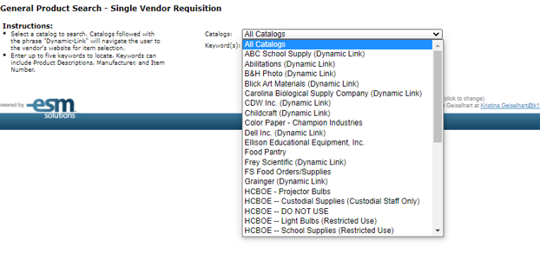
Esm catalogs

Slide 18
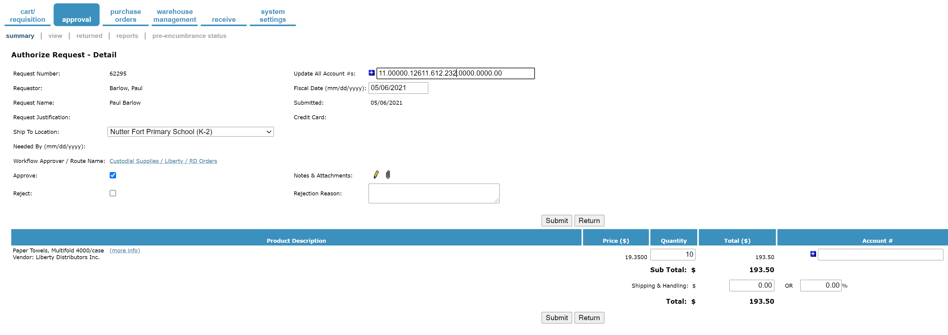
Esm requisition

Slide 19
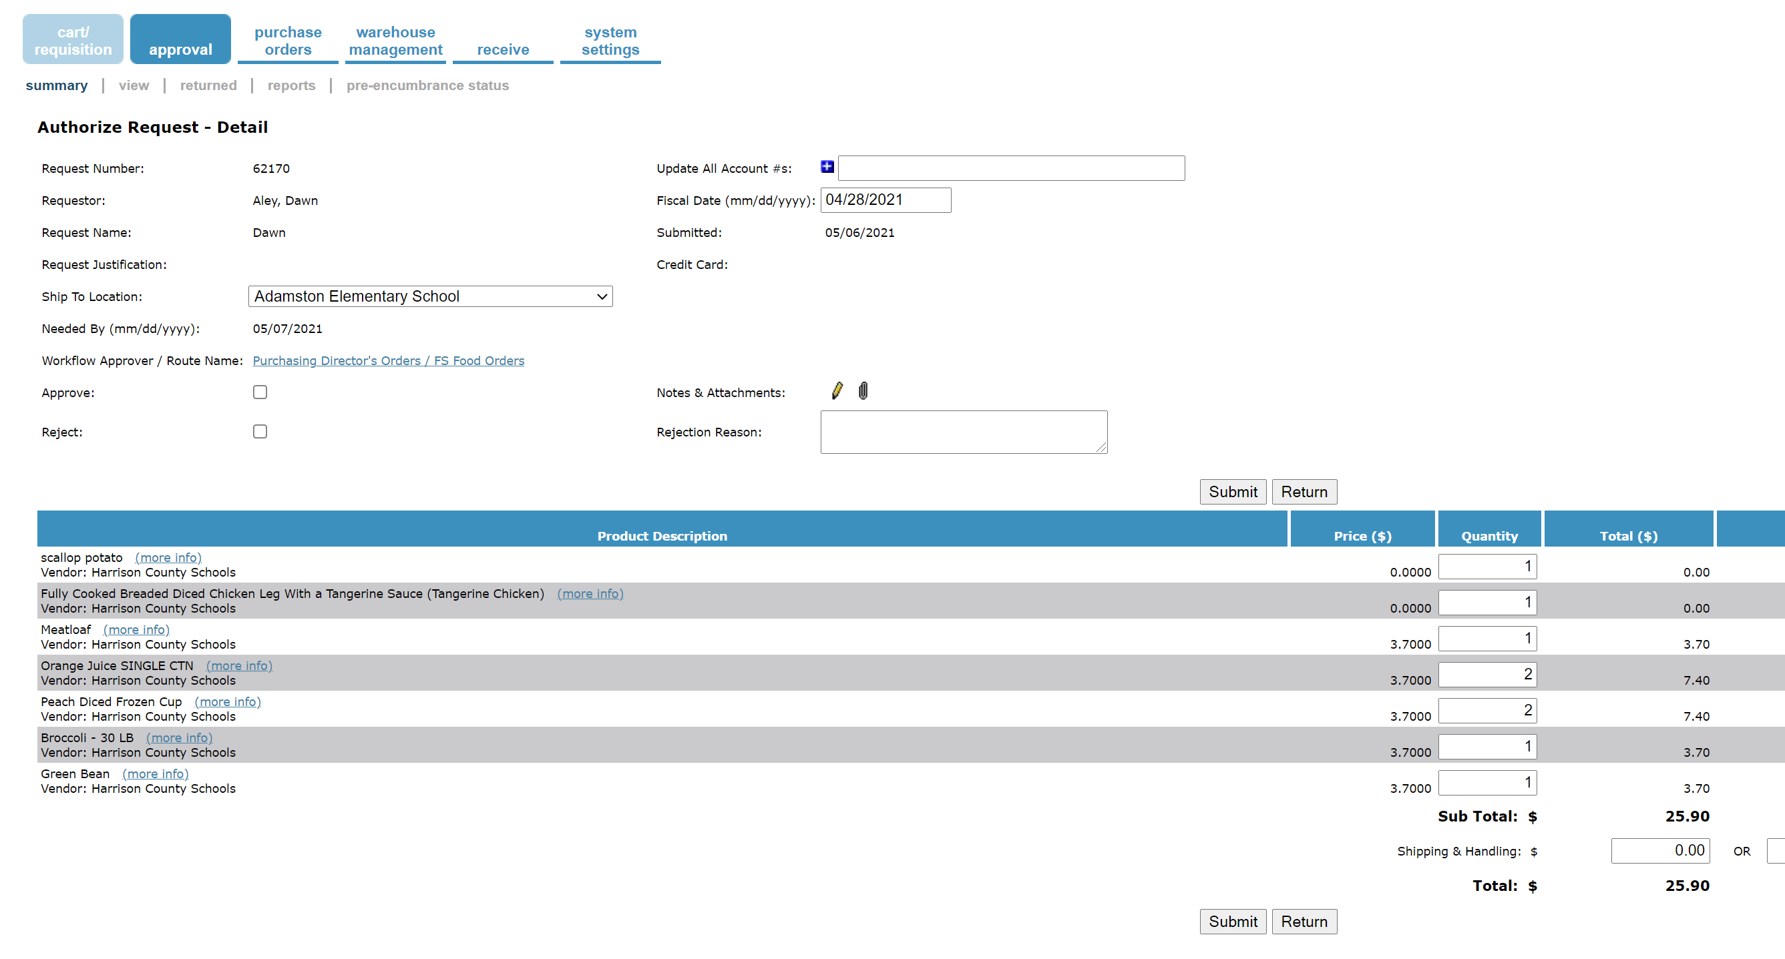
ESM Requisition – warehouse fulfillment

Slide 20
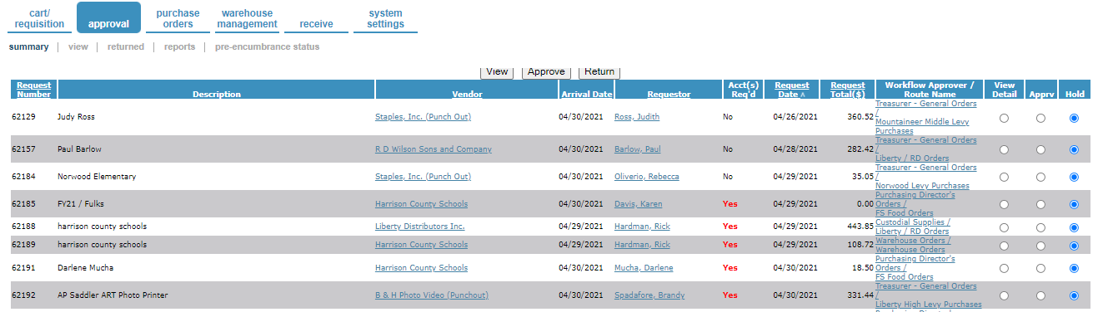
ESM Approval

Slide 21
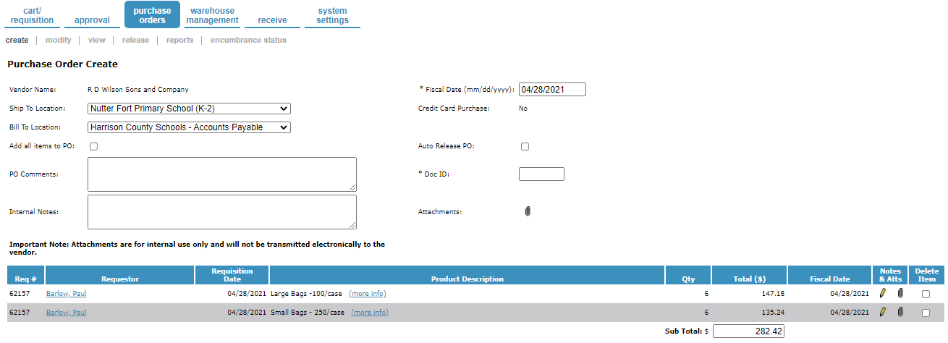
ESM purchase order creation

Slide 22

Amazon – creating groups

Slide 23
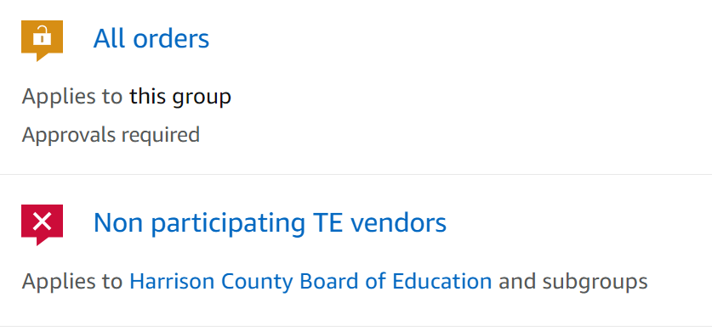
Amazon – tax exemption

Slide 24
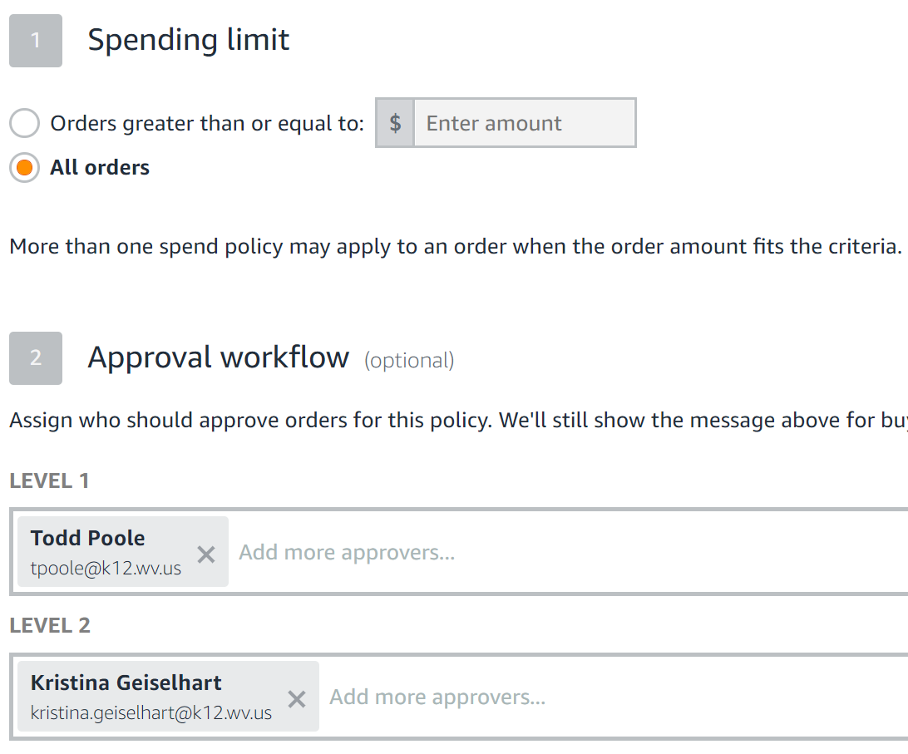
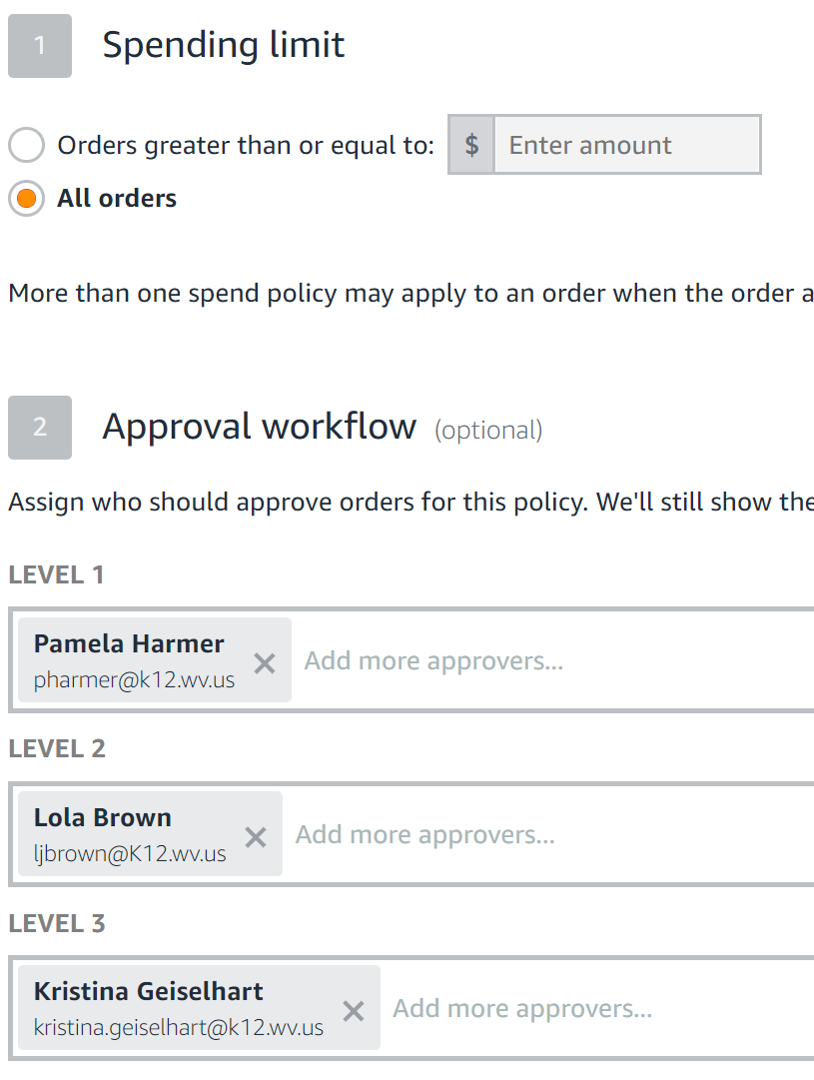
Amazon – approval routes

Slide 25
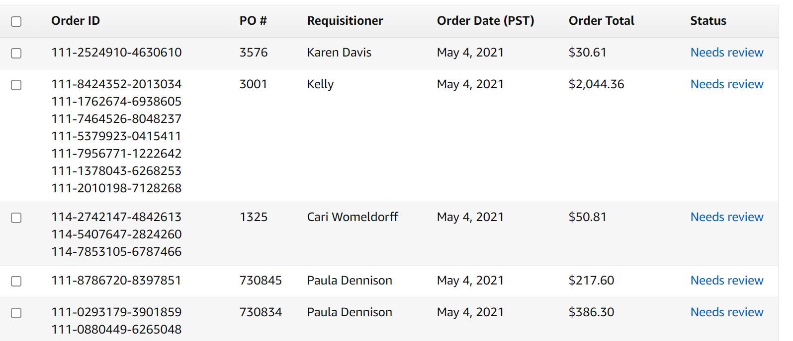
Amazon – approval of requisitions/orders

Slide 26
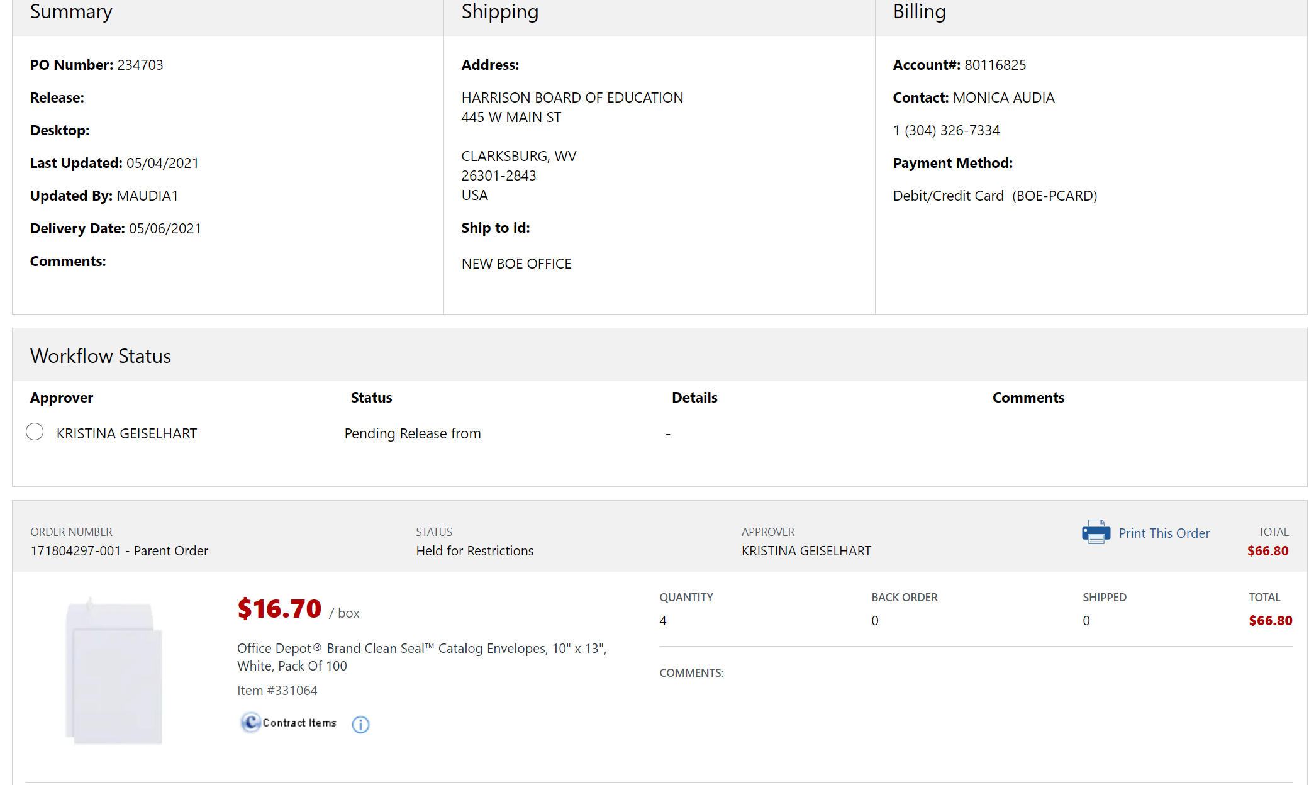
Office Depot – state contract

Slide 27
For Additional information …
Questions? Do not hesitate to reach out – we would love to help out in any way - PCard, purchasing, you name it! There is power in numbers!
Program specific contacts:
  Amazon – Nancy Ballentine - nballent@amazon.com
  ESchool Mall – Dick Breeser - DBreeser@esmsolutions.com
  Grainger – Alicia Iburg - Alicia.Iburg@grainger.com
  Office Depot – John Sharp - Michael.Sharp@officedepot.com

