Slide 1

West Virginia
Ethics Commission
2021 Ethics and
Open Meetings Acts Training
Presented By:
Kimberly B. Weber
Executive Director

Slide 2
Jurisdiction
Ethics Act
W. Va. Code § 61-10-15 (County officials and employees)
Open Meetings Act
School Board eligibility
Administrative Law Judge Code of Conduct
Lobbyists registration
Financial Disclosure Statements

Slide 3
Topics of Ethics Act
Use of Office for Private Gain
Solicitation and Gifts
Name/Likeness (“Trinkets”)
Prohibited Public Contracts
Voting
Conflicts of Interest
Employment Restrictions

Slide 4


Use of Public Office for
Private Gain
May not use public resources, including time and subordinate staff, for someone’s personal benefit.
Ethics Act prohibits more than a de minimis use for personal purposes.
W. Va. Code § 6B-2-5(b)
Notes:
Motorcycle on pcard
Law enforcement vehicle

Slide 5


Slide 6

Use of Public Office for
Private Gain
    Nepotism
    “Nepotism" means favoritism shown or patronage granted in employment or working conditions by a public official or public employee to relatives or persons with whom the public official or public employee resides.
"Relative" means spouse, mother, father, sister, brother, son, daughter,
grandmother, grandfather, grandchild, mother-in-law, father-in-law,
sister-in-law, brother-in-law, son-in-law or daughter-in-law.

Slide 7
Use of Public Office
Private Gain
    Nepotism
    To the extent possible, a public official or employee may not directly supervise or participate in decisions affecting the employment and working conditions of his or her relative or a person with whom he or she resides.
    Else need independent third party
    Legislative Rule at 158 C.S.R. § 6.
Notes:
2021-04 Prosecutor hired boyfriend. Nep did not apply. Private gain did because no advertising. Only called a few attys and assumed no one would be interested.

Slide 8

Use of Public Office for
Private Gain
    Nepotism
    A.O. 2019-03: Teachers putting relatives on preferred sub list is prohibited when the principal can choose subs.

Slide 9
Use of Public Office for
Private Gain
    Nepotism
A.O. 2020-13 A principal’s spouse, sister, and brother-in-law may be employed in the same school where he or she serves as principal, but that the principal may not be involved in hiring them and must comply with the nepotism restrictions.

Slide 10

Unauthorized Spending
Use of Public Office for
Private Gain
The Ethics Commission only has authority to determine whether a proposed expenditure violates the private gain provision of the Act.
The Commission considers, among other factors, whether the proposed expenditure is authorized elsewhere.
  W. Va. Code
  Legislative Rules
  Attorney General Opinions
  Auditor Opinion Letters

Slide 11

Use of Public Office for
Private Gain
Question: May a BOE use public funds to pay for an attorney for a superintendent who was the subject of an Ethics Complaint?
Power’s test:
Employee was performing his official duties
Good faith
Public agency has express or implied authority to pay.
Best interest of agency
A.O. 2021-01
This Photo by Unknown Author is licensed under CC BY-ND

Slide 12

Unauthorized Spending
Use of Public Office for
Private Gain
May you use BOE funds to reward the superintendent with a trip to Myrtle Beach?
May you use BOE funds to support a candidate for governor?

Slide 13
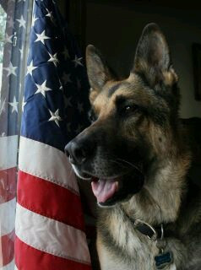
Use of Public Office for
Private Gain
Question: May a Sheriff’s Office use public funds to install a fence at a K-9 handler’s private residence for security and liability purposes? What if the K-9 is retired from the force?
A.O. 2020-14
This Photo by Unknown Author licensed under CC BY-SA-NC

Slide 14


Slide 15
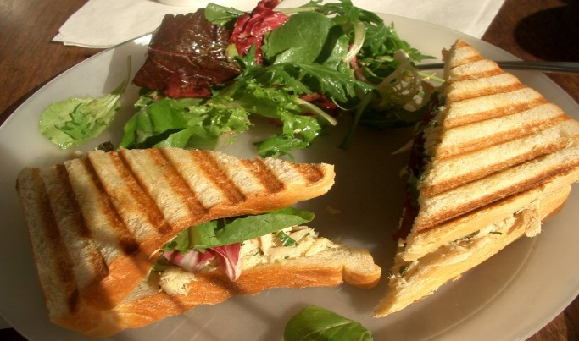
Paying for Meals
Use of Public Office for
Private Gain
Review applicable laws to determine whether there is express or implied authority for the expenditure.
Unauthorized expenditures for meals violate the private gain provision of the Act if the overriding benefit is to the employee, or another person, and not the government agency.
This Photo by Unknown Author is licensed under CC BY-NC-ND
Notes:
2018-04 -When a meal is authorized, reimbursement at a rate established by the West Virginia Travel Rules does not violate the Ethics Act.

Slide 16


Spending Public Funds
Use of Public Office for
Private Gain
QUESTION: May a public agency use public funds to purchase coffee makers or refrigerators for office employees?
A.O. 2016-09
This Photo by Unknown Author is licensed under CC BY-SA-NC
Notes:
2016-09 – Permissible because of the public benefit to the agencies including increased employee productivity, when facing deadlines and emergencies.
Not the same thing as spending public coffers to feed your employees.

Slide 17

2020 Employee Recognition/Retirement Events
Use of Public Office for
Private Gain
Food and beverages, entertainment, and gift or memento.
Total public funds = $25 per employee per year. May be allocated between events and employees. (Maximum $100 per employee.)

Slide 18

Retirement Gifts/Events
Use of Public Office for
Private Gain
May spend up to $100 of public funds to purchase plaque or other commemorative item.
This Photo by Unknown Author is licensed under CC BY-NC

Slide 19


Slide 20

Endorsements
Use of Public Office for
Private Gain
Do not endorse commercial products. Do not give testimonials such as town was a “satisfied customer.”
A.O. 2017-24: Can sell ads but should use disclaimers and make ads available to other businesses.
This Photo by Unknown Author is licensed under CC BY-SA
This Photo by Unknown Author is licensed under CC BY

Slide 21
Endorsements
Use of Public Office for
Private Gain
QUESTION: May public educators appear in a software vendor’s promotional video and articles demonstrating how West Virginia teachers and students use the vendor’s products?
ANSWER: See A.O. 2015-17

Slide 22
Endorsement candidate
Use of Public Office for
Private Gain
May not exclusively invite and allow one candidate to speak to a class at a public institution of higher education about his or her platform without giving other candidates in the same political race the same opportunity.
A.O. 2021-06

Slide 23


Slide 24

Confidential Info
W. Va. Code § 6B-2-5(e)
No present or former public official or employee may disclose confidential information or use that information to further his/her personal interests or the interests of another person. [Address, SS#, credit card, driver’s license and marital status]
Improper disclosure of confidential information is a criminal misdemeanor.
Notes:
Sheriff used deputy’s sick leave in campaign.

Slide 25
Gift Rules
No Gifts over $25 from Interested Persons
An interested person is:
A Lobbyist
Or one who:
Seeks or does business with the public servant’s agency (vendor);
Is engaged in activities regulated or controlled by the agency; or,
Has financial interests which may be substantially & materially affected, in a manner distinguishable from the public generally, by the performance or nonperformance of official duties.
Notes:
2020 – Even police officer saved by a bullet proof vest could not accept gift from vest man.

Slide 26
Gift Rules
Some Exceptions
Meals and beverages of any value if the person purchasing them is present
Ceremonial gifts with insignificant value – for example, a plaque
Reasonable travel, meals and lodging expenses for being a speaker at conference or benefit performance of public job
Gifts that are purely private in nature
Ethics Commission Gift Guideline – outlines other exceptions
Notes:
Return
Donate to charity
Donate to the agency

Slide 27

Gift Rules
Solicitation of gifts is generally prohibited.
W. Va. Code § 6B-2-5(c)

Slide 28

Gift Rules
Charitable Solicitations
W. Va. Code § 6B-2-5(c)
Gifts may only be solicited for a charitable purpose, such as the United Way.
Public agency may impose stricter standards.
Supervisors may not solicit contributions from a subordinate.
May solicit other public agencies 2019-11
Notes:
Selling products as part of a fundraiser is not soliciting. Foster family donations. Mayor
May appear in a video using his name and public title to promote and solicit donations for a local nonprofit drug and alcohol recovery center as it provides a charitable purpose.

Slide 29


Gift Rules
May you ask a vendor for free dog food for your dog?
What about dog food for the humane society?
If the solicitation is okay, are there rules on oral solicitations? Yes. Legislative Rule, Title 158, Series 7.
Notes:
In writing, don’t target vendor.

Slide 30
Limitations on Public Official’s Name or Likeness
    May not use public funds, public employees, or public resources to distribute, disseminate, publish or display the public official’s name or likeness for the purpose of promoting public official or political party. W. Va. Code § 6B-2B-2(b).
Notes:
May
Purchase and distribute with private funds and on own time

Slide 31
Public Official’s Name or Likeness
    May not use name or likeness on trinkets:
      examples- magnets, mugs, cups, keychains, bags
    May not be used on publicly owned vehicles or table skirts/banners.
Notes:
Sheriff coins case

Slide 32
Public Official’s Name or Likeness
    May use name or likeness on educational material and press releases so long as the primary purpose is to provide information. W. Va. Code § 6B-2B-2(d)-(e).
    Educational material defined as publications, guides, calendars, handouts, pamphlets, reports or booklets….It includes information…about the office, services the office provides to the public, updates on law…. W. Va. Code § 6B-2B-1(c).
Notes:
Statute amended, effective June 5, 2018. Old statute prohibited name or likeness to be placed on any educational material paid for with public funds.

Slide 33



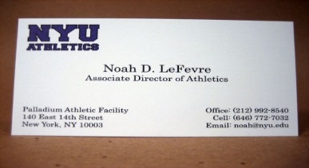
Public Official’s Name or Likeness
  May use public funds to communicate with constituents in the normal course of duties but do not include any reference to voting in favor of the public official in an election.
  May use name on letterhead, envelopes, reports, certificates, office signs, press releases, bios

Slide 34




Public Official’s Name or Likeness
Websites & Social Media
May appear on the agency’s website or social media so long as it is reasonable and has a primary purpose to promote the agency’s mission and services rather than to promote the public official.

Slide 35
Prohibited Interest in Agency Contracts
W. Va. Code § 6B-2-5(d)
Elected public officials and employees may not have a financial interest in a public contract under their authority or control.

Slide 36

Prohibited Contracts
Exceptions
W. Va. Code § 6B-2-5(d)
$1,000 threshold
Part-time appointed officials and legislators are not subject to prohibition but must recuse themselves if a conflict arises.
Public employment.
This Photo by Unknown Author is licensed under CC BY-NC

Slide 37

Prohibited County
Contracts
W. Va. Code § 61-10-15
W. Va. Code § 61-10-15 prohibits some county officials, including school officers and employees, from having personal financial interests, directly or indirectly, in a contract, purchase or sale over which their public position gives them voice, influence or control.
Notes:
Criminal offense: $500 fine, 1 yr jail time and removal from public office and employment
List of officials: county commissioners, BOE members, district school officers, supervisors, superintendents, secretaries, any other county or district board or district officer.
Examples: PSD members, airport authority
Employment and part-time officials. CC spouse may not work in the assessor’s office.

Slide 38
Prohibited County
Contracts
W. Va. Code § 61-10-15
School officers and employees include:
“District school officer, secretary of a Board of Education, supervisor or superintendent, principal or teacher of public schools or any member of any other county or district board or any county or district officer.”
Notes:
Criminal offense: $500 fine, 1 yr jail time and removal from public office and employment
List of officials: county commissioners, BOE members, district school officers, supervisors, superintendents, secretaries, any other county or district board or district officer.
Examples: PSD members, airport authority
Employment and part-time officials. CC spouse may not work in the assessor’s office.

Slide 39
Prohibited County
Contracts
Voice, Influence, and Control
General Rules:
School Board members can’t have contracts with or be employed by the BOE.
If a School Board appoints another entity’s board members or makes appropriations to an entity, a BOE member (or spouse) should not work for the entity or have a contract with it w/o contacting us.
Appointment power and appropriations:
2018-05 (BOE member may work for WVU extension because BOE made only limited appropriations.) But not, in AO99-29-member could not contract w training center partially supported by the BOE.)
Notes:
Examples: PSD members, airport authority
Employment and part-time officials. CC spouse may not work in the assessor’s office.

Slide 40
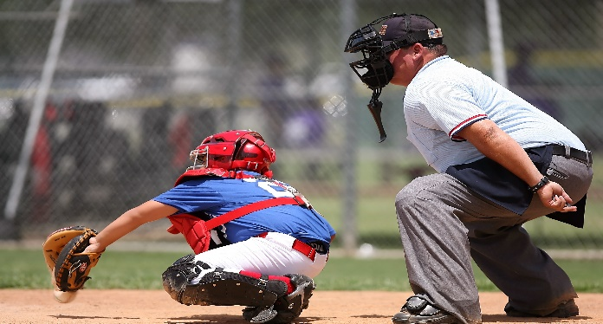
Prohibited County
Contracts
W. Va. Code § 61-10-15
May a school official be paid to serve as a referee at baseball games for the school system?
Answer: See A.O.s 2005-03, 2005-18 and 2010-15

Slide 41
Prohibited County
Contracts
W. Va. Code § 61-10-15
2017-15 (BOE may not contract with a member’s spouse’s tenant.)

Slide 42
Prohibited County
Contracts
Exceptions
Nothing prevents or makes unlawful the employment of a spouse as a principal or teacher or auxiliary or service employee in the public schools of any county.
Does not apply to any person who is a salaried employee of a vendor or supplier if the employee meets the five criteria found in W. Va. Code § 61-10-15(e). (No commission, not owner, etc.)
For example, A.O. 2018-10 (BOE member may work for business that markets for textbook company that sells to BOE.)
Notes:
2015-15-prohibits a County Board of Education from employing the Superintendent’s spouse as a literacy coach.

Slide 43

Public
Contract
Ethics Commission has discretion to grant an exemption to public entity based upon undue hardship or excessive cost.
Exemptions

Slide 44

Voting
W. Va. Code § 6B-2-5(j)
May not vote if public official or employee, or an immediate family member, or a business with which they or a family member is associated, has a financial interest.
Public officials may not vote on a personnel matter involving a relative.
(Class exception - five similarly situated)
2019-08 hotel development in mayor’s neighborhood
Notes:
Class example: a physician or health care provider to vote on health care legislation or for a teacher to vote on matters affecting education, or for a coal miner to vote on laws regulating the coal industry.

Slide 45
Voting
W. Va. Code § 6B-2-5(j)
The Ethics Act does not require a member of a BOE to recuse herself from hearing updates on a lawsuit filed against the BOE by her brother who is a former employee of the BOE, when there is no financial relationship between the siblings and the lawsuit does not relate to the sibling’s prior employment with the BOE. A.O. 2021-08
Notes:
Class example: a physician or health care provider to vote on health care legislation or for a teacher to vote on matters affecting education, or for a coal miner to vote on laws regulating the coal industry.
2019-08 hotel development in mayor’s neighborhood

Slide 46

Voting
W. Va. Code § 6B-2-5(j)
2017 Amendment: If member also serves on a non-profit, the agency may still make appropriations to the non-profit.
Member or spouse may not vote if either is employed by non-profit.
If Board member is unpaid, he/she may vote only if disclosed on agenda and at the meeting.
Notes:
(D) The appropriations of public moneys or the awarding of a contract to a nonprofit corporation if the public official or an immediate family member is employed by, or a compensated officer or board member of, the nonprofit: Provided, That if the public official or immediate family member is an uncompensated officer or board member of the nonprofit, then the public official shall publicly disclose such relationship prior to a vote on the appropriations of public moneys or award of contract to the nonprofit;

Slide 47

Voting
Proper Recusal
A public servant who is required to recuse himself or herself must:
Fully disclose his or her interest
Leave the room during both the discussion of, and the vote on, the issue
Minutes must reflect recusal
Notes:
5.2. Making a full disclosure of one's interest means making a prior public disclosure including the amount of interest held directly or indirectly by a public employee or public official or immediate family thereof in a public contract.

Slide 48

Employment Restrictions
Full-time public employees may not seek employment with, or buy, sell or lease property to or from, any person who:
Had a matter on which they or their subordinate took regulatory action within the past 12 months, or
Currently has a matter before their agency on which they or a subordinate is working, or
Is a vendor over which they exercise control
Employment Exemptions available
2019-17 and 2020-05
W. Va. Code § 6B-2-5(h)
Notes:
Fire code deputy owned bar ok

Slide 49
Post-employment restrictions
Prohibited Representation
Public official or employee may not represent a client in a matter in which he or she is or was substantially involved on behalf of the agency.
Prohibition applies forever.
Agency can waive.
Notes:
Cant rep client after you personally involved in matter effecting / prosecuting client

Slide 50

Post-employment Restrictions
          Revolving Door
No elected or appointed public official or full-time staff attorney or accountant, shall:
for ONE YEAR after the termination of that service, appear in a representative capacity before the entity he or she served in:
  A contested administrative matter,
  To support or oppose a proposed rule,
  To support or oppose issuance of a license or permit,
  Rate-making proceedings, or
  To influence the expenditure of public funds
W. Va. Code § 6B-2-5(g)
This Photo by Unknown Author is licensed under CC BY-SA-NC

Slide 51
State Contracts
$1,000,000
NEW (2018) for state agency contracts of $1 million, the state agency must file the disclosure of interested parties form with the Ethics Commission - before the contract may be entered into.

Slide 52

Financial Disclosures
W. Va. Code § 6B-2-6
Elected and certain appointed officials and employees in state government and elected county officials must file by February 1 annually.
File within 30 days of taking office or employment; and candidates or elected officer must also file within 10 days after filing their candidacy papers with Secretary of State.
Must report business interests, sources of income and contracts with public agencies in the state.
Must report receiving gifts over $100 from a person or entity who has direct and immediate interest in the outcome of the public official’s work.

Slide 53
Financial Disclosures:
Executive Branch filers
All members of state boards, commissions and agencies appointed by the governor; and
Secretaries of departments, commissioners, deputy commissioners, assistant commissioners, directors, deputy directors, assistant directors, department heads, deputy department heads and assistant department heads. This category is for only the executive branch, but not to those in state colleges and universities.

Slide 54
BOE Eligibility
W.Va. Code § 18-5-1a
BOE member may not become a candidate for or hold any other public office, unless:
The member does not receive compensation; and the primary scope of the board is not related to public schools.
    SBAO 2017-01 (Resign from BOE before candidacy for county commission.)

Slide 55
Sanctions
W. Va. Code § 6B-2-4(s)(1)
  Public reprimand
  Restitution
  Fines of $5,000 per violation
  Reimbursement to the Commission
  Recommendation that a Respondent be terminated from employment or removed from office.

Slide 56

Open Meetings Act
Enacted in 1975
State, county, and municipal administrative and legislative bodies, and any bodies that meet the definition of ‘public agency,’ are subject to the Act.

Slide 57
Coronavirus
https://ethics.wv.gov/Pages/default.aspx
Staff opines that allowing citizens to attend a meeting in person is not required if the governing body determines, based upon guidance issued by the federal government, the state of West Virginia, the Centers for Disease Control and Prevention or other government agencies authorized to make these types of decisions, that it constitutes a public health risk to allow citizens to attend in person. The governing body may instead provide citizens with a call-in number for a telephonic meeting or provide access via web link to a livestream of the meeting.

Slide 58

Topics of Open Meetings Act
Definition of meeting
Exceptions to having an open meeting
Notice of meeting
Agenda for meeting
Executive session
Meeting minutes
Violations

Slide 59
Meeting defined
A meeting is defined by the Act as:
  The convening of a governing body of a public agency
  For which a quorum is required in order to make, or deliberate toward, a decision
  On a matter which results or will result in official action.
Notes:
A gathering where a quorum of the governing body meets with staff is a “meeting” within the scope of the Act.
W.Va. Code § 6-9A-2(5)
OMAO 2011-02
One member of the body meeting with staff is not governed by the Act.

Slide 60
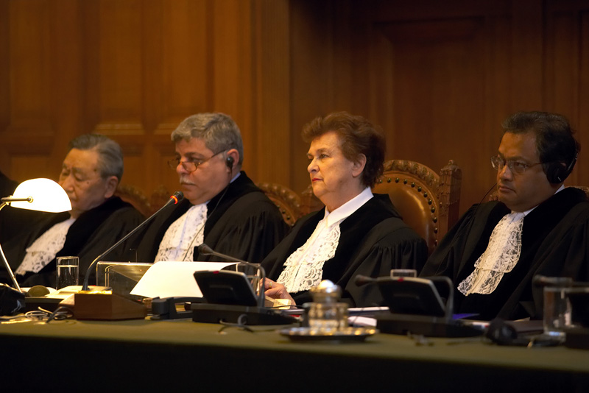
Exceptions
Adjudicatory
On-site inspection
  Construction site
Political party caucus
This Photo by Unknown Author is licensed under CC BY-SA

Slide 61

Exceptions
General Discussion
  Planned or unplanned
  Social, educational, training, informal, ceremonial or similar setting
  Without intent to conduct public business
  No intention for the discussion to lead to an official action

Slide 62
Exceptions
The ‘general discussion’ exception is most difficult to follow. Some guidelines:
  If discussion is about something that will lead to official action, either right then or later, the meeting must be noticed.
  Does not prevent a quorum of members of the governing body from going to the mayor’s house for barbecue.
  Does prevent a quorum of members of the governing body from going to the mayor’s house for barbecue and a discussion about the new budget.
Notes:
Open Meetings Advisory Opinion 2017-01 – does not apply to members-elect (but could be quorum of current sitting members)

Slide 63
Exceptions
May a quorum of school board members visit a school and observe building conditions, educational programs, teaching strategies and other school activities?
OMAO 2001-03
Notes:
Open Meetings Advisory Opinion 2001-03 – on-site inspections of projects or programs not considered meetings and exempt.

Slide 64


Notice
  The Open Meetings Act requires advance notice of the date, time, and place of the meeting, including any committee meeting, and an agenda of all matters to be considered and/or discussed.

Slide 65

Meeting Notice
‘Regular meeting’ notice must be posted and agendas made available THREE business days in advance (unless you meet every week, then two days).
‘Special meeting’ notice must be posted and agendas must be made available TWO business days in advance.
But – state agency = FIVE business days notice.
Notes:
Each governing body shall promulgate rules by which the date, time, place and agenda of all regularly scheduled meetings and the date, time, place and purpose of all special meetings are made available, in advance, to the public and news media.
In regard to emergency meetings, W. Va. Code § 6-9A-2(2) states as follows:
(2) "Emergency meeting" means any meeting called by a governing body for the purpose of addressing an unexpected event which requires immediate attention because it poses:
(A) An imminent threat to public health or safety;
(B) An imminent threat of damage to public or private property; or
(C) An imminent material financial loss or other imminent substantial harm to a public agency, its employees or the members of the public which it serves.
W. Va. Code § 6-9A-2 also reads:
(h) In the event of an emergency a governing body may call an emergency meeting.
(1) The governing body of a state executive branch agency shall electronically file a notice for an emergency meeting with the Secretary of State, as soon as practicable prior to the meeting. Any other governing body shall notice an emergency meeting in a manner which is consistent with this article and the Ethics Commission Committee on Open Governmental Meeting's opinions issued pursuant to the authority of section ten of this article, as soon as practicable prior to the meeting.
(2) The emergency meeting notice shall state the date, time, place and purpose of the meeting and the facts and circumstances of the emergency.

Slide 66
Notice: Ethics Commission website
Notes:
Minimum requirements for posting a notice is in a public place.

Slide 67

Agenda
Regular meeting agenda must be posted and agendas made available THREE business days in advance (unless you meet every week, then two days).
Special meeting – TWO business days
Notes:
Each governing body shall promulgate rules by which the date, time, place and agenda of all regularly scheduled meetings and the date, time, place and purpose of all special meetings are made available, in advance, to the public and news media.

Slide 68
Meeting Agenda
Agendas must give reasonable notice to the public of every issue to be discussed.
Items must be specific enough to put the public on notice of intended action.
Vague headings are insufficient, e.g.,
  Old Business
  New Business
Open Meetings Advisory Opinion 2008-17

Slide 69

Meeting Agenda
‘Personnel” is also too vague a description
Instead, use ”filling position of office manager,” or
“‘open sealed bids for XYZ project.”
  OMAO 99-10: Marshall Co BOE. Employee grievance: ”Level III grievance” is sufficient.

Slide 70
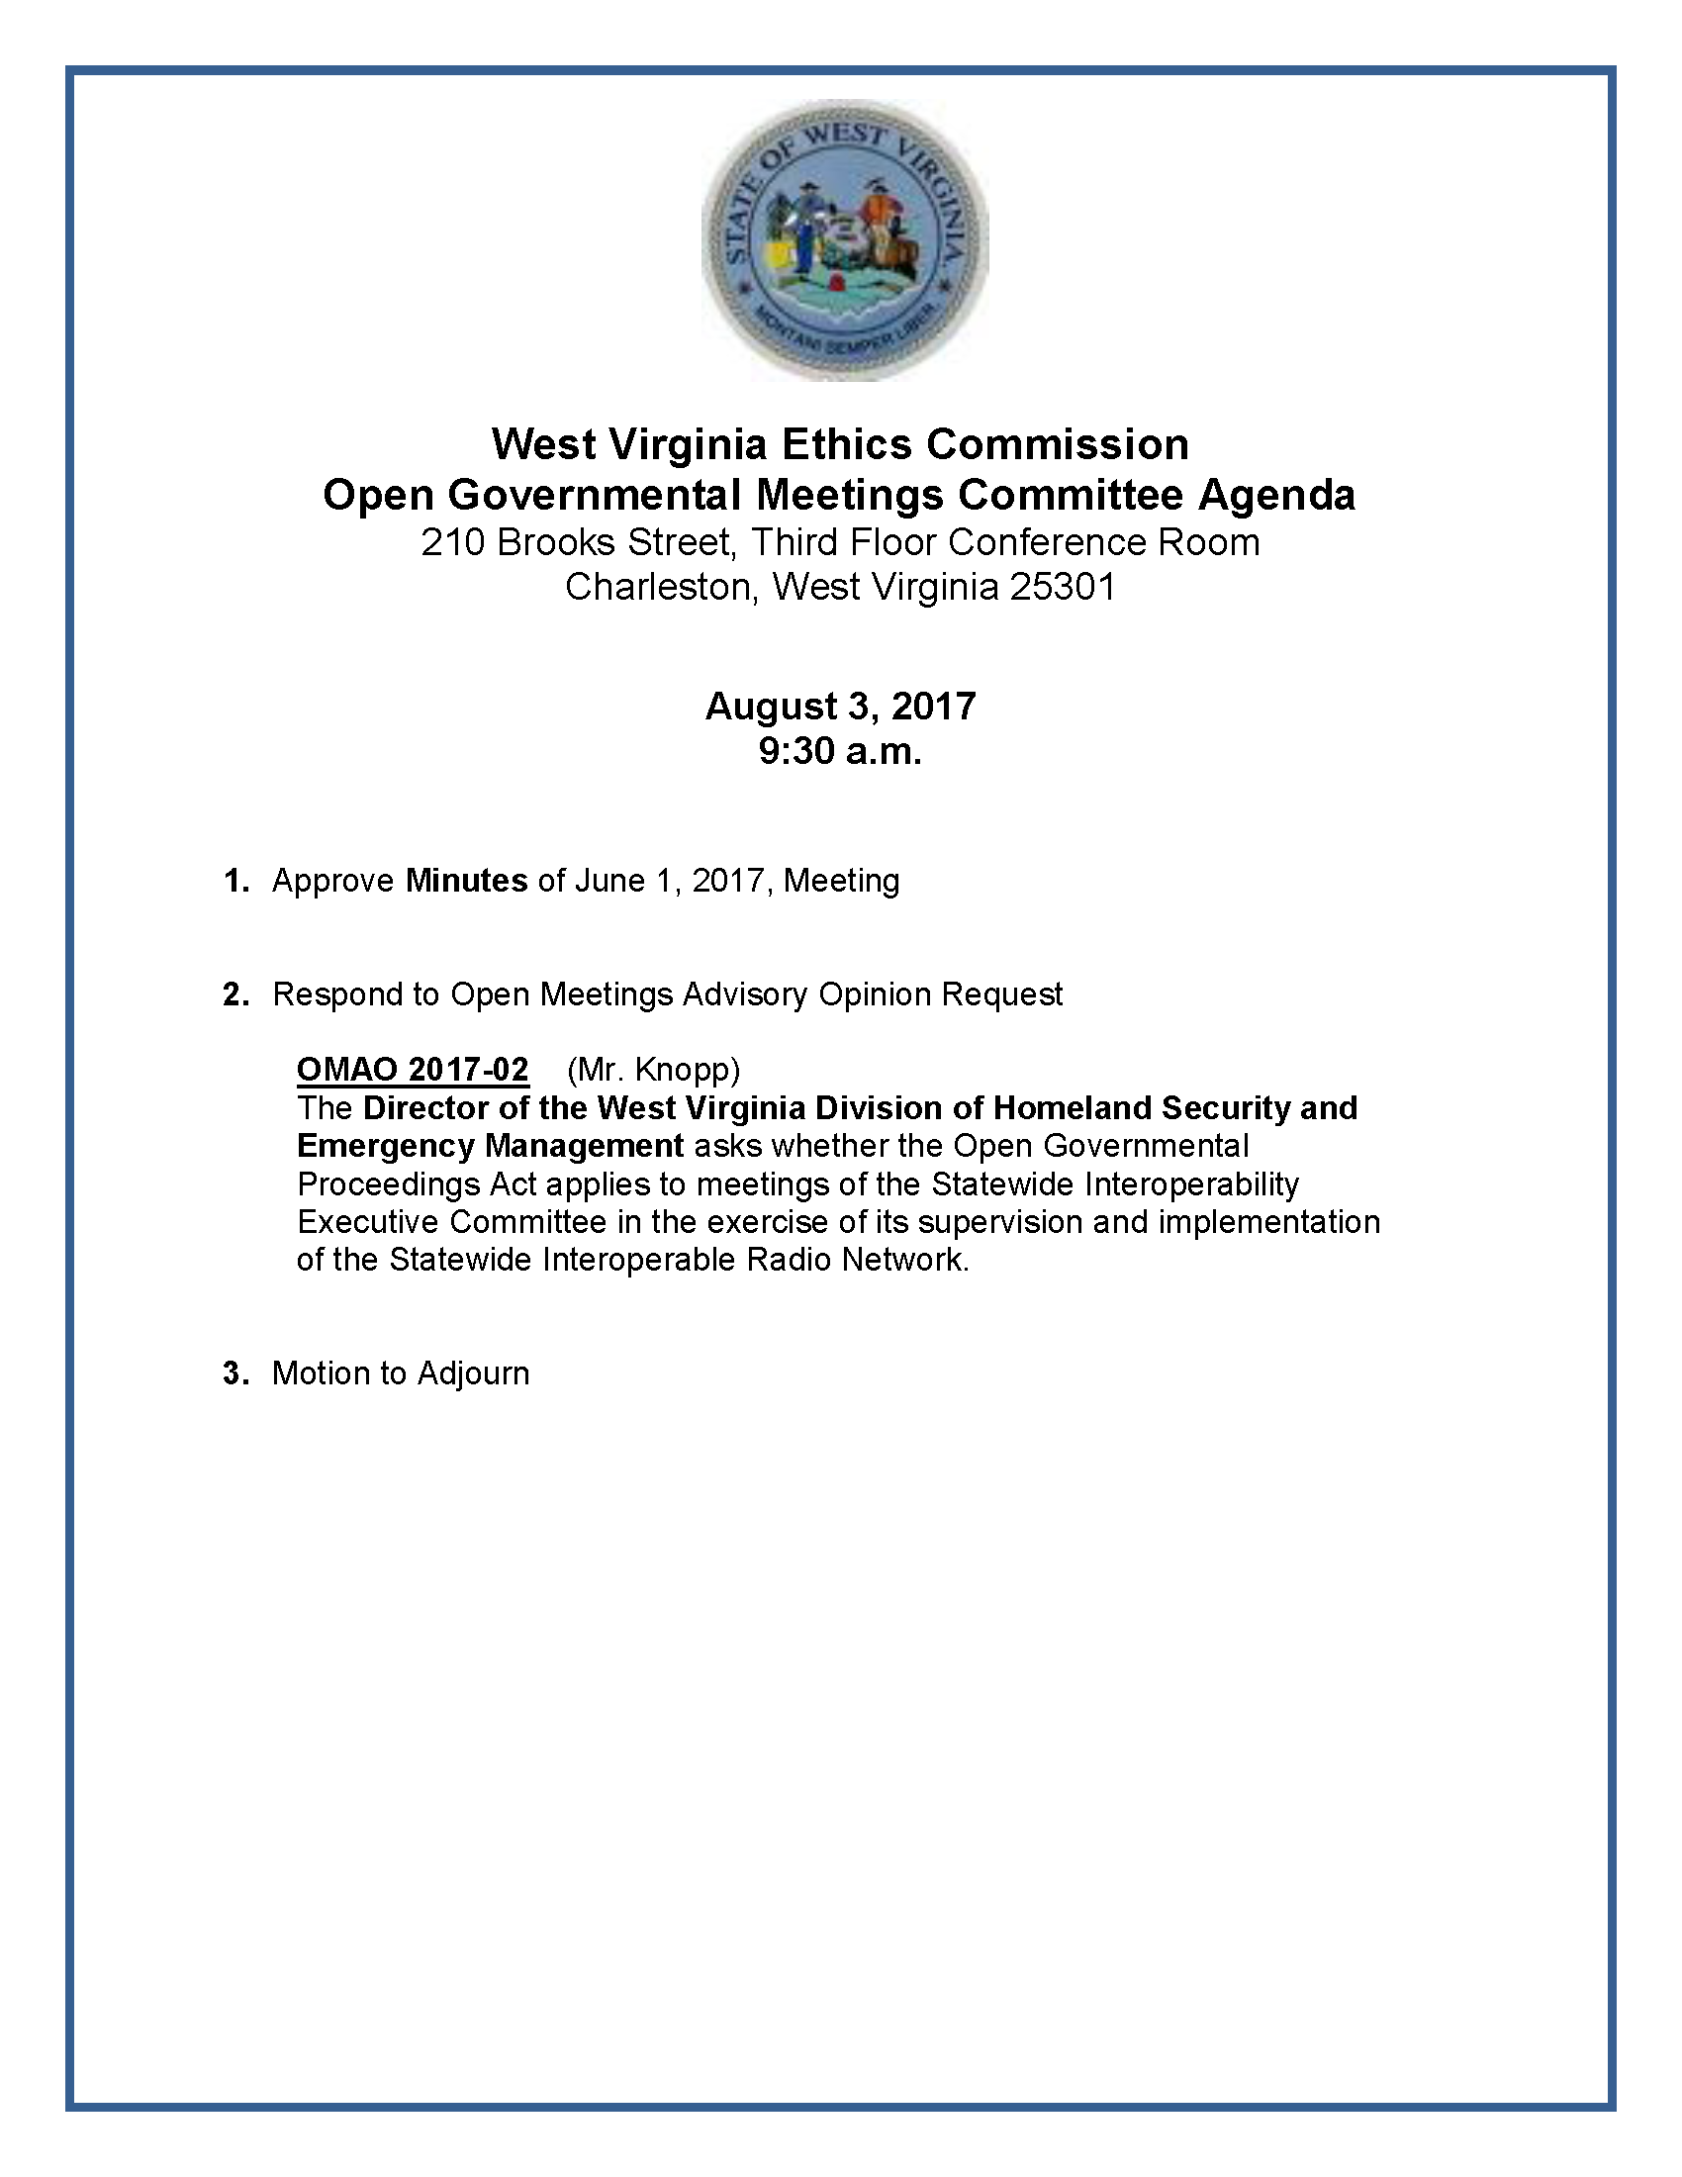
Sample Combined Notice and Agenda

Slide 71
Executive Session
W.Va. Code § 6-9A-4
May only go into executive session for reasons permitted by the Open Meetings Act.
There must be a corresponding agenda item.
The motion to go into executive session must identify the reason for entering the session.
Majority vote of those present is required.
No vote may be made in the executive session (except for student matters).
Notes:
OM 2001-24 – may interview engineering firm in an executive session

Slide 72
Executive Session reasons include -
To consider personnel matters of a particular public official or employee. But must vote in public and announce employee’s name. OMAO 99-10
To issue, effect, deny, suspend or revoke a license, certificate or registration…, unless the licensee requests an open meeting;
To discuss matters which, by express provision of federal law or state statute or rule of court is rendered confidential. OMAO 2017-02.
W. Va. Code § 6-9A-4 (contains complete list)

Slide 73


Meeting Minutes
W.Va. Code § 6-9A-5
Minutes required for all meetings, including committee and sub-committee meetings, but not executive sessions
OMAO 99-09

Slide 74
Minutes
The Open Meetings Act specifies the information required to be in the minutes:
The date, time and place of the meeting;
The name of each member of the governing body present and absent;
All motions, proposals, resolutions, orders, ordinances and measures proposed, the name of the person proposing the same and their disposition, and
The results of all votes and, upon the request of a member, pursuant to the rules, policies or procedures of the governing board for recording roll call votes, the vote of each member by name.

Slide 75
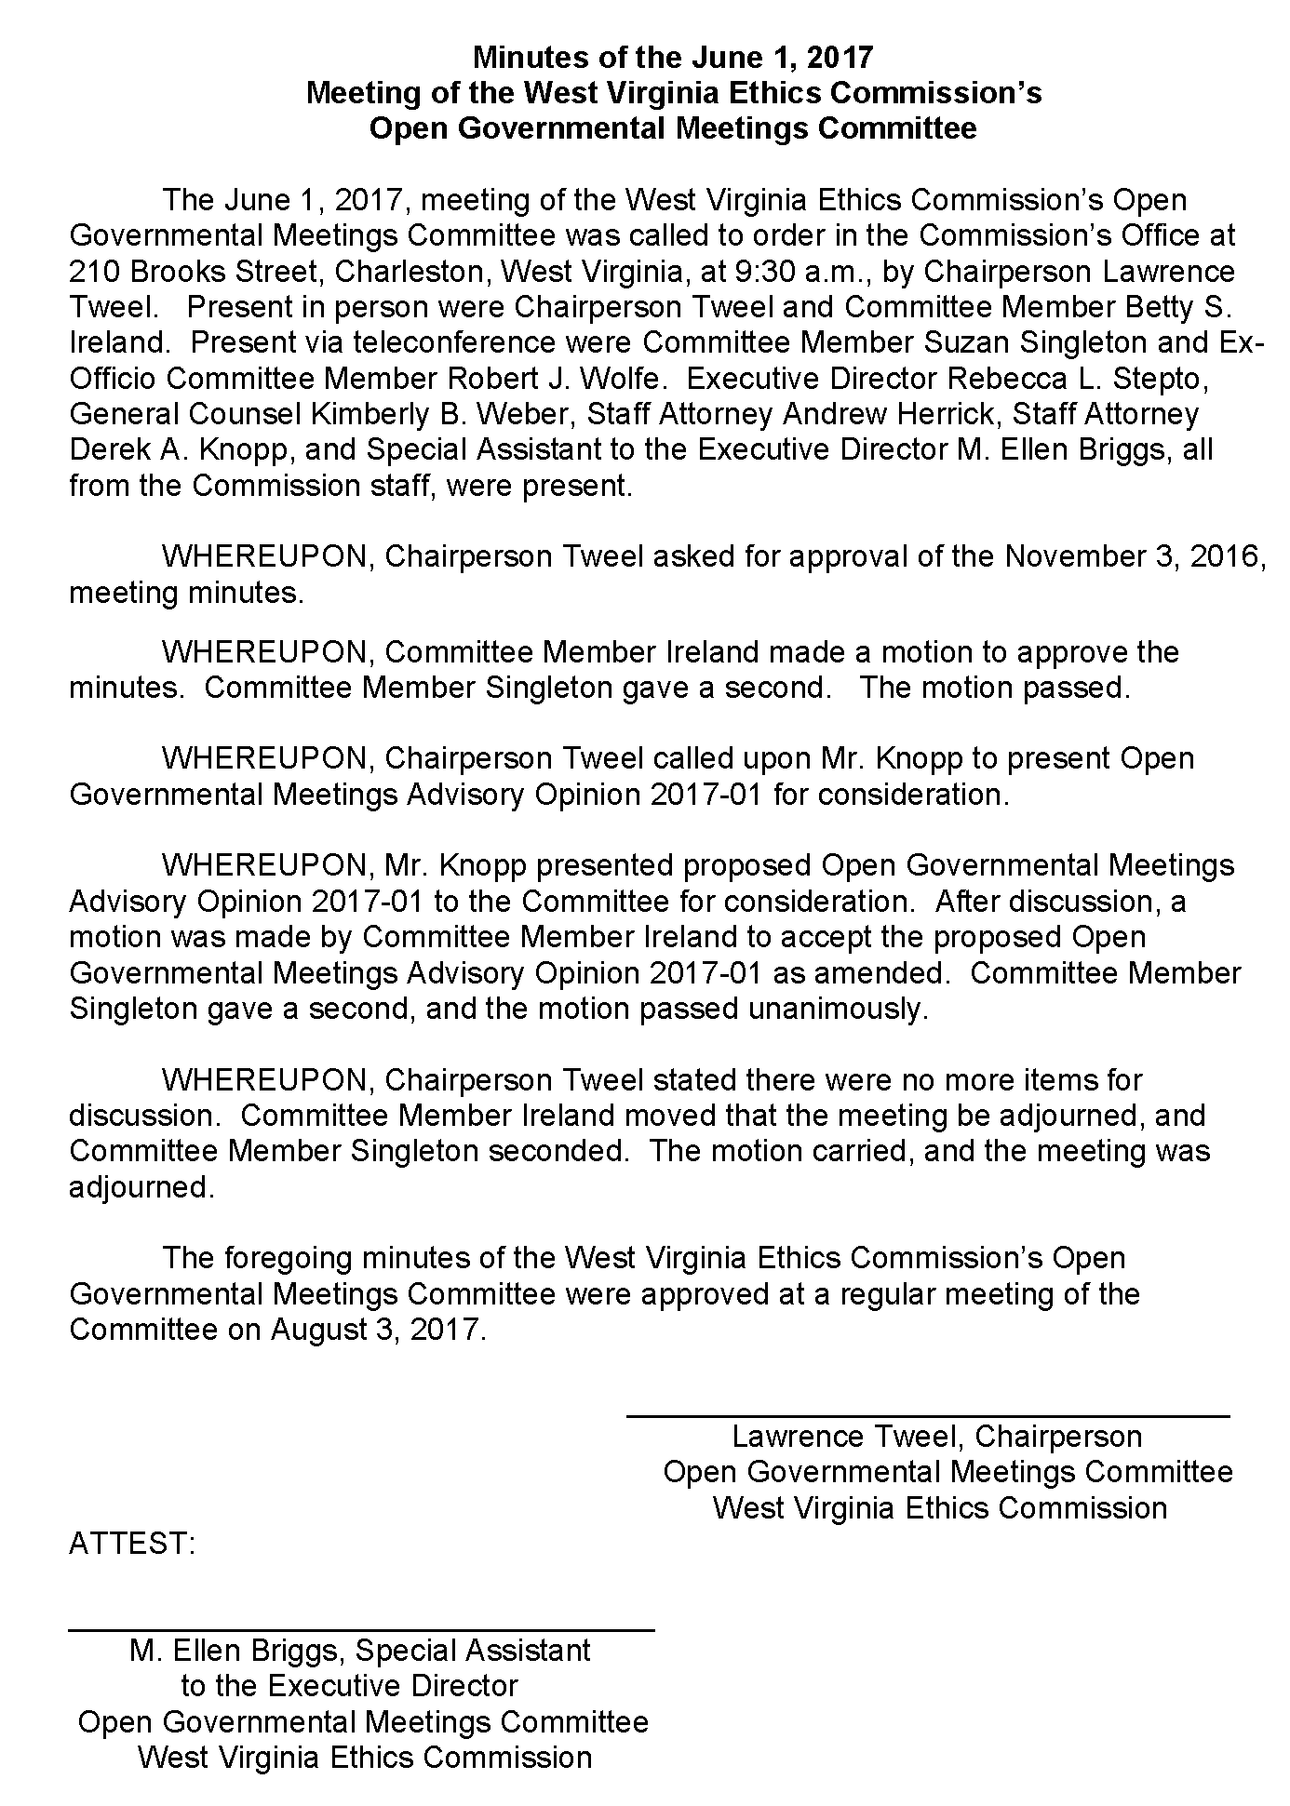
Sample Minutes

Slide 76
Minutes
W.Va. Code § 6-9A-5
Meeting minutes must be made available within a ‘reasonable time.’
‘Reasonable time’ defined by OMAO 2010-04 as ‘close of business on the next business day following [the next meeting].’
If material changes to the minutes are necessary, then the minutes should be available no later than three business days following the next meeting.
Draft minutes are encouraged, but not required, to be made available for public inspection.

Slide 77

Violations
W.Va. Code § § 6-9A-6 and 7
An intentional violation is a criminal misdemeanor subject to prosecution by the county prosecutor and up to a $500 fine. ($1,000 for additional violations)
May also be liable to wronged parties in civil court. (within 120 days of action)
Court may annul vote taken in violation of Act.

Slide 78
West Virginia
Ethics Commission
210 Brooks Street, Suite 300
Charleston WV 25301
(304) 558-0664
www.ethics.wv.gov
Email: ethics@wv.gov

