Slide 1

FMS YEAR END PROCESSING
Kim Harvey
WV State Department of Education
knharvey@k12.wv.us
419 202 9898

Slide 2
FMS YEAR END

Slide 3
FMS FISCAL YEAR CHECKLIST
PRIOR YEAR
Print a Purchase Order Status Report
Close PO’s that are paid
Post Invoices received as of 6/30
Write Checks 6/30
Enter and post invoices received after 7/1 with a material impact
Print Schedule of Checks to be Written to be used to carryover invoices and balance to liability account
Print Purchase Order Status Report
Close PO’s you do not want to carryover to new year
Print Purchase Order Status Report
Print Outstanding Encumbrance Report
Print Aged Open Invoice Report after invoices have been carried over to new year
Notes:
These steps are run in old year but may not necessarily be in this order.

Slide 4
GETTING READY - FOLLOWING STEPS PERFORMED IN CURRENT OR OLD YEAR

Slide 5
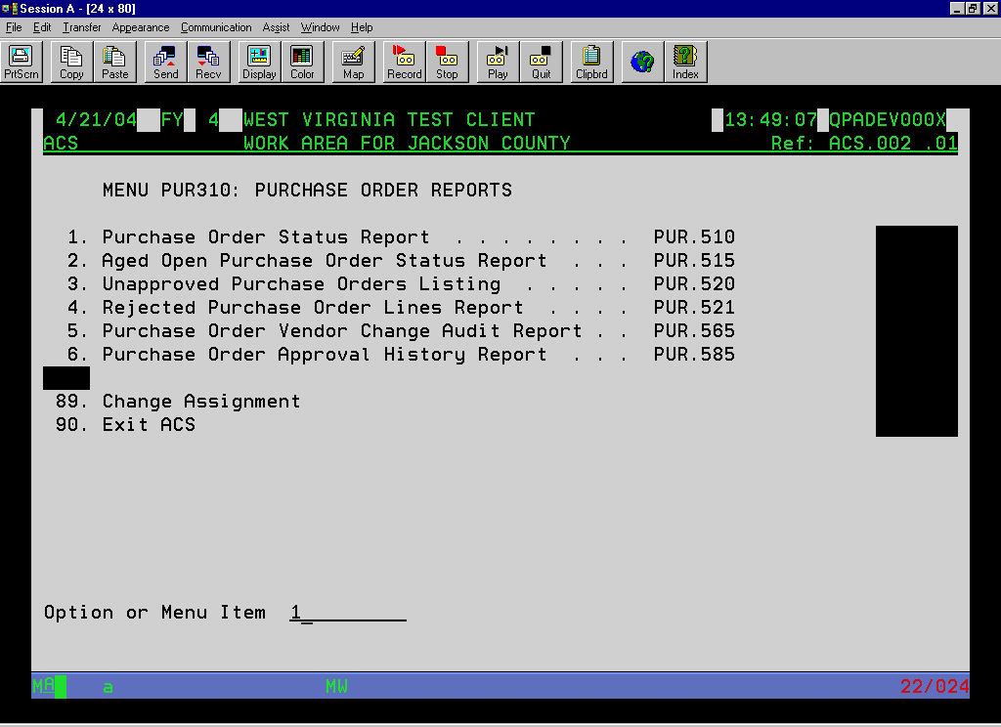
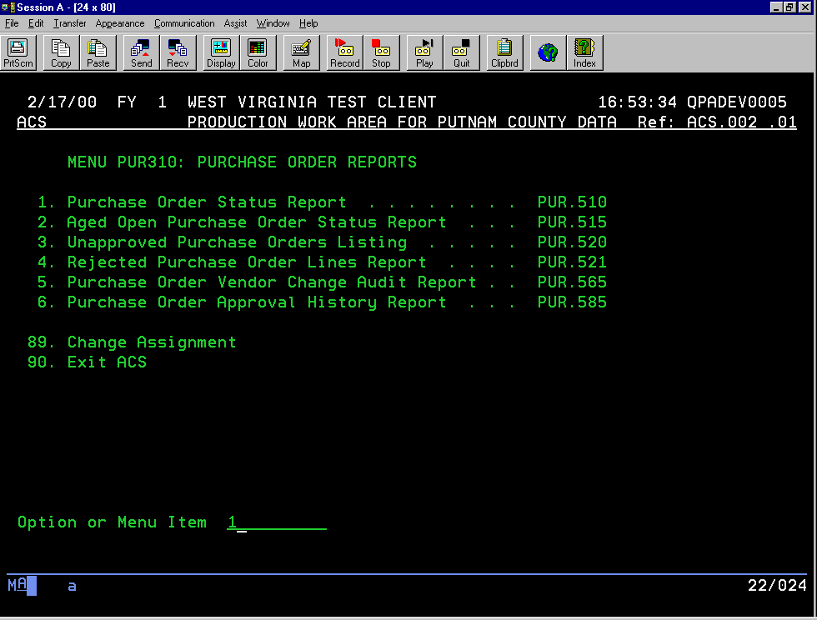
Notes:
Before carrying over your PO’s, it is suggested that you run this report to see what PO’s are still open and have money encumbered. If the PO is open, but has no encumbrances left, you may want to close the PO to prevent this PO from carrying over into the new year. You can also use this report to verify total encumbrances in the current year and as a reference when carrying over the PO’s to the next year. You will run this report several times.

Slide 6
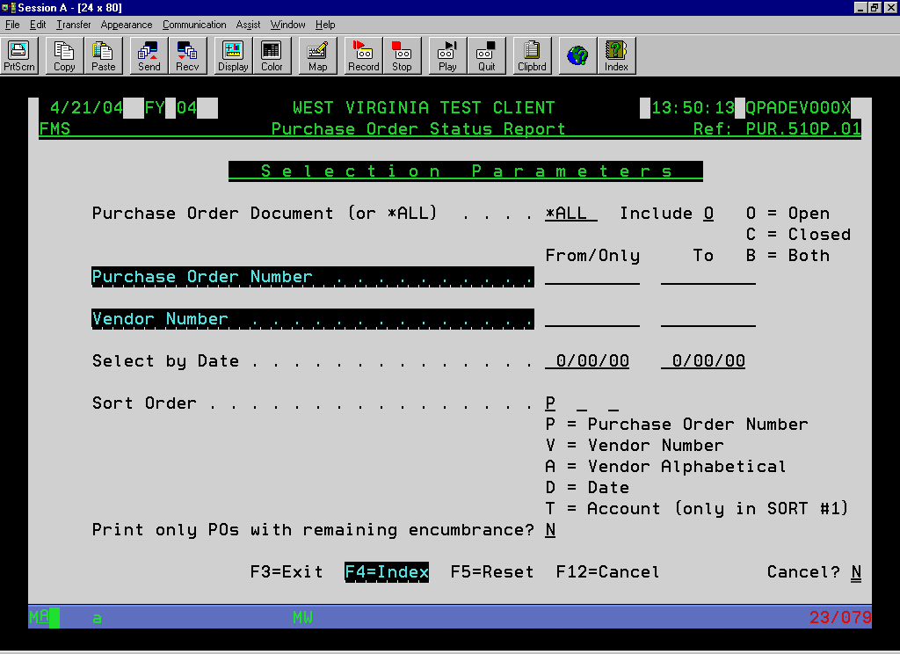
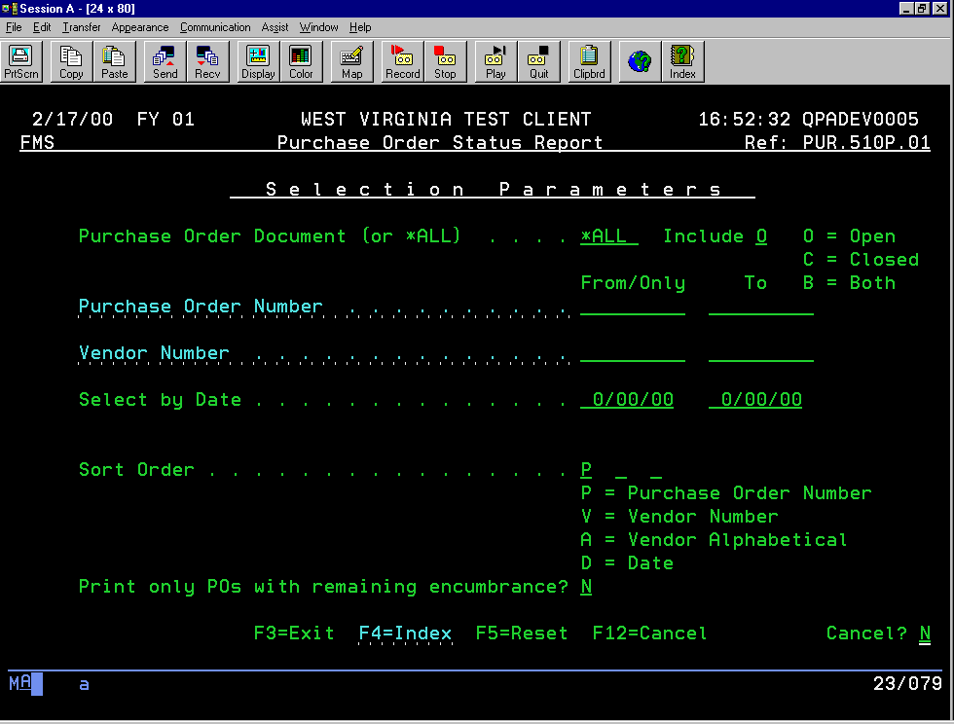
Notes:
I would recommend that you run this report for *ALL PO document ID’s and open PO’s with or without encumbrances remaining.

Slide 7
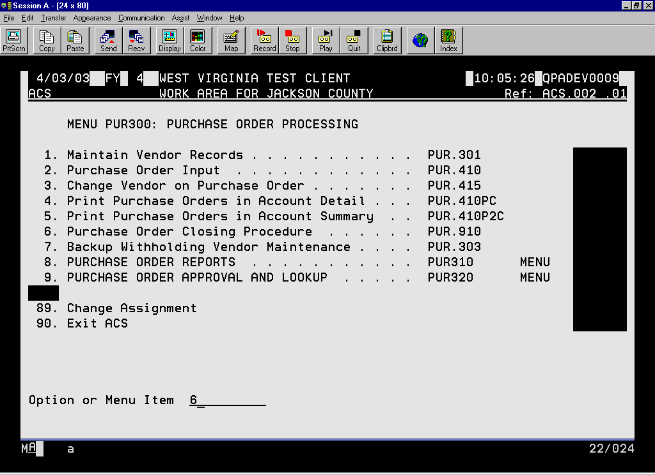
Notes:
Use this program to close any PO’s that you do not want to carryover to the new year.

Slide 8
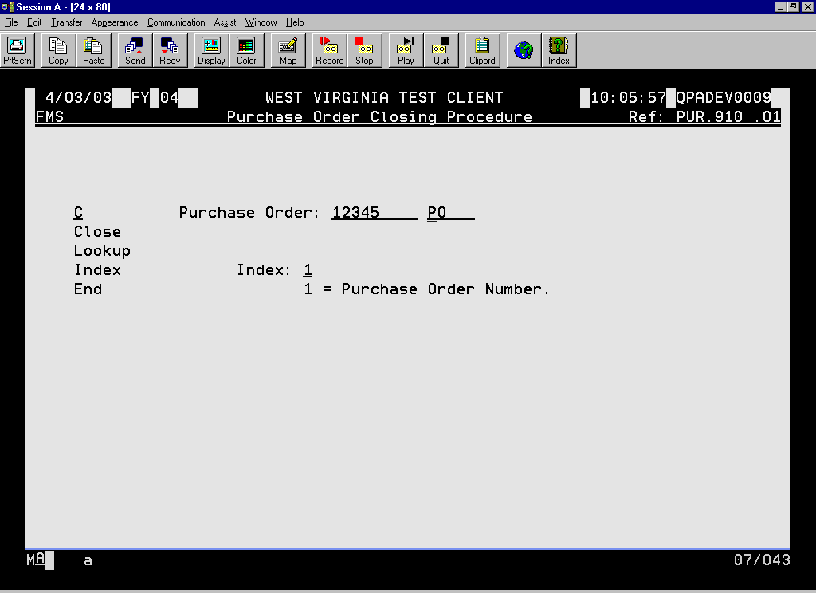
Notes:
To close the PO, answer “Y” to Continue? On the next screen.

Slide 9
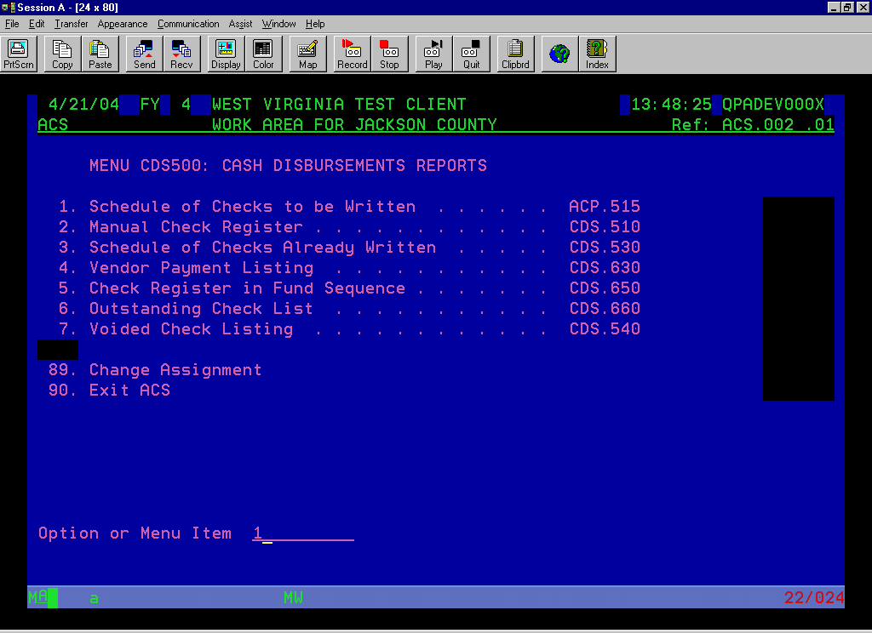
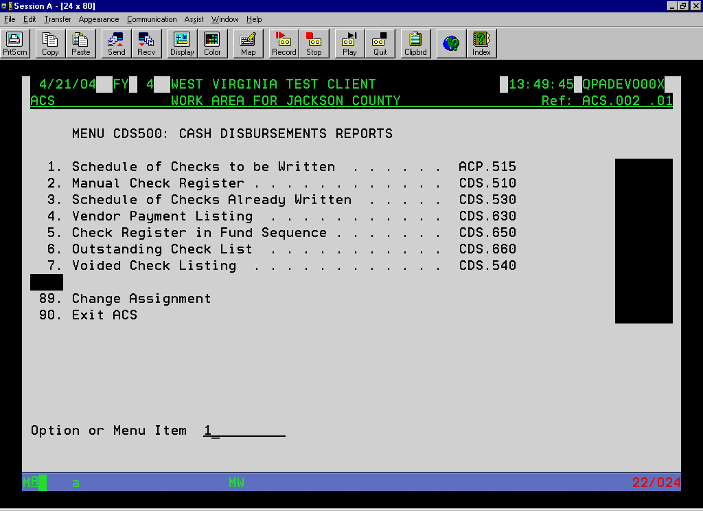
Notes:
Enter and post invoices in the prior year that you receive as of 6/30. Write checks as of 6/30. Enter and post invoices in the prior year received after 7/1 with a material impact. Run a Schedule of Checks to be Written to see what invoices you want to carry forward to the next year and to balance your AP liability account. After you post your invoices in the old year, run another Purchase Order Status Report to get an updated copy of encumbrances and PO’s left open. Close as needed.

Slide 10
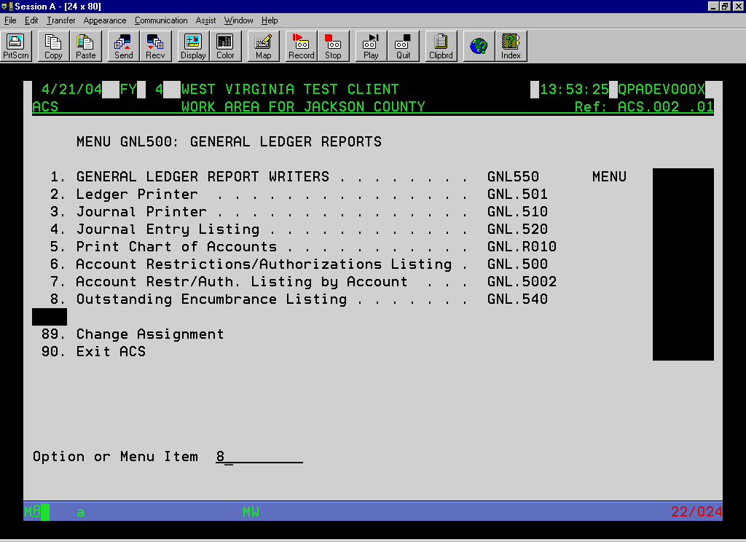
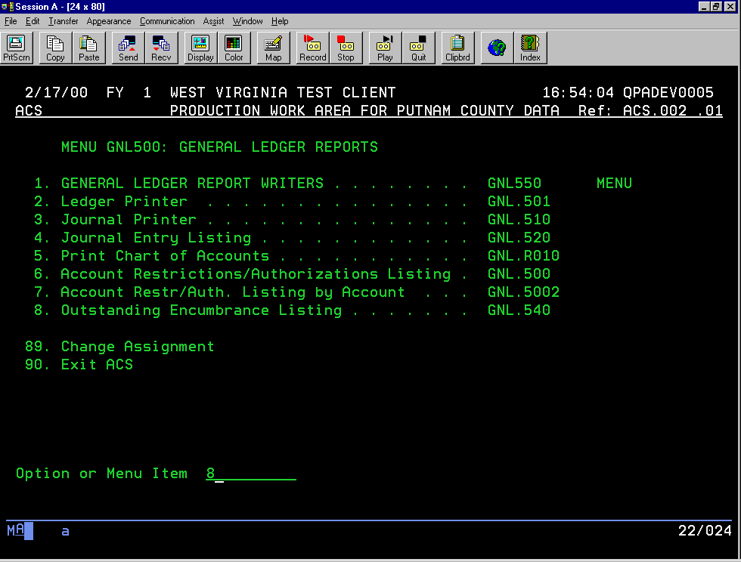
Notes:
This report prints a different picture of your encumbrances. It prints by account number and only prints PO’s with outstanding encumbrances. This is also the report you will include with your year end financials to the state.
Compare the balance of this report to the PO status report to verify the amounts are the same. If they do not, you may want to run ENC.920S to find and correct what PO’s are “out of sync.”

Slide 11
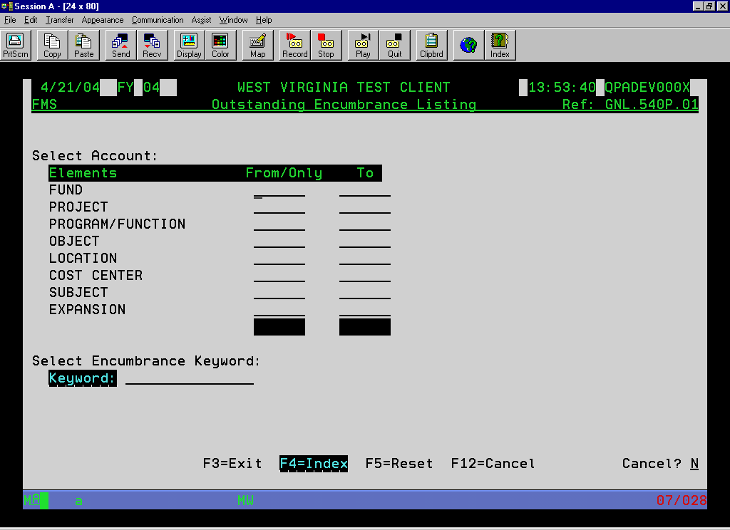
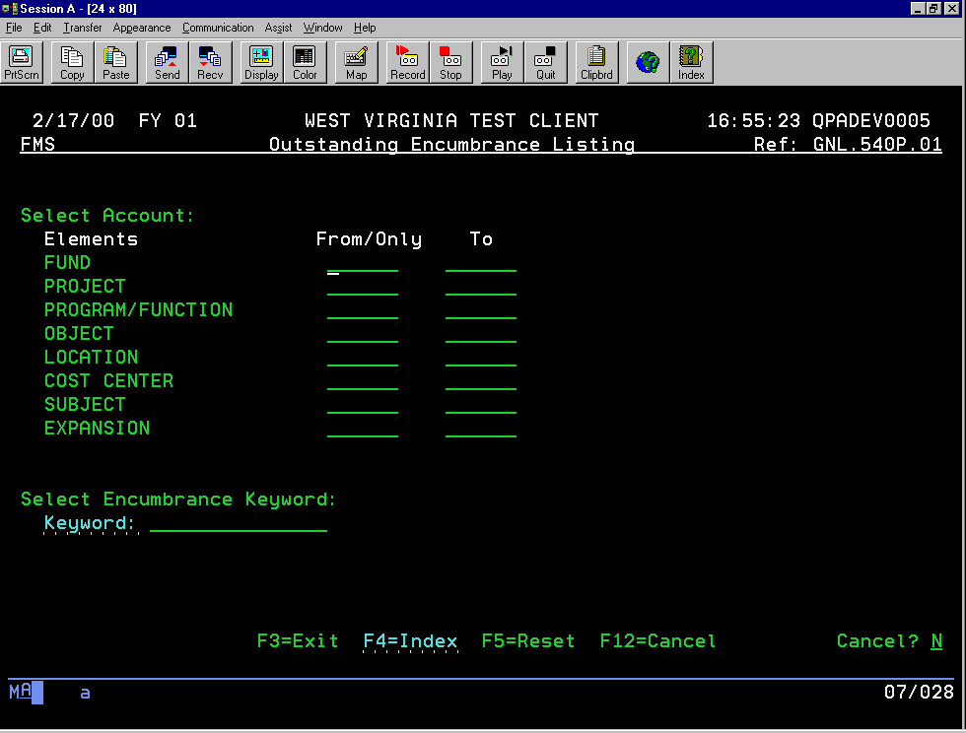
Notes:
Leave all fields blank to include all PO’s or you can restrict based on element ranges and keywords.

Slide 12
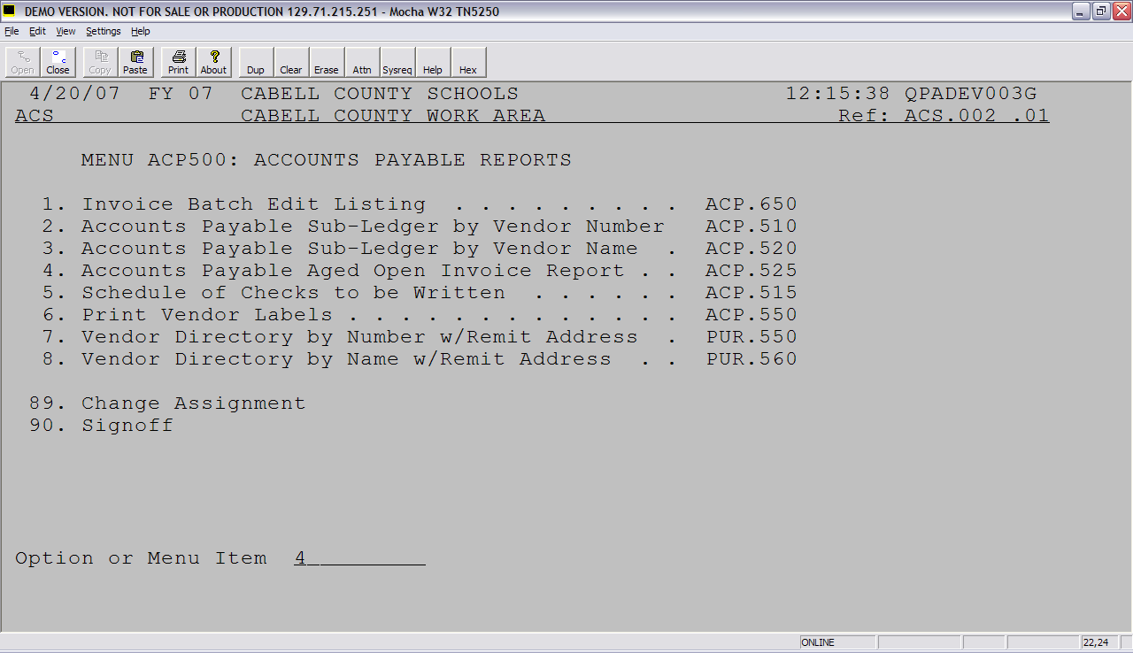
Notes:
This report will print invoices posted but not paid in the old year. You can print this at any time to see a listing of invoices that were carried over to the new year for payment.

Slide 13
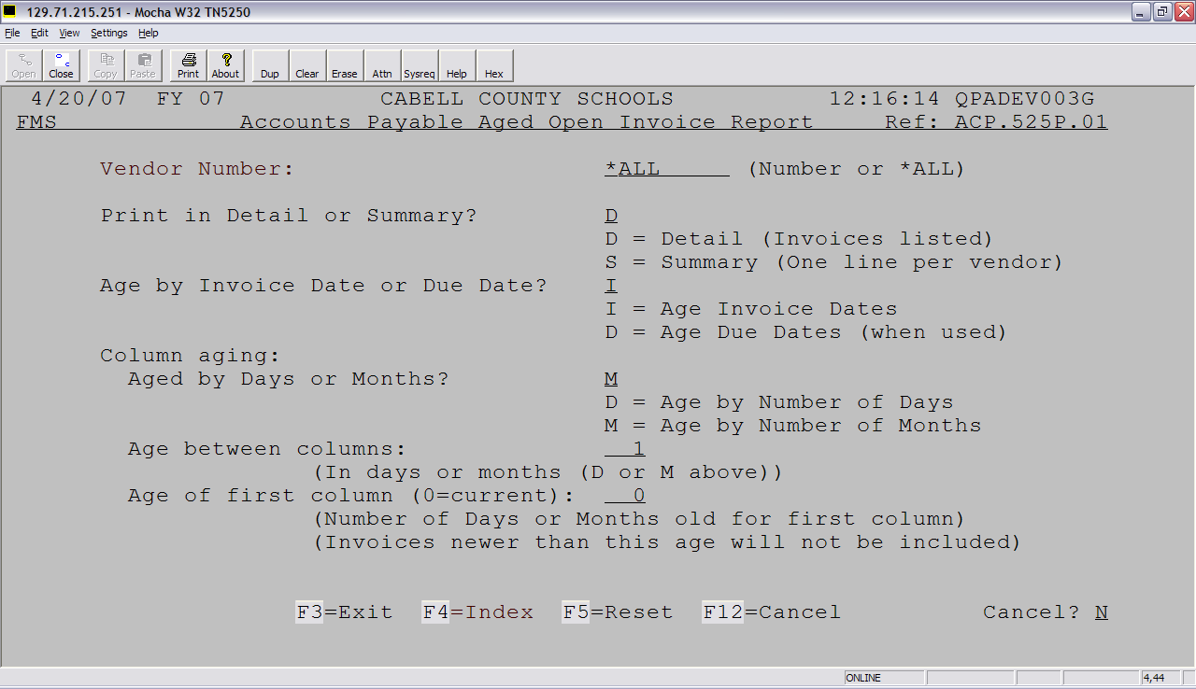

Slide 14
FMS FISCAL YEAR CHECKLIST
NEW YEAR
Run the Cross Reference File Builder
Mass Add Accounts (optional)
Mass Change Accounts (optional)
Review Invoice Batch Edit Options
Add new accounts or update budget
Review Document ID’s
Carry Forward PO’s
Carry Forward Invoices
Carry Forward Balance Sheet Balance (optional)
Do a change on your FMS Client Member
Notes:
These steps are run in the new fiscal year.

Slide 15
FMS CHECKLIST
ALL STEPS PERFORMED IN NEW YEAR

Slide 16
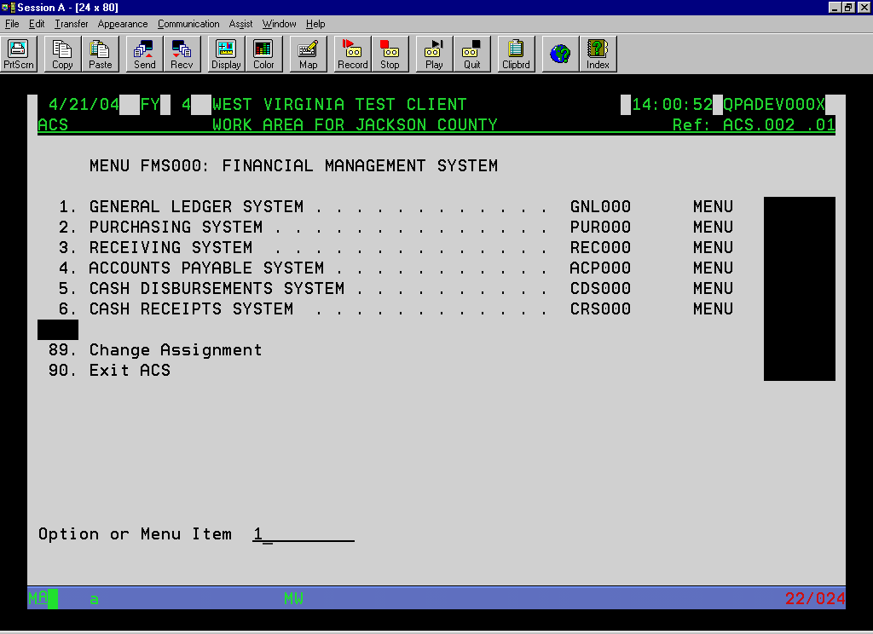

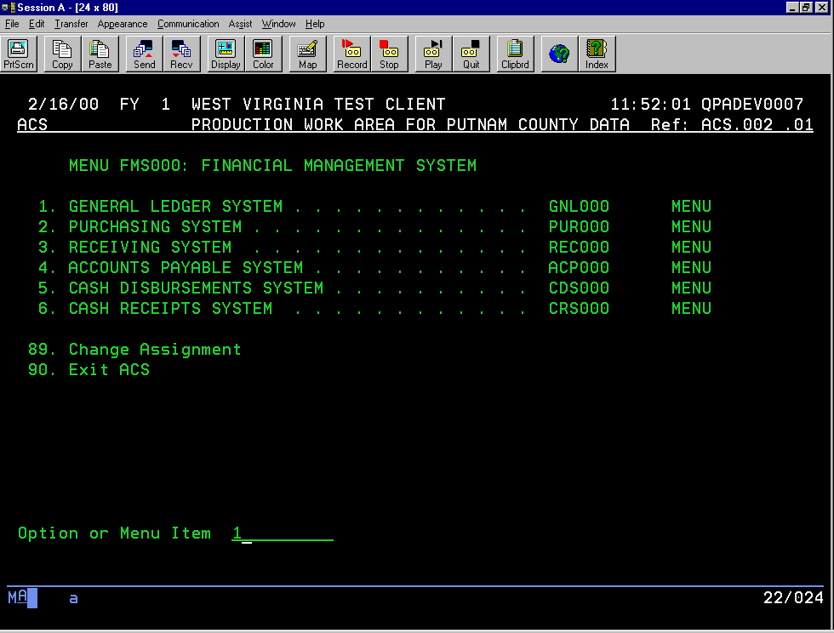

Slide 17
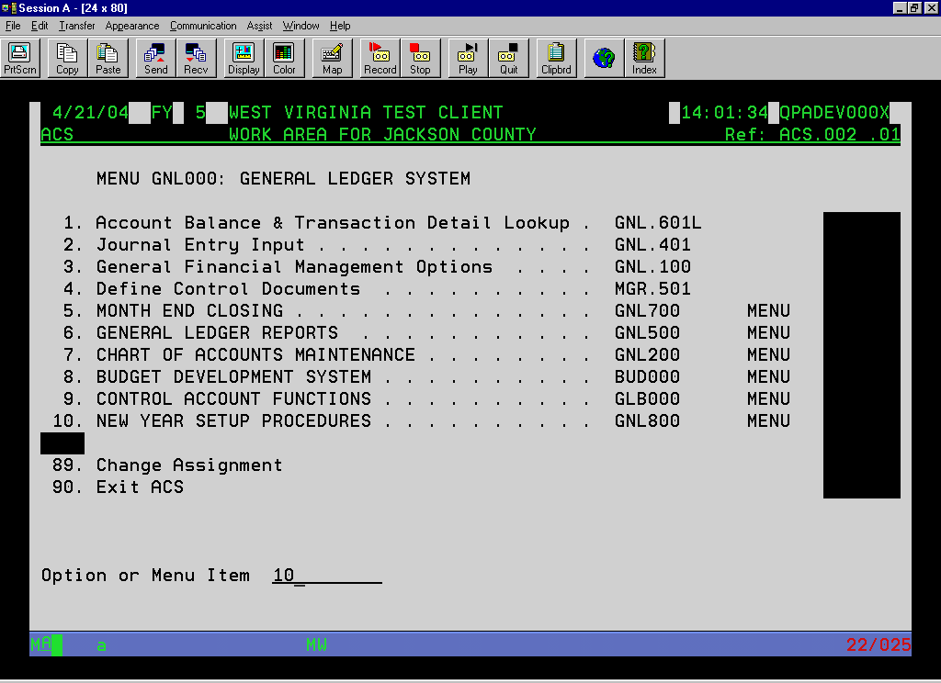
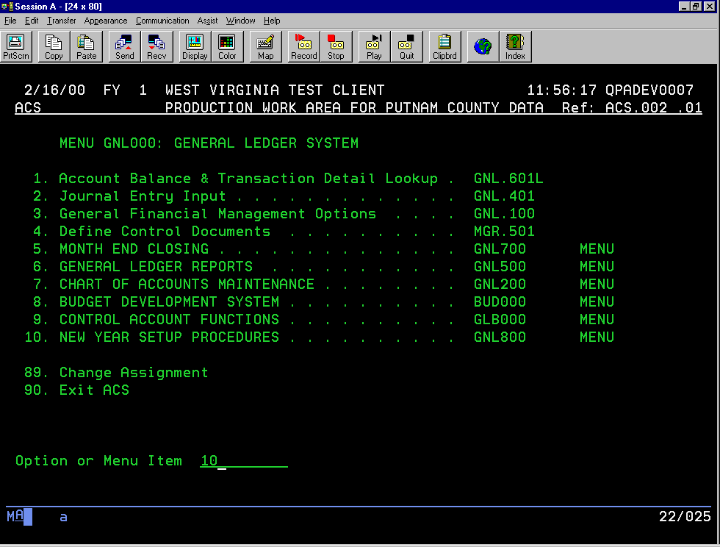

Slide 18
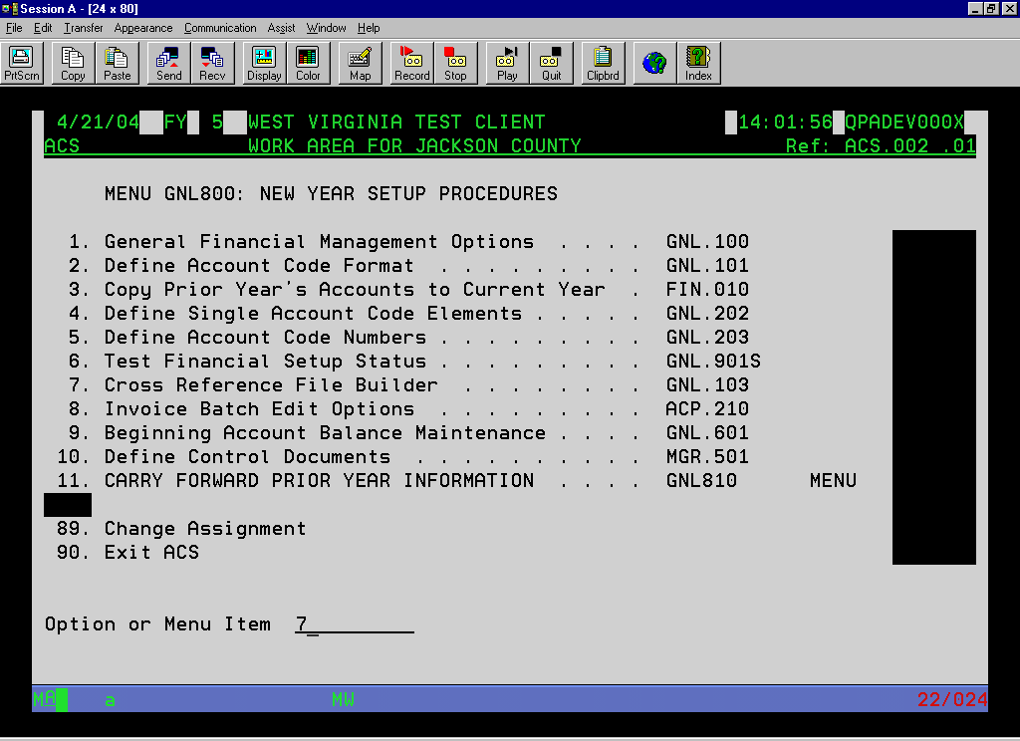
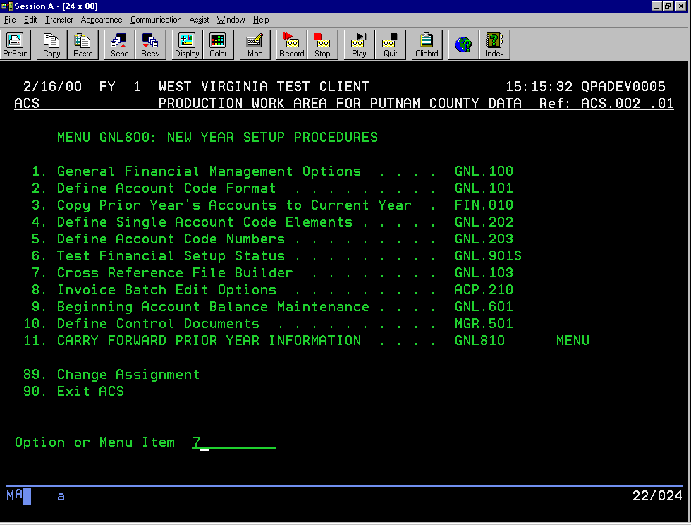
Notes:
You should run this program again. This will make sure that the accounts entered in the old year since you carried over to the new year are in the new year if all account elements have been defined in the new year. Be sure to review the small reports generated to make sure everything carried over OK. DO NOT RUN the Copy Prior Year’s Accounts to Current Year.

Slide 19
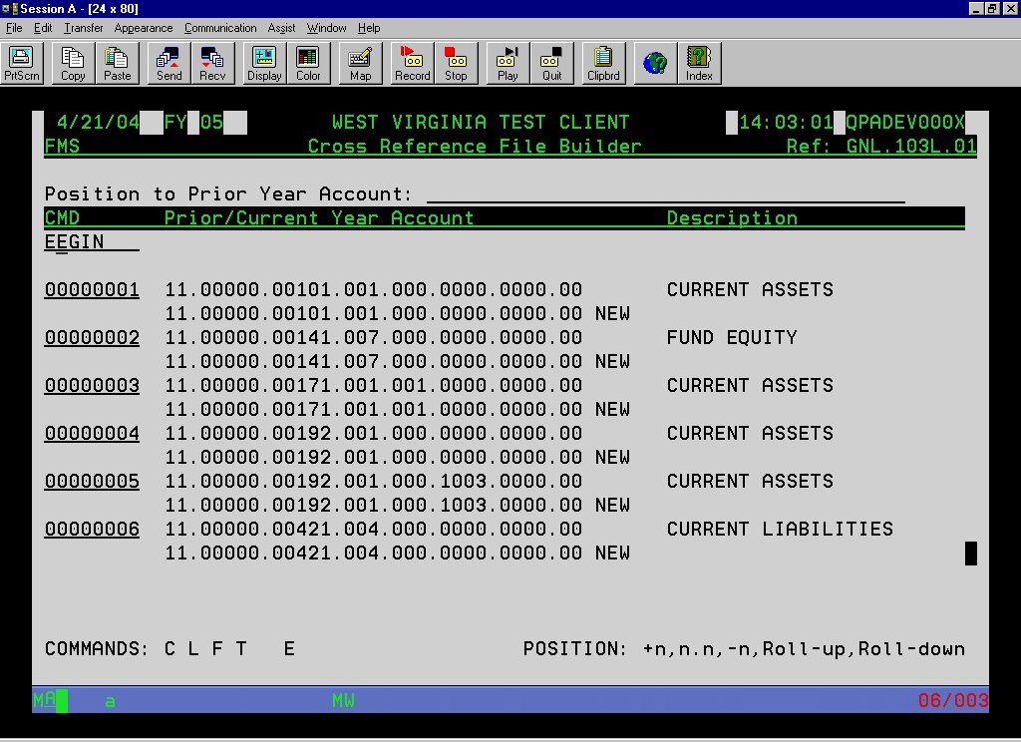
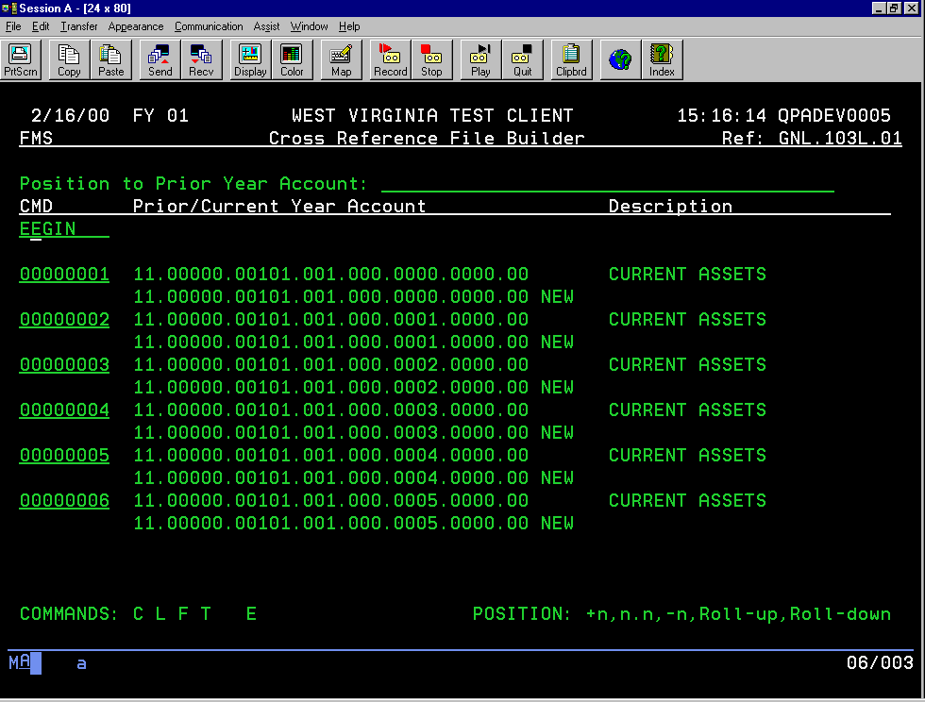
Notes:
This screen does a crosswalk between last year’s accounts and this new year’s accounts. You can use this program to cross reference an account from last year to a new year account in the new year. Do a “C” to change on each line and the current (new year) account will pull up to allow any changes. When finished, enter an “E” to end.

Slide 20
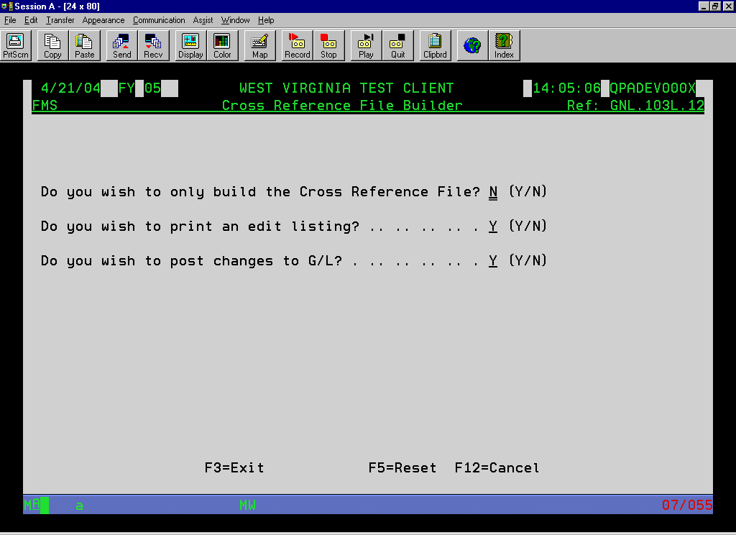
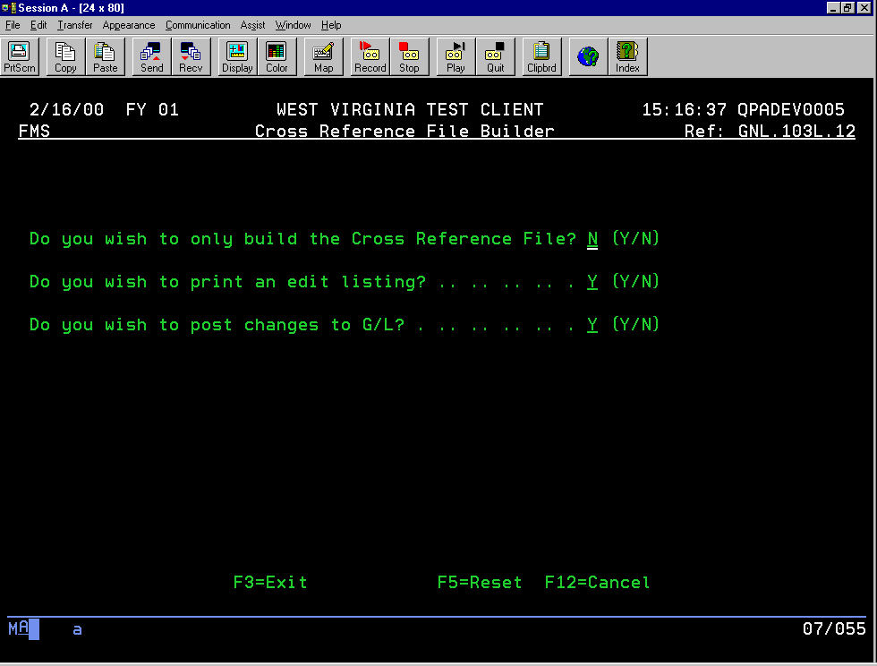
Notes:
Running this program again will carryover any new accounts, account restrictions, bank account and keyword changes to the new year. You can run this program as often as needed.

Slide 21
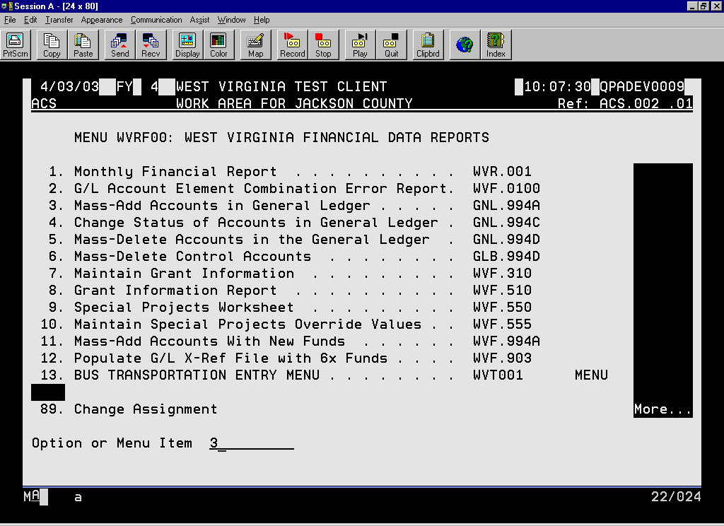
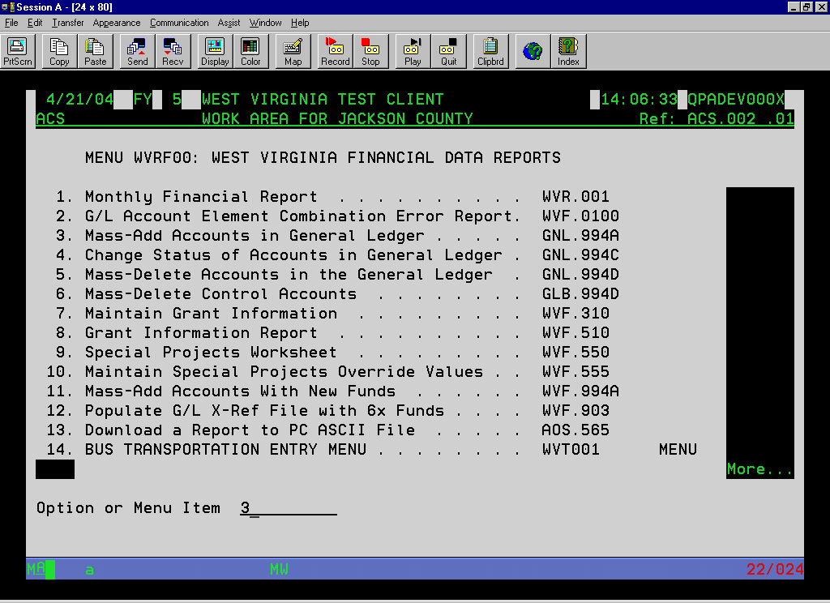
Notes:
Use this optional program to mass add accounts with the new project number.

Slide 22
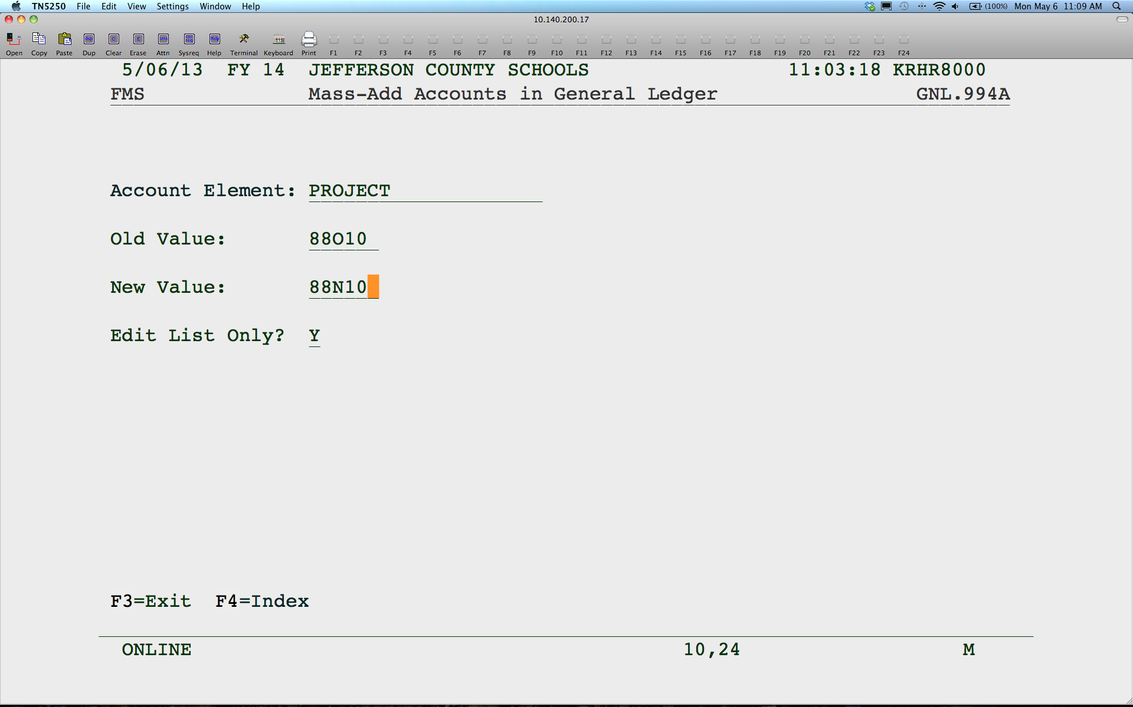
Notes:
O Would be Old year and N would be New year. Edit List Only Y will just give a report. N will add the new accounts.

Slide 23
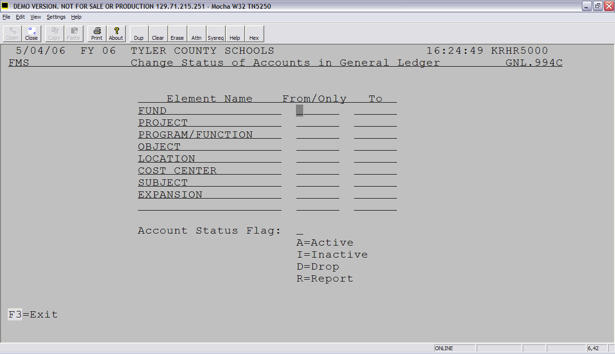
Notes:
You can enter any range of accounts to change the status of the account, for example, to make a series of project accounts inactive.

Slide 24

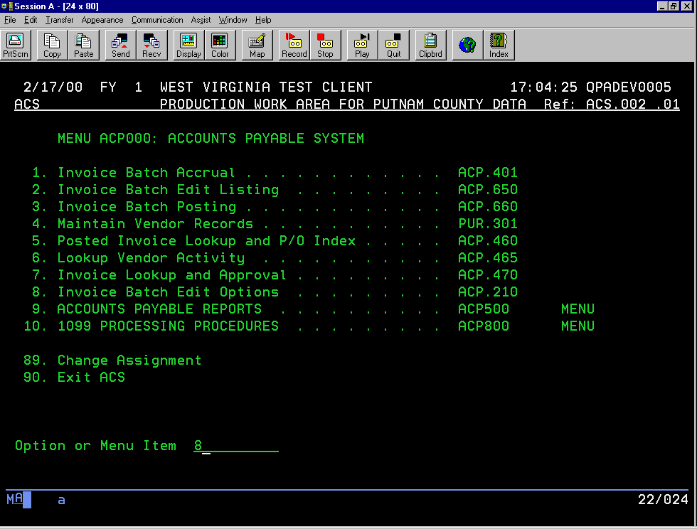
Notes:
You can do a quick review or change, if you wish, to these options.

Slide 25
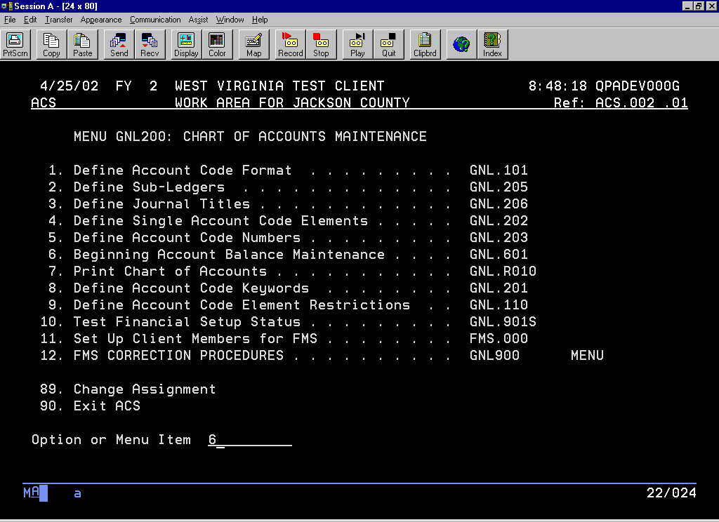
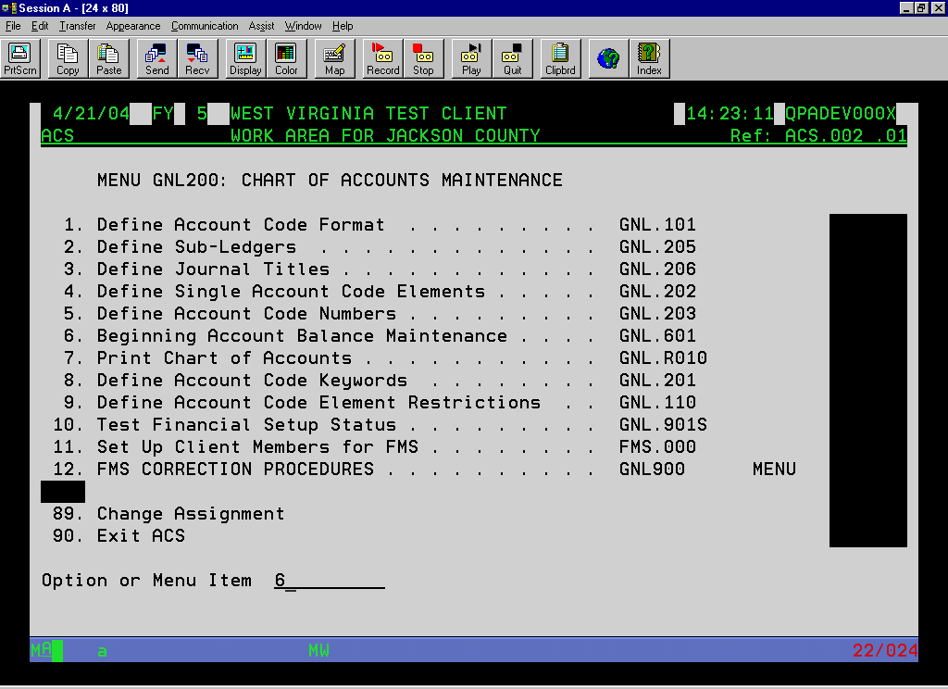
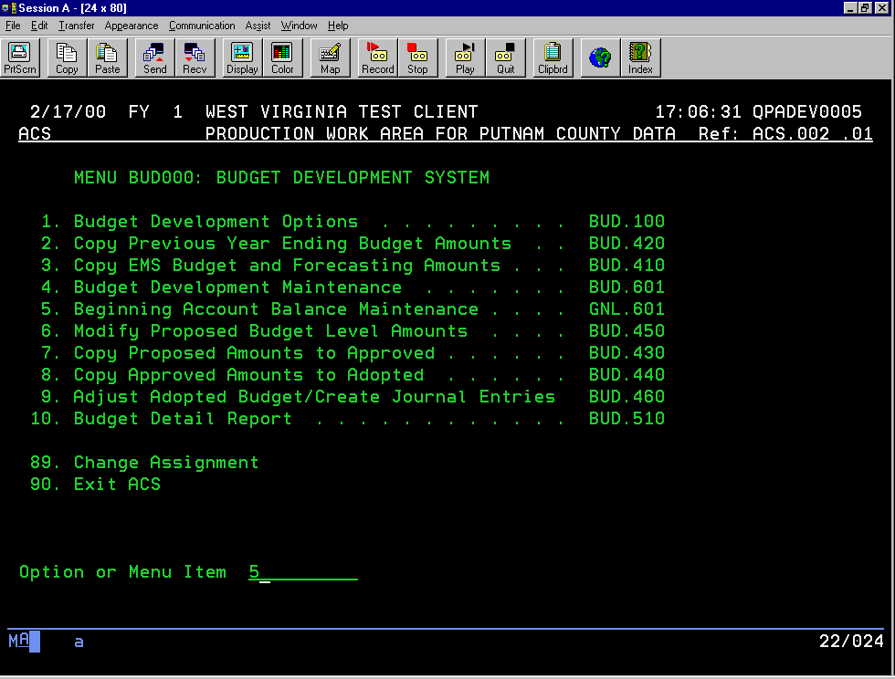
Notes:
Use this program to add new accounts or change your beginning budget.

Slide 26

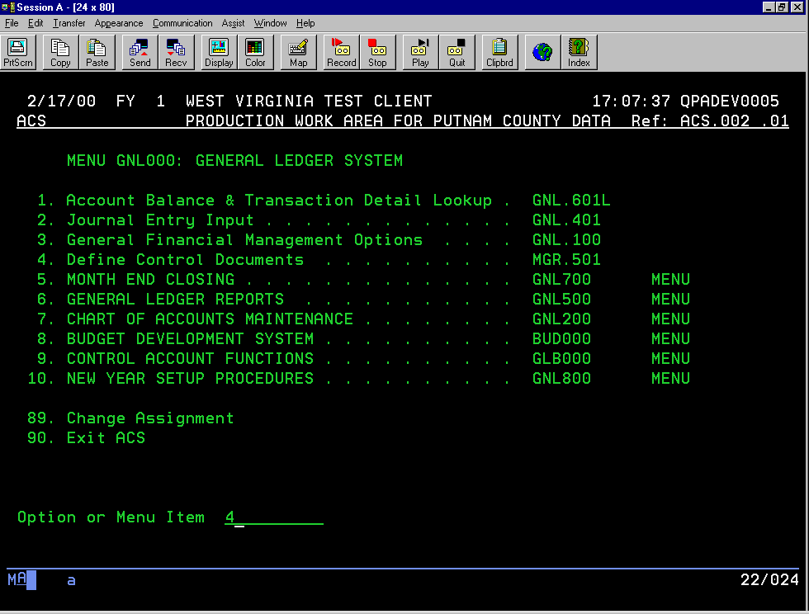
Notes:
If you need to add or change document ID’s for the new year, do so here.

Slide 27

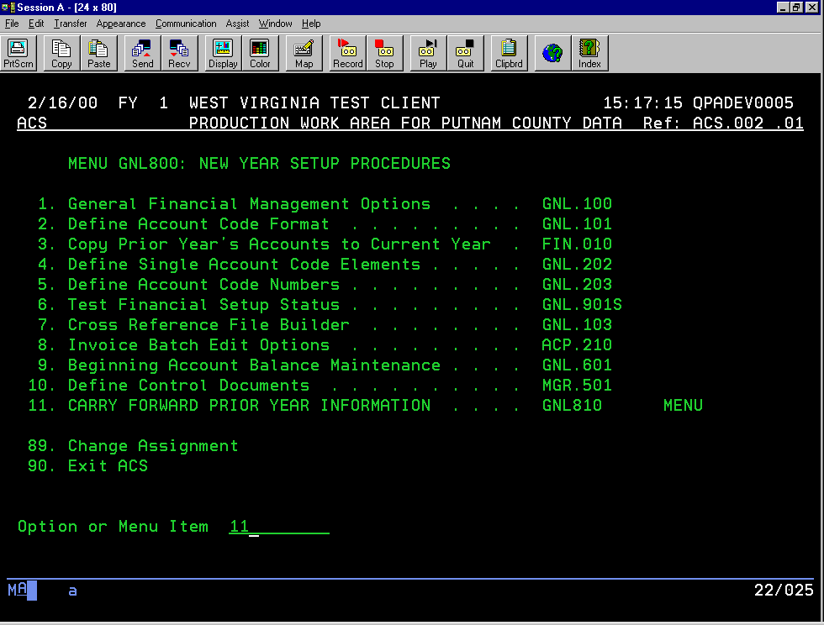

Slide 28
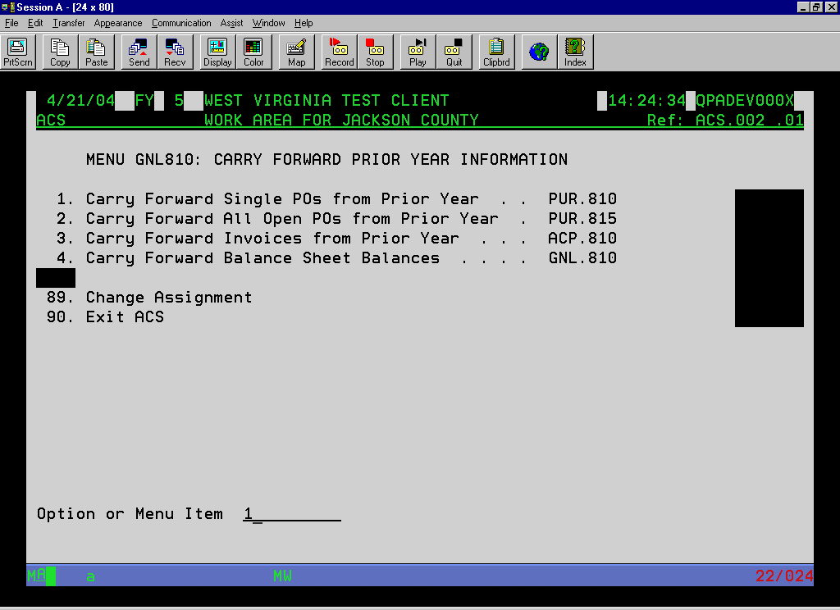
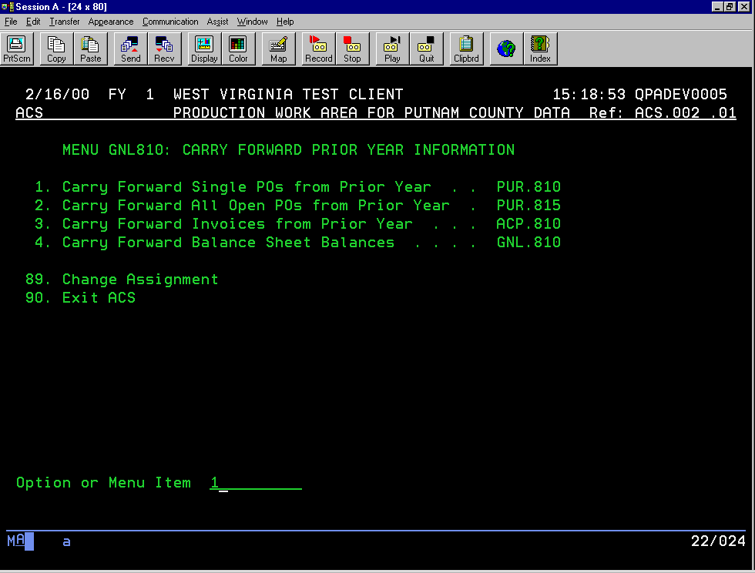
Notes:
You can carry forward PO’s one at a time or as a group or both. If you need to change the account for a PO line, you must use this program to carryover the PO.
You may use this program initially to bring over PO’s as needed into the new year for payment.

Slide 29
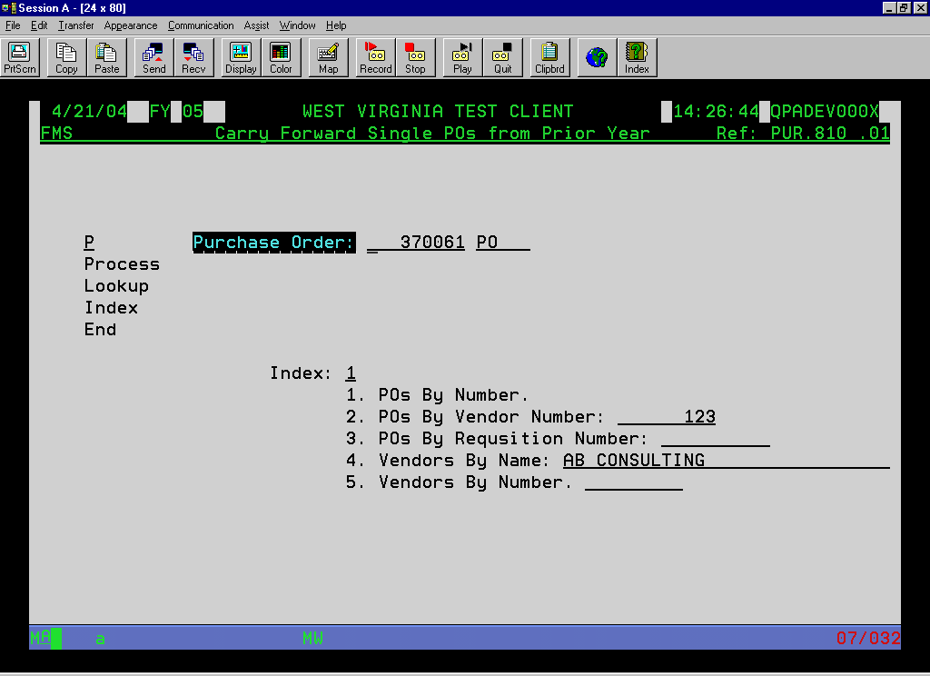
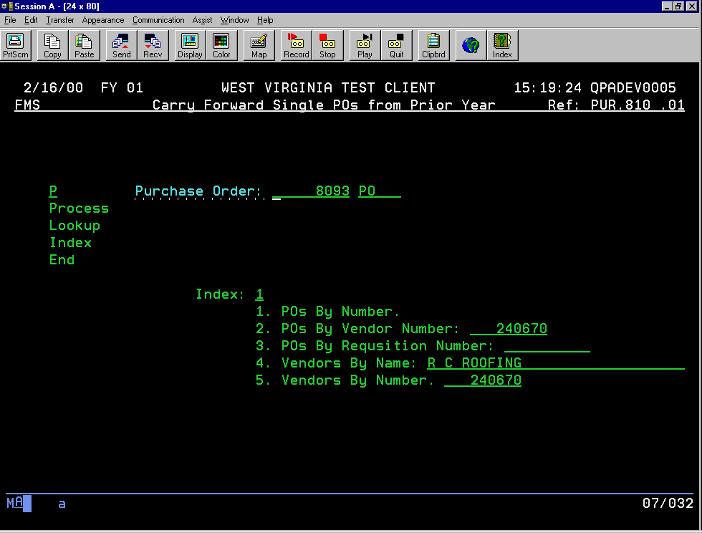

Slide 30
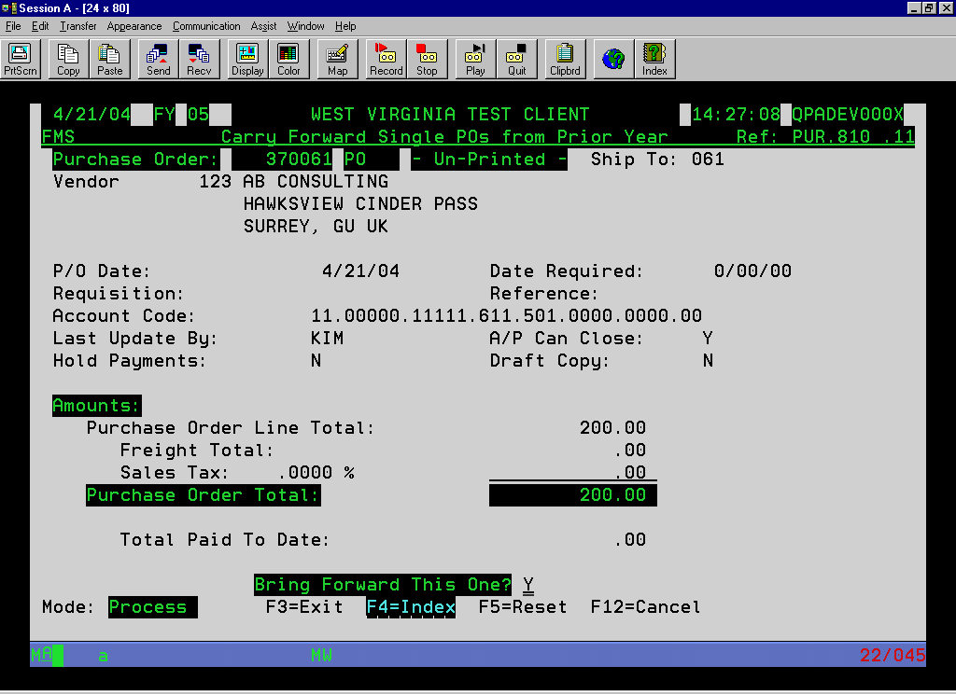
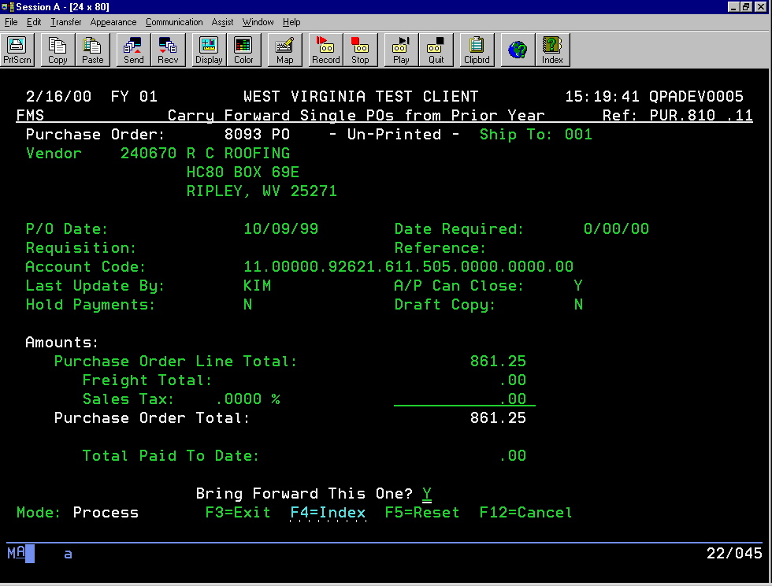
Notes:
To carry forward this PO, change the “Bring Forward This One?” to “Y”.

Slide 31
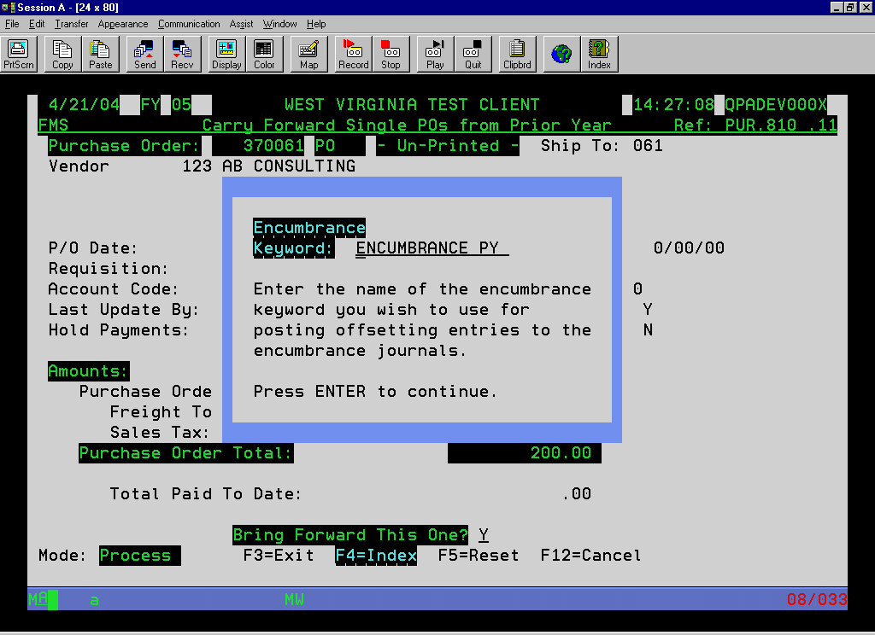
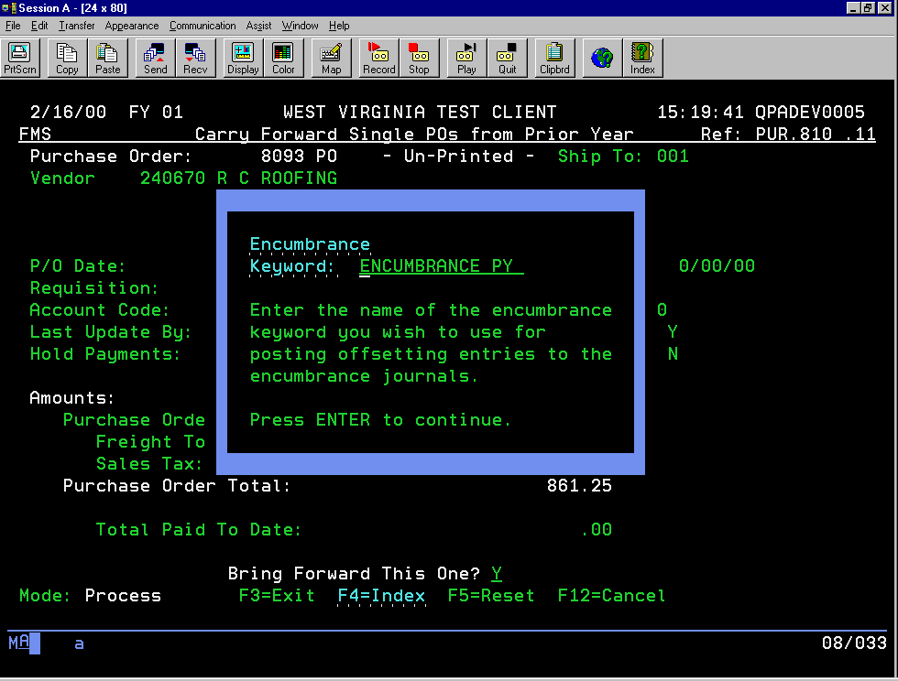
Notes:
You can change this keyword, if you wish. Some people like to use the PY keyword to separate encumbrances from the prior year and the new year encumbrances. You can also use the Outstanding Encumbrance Listing to just print for the PY keyword to keep track of the PO’s that you carried over.

Slide 32
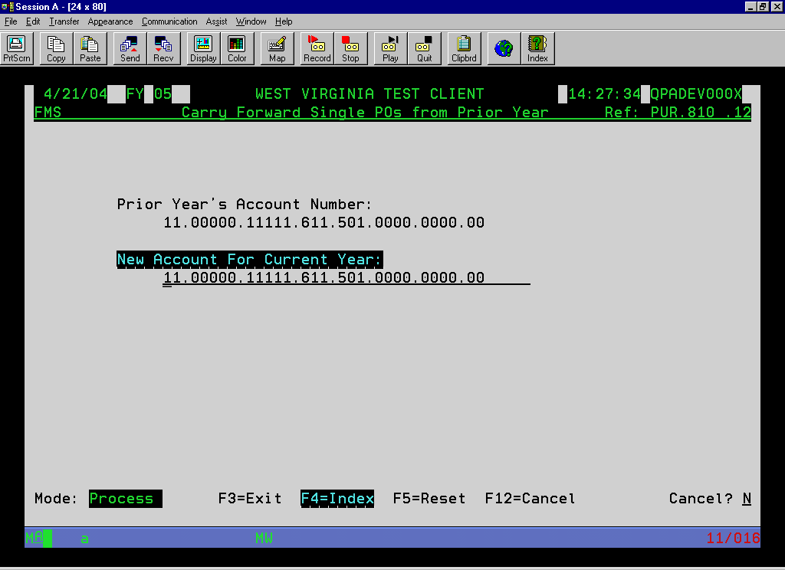
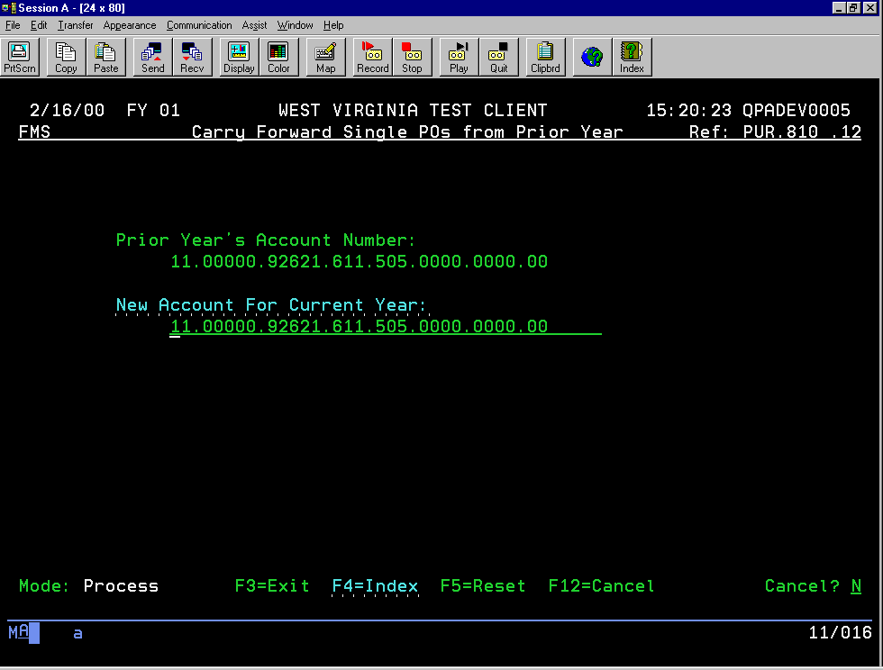
Notes:
The system will prompt you with each line of the PO to make a change to the account for the new year, if you wish. You will be prompted with this screen for as many lines there are on the PO. Continue to hit enter until you get back to the command screen. Do not cancel or else the PO will not carryover.

Slide 33


Notes:
You may want to wait to bring over all PO’s at once. As you post invoices in the prior year, they will continue to adjust the encumbrance balance. Ideally, you would wait to bring forward all PO’s when you feel certain you do not have many invoices left, if any, to post in the old year. Otherwise, you can use the single PO carryover to bring over individual PO’s to the new year to be paid in that year.
This program can be run as many times as necessary if any PO’s fail to carryover or to carryover certain groups of PO’s. Just to be sure that all PO’s carried over, you may want to carryover all PO’s one final time and make sure that the report generated shows all PO’s already on file, with no other errors. This should indicate that all open PO’s have been carried forward.

Slide 34
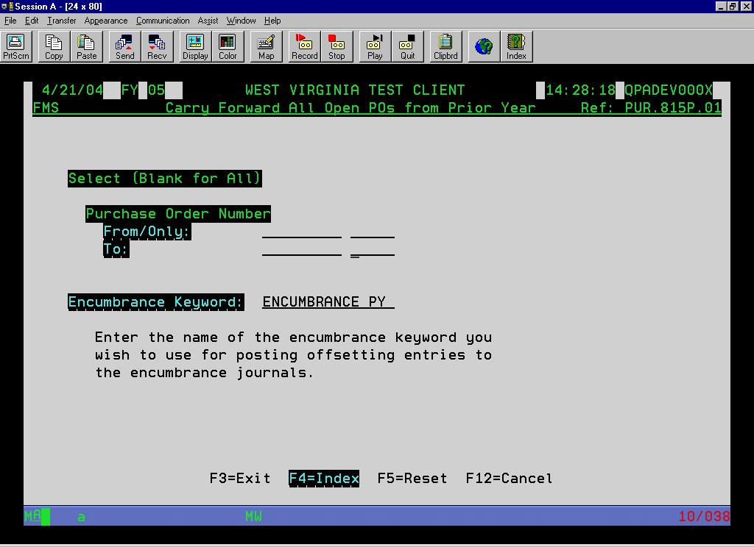
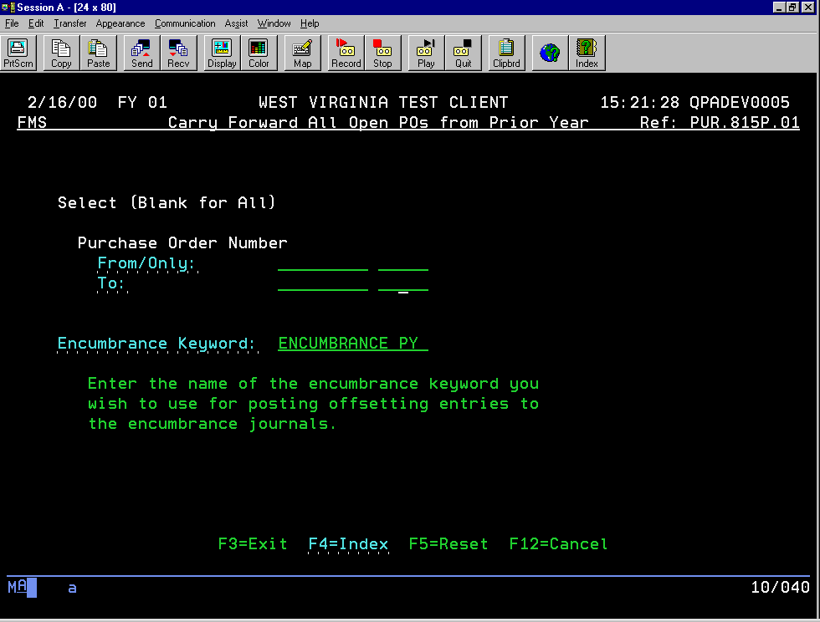
Notes:
To carry forward all PO’s regardless of document ID, blank out the document ID fields in the PO number range fields or you can enter a range by document ID.

Slide 35
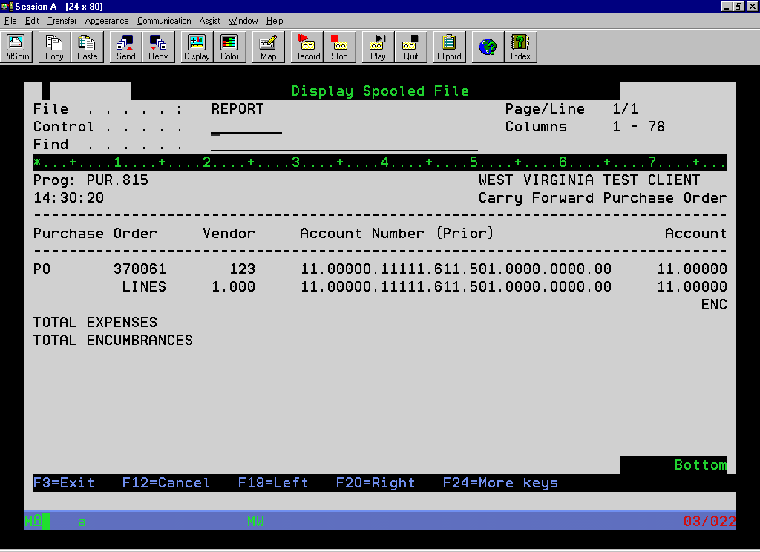
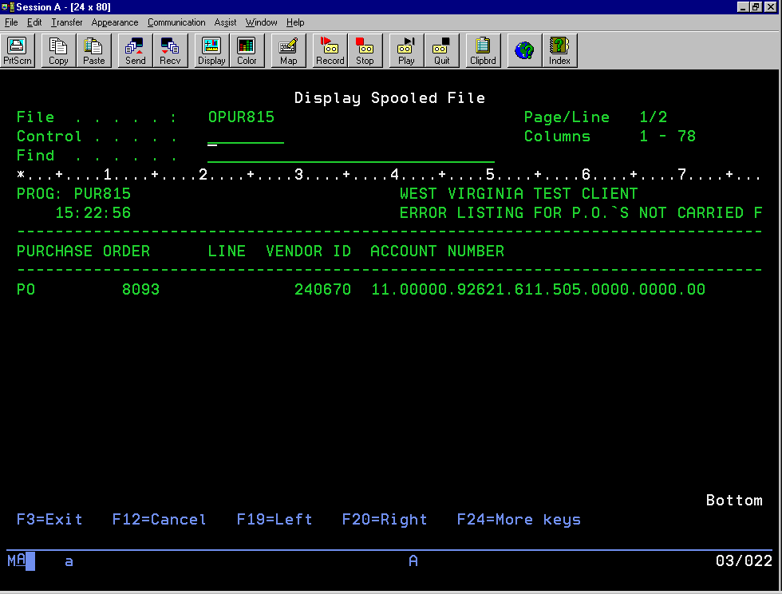
Notes:
A report will probably generate. Review any errors. You will need to correct the error before the system will carry forward the PO unless the message is that the PO is already on file. The system will not carry forward the same PO twice.

Slide 36
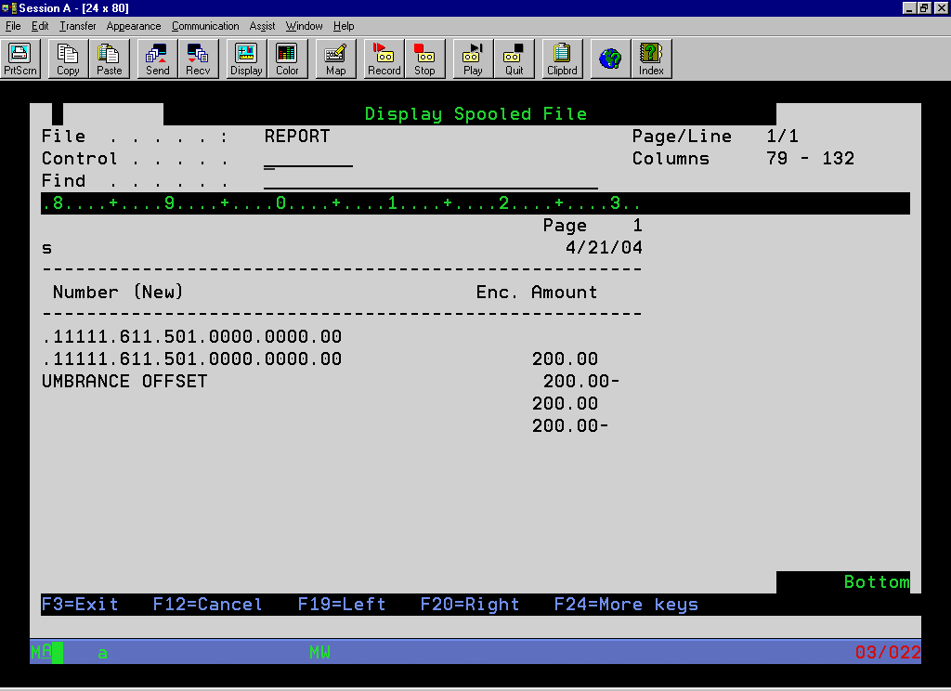
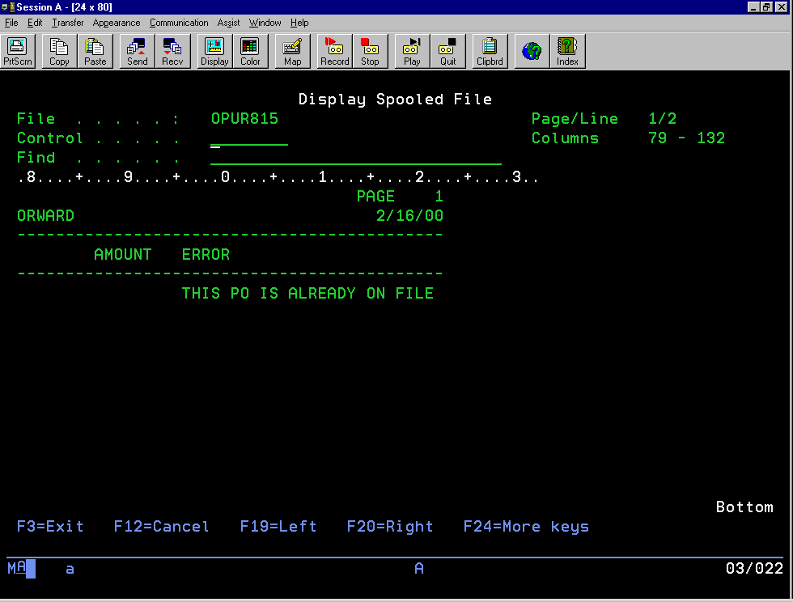
Notes:
Sample report.

Slide 37


Notes:
Run this program to carryover posted invoices not paid in the prior year. This program will not post the expense to the new year but will allow you to pay and post to the appropriate liability and cash accounts. This program will allow multiple invoices to be carried over at one time. The account number does have to be a valid account in the new year, even though it will not post to the account. Either create the account in the new year or process the invoice individually and change the account when you manually carryover.

Slide 38


Notes:
You can use this program to copy one invoice forward at a time or multiple.
To carry over one at a time, enter a P for Process, the vendor and invoice number. Answer “Y” to Bring Forward this One on the next summary screen and make any changes to accounts on the following screens.
To carry over multiple invoices, enter an “I” to index and 2 for the index option and hit enter. It is very important that you use option 2 only to carryover multiple invoices.

Slide 39


Notes:
If carrying over multiple invoices, you will get a list of all unpaid invoices from the prior year. If there are invoices you do not want to carry forward at this time, take the “P” out. Hit enter to bring the invoices still marked with a “P” forward. You can run this program as many times as you want. It will only show the invoices left to be carried over. To exit without carrying over, hit F3 or F12.

Slide 40


Notes:
Use this program to carryover any balance sheet balances and adjust the fund equity account. This will create beginning transaction balances for any balance sheet account with a balance in the prior year.

Slide 41


Notes:
One final note: Don’t forget to ask WVEIS Support to do a change on your FMS client member for the new year or you can go to the Setup Client Members for FMS program on the Chart of Accounts Maintenance menu and enter a C for the new FY.

