Slide 1


West Virginia Consolidated Public Retirement Board
2022 WVASBO Spring Conference

Slide 2
Today’s Agenda
Topic
COMPASS AND WVEIS
Discussion Topics
Post Retirement Employment Critical Need Delinquent Employers ACH Retirement Certification Payroll Schedules – Deferred Summer Pays Prior Pay Adjustments/Corrections System Terminated Employees Contract Lengths & Days Worked Enrolling in Correct Plan Improvements/Suggestions

Slide 3
Post Retirement Employment
§ 162-4-6
Any retirant who accepts employment by a participating employer, other than as a college teacher, for a relatively short period (no more than a one hundred-forty (140) day contract) who is not considered in any way a permanent or regular employee is considered a temporary, part-time or substitute employee and shall continue to receive his or her normal monthly benefit during the temporary employment. The days may be consecutive.
Retirees exceeding the 140 days worked will be reduced to the minimum guarantee for each month he or she continues to work
Annuity will be restored to full benefit the month following termination
140 Days start over each fiscal year (July 1)

Slide 4
Post Retirement Employment
Retiree Responsibility
Track Days worked
Report to CPRB when exceeded 140 limit
Inform CPRB upon termination so benefit can be restored
Substitute “teachers” can add their hours together to equal a day worked. Eight (8) hours worked equals one (1) day
All other positions count as 1 day worked no matter the hours per day

Slide 5
Critical Need Substitutes
§ 18A-2-3. Employment of substitute teachers; employment of retired teachers as substitutes in areas of critical need and short-age
When does Critical Need occur?
Critical Need occurs when the number of available substitute teachers with the required certification and training is not sufficient to meet the need of the county.
Who?
- Classroom teacher
- Speech Pathologist
- Nurse
- School Counselor

Slide 6
Area of Critical Need and Shortage
County school board adopts a policy recommended by the state superintendent to address areas of critical need and shortage
The policy provides for the employment of retired teachers as substitute teachers during the school year on an expanded basis
The policy is effective for one school year only and is subject to annual renewal by the county board
The state board approves the policy and the use of retired teachers as substitute teachers on an expanded basis
Prior to employment of critical need teachers, the county board of education needs to complete these steps
- A form affidavit approved by the CPRB needs to be completed on each classroom teacher returning as a critical need substitute
- Mail that form with a copy of the policy adopted by the BOE, along with a copy of the approval letter from the State Superintendent to the CPRB

Slide 7
Area of Critical Need and Shortage
WVDE must receive required information prior to retiree working the 141st day
If approved for critical need, the number of working days is unlimited during that fiscal year
Can a teacher who retires in the same school year substitute under critical need?
NO - Any person who retires and begins works as a critical need substitute teacher within the same employment term shall lose those retirement benefits attributed to the annuity reserve, effective the first day of employment as a retiree substitute in that employment term and ending the month following the date the retiree ceases to perform service as a substitute

Slide 8

Critical Need Substitute Teacher Affidavit
Return the affidavit to the WV Department of Education & NOT the WVCPRB

Slide 9
2019 Legislation
House Bill 2739 – Delinquent Employers - §5-10D-13 and 61-10-20
Effective June 6, 2019
Makes it a crime for employers of all CPRB administered plans to not remit employee and/or employer contributions within 60 days of when they are due
CPRB now required to notify the State Auditor, the County Commission of the county in which the employer is located and the Sheriff of the county in which the is located of the delinquency
All 3 parties notified are directed to withhold any money due the employer and remit to CPRB until the delinquency & interest amounts are paid
Applies to ALL CPRB plans
Any person who is responsible for ensuring that retirement contributions are timely made to a CPRB administered retirement plan and who knowingly & willfully fails to make employee and/or employer contributions to the retirement plan for 60 days or more can be found guilty of a misdemeanor. Upon conviction, he or she shall be fined not less than $100 nor more than $500 and/or may be confined in jail not to exceed 6 months

Slide 10
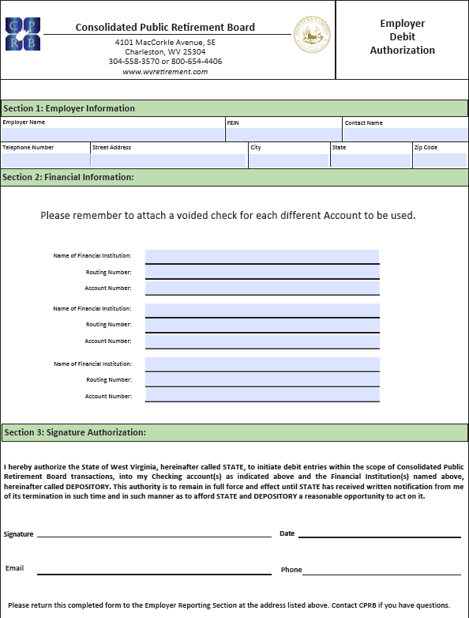
Automated Clearing House
BENEFITS OF ACH
Lower Cost
Increased Security
Convenience
Reduced Human Error
Faster Processing Time
Complete the Employer Debit Authorization form & return it to the WVCPRB with the copy of a Voided Check
- One bank account per agency code

Slide 11
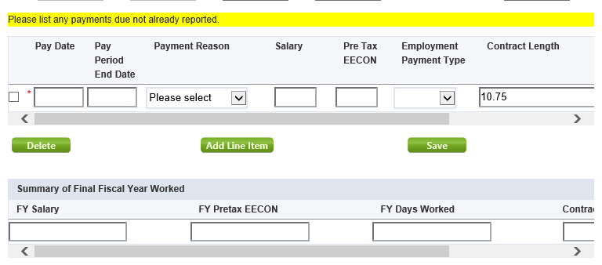
Retirement Certification
“Summary of Final Fiscal Year Worked” is a required field. If not completed the certification will be returned.
Can be completed on/after the termination date.

Slide 12

Payroll Schedule
The Payroll Schedule is critical information that must be reported annually to CPRB in order to submit contribution reports and payments for the upcoming year in a timely manner.
Notes:
Facilitator Notes:
All invoices that are generated by a batch process (or manually) in COMPASS appear on the Invoices page. Additionally, employers have the option of remitting payment for invoices as part of the Monthly Report submission process. Each invoice will be viewable in PDF form and the employers stored EFT or e-Check payment account information can be used to remit payment for the invoices.
Note: The most recent unpaid invoices display on the screen. Invoices with a status of Cancel or Write Off do not display here. Credit invoices also do not display on the Invoices page.

Slide 13
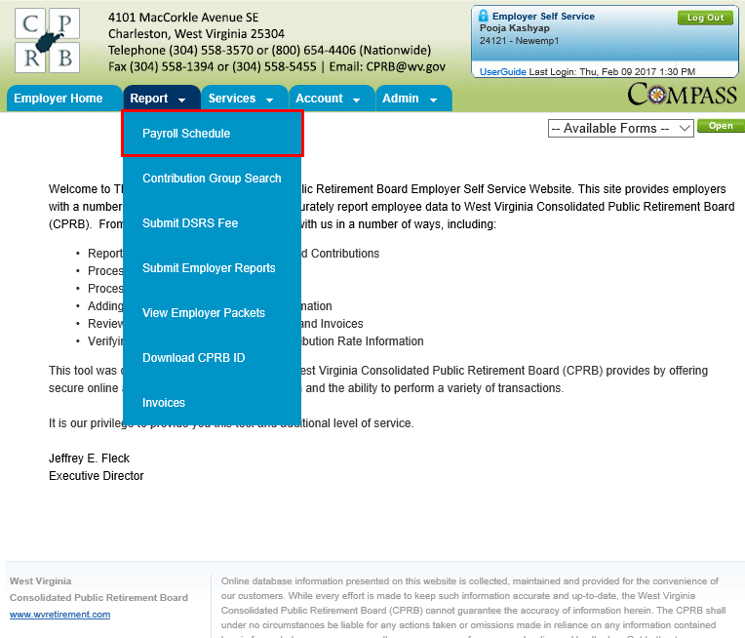
Manage Payroll Schedule
To add and view a payroll schedule.
Payroll Schedule
Add Payroll Schedule
View Payroll Schedule
Notes:
Facilitator Notes:
Perform a walk through of the steps mentioned in the different sections of the Employer Self Service user guide.
Ensure all participants sitting through this module have the required ESS Administrator rights.
Ensure that contact persons are added via the Maintain Members module in COMPASS, so that they reflect in ESS.
Go over the three key ESS roles like in a quick quiz for participants will need to assign these roles in the Manage Users activity.

Slide 14
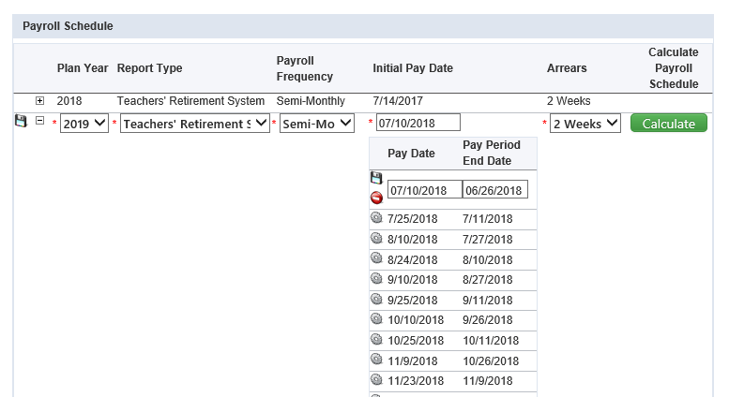
Creating/Adjusting the Payroll Schedule

Slide 15
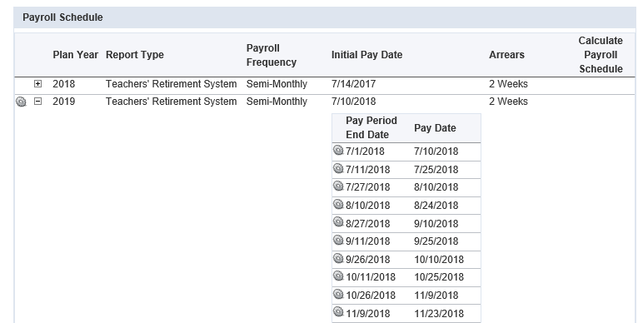
Updating the Payroll Schedule
Remember: Once you have submitted a report for that plan year, the payroll schedule cannot be changed through ESS.
Please contact CPRB to make any needed changes after that point.

Slide 16
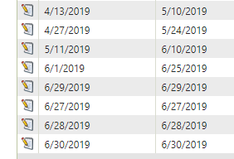
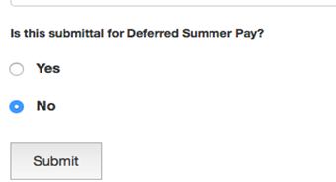
Deferred Summer Pays
All deferred summer pays are due to the CPRB by July 15th
Designated dates must be on COMPASS Payroll Schedule. If not already on FY22 schedule, contact CPRB with the dates. Since payroll schedule dates in COMPASS cannot cross fiscal year, use June Pay Dates and Pay Period End Dates
Report each Deferred Summer Pay as a separate submission in COMPASS
Please answer YES in WOW program so pays are identified as Deferred

Slide 17
Adjusting a Previously Submitted Record
When an adjustment needs made for a pay period end date previously submitted for a member, then the adjustment will be made on the next available report for that system. Please only adjust payments made in the 2018 Fiscal Year and forward through ESS.
Prior years will have records converted from our legacy system and adjustments for prior years may also require service purchases. Please contact CPRB for assistance in making corrections to 2017 and previous Fiscal Years.
Corrections to days, contributions, wages, etc. can all be performed through ESS on a per pay period basis and such corrections should always be done whenever a check previously reported to CPRB is voided through WVEIS and either re-issued for a different amount, or not re-issued at all.

Slide 18
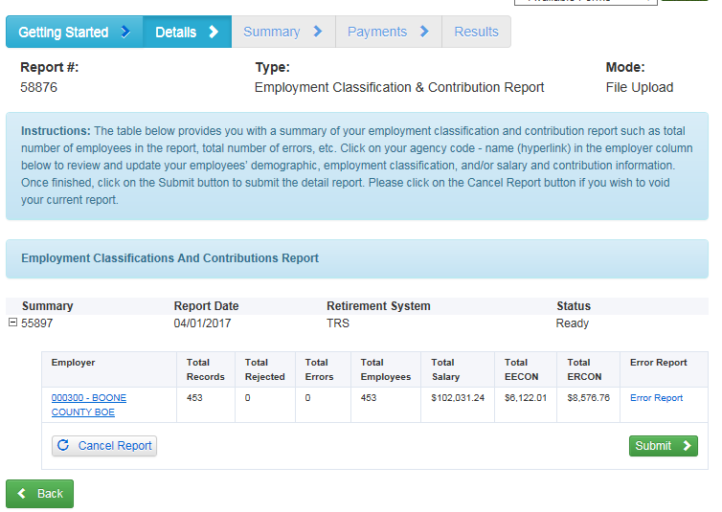
Click on the Employer Name and Code

Slide 19
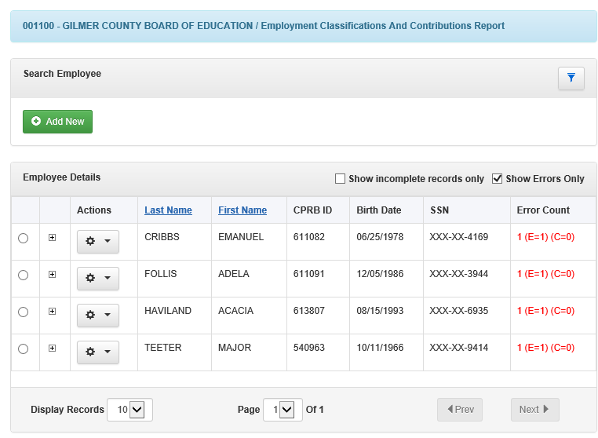
Detailed List of Employees within the Report

Slide 20
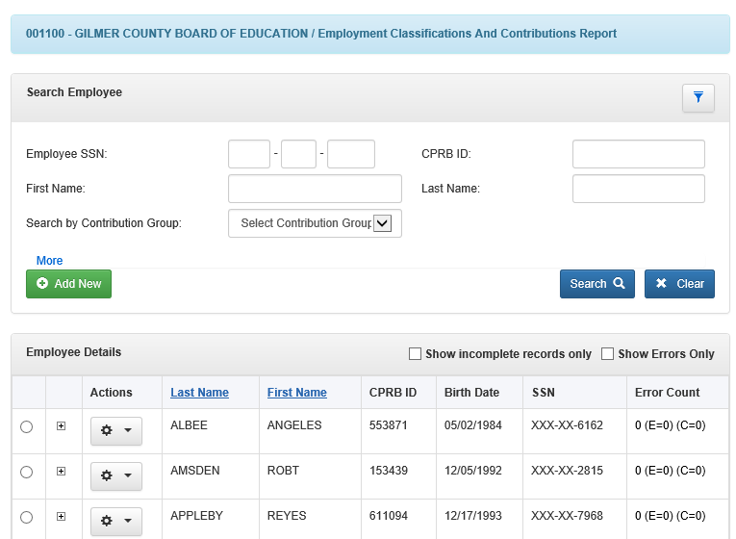
Uncheck Show Errors Only and Expand Search

Slide 21
Search by any field if Person is on the Report

Slide 22
Click on Add New if Person is NOT on Report

Slide 23
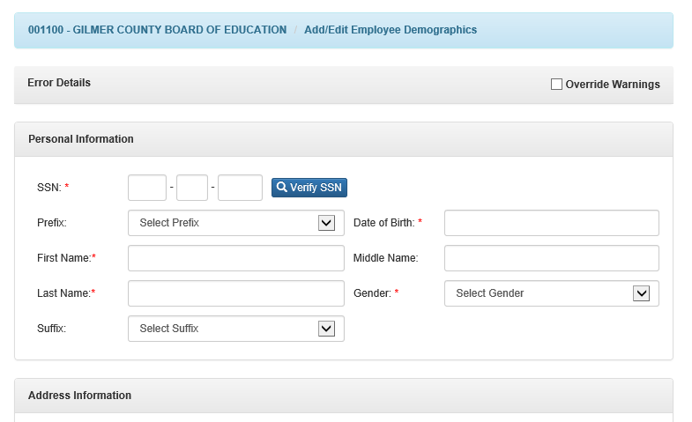
After Add New is Clicked, Enter SSN, Verify SSN

Slide 24
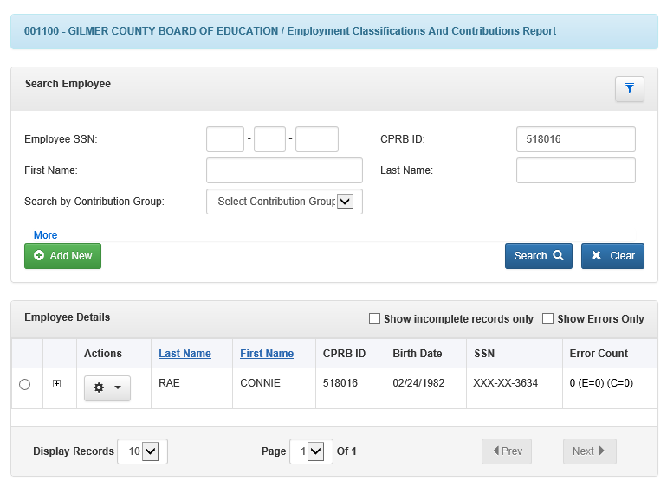
Once the Person is Already in the Report

Slide 25
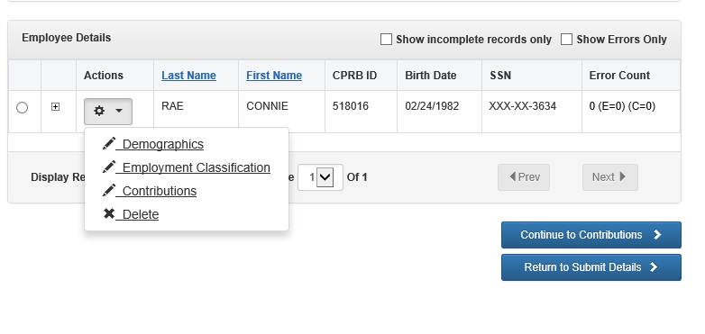
Once the Person is Added or Found in Report
Click the Gear Wheel for Options

Slide 26
Once the Person is Added or Found in Report
Click the Gear Wheel for Options, Select Contributions from Drop Down Menu to adjust Days, Wages and/or Contributions

Slide 27
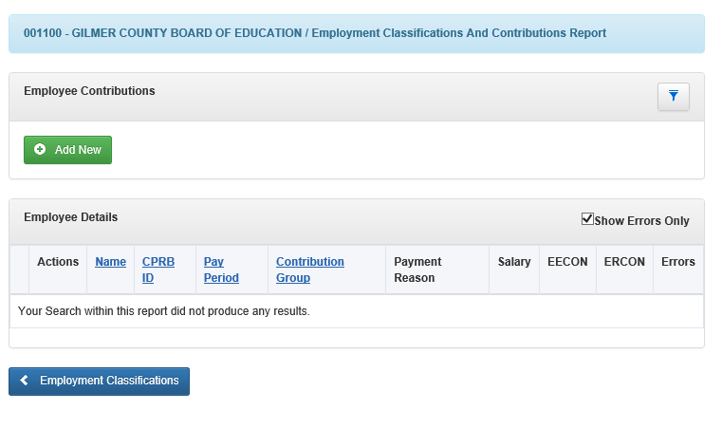
After selecting Contributions from Gear Wheel
Uncheck the Show Errors Only box to show any existing contribution records for the person in the report, expand search icon to see member details, click on Add New

Slide 28
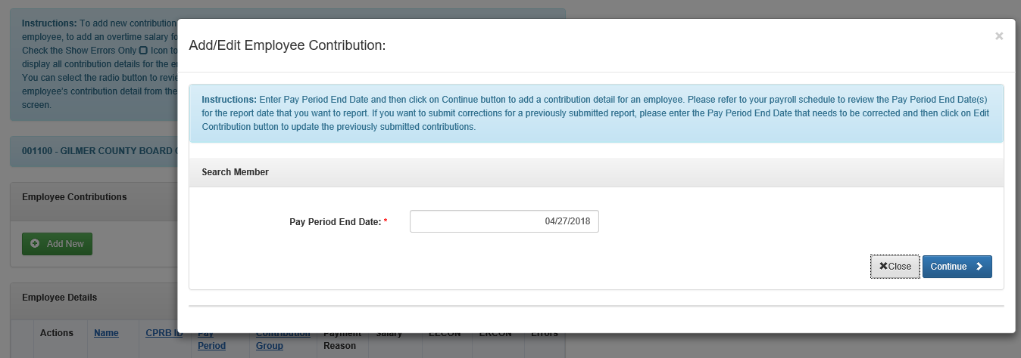
After clicking on Add New button
Enter the Pay Period End Date that needs to be adjusted and then click on Continue, if the Pay Period End Date entered has been reported in the past, then you will have the option to edit the existing contribution, or to add a new contribution

Slide 29
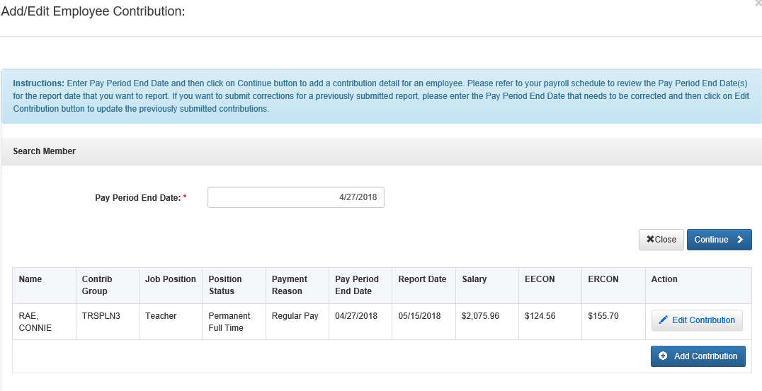
After clicking on Add New button
Click on Edit Contribution

Slide 30
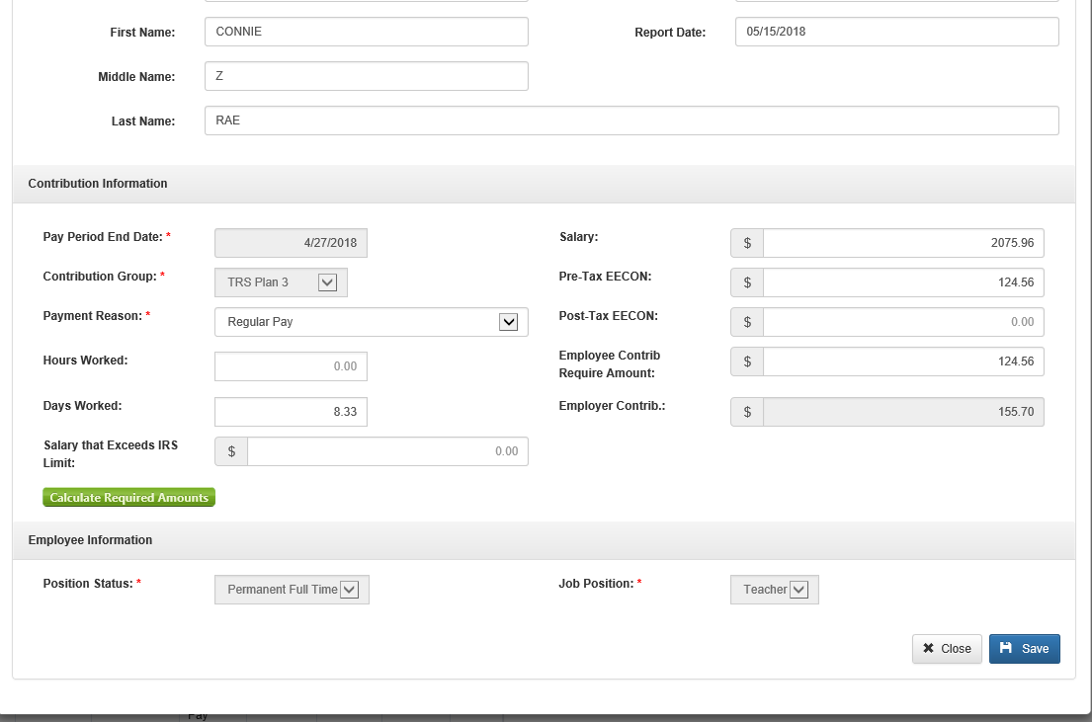
Adjust the Days Worked or Salary Amount

Slide 31
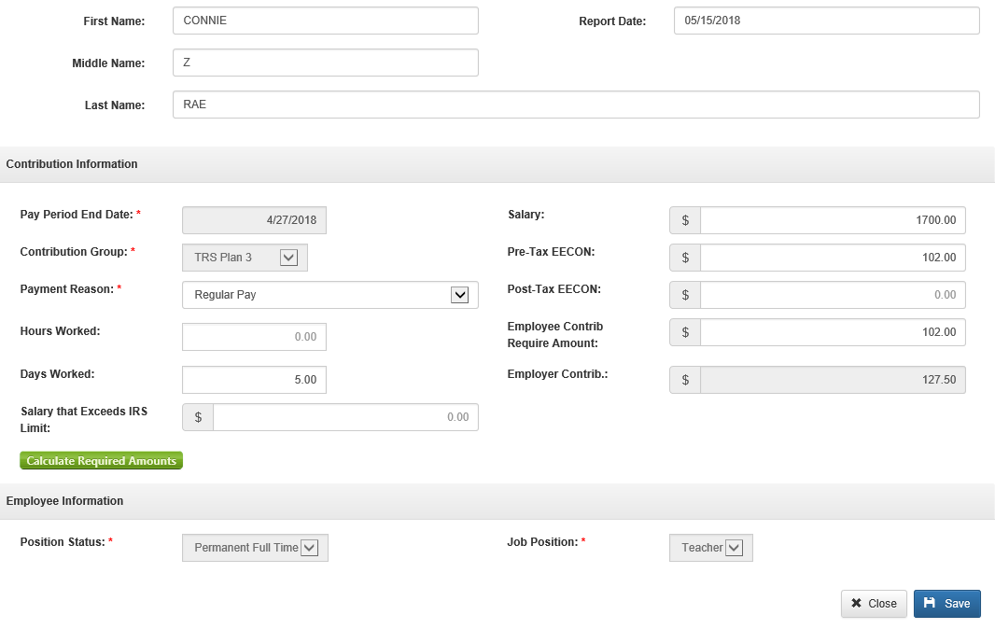

Click on Calculate Required Amounts, then Save

Slide 32
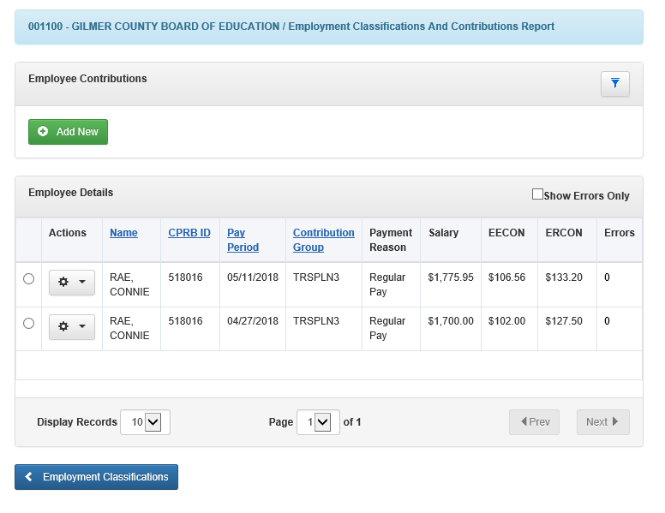
After Record Has Been Saved

Slide 33
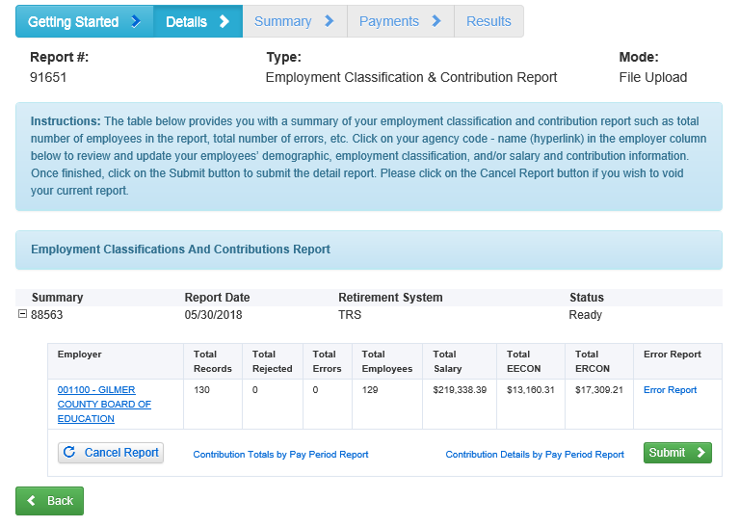
Submitting After Editing or Adding
Note: the difference between total records and total employees shows there is an employee with 2 records

Slide 34
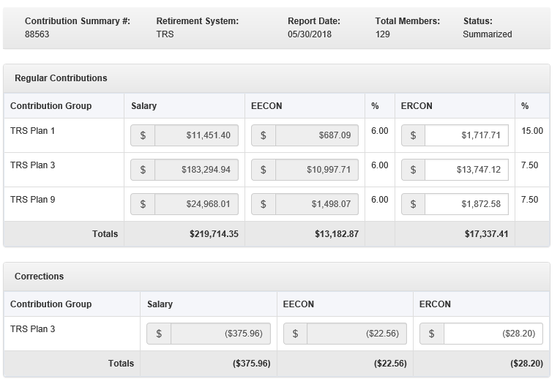
Adjustment will be shown in Corrections Grid
After clicking on Submit, details are displayed of credit or debit due based on the adjusted records within the report.

Slide 35
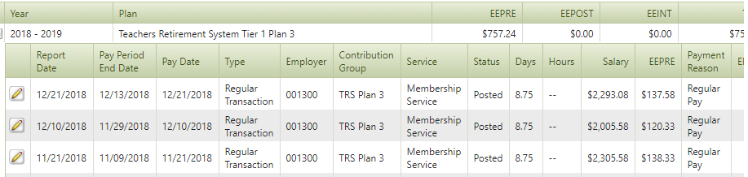
System Terminated Employees
Why is employee “System Terminated” in COMPASS?
Member does not have a contribution reported in COMPASS for 120 days since last Pay Period End Date
CPRB does not know if employee is on Leave Without Pay or Terminated

Slide 36
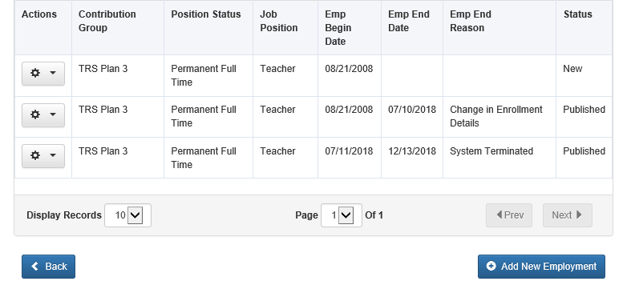
System Terminated Employees
ESS View of a System Terminated Employee

Slide 37
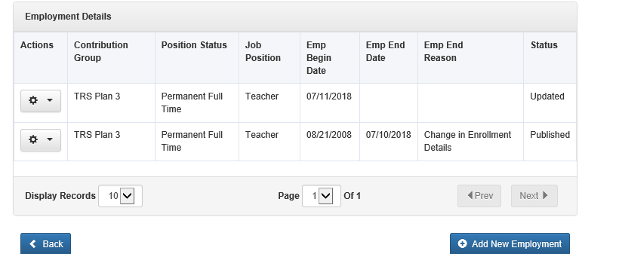
System Terminated Employees
How Should Employers Correct?
Contact CPRB when an “error” occurs for a system terminated employee
CPRB Staff can remove the date (if all other employment details remain same) and error will be fixed

Slide 38
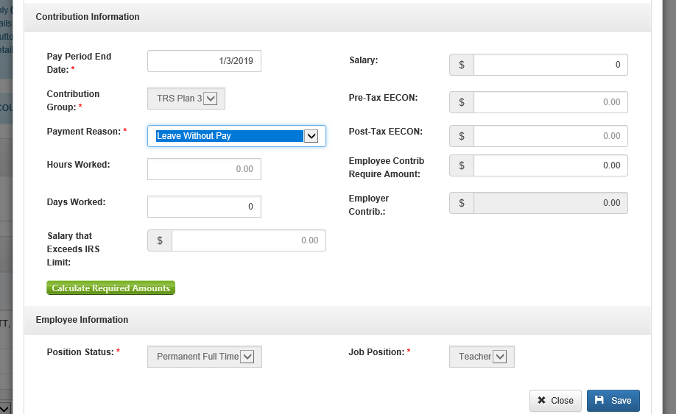
System Terminated Employees
How can this be prevented?
Every employer can manually add record for a member that is off payroll
Submitted information through ESS will prevent the “System Termination”

Slide 39
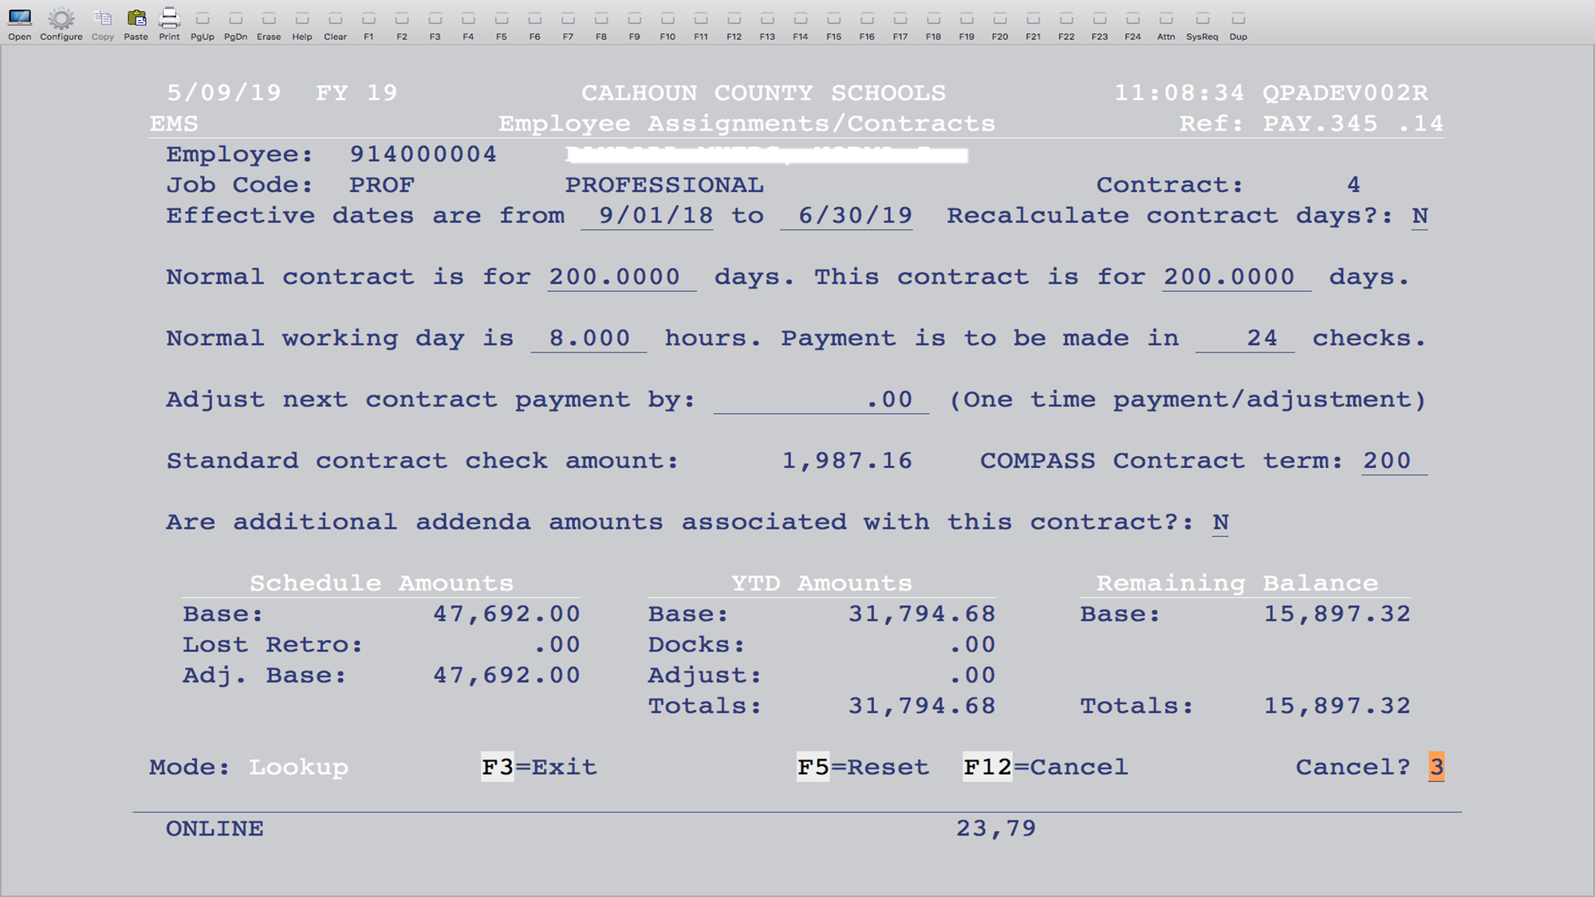
WVEIS Assignment / COMPASS
“Normal contract is for 200.0000 days” is defaulted to 200 in WVEIS based on pay table.
“This contract is for ____ days” should be how many days employee will work that year.
“COMPASS Contract term: ___” is based on the number of days in the POSITION. (This may match the “contract is for” days if they work the full year.)
“Payment is to be made in ___ checks” is total number of checks employee will receive.

Slide 40
How Days Worked are Calculated
The number of days from “This contract is for ___ days” divided by the number of checks.
Example:
Contract for 200 days / 24 checks = 8.333 days

Slide 41
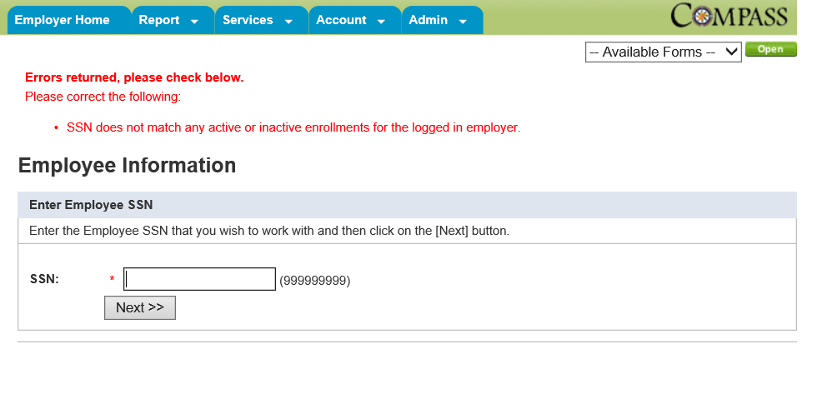
Determine Correct Plan
Services Tab – Employee Information
Enter SSN of new employee

Slide 42
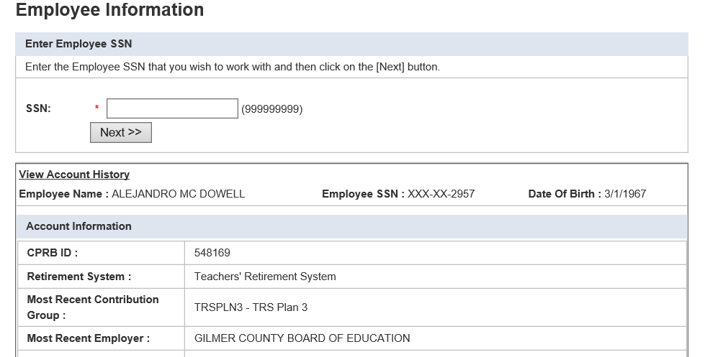
Determine Correct Plan
Services Tab – Employee Information
Enter SSN – Click Next

Slide 43
Improvements/Suggestions
The CPRB is always looking for ways to improve. Please feel free to share insight into any ideas that can improve the current processes.

Slide 44
Questions?
Send questions via email to CPRBEmployerHelp@wv.gov

