Slide 1

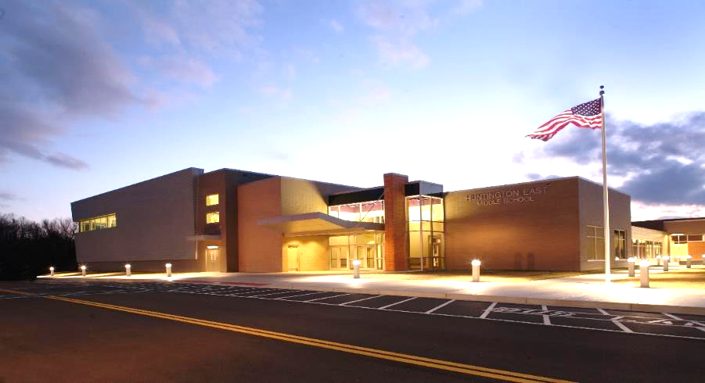

School Building Authority
of
West Virginia
Requisition Reimbursement and Closeout Processing
WV ASSOCIATION OF SCHOOL BUSINESS OFFICIALS
May 18, 2022
10:30 AM

Slide 2
Overview
SCHOOL BUILDING AUTHORITY OF WEST VIRGINIA
Items Needed for Requisition Reimbursement Processing
Common Delays in Requisition Reimbursement Processing
Requisition Reimbursement Form Examples
SBA Requests When Providing Final Project Invoices
SAGA Compliance Reporting Requirements
Grant Closeout Requirements
Common Issues in Grant Closeout Processing
Grant Closeout Form Examples
Image on cover: New Huntington East Middle School – Cabell County

Slide 3
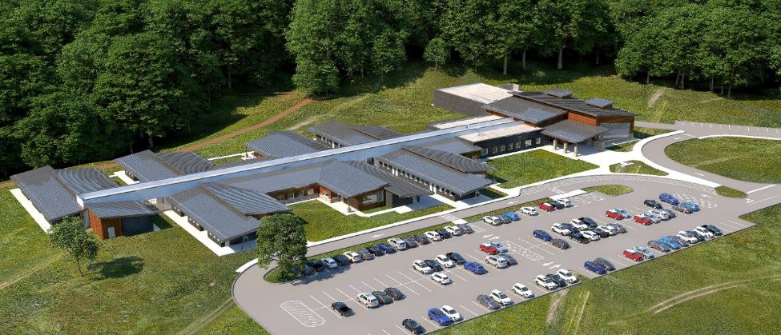
Items Needed for Requisition Reimbursement Processing
SCHOOL BUILDING AUTHORITY OF WEST VIRGINIA
Exhibit B – Requisition Form
SBA Requisition Reconciliation Summary
Invoices/Pay Apps
  In order of Requisition Reconciliation Summary
  Clean Versions of Invoices (No Markups)
  Pay Apps must be completed with all appropriate signatures and backup Continuation Sheets
Architect’s rendering of the proposed Clendenin-Bridge Elementary School – Kanawha County

Slide 4

Common Delays in Requisition Reimbursement Processing
SCHOOL BUILDING AUTHORITY OF WEST VIRGINIA
Personally Identifiable Information on backup documents
  Account Numbers
  Banking Information
  Check Numbers
  FEIN
  Other forms of PII
Incorrect Date(s) of Service
Information inconsistent between Reconciliation Summary and Backup documents
Reimbursement requests outside of Grant Award period
Not providing Grant Award Numbers in correspondence
Note: Documentation must be approved by SBA Finance Staff and the WV State Auditor’s Office before processing reimbursement

Slide 5
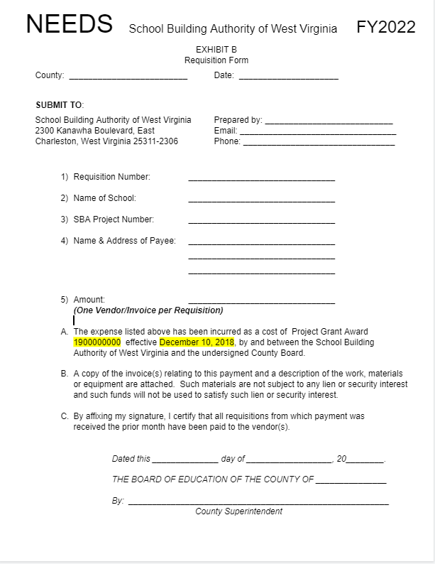
Requisition Reimbursement Form Examples
SCHOOL BUILDING AUTHORITY OF WEST VIRGINIA
Exhibit B – Requisition Form
5

Slide 6
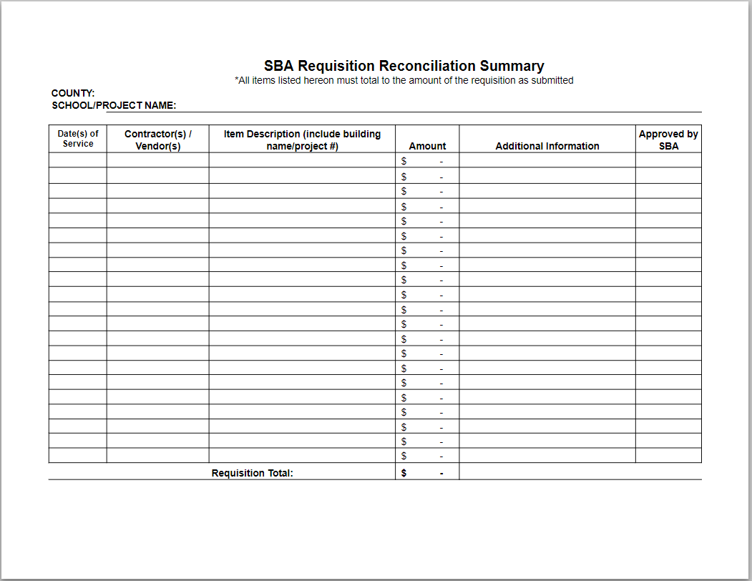
Requisition Reimbursement Form Examples (Continued)
SCHOOL BUILDING AUTHORITY OF WEST VIRGINIA
SBA Requisition Reconciliation Summary Form
6

Slide 7
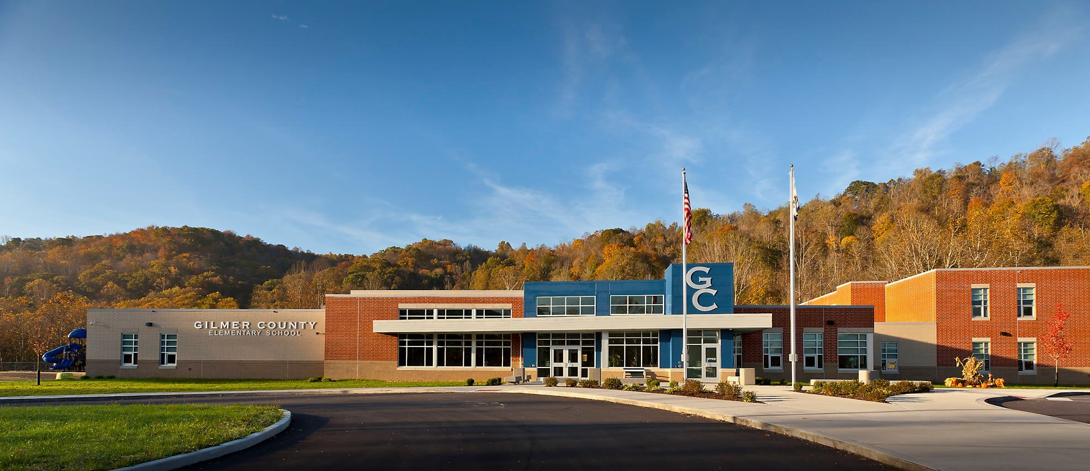
SBA Requests When Providing Final Project Invoices
SCHOOL BUILDING AUTHORITY OF WEST VIRGINIA
Email architect or provide memorandum with final invoice
  Must state that this is final invoice and no further billing forthcoming
  This sets up Closeout Process
For projects such as roofs, HVAC, etc., remember to set aside depreciation funds
Entrance of the new Gilmer Elementary School – Gilmer County
7

Slide 8
SAGA Compliance Reporting Requirements
SCHOOL BUILDING AUTHORITY OF WEST VIRGINIA
Per WV State Code § 12-4-14(9)(c)(4), “Reports and sworn statements of expenditures required by this section shall be filed within two years of the end of the grantee’s fiscal year in which the disbursement of state grant funds by the grantor was made. The report shall be made by an independent certified public accountant at the cost of the grantee…”
  Counties must provide total SBA funds reimbursed by Grant Award as of the Fiscal Year ending June 30.
  i.e., If grant awarded January 1, 2020, a Notarized SAGA Verification Form, Sworn Statement of Expenditures and WVEIS Backup Information for the period covered (January 1, 2020 – June 30, 2022) must be provided even if the grant has not been closed out at that point
    The SAGA Verification Form contains an option of selecting “Interim – Additional Invoicing Probable” or “Final - No Additional Invoicing.”
    If selecting “Interim – Additional Invoicing Probable,” the County must provide another SAGA Verification form at the end of each Fiscal Year until the project is complete.
    NOTE: If selecting “Final - No Additional Invoicing,” this information can be submitted along with the Final invoice instead of waiting.
8

Slide 9
Grant Closeout Requirements
SCHOOL BUILDING AUTHORITY OF WEST VIRGINIA
As previously mentioned, email architect or provide memorandum with final invoice stating that this is final invoice, and no further invoicing is forthcoming
SAGA Verification form
  Marked as FINAL – No Additional Invoicing
Sworn Statement of Expenditures
WVEIS Backup Information
For projects such as roofs, HVAC, etc., remember to set aside depreciation funds over the useful life of the item.

Slide 10
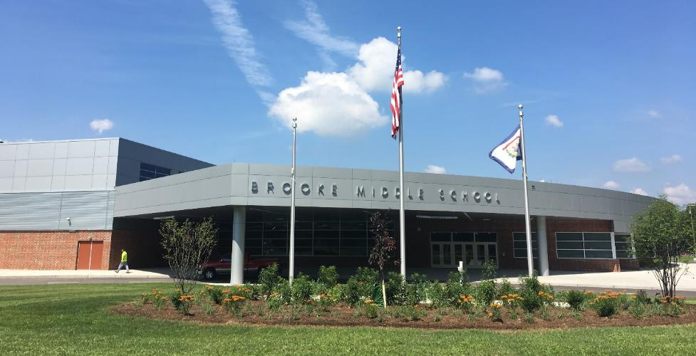
Common Issues in Grant Closeout Processing
SCHOOL BUILDING AUTHORITY OF WEST VIRGINIA
Information not provided in a timely manner
Sworn Statement of Expenditures reflecting incorrect information
  FY Ended Date
  Grant Period not indicating amendments
  Grant Expenditure section not indicating FYs covered in Statement
  Incorrect Addition
Not responding to emails requesting closeout requirements
Entrance of the new Brooke Middle School – Brooke County

Slide 11
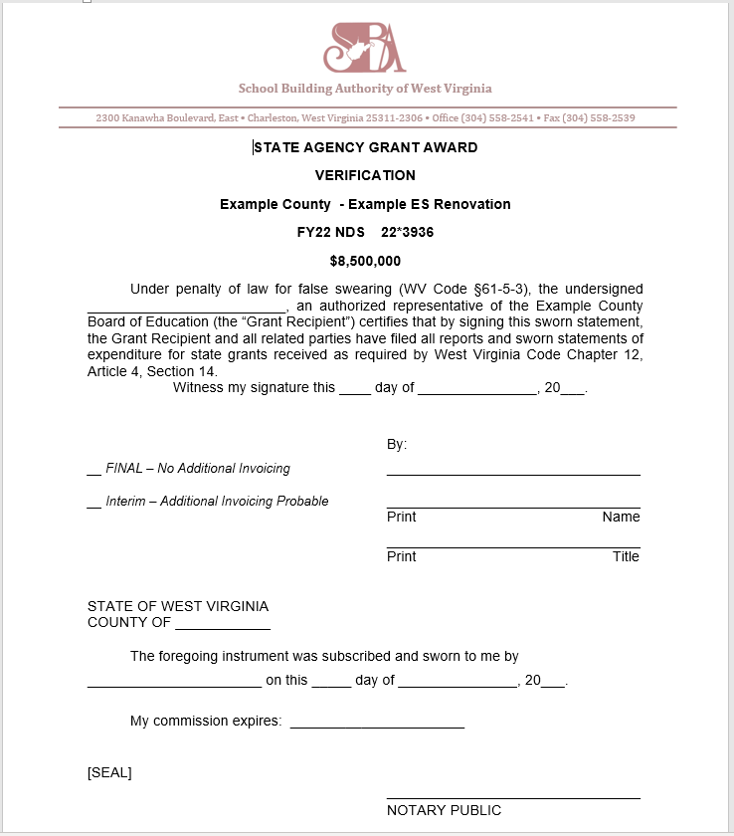
Grant Closeout Form Examples
SCHOOL BUILDING AUTHORITY OF WEST VIRGINIA
SAGA Verification Form

Slide 12
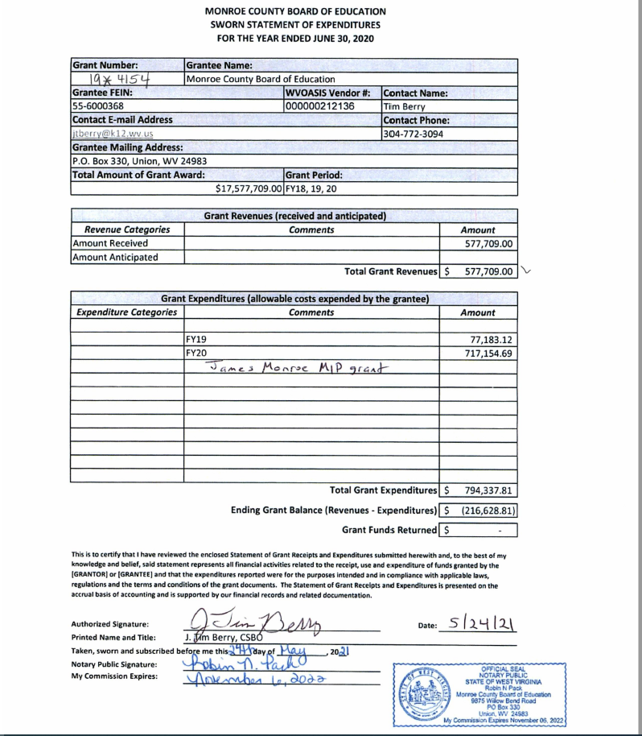
Grant Closeout Form Examples (Continued)
SCHOOL BUILDING AUTHORITY OF WEST VIRGINIA
Sworn Statement of Expenditures

Slide 13
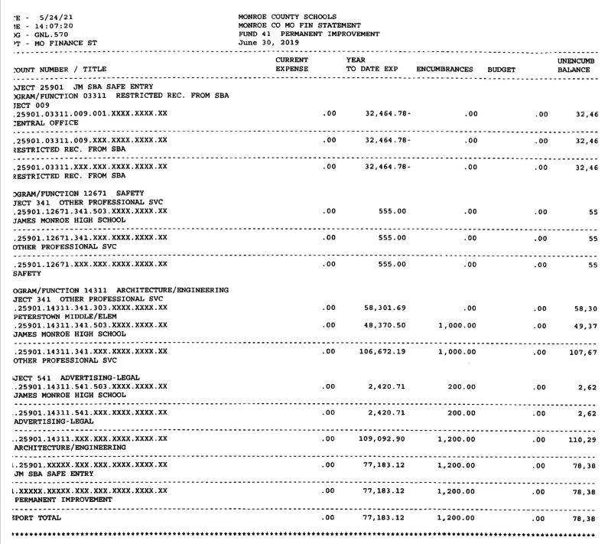
Grant Closeout Form Examples (Continued)
SCHOOL BUILDING AUTHORITY OF WEST VIRGINIA
WVEIS Backup Information
13

Slide 14
Contact Information
SCHOOL BUILDING AUTHORITY OF WEST VIRGINIA
School Building Authority of West Virginia
2300 Kanawha Blvd., East
Charleston, WV 25311
304-558-2541
sba.wv.gov
Jordan.L.Kirk@wv.gov
14

