Slide 1
School Based Health Services: Annual Medicaid Cost Report and Cost Settlement Training
Fall 2022
Public Consulting Group, LLC

Slide 2


Agenda
03 | Cost Settlement Overview
09 | Cost Settlement Components
13 | Quarterly and Annual Financials
16 | Claiming System
18 | Annual Cost Report Components
49 | Cost Report Next Steps
61 | Deadline and Contact Information

Slide 3
Cost Settlement Overview
What is Cost Settlement?

Slide 4

School Based Health Services Overview
The School Based Health Services (SBHS) program allows for a recovery of a portion of the costs associated with providing health-related services to Medicaid eligible special education students.
Medicaid will reimburse a portion of the costs counties incur based on what is allowable and outlined in the Centers for Medicare and Medicaid Services (CMS) approved state plan amendment.
The SBHS program reimbursement is based on the county’s actual cost of providing eligible direct medical services (DS), and specialized transportation services to students who are Medicaid-eligible and have an Individualized Education Program (IEP).

Slide 5
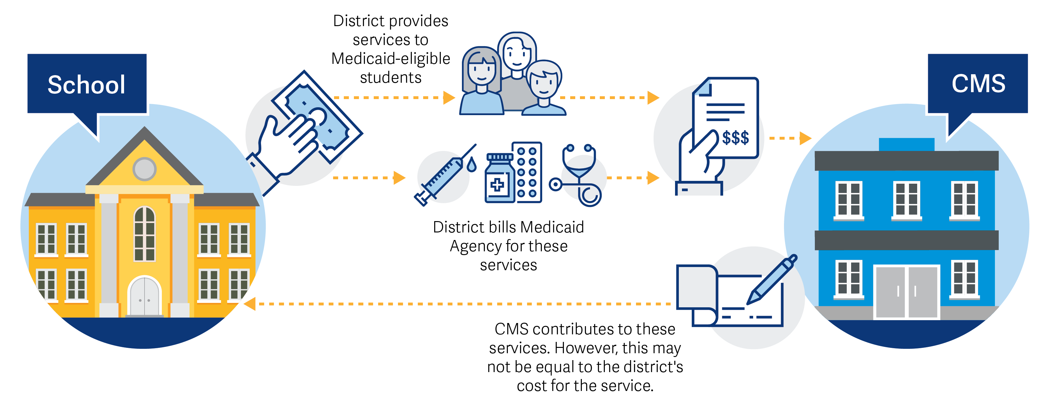
Why is there a Cost Settlement Process?
Cost settlement ensures that counties are reimbursed appropriately with a cost-based reimbursement methodology to determine the actual cost of delivering SBHS related services to special education students.
Cost Settlement compares ACTUAL COSTS to MEDICAID INTERIM PAYMENTS (received through regular Fee-for-Service billing).

Slide 6








Cost Settlement Process Summary
LEA receives payment through periodic Interim Payments
Joe, who is eligible for Medicaid, requires speech therapy per his IEP
Sally logs the service
LEAs complete the Annual Cost Report to determine the costs for providing services such as Sally’s speech therapy services
LEA adds eligible providers like Sally, a speech language pathologist, to their SPL
The service is billed to Medicaid in the form of a submitted Medicaid Fee-For-Service (FFS) claim
Joe receives speech therapy from Sally
Cost settlement calculates the difference between the identified costs for services and the reimbursement received from Interim Payments
Medicaid pays for the service at the established Medicaid Rate Schedule

Slide 7


Cost Differences Across the State
Cost settlement helps ensure counties receive the right amount of reimbursement because county costs can vary across the state.
Costs
Costs
Employs 2 Occupational Therapists for $50,000 each
($100,000 total)
Employs 2 Occupational
Therapists for $60,000 each
($120,000 total)
Utilization
Utilization
County A
Each Occupational Therapist has a case load of 1:10
(20 students total)
Each Occupational Therapist has a case load of 1:10
(20 students total)
County B
Cost Per Student
Cost Per Student
$5,000
$6,000

Slide 8
Cost Settlement Scenarios
The Annual Cost Report is a requirement for LEAs to report their actual costs for providing SBHS services in order to reconcile with the interim revenue received.
If the county’s Medicaid Allowable Costs are less than the interim payments received, the LEA will pay back the difference, refunding the amount due.
Medicaid Allowable Costs | Interim Payments Received | Settlement Due
$100,000 | $110,000 | ($10,000)
LEA owes back $10,000
      If the county’s Medicaid Allowable Costs exceed the interim payments received, the LEA will receive a payment for the amount due.
Medicaid Allowable Costs | Interim Payments Received | Settlement Due
$120,000 | $110,000 | $10,000
LEA is owed $10,000

Slide 9
Cost Settlement Components
What are the different components of the Cost Settlement process?

Slide 10






SBHS Program Components
Random Moment Time Study (RMTS)
Staff Pool List
Cost Settlement or MAC claim
Logging and Billing Services; Receive Interim Payments
$$$
Quarterly & Annual Financials
The process begins with the Staff Pool List
10

Slide 11


What is the SPL and RMTS?
Staff Pool List (SPL)
Random Moment Time Studies (RMTS)
The SPL is the foundation of both the MAC and Annual Cost Settlement process and is certified four times per year.
The SPL indicates who at your county provides services on behalf of the MAC/SBHS program. ALL employees who perform Medicaid eligible services should be included on the appropriate cost pool, UNLESS:
100% Federally Funded
Direct Service Contracted Employee
July – September SPL is not an active quarter to receive moments. Only direct replacements can be made. No new positions can be added and no obsolete positions can be removed at this time.
The RMTS process is a federally approved technique of producing a statistically valid sampling of randomly selected moments (one moment = one minute) that are assigned to randomly selected participants.
Each county’s SPL or “list” of staff employees is eligible to RMTS moments and respond to the survey.
This study determines the portion of time individuals spend doing reimbursable activities.

Slide 12
RMTS Best Practices
Each moment has value. Moment percentages directly tie into the total reimbursement to each LEA, which could provide for extra staff positions, needed supplies, or new programs in the district.
If the statewide compliance (response) rate for a quarter does not reach at least 85%, the Bureau for Medical Services (BMS) will send out a non-compliance warning letter to each LEA that didn’t achieve 85% compliance. Please remember to monitor your compliance percentage for each of your cost pools.
  LEA’s that are issued a warning letter will need to submit a corrective action plan to DHHR/BMS within 30 days of receiving the letter. If the LEA has a non-response rate greater than 15% for two consecutive time study periods, the state will implement consequential action such as fiscal penalties to the district.
Each staff pool must answer at least 2,401 valid working moments.

Slide 13
Quarterly Reports and Annual Financials

Slide 14

Differences Between The Two Reports
Q1
365
Quarterly Reports
Annual Reports
Costs associated with Medicaid Administrative Claiming (MAC)
Costs associated with Direct Service (DS) and Specialized Transportation
Report costs for direct service staff (except for direct service contractors), support staff, and administrative staff
Report costs for direct service and specialized transportation staff (including direct service contractors)
Cash Accounting (date of PAYMENT driven reporting)
Accrual Accounting (date of SERVICE driven reporting)
Cost report provides an additional revenue stream in addition to funding for provision of direct medical services
Cost report tied directly to the interim revenue that an LEA receives through Medicaid billing for SBHS services

Slide 15
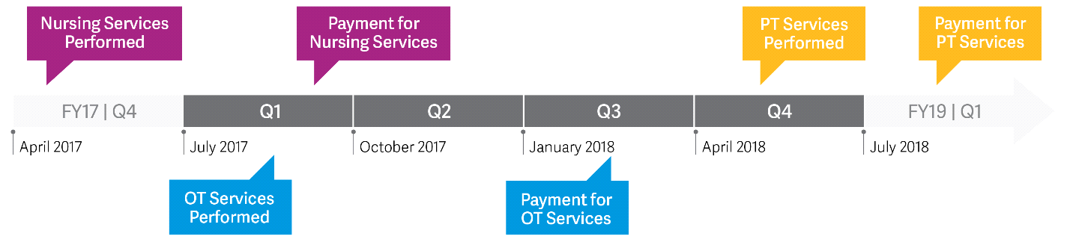
Cash Basis VS. Accrual Basis
FY21 Q4
FY23 Q1
April 2021
July 2021
October 2021
January 2022
April 2022
July 2022
July
202
1
 | Claim on Quarterly (FY22)? | Claim on Annual (FY22)?
Nursing Services | YES, these costs would be claimed in Q1 when they were paid | NO, the payment is for services rendered outside of the fiscal year and cannot be claimed in the FY22 annual report. Costs should have been claimed on the FY21 annual report.
OT Services | YES, because the services were paid for in Q3 of FY22 | YES, because the services were rendered during FY22
PT Services | NO, these costs would be claimed in Q1 of FY23 because that is when they were paid | YES, even though these services were paid in a different fiscal year, the services were performed during FY22

Slide 16
Claiming System

Slide 17
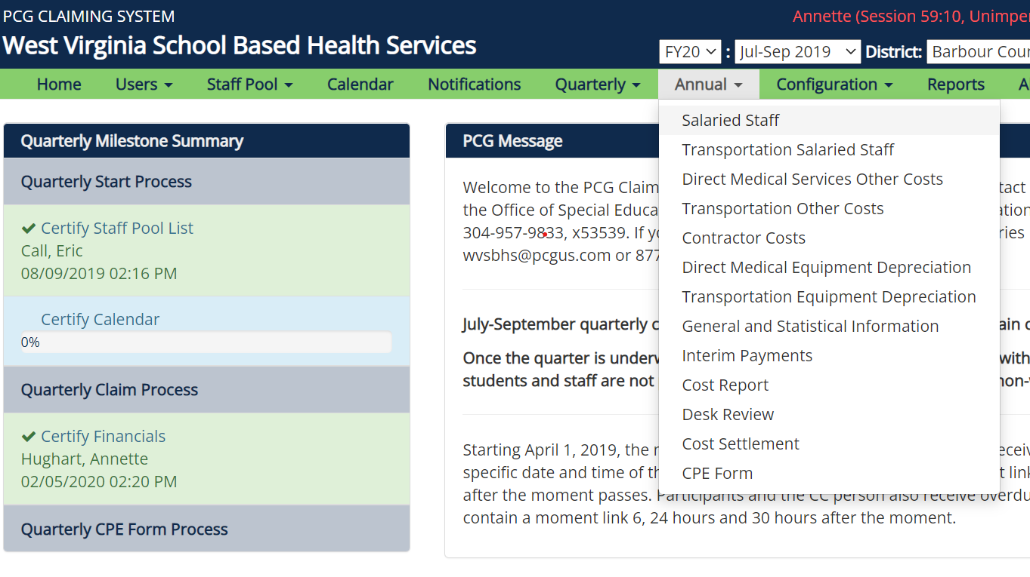

Navigating the Claiming System
2
1.
Log into the claiming system at:
FY22
2021
https://claimingsystem.pcgus.com/wv
2
2.
Choose the appropriate Fiscal Year (FY22). NOTE: For the Annual Cost Report – the Quarter does not matter
2
3.
Navigate to the “’Annual’ section and work through the report

Slide 18
Annual Cost Report Components

Slide 19



Cost Reporting Elements
  The cost reimbursement methodology includes the following main cost elements:
Direct Medical Services Costs
Specialized Transportation Costs
Indirect
Costs
Costs related to the provision of direct medical services
Costs related to the provision of specialized transportation services
Costs related to indirect overhead costs

Slide 20

Cost Report Components
Direct Medical Costs

Slide 21
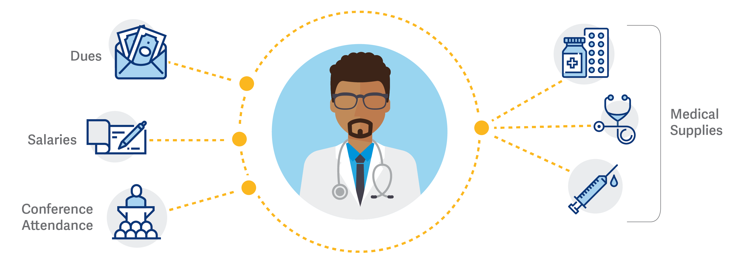

Direct Medical Services Costs
Benefits
Direct Service Contractors
Salary, Benefits, and Contractor
Direct Service providers on the Staff Pool List and Direct Service Contractors are the only individuals included on the Annual Cost Report.
  Note that Administrative Personnel
  are not included on this report.
Materials and Supplies
Materials and supplies on the CMS List of Allowable Materials and Supplies

Slide 22

Direct Medical Services Providers
Audiology Services
Occupational Therapy Services
Speech, Language Pathology Services
All Annual Cost Report costs must pertain to one of the following service types:
Nursing Services
Physical Therapy Services
Psychological Services
Personal
Care &
Targeted case
Management

Slide 23
Salary and Benefits

Slide 24


Personnel Costs: Eligible Salary Costs
Be mindful of the Job Span Toolbar for each staff member. Although this is an Annual cost report, you may only report costs relevant to each staff member’s length of time on the staff pool list
GROSS SALARY
Report gross salary earned for services delivered while actively listed on the Staff Pool List.
This includes:
Regular Wages
Extra Pay / Overtime
Paid Time Off (PTO)
Sick Pay
Bonuses
Longevity
Any amounts paid to retiring staff must be reported on the cost report for the school year the staff member retired.
For example, if John Smith retired on June 30, 2022 – all PTO/Sick Time payout should be reported on the FY22 annual cost report, even if it was paid in FY23.
.
Do not reduce the salary cost for any pre- and post- tax employee deductions

Slide 25


Personnel Costs: Eligible Benefit Costs
Make sure to include all county or state-paid retirement and social security costs
BENEFITS
Eligible benefits include county or state paid benefits on behalf of staff members listed on the Staff Pool List.
This includes:
Health, Life, Disability, Dental Insurance
Workers’ Compensation
FICA (Social Security & Medicare)
Retirement Contrib.
Benefits should be prorated for the accrual months based on both Staff Pool List participation and months worked.
For example, if John Smith is on the staff pool list for 7 out of the 10 months that he worked, then 70% of benefits should be reported
Do not include any employee deductions as benefit costs. Only report the county or state incurred portion of benefit costs.

Slide 26
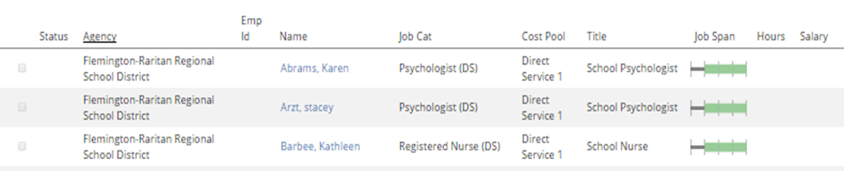


Personnel Costs: Job Span Bar
The job span bar indicates when that individual was listed on the SPL as a direct service provider for the year. Only costs during the time shown on the job span bar may be included on the annual report.
Note: Although the individual may have worked the entire school year, they may not have been listed on the Staff Pool List for the entire school year. The job span tool bar measures the exact time that an individual is listed on the SPL, therefore the amount of time for which the position’s costs are eligible to be recorded on the Annual report.

Slide 27
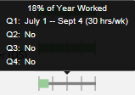
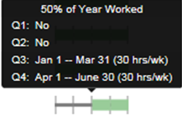
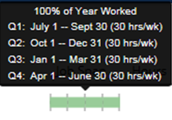
Job Span Toolbar Examples
Always refer to the Job Span Toolbar to determine allowable costs
1.
Costs can be recorded for services provided from July 1st to September 4th
2.
Costs can only be recorded for eligible services provided when included on the SPL for the third and fourth quarter, from January 1st to June 30th.
3.
Full annual costs can be recorded.

Slide 28



Common Reporting Scenarios
1.
New Position
Assuming this Psychologist is a 10-month employee - Even though this staff member is on the staff pool list for 75% of the fiscal year, the costs that should be claimed should be calculated for accrued costs based on the time period they were on the staff pool list.
2.
Retired Position
Assuming this Speech Language Specialist retired at the end of the last reporting school year, you should NOT report any salary or benefit costs regardless if they were paid during the current reporting year. Whenever applicable, counties can make direct replacements for any position on the staff pool list.
3.
Leave Of Absence
Assuming this Speech Therapist was on leave during the time period of January-April, even though the county may have incurred salary or benefit cost during this time, you should only report the accrued costs based on the time period they were on the staff pool list. Counties can make a direct replacement if this position was temporarily replaced.

Slide 29
Contractor Costs

Slide 30
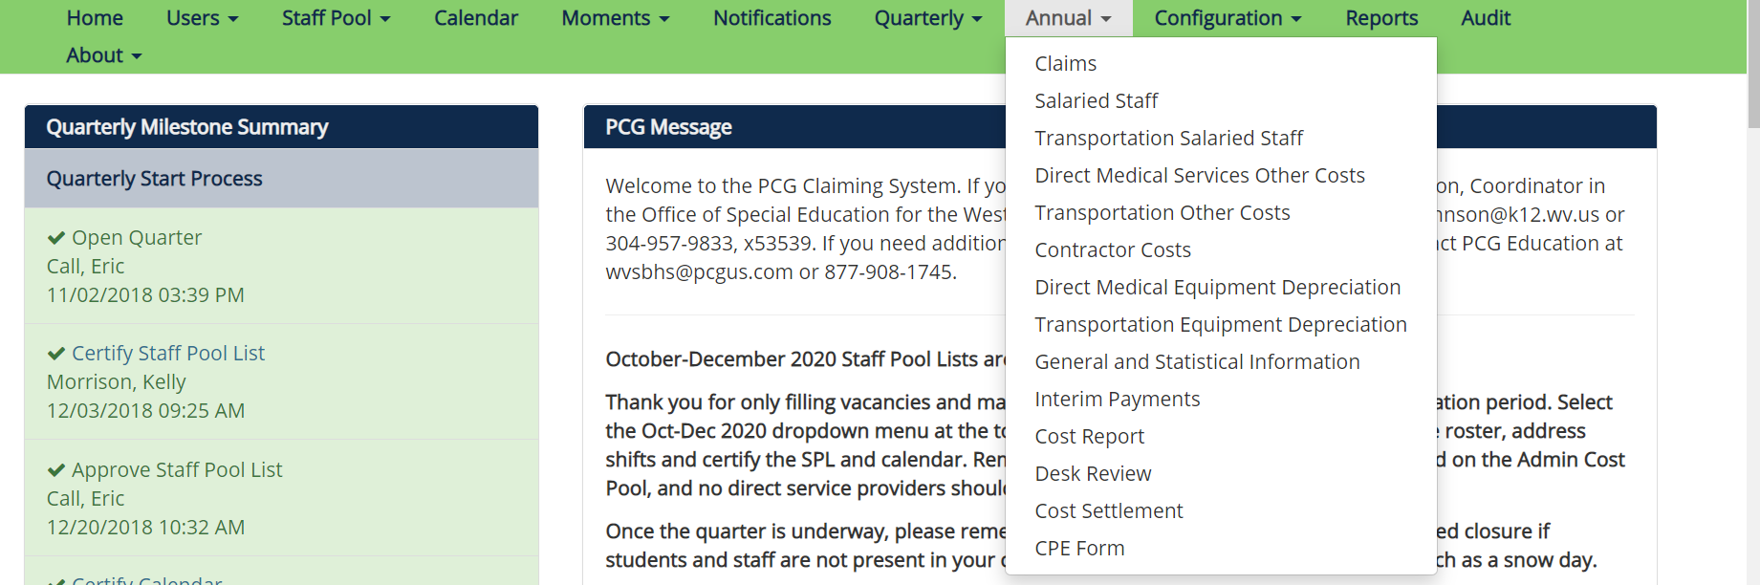
Contractor Costs
Direct Medical Service Contractors are NOT listed on the Staff Pool List and are NOT included in the Random Moment Time Study
For the Annual Cost Report, counties may include costs for these contractors in the “Contractors” section of the cost report.
Please note that Direct Medical Service Contractors should only be reported on the Annual Cost Report and not the Quarterly Cost Reports
Notes:
A

Slide 31
Materials and Supplies

Slide 32
Materials and Supplies
Materials and supplies must fit the following criteria:
Materials and supplies must fit the following criteria:
Do NOT include any materials and supplies that:
Included on the CMS List of Allowable Materials and Supplies (Refer to the “Resources” section of the Claiming System Homepage).
Are applicable to ONLY general education students.
Pertain to special education students.
Tie back to direct medical needs identified in the student’s IEP.
Are federally funded costs
Are individual items costing more than $5,000.
These should be depreciated in the depreciation section

Slide 33




Materials and Supplies Examples
iPad used as an
e-book for special education students
Audiology testing materials used by special education students
Wheelchair used by special education student
Not allowable because it is not on the CMS approved list of materials and supplies
Allowable because it is on the CMS approved list of materials and supplies and is used for special education students
Allowable because it is on the CMS approved list of materials and supplies but must be depreciated if over $5,000

Slide 34
Ratios

Slide 35




Direct Medical Percentage
The purpose of this percentage is to identify the percentage of time providers spend, on average, performing eligible direct medical services
Calculated from the results of the quarterly Random Moment Time Study (RMTS) - the average results of the three quarterly time study periods (Oct – Dec, Jan – Mar, and
Apr – Jun) that occurred during the fiscal year
It is a state-wide percentage and is not county specific
This percentage is applied to the Direct Medical Service Costs and directly affects the cost settlement for every county

Slide 36

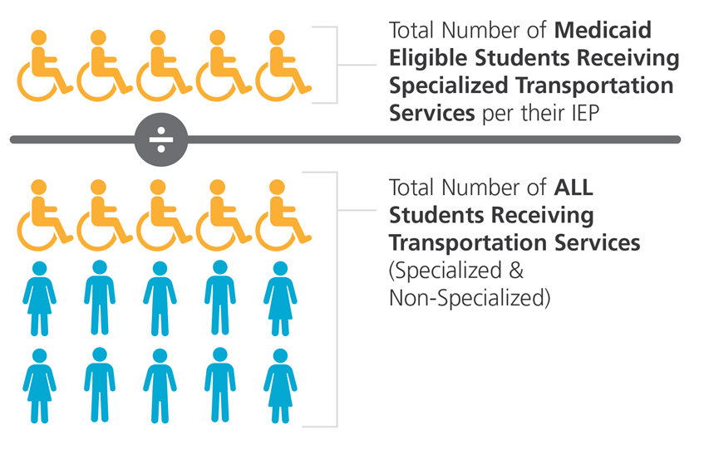
Individualized Education Program (IEP) Ratio
The Individualized Education Program Ratio identifies the portion of costs that pertain to the delivery of direct medical services specifically to Medicaid-eligible special education students
Total Number of Medicaid Eligible Special Education Students with an IEP Prescribed Direct Medical Service
Total Number of ALL Special Education Students with an IEP Prescribed Direct Medical Service

Slide 37

Cost Report Components
Specialized Transportation

Slide 38
Transportation Reimbursement
Specialized Transportation services include:
Travel to and from a Medicaid covered direct IEP service to be rendered on school premises or another location
Use of a specially adapted vehicle (such as a specially adapted bus or van)
Specialized transportation included on the IEP as a separate service
LEA is reimbursed for Specialized Transportation if:
Vehicle has modified specialized equipment
Transport occurs on the same day student receives a direct medical service
Written in IEP (retain copies)
Keep bus logs of one-way trips
Bill Medicaid & log service

Slide 39




Specialized Transportation Costs
DHHR has indicated that only a bus with a lift meets the criteria to provide specialized transportation.
Only buses with a lift and their associated drivers would be considered specialized transportation.
This vehicle must be used to transport a student who has specialized transportation listed in their IEP.
An IEP alone is not enough to qualify transportation as specialized – Medicaid will not cover transportation costs for (as an example) a student with Speech Therapy in their IEP who is able to ride a regular school bus.

Slide 40








Types of Transportation Costs
Counties may report salary and benefit costs for drivers, bus aides, and mechanics who provide specialized transportation
Counties may report costs for Renting or Contracting specialized transportation services
Counties may report insurance for all vehicles which provide specialized transportation
Counties may depreciate costs for all vehicles which provide specialized transportation
Counties may report fuel and oil for all vehicles which provide specialized transportation
Counties may report repairs and maintenance for all vehicles which provide specialized transportation

Slide 41






Reporting Only Specialized or Not Only Specialized Cost
Only Specialized Transportation
Costs that can be attributed exclusively to specialized transportation students only
Bus/Van | Bus Driver | Contract Transportation Services | Mechanic | Maintenance and Repairs, Fuel and Oil, & Insurance
 | 3
ONLY SPECIALIZED
Vehicle only transports specialized transportation students and no other types of students
Bus driver only transports specialized transportation students and no other types of students
Contract is specifically for transportation of only specialized transportation students and no other types of students
Mechanic only works on vehicles that are categorized as Only Specialized
These additional costs are only for vehicles that are categorized as Only Specialized
Not Only Specialized Transportation
Costs that are attributed to a mix of specialized transportation students and general transportation students
NOT ONLY SPECIALIZED
Vehicle transports a mix of specialized transportation students and general transportation students, or vehicle has multiple routes
Bus driver has multiple routes or drives a vehicle that transports both specialized and general transportation students
Contract is for both specialized transportation and general transportation services
Mechanic works on both types of vehicles categorized as Only Specialized and Not Only Specialized
These other costs are for both types of vehicles categorized as Only Specialized and Not Only Specialized

Slide 42
Transportation Service Type: Only and Not Only
 | Only Specialized Transportation | Not Only Specialized Transportation | General Transportation Costs
Report When: | Costs that pertain only to providing specialized transportation services should be reported as ‘Specialized Only’. These are costs that can be isolated from your general transportation costs. | If an LEA is unable to isolate special transportation costs from general transportation costs. | Any costs pertaining to transportation costs for only general education students should not be included.
Example: | Salaries and benefits coded to 227XX (Special Education Transportation) and buses with a wheelchair lift which transport only special education students. | A bus is adapted to transport special education students per their IEP, but also transports general students. Fuel costs may be listed as ‘Not Only Specialized’ if the total fuel cost includes fuel for both specialized vehicles and general transport vehicles. | Unallowable costs that include buses that only transport general education students (including related bus driver salaries) or fuel, maintenance, and insurance costs for these vehicles if separately available in the accounting system.
Ratio(s) Applied: | One-Way Trip Ratio ONLY | Specialized Transportation Ratio AND One-Way Trip Ratio | N/A

Slide 43
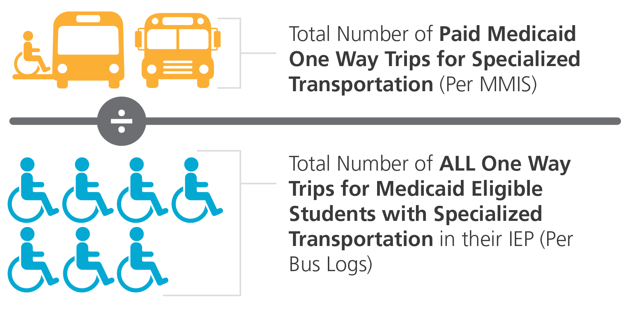
Specialized Transportation Ratios
Specialized Transportation Apportioning Ratios
SPECIALIZED TRANSPORTATION RATIO
ONE WAY TRIP RATIO
The Specialized Transportation Ratio is used when reporting Not Only Specialized Transportation costs:
The One Way Trip Ratio is used when reporting all types of Specialized Transportation costs.

Slide 44

Cost Report Components
Indirect Costs

Slide 45
Unrestricted Indirect Cost Rate (UICR)
The Unrestricted Indirect Cost Rate is used to include additional costs of doing business that cannot be easily identified within a particular grant, contract, or program, but are necessary for the general operation of the organization.
  Example: overhead costs, such as heating or electricity
  The UICR will be prepopulated in the system by PCG based upon county data provided by WVDE
  Example Calculation:
Net Direct Service Costs (less federal funds) | $800,000
Indirect Cost Rate (10%) | .10
Indirect Costs | $80,000
Net Direct Service Costs + Indirect Costs | $880,000

Slide 46
Cost Reporting Best Practices

Slide 47



Non-Allowable Costs: Federal Funds
Costs paid for by the county using federal funds (i.e. IDEA, ESSER, etc.) should not be represented in the cost settlement calculation.
To assure federal funds are properly removed, the county must report costs as a gross amount (State, Local & Federal Dollars) and then identify the federal funds amount (Federal Dollars).
The system will subtract out the federal funds and find the net.
Staff members or costs that are 100% federally funded should not be reported and should not be included on the Staff Pool List.

Slide 48
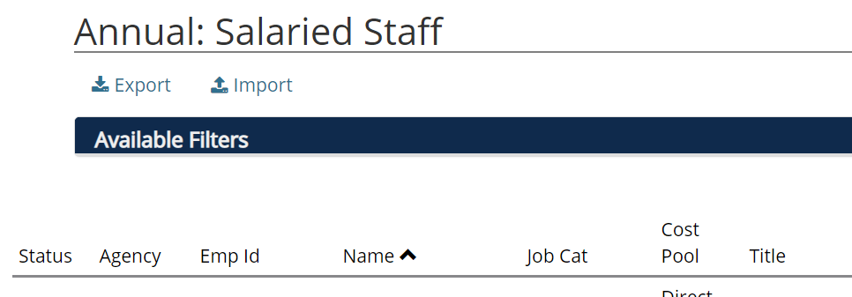

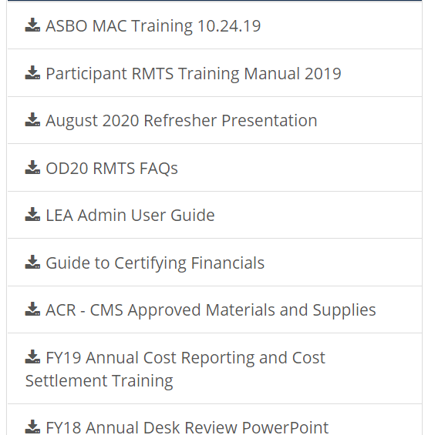
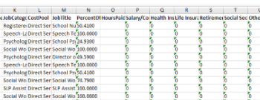
Tips and Hints for Reporting Costs
1
2
Use the export and import
functionality!
Refer to the guides and trainings on the Claiming System homepage

Slide 49
Cost Report Next Steps

Slide 50
Financial Reporting Process
County Submits Cost Report
PCG performs in-depth Desk Reviews
PCG calculates Cost Settlement
Annual Cost Report | Input Salaries, Benefits, Contractor Costs, Materials and Supplies, Staff Travel and Training, Professional Dues and Fees, and Specialized Transportation Costs, Certify Financials in Claiming System on an annual basis. | Reviews all report data for accuracy & completeness. Follows-up with LEA with data concerns and insufficient explanations. Desk reviews help protect LEAs from federal audits | PCG calculates counties’ net settlement amounts and notifies LEAs CPE forms are ready for signature. Authorized Officer of the LEA (CEO, CFO, Superintendent) electronically signs CPE form in the Claiming System.

Slide 51
Upcoming Dates and Timeline
Type | Description | Start | Deadline
MAC | Jul – Sept 2022 Quarterly Financials | October 3, 2022 | November 18, 2022
MAC | Apr – Jun 2022 Desk Reviews | September 21, 2022 | October 10, 2022
ACR | FY22 Annual Cost Report | October 10, 2022 | December 16, 2022
MAC | Apr – Jun 2022 CPE | January 2023 | TBD
MAC = Medicaid Administrative Claiming
SPL = Staff Pool List
ACR = Annual Cost Report

Slide 52
Cost Report Certification and Desk Reviews

Slide 53
Annual Cost Report Certification
Each year, every LEA will need to log into the PCG Claiming System to certify their cost report. This certification tells the State and PCG that your reported costs are complete and have been reviewed for accuracy.
  Review reported costs for accuracy
  Make sure all questions are answered and explanations for warnings are entered if necessary
  Go to FY22 in the PCG Claiming System
  Click on Annual → Cost Report
  Click the green Certify button
  Desk Reviews for each LEA
What do I need to do to certify my cost report?
Make sure your county enters all eligible costs for each section of the Cost Report before certifying and submitting!
What comes next?

Slide 54
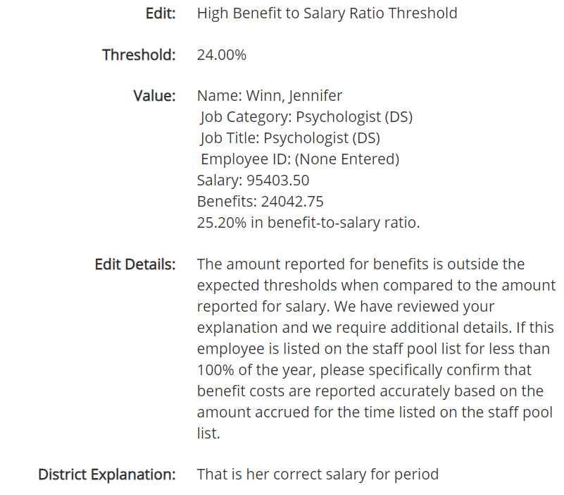
Desk Reviews
In order to help ensure accuracy and completeness of each cost report, at the direction of the State, PCG conducts desk reviews after all cost reports have been certified.
During this time, PCG will review all LEA responses to triggered warnings and thresholds.
Desk reviews help protect LEAs from federal audits and potential pay-back situations.

Slide 55
Desk Reviews
PCG conducts desk reviews in the PCG Claiming System; Communication with LEAs will take place in the system, eliminating back and forth email correspondence.

Slide 56
To Ensure a Smooth Desk Review Process:
  When preparing your cost report, keep clear & organized documentation for ease of reference during the review
  Develop a response plan with your team and coordinate internally to provide requested information
  Confident statements of understanding are necessary! Avoid phrases like “I believe…” or “Somebody told me…”
    If you are not 100% sure if a cost or ratio is accurate and cannot find any supporting documentation, you’ll need to remove the cost
    Respond in a timely fashion
    Look out for any potential follow-up questions from PCG and the State until the review is closed

Slide 57
Common Errors & Potential Audit Risks
1
Reported Salary and Benefit costs are inconsistent with the staff member’s Job Span Bar, which is their allowable claimable time listed on the Staff Pool List
2
Salary and Benefit documentation does not align with what is reported in the PCG Claiming System
If you have any questions about documentation and allowable costs,
don’t ever hesitate to reach out to PCG!
PCG should always be your first point of contact!
3
Counties who do not report Direct Medical Service Other costs could be leaving funding on the table
4
Transportation costs are not correctly categorized as either “Only Specialized Transportation” or “Not Only Specialized Transportation”
What does your documentation support?
5
Costs paid with federal funds have been included on the Cost Report without reporting federal funds in the appropriate fields

Slide 58
Cost Settlement Calculation and CPE Form

Slide 59
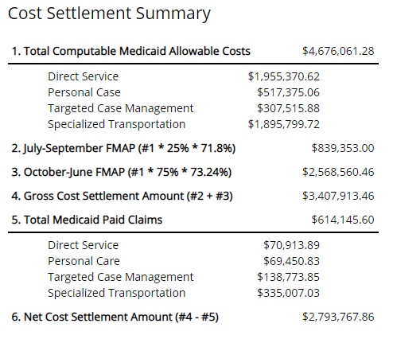
Cost Settlement Calculation
Find this by going into the PCG Claiming System. Choose a previous fiscal year, click “Annual” → Cost Settlement.

Slide 60

Certification of Public Expenditure (CPE) Form
Signing off on your Certification of Public Expenditures Form confirms for the federal government that all costs and ratios are reported accurately and supported by documentation.
Signing off on your Certification of Public Expenditures Form will be done in the PCG Claiming System using electronic signature.
This page will not be available to view until the cost settlement amount has been finalized, and your county has approved the settlement amount.
“I am the officer authorized by the referenced government agency to submit this form and I have made a good faith effort to assure that all information reported is true and accurate.”

Slide 61
Deadline and Contact Information

Slide 62

Annual Medicaid Cost Report – FY22 Deadline
This is due in the PCG Claiming System site by Friday, December 16th.
Make sure your county enters all eligible costs for each section of the Cost Report before certifying and submitting!

Slide 63

Contact Information
If you have any questions about the Annual Medicaid Cost Report, or the Cost Settlement process, please reach out to us!
Public Consulting Group
WVSBHS@pcgus.com
1-877-908-1745, Ext 3

Slide 64
Thank you for joining us today!
Questions/comments after today’s session?
Please contact us at WVSBHS@pcgus.com

