Slide 1
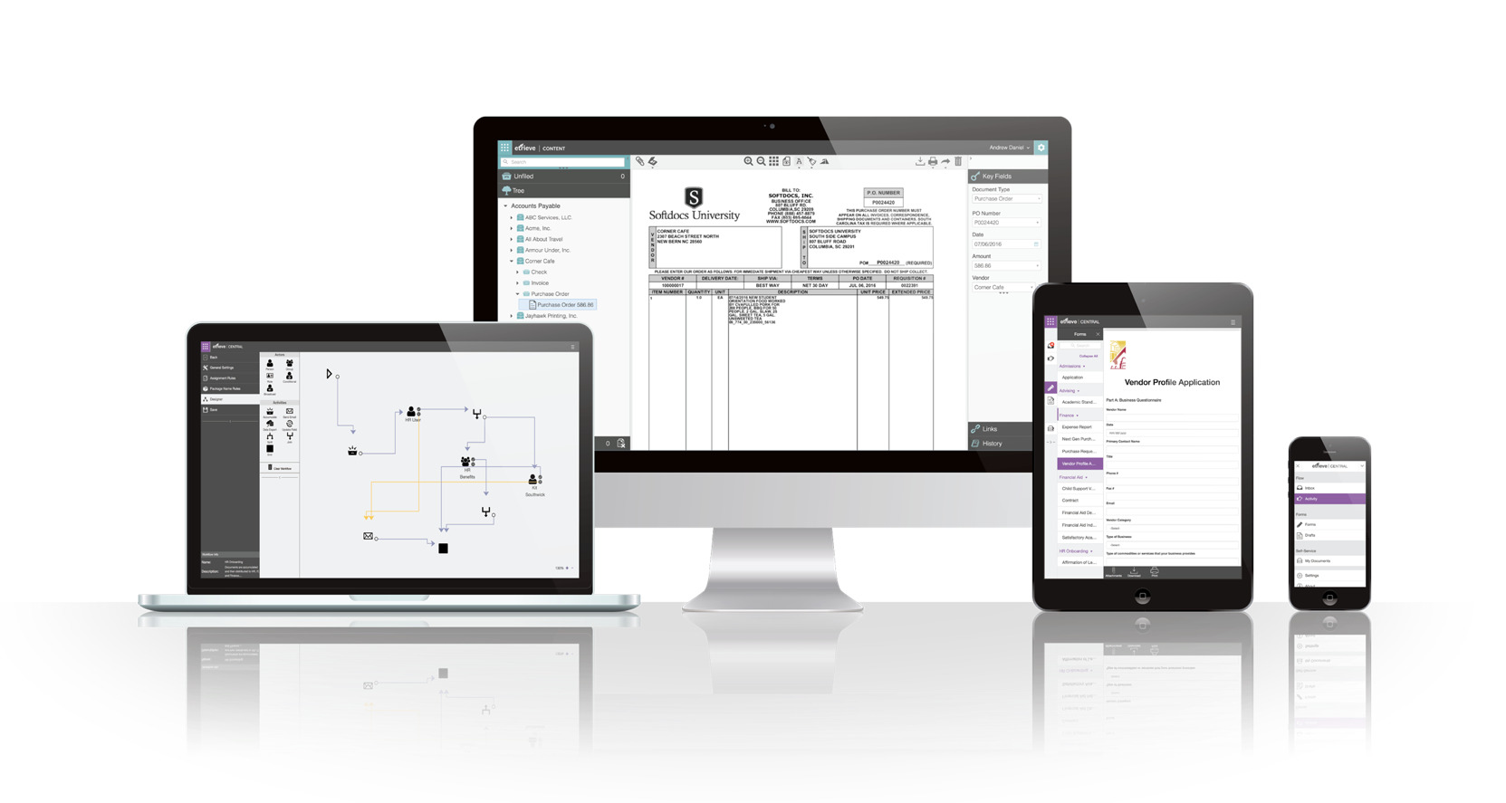
Document Management & Campuswide Process Automation

Slide 2

AGENDA
Wood County Schools & Softdocs:
Partnering to Accelerate Process Automation
Wood County’s Story of Efficiency Gains and Continuation of Services
Hosted by:​
Whitni Kines| Finance Director| Wood County Schools​
Corey Davis| Client Success Manager| Softdocs

Slide 3

AGENDA
Today’s
Agenda
Preparing for Growth
Introductions
WV School District Challenges
The Solution
The Wood County Story
Questions – Let’s Dive Deeper
Wrap it up!

Slide 4
Introductions
Whitni Kines
  Finance Director of Wood County Schools
Corey Davis
  Client Success Manager for Softdocs – Serving Softdocs’ K-12 Clients
  Has been with Softdocs for 7+ years
  Has been in Support, Services & Client Success roles at Softdocs
Lanie Hudson
  K-12 Account Executive for Softdocs
Scott McQueen
  K-12 Solutions Director for Softdocs

Slide 5

Wood County Schools
Softdocs client since FY2019
RY2K Virus November 2020 – data not compromised
Leveraging Softdocs’ Etrieve Platform for electronic forms, workflow automation, and content management
    Purchase Requisition Import to WVEIS – FY2022
Also leveraging Serve, Softdocs print customization tool
    File copies of PO, AP Check, Payroll Check
Notes:
TERESA

Slide 6



Softdocs Overview
Softdocs is a provider of Enterprise Content Management, Electronic Forms, and Workflow solutions, focused on building a world without inefficiencies – and removing technology barriers so that you can focus on the hard work of impacting students’ and staffs’ lives.
Exclusively serving the education marketplace for over two decades with more than 700 clients
Clients ranging in size from 500 to over 80,000 students
Trusted partner with over 250 School Districts in the US.

Slide 7
Declining Enrollment = Decreased Funding:
Home Schooling, Public Charter Schools,
Potential Public Support of Non Public Educational Choices
Challenges faced by
WV School Districts
Decreased Funding impacts all aspects – specifically personnel. Finance Departments have not been spared.

Slide 8
Increasing amounts of reports and data to maintain.
Potential pitfalls of paper documentation
  Time requirement for filing
  Space requirement
  Human error
  Record research cumbersome and time consuming

Slide 9
Cybersecurity continues to be a primary concern, as educational institutions are getting attacked more than ever.

Slide 10
Cloud-based and mobile-accessible technology solutions like Softdocs’ Etrieve Platform can help address these challenges – securely!
Through its partnership with Softdocs, Wood County Schools is working to resolve these challenges and progressing!

Slide 11




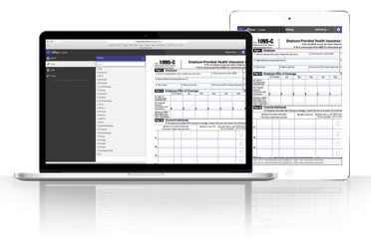





Softdocs’ Solution

Slide 12
Wood County Live Demo
Requisitions Check Issuance
All with documented approvals as required by policy – plus documentation of inquiries, and resolutions to boot!

Slide 13
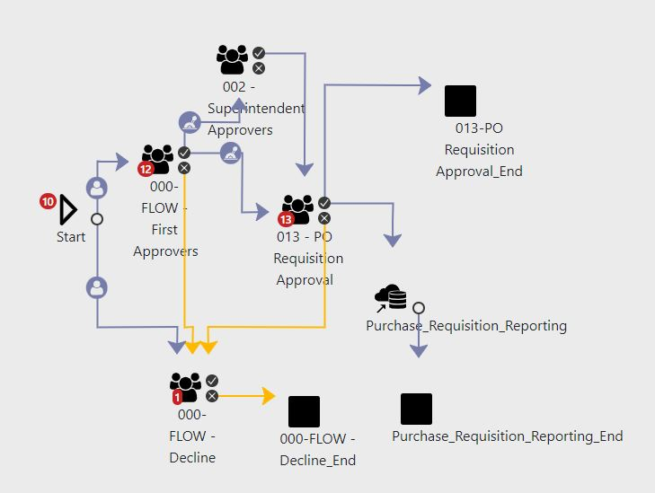
Purchase Requisition Approval Workflow

Slide 14
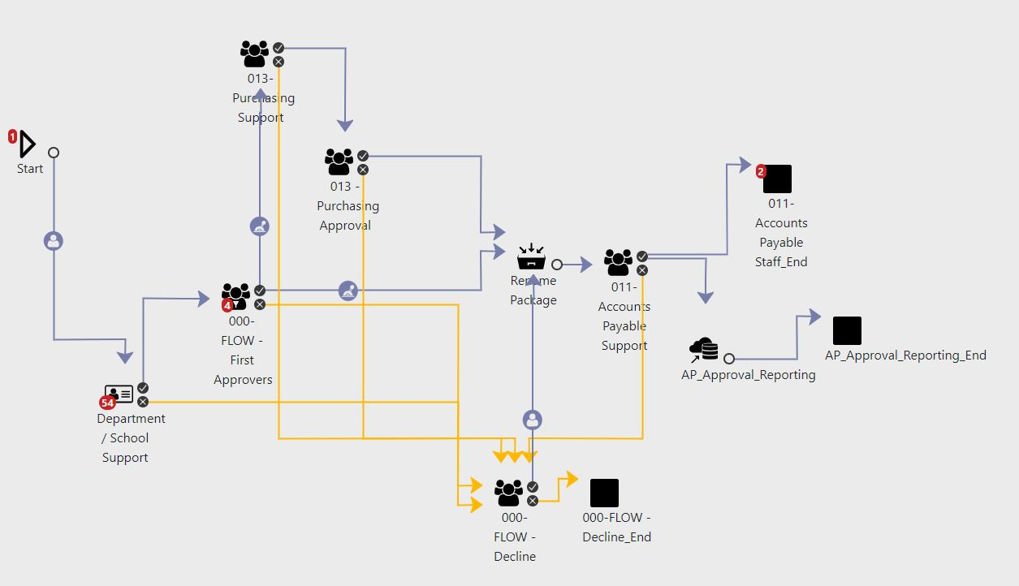
AP Origin – Invoice Approval Workflow

Slide 15
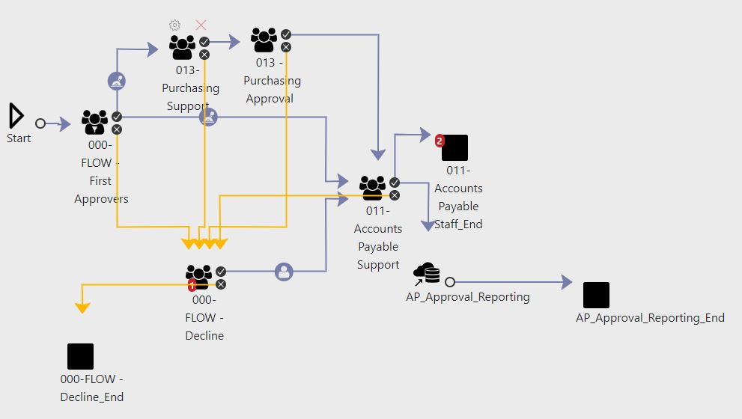
School Origin – Invoice Approval Workflow

Slide 16
Q:
What led you to kick-off this strategic initiative to implement your Finance related processes and forms live in Etrieve?

Slide 17
Q:
Can you point to any clear benefits realized by being on the cloud version of Etrieve?

Slide 18
Q:
As you continue to grow and adapt, what areas or processes do you plan to tackle with Etrieve next?

Slide 19

THANK YOU!
Whitni Kines | whitni.kines@k12.wv.us,
Corey Davis | cdavis@softdocs.com

