Slide 1
Certified List of Personnel
Kim Harvey, WVEIS Consultant
419-202-9898
knharvey@k12.wv.us

Slide 2
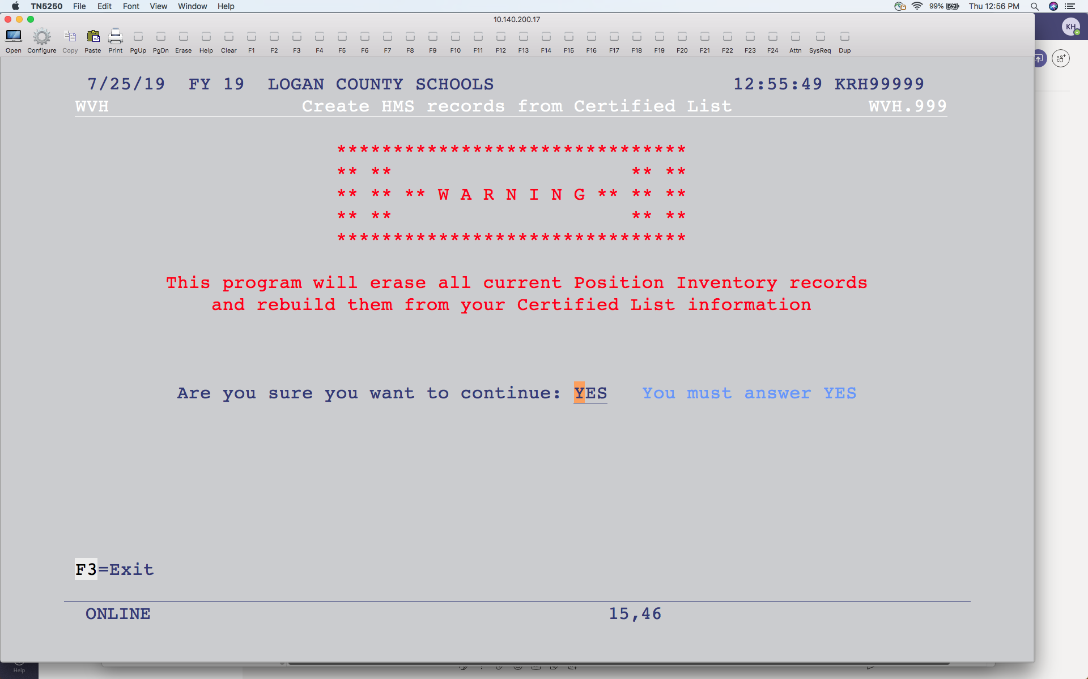
Creating Position Inventory from CL
Notes:
The first thing you may want to do is copy last year’s certified list to create the Position Inventory for this year. This program is optional and should be used only if you haven’t been maintaining position inventory throughout the year. You will find the program on the WV Employee Data Reports menu – WVH.999 – Load HMS Position Codes from Certified List. It will also be on the Position Control System Utilities menu. The warning will display if you have information in your position inventory for the year you are signed into. Answer YES to replace your current position inventory with the last CL file.

Slide 3
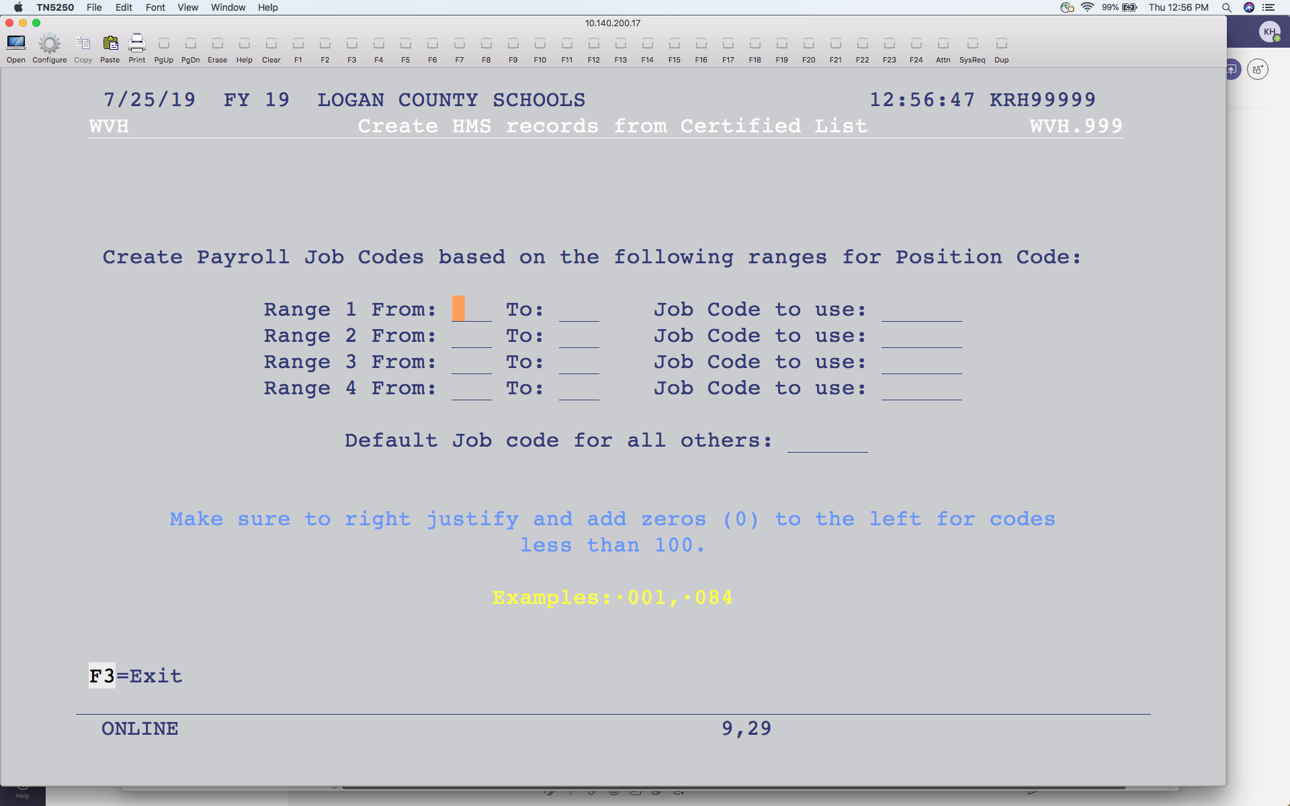
Creating Position Inventory from CL
Notes:
You can enter the range of position codes and the Payroll Job Code they are connected to. For example, 100-499 would have a job code of PROF and 500-699 would have a job code of SVC or whatever job codes payroll uses. Enter a default job code for anything outside the ranges specified. This will create the Position Inventory based on the last Certified List.

Slide 4
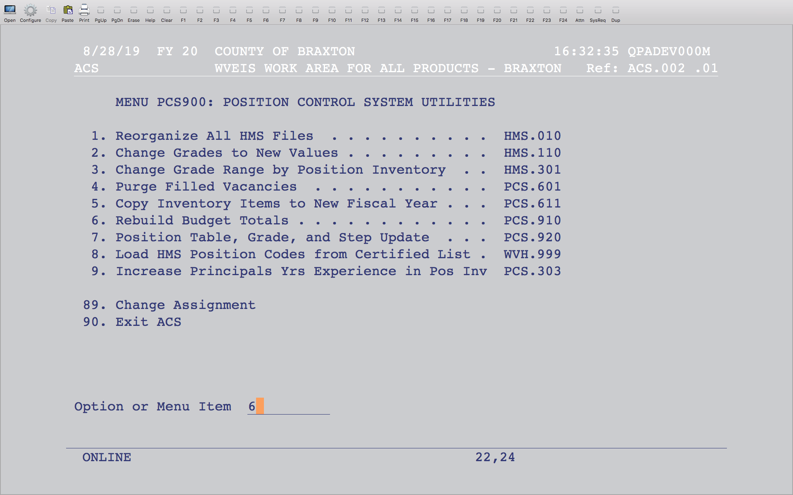
Notes:
If you ran the program to create the position inventory from last year’s certified list, run this program to recalculate the head count.

Slide 5
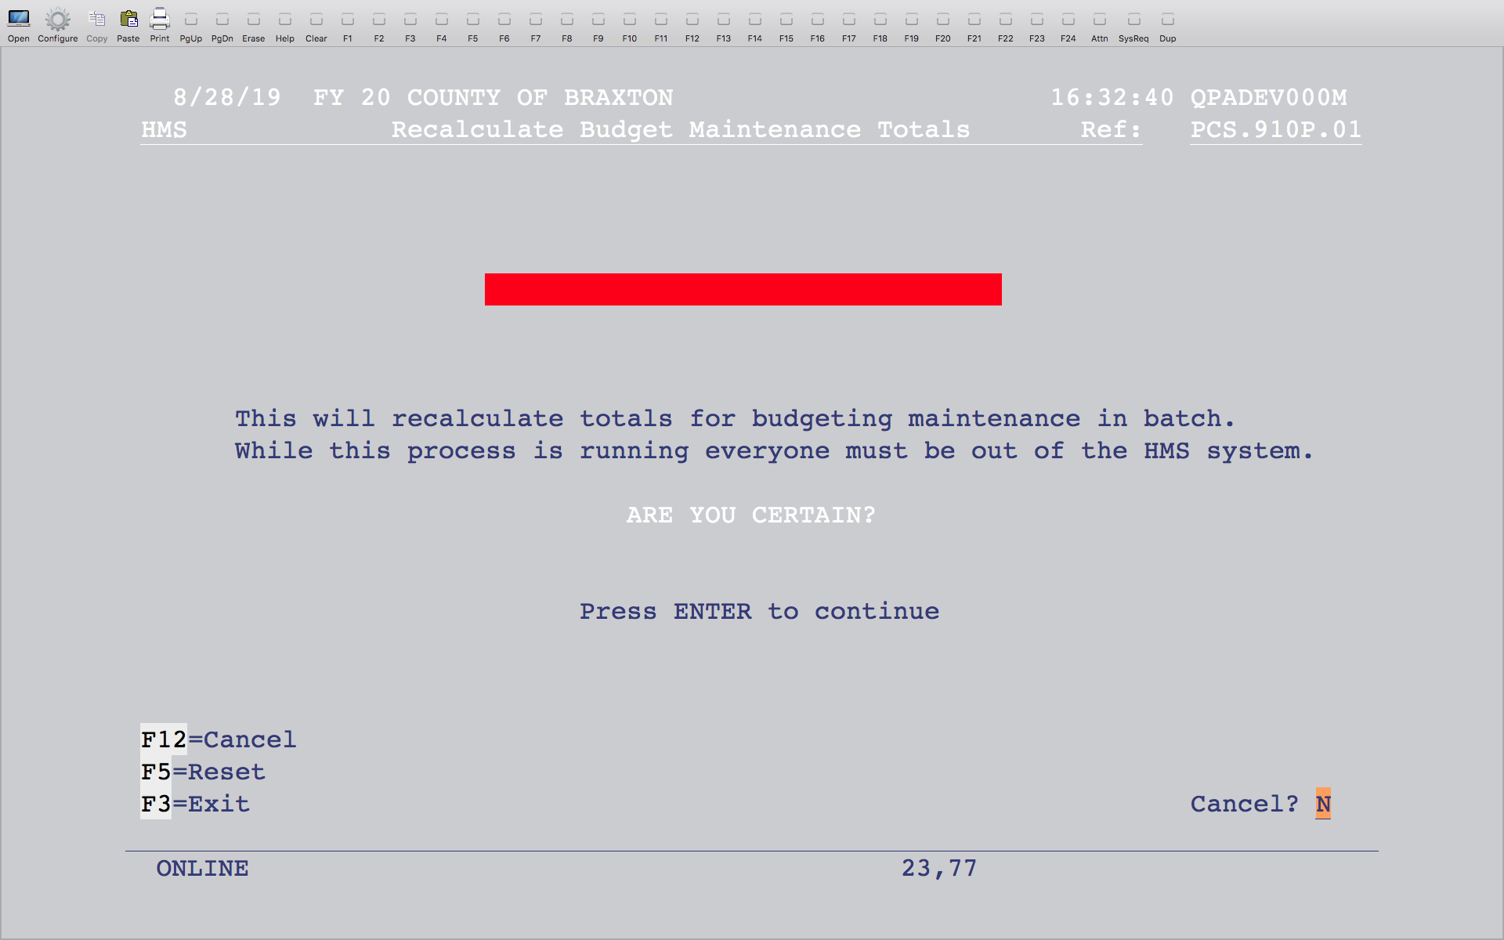
Notes:
Hit enter.

Slide 6
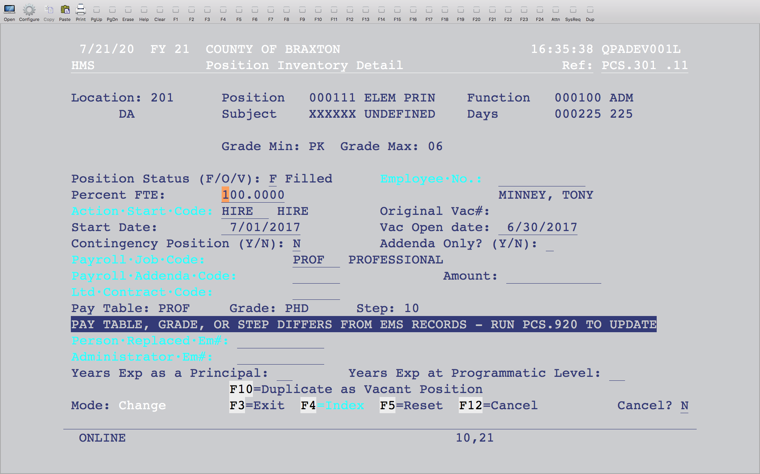
Principal step in Position Inventory
Notes:
The newer fields that have been added to the Position Inventory program to maintain years experience for principals display at the bottom and can be manually entered or bumped up by 1 using the bump up program - PCS.303.

Slide 7
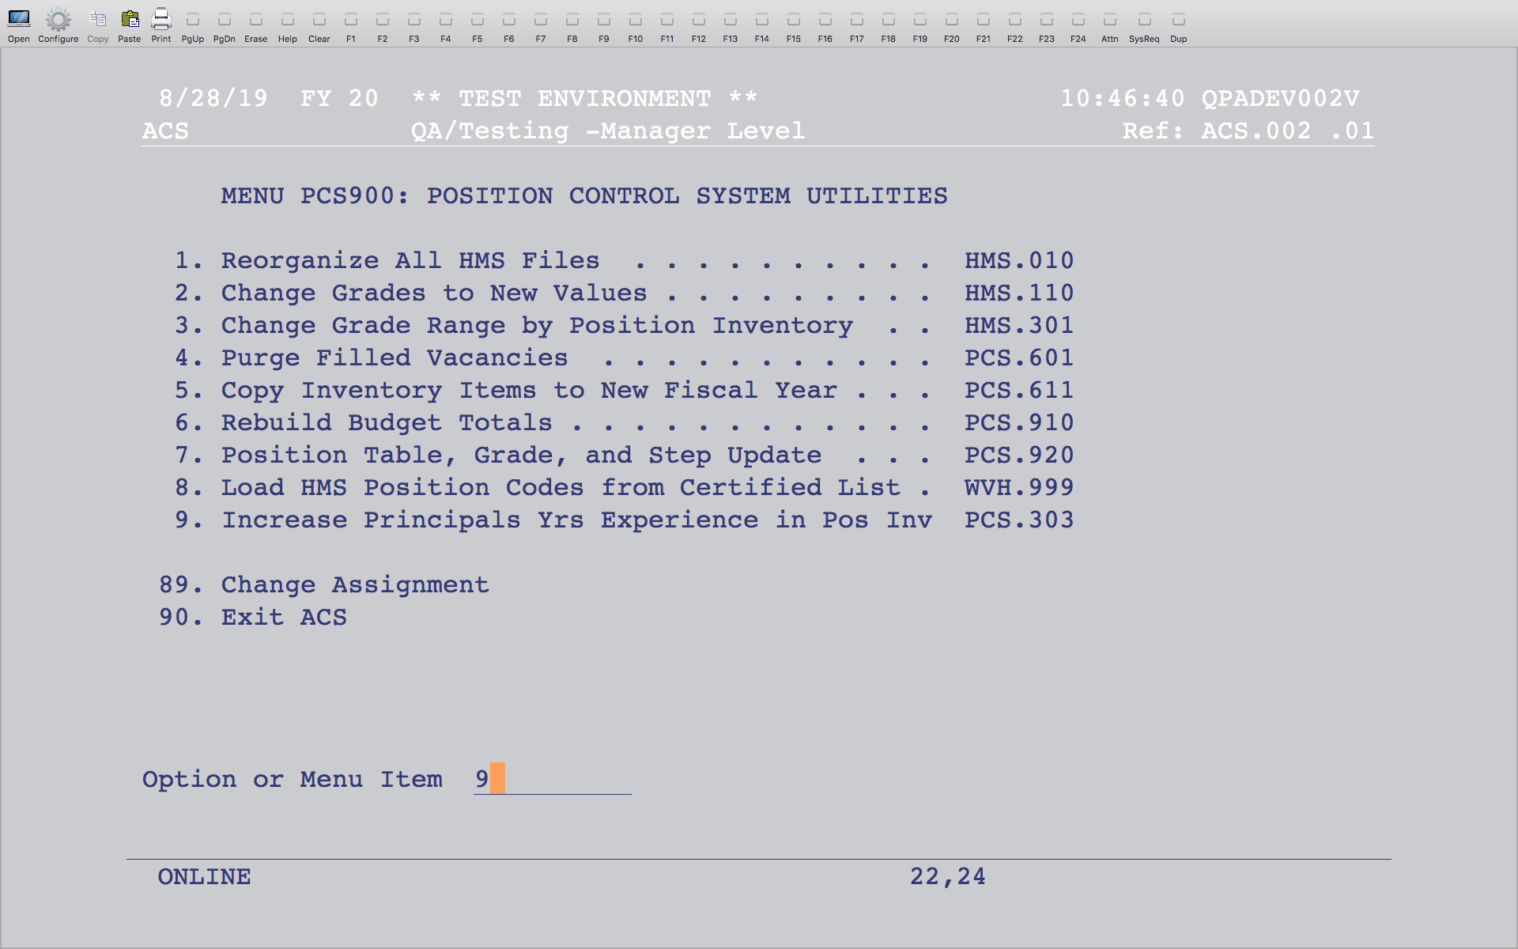
Bumping up step for principals
Notes:
A program on the Position Control System Utilities menu will bump up the step for those that have a value in the appropriate fields in position inventory for the Principals Experience. This does not bump up the field on the existing certified list file, only the field in the position inventory, which will be reflected when the certified list is built.

Slide 8
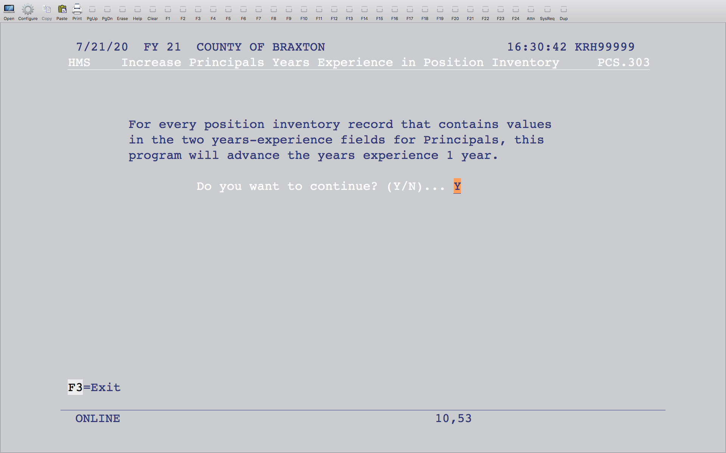
Bumping up step for Principals
Notes:
Enter a Y to bump the step up.

Slide 9
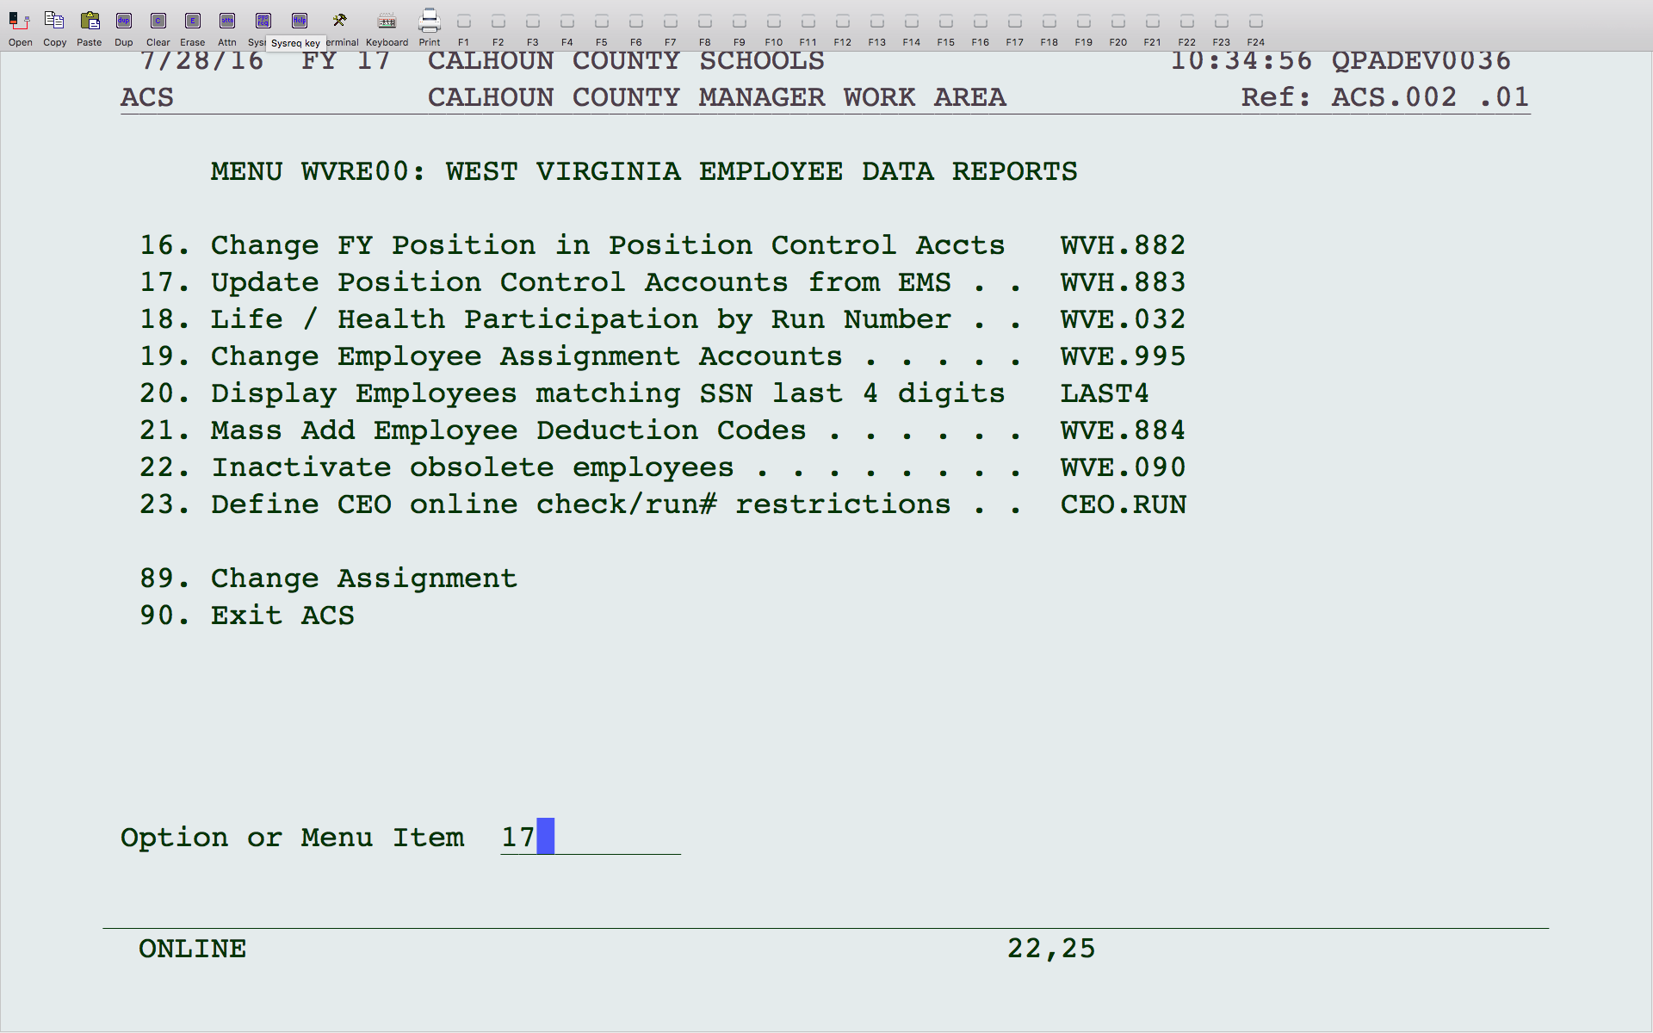
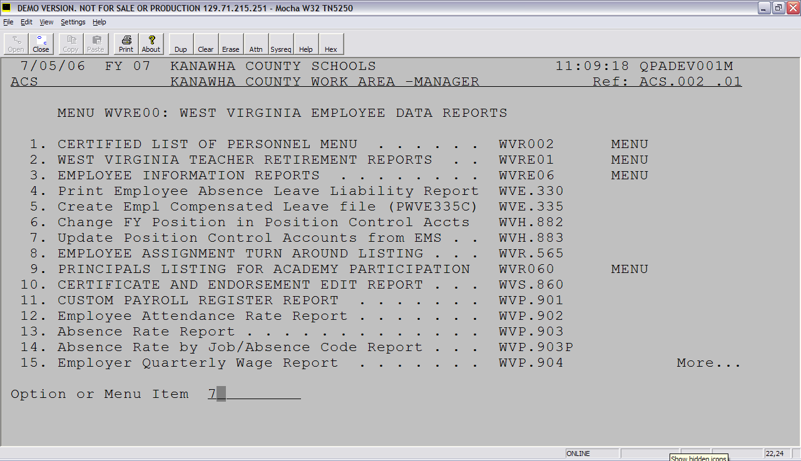
Notes:
This program will copy the EMS accounts to HMS. The certified list pulls the account information from HMS, but HMS isn’t always kept up to date. You can run this program to copy the EMS accounts to update your HMS. This program is found on the WV Employee Data Reports menu, but may be in a different place on your menu. Look for WVH.883.

Slide 10
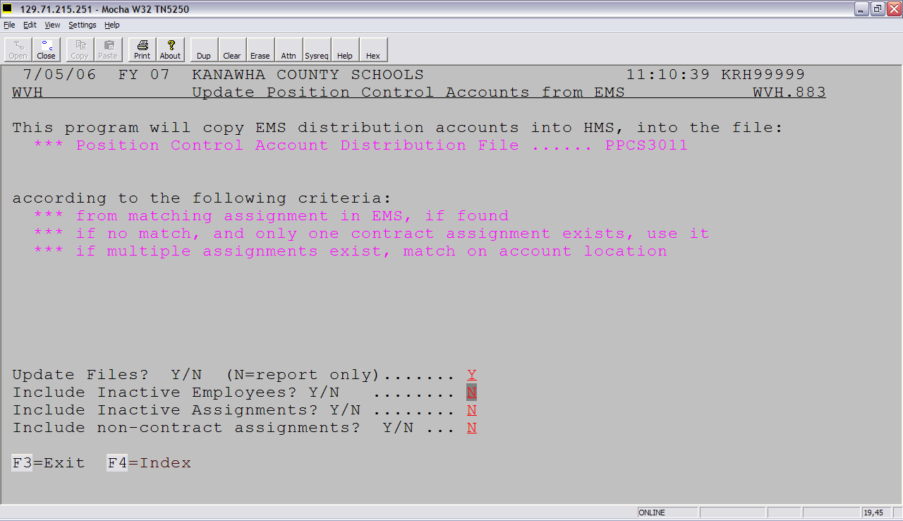
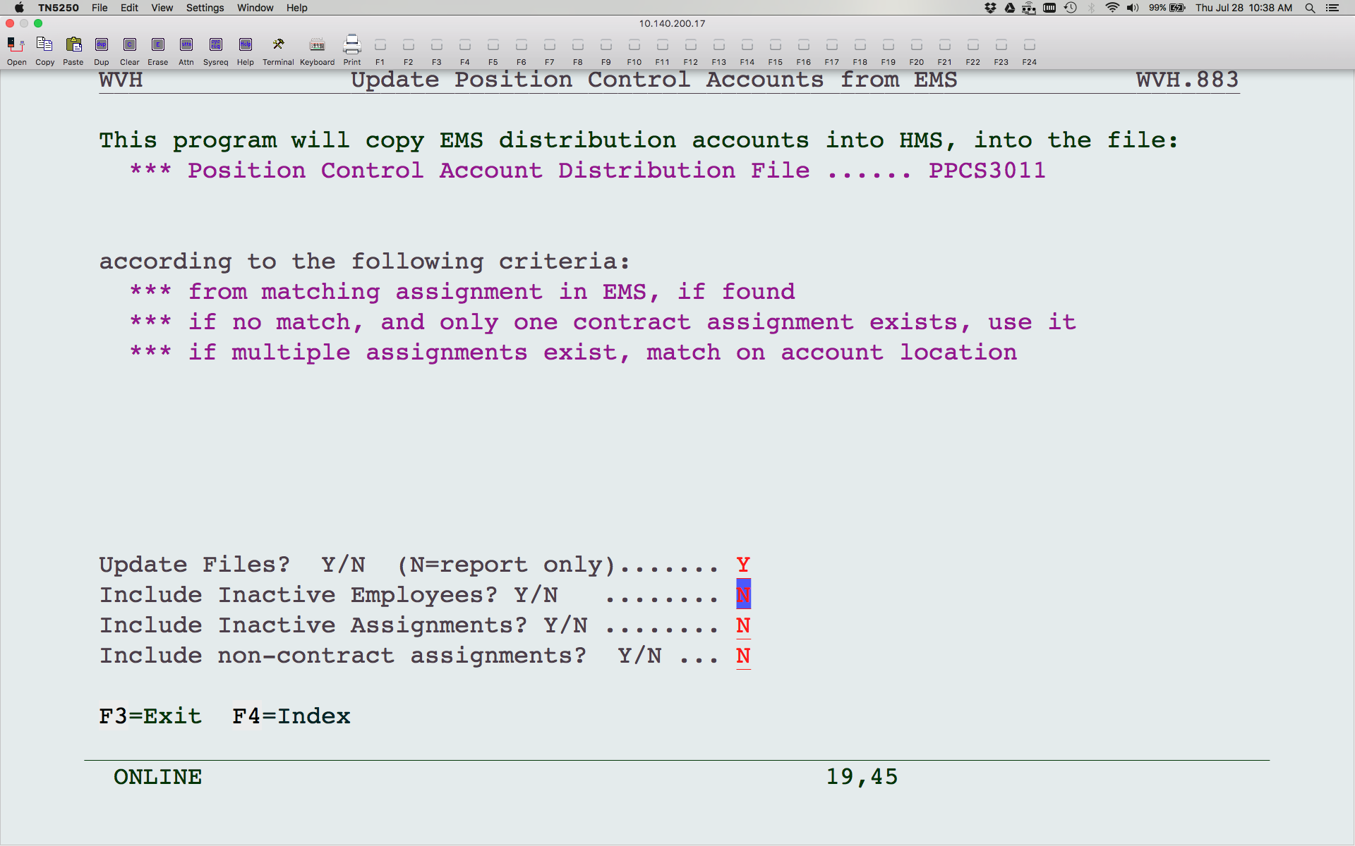
Notes:
This program will copy the accounts in EMS to HMS as best it can. There will be some exceptions that you may have to manually change, but it should take care of the majority. You can run an edit first to see what it will do by answering “N” to Update Files? This will create a report only without updating.

Slide 11
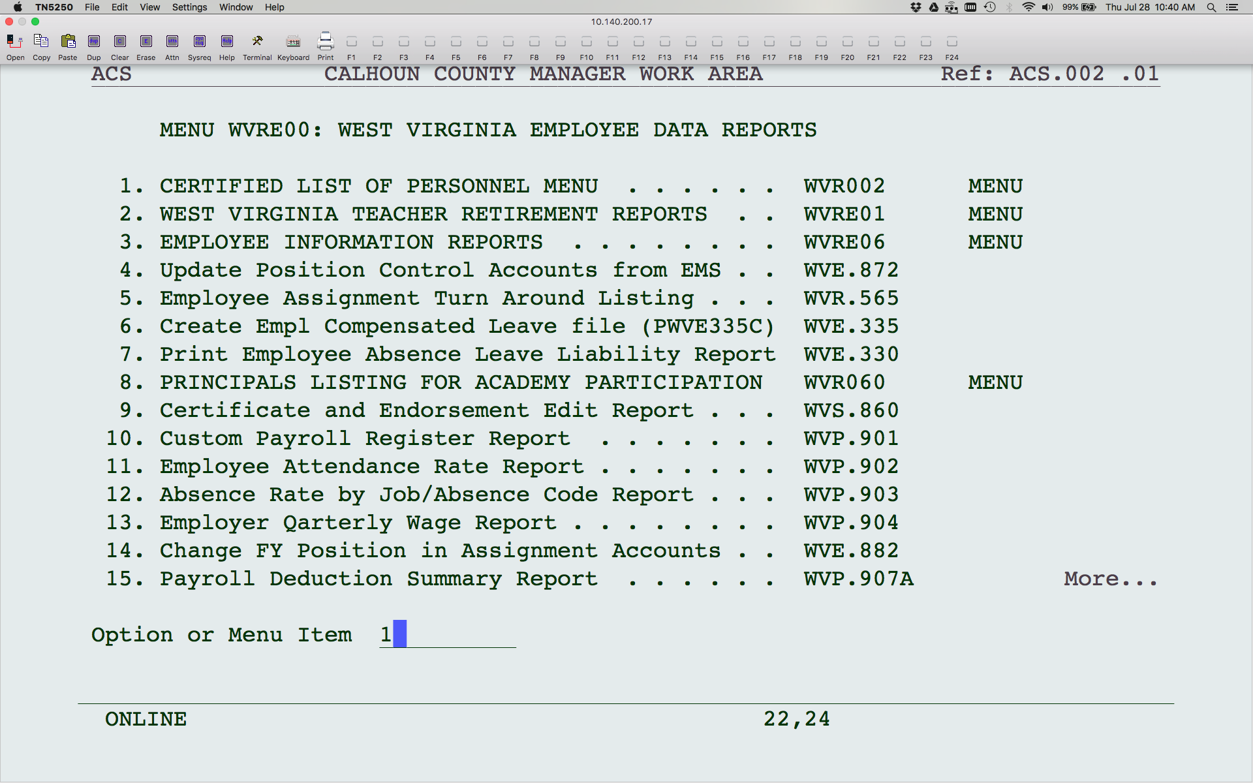
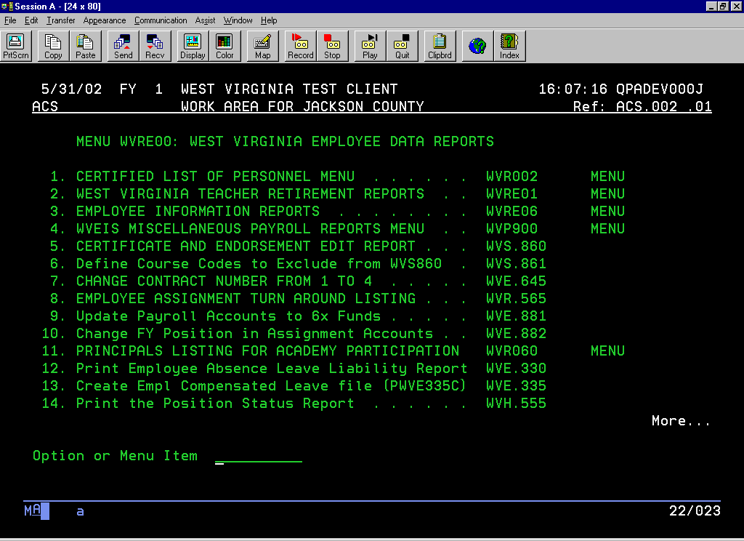
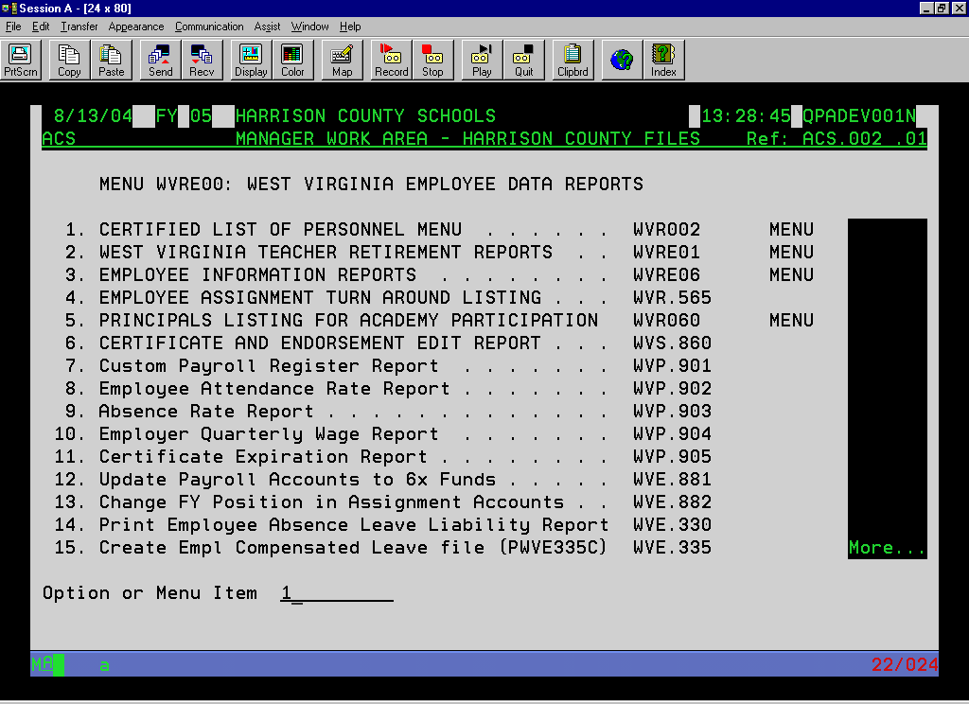

Slide 12
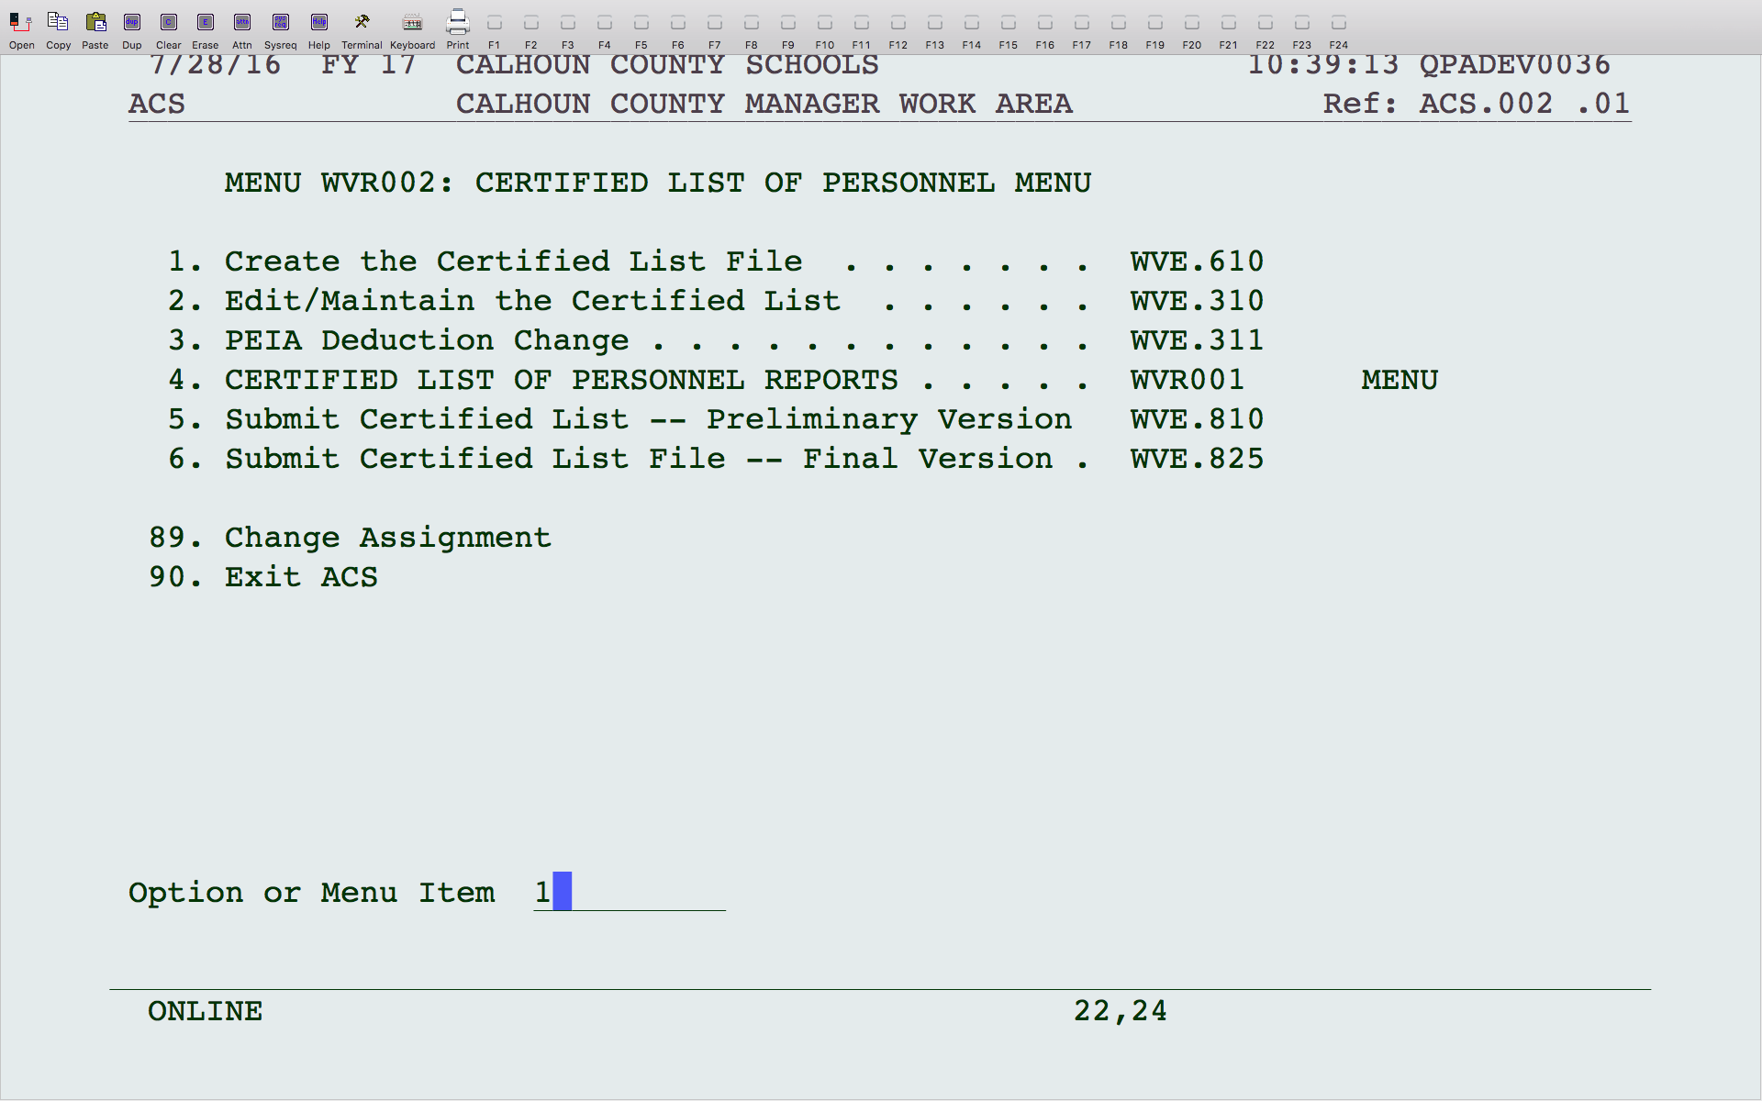
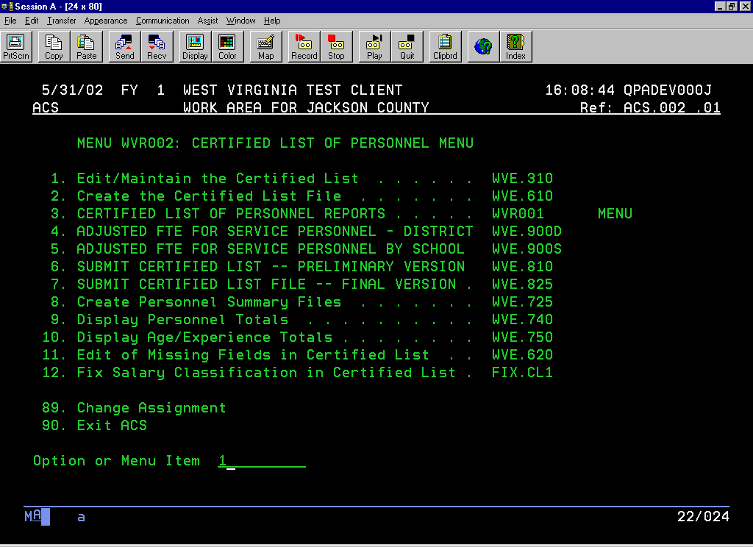
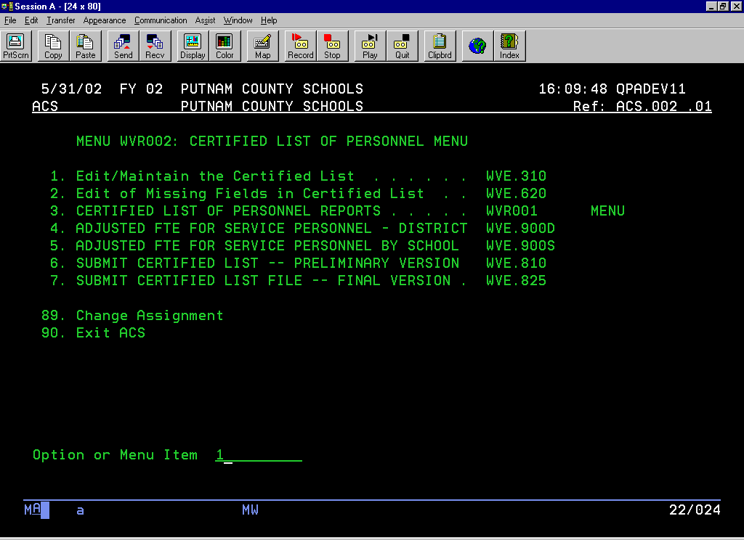
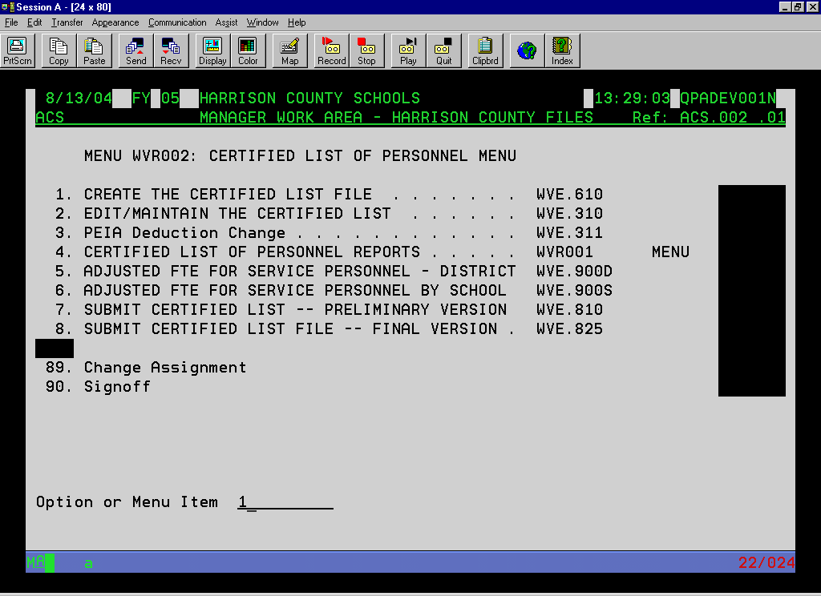
Notes:
The next step is to create the certified list. If you do not have this option on your menu, contact the WVEIS Help Desk.
You can print the certified list report to verify the information. When necessary, use option 2 to make changes to the certified list information.
Every time the file is built, it will replace whatever is in the certified list at that time and replace based on the information in EMS and HMS. Any manual changes you made using option 2 would be wiped out.
Option 3 allows you to make any mass changes to your PEIA amounts, if needed.

Slide 13
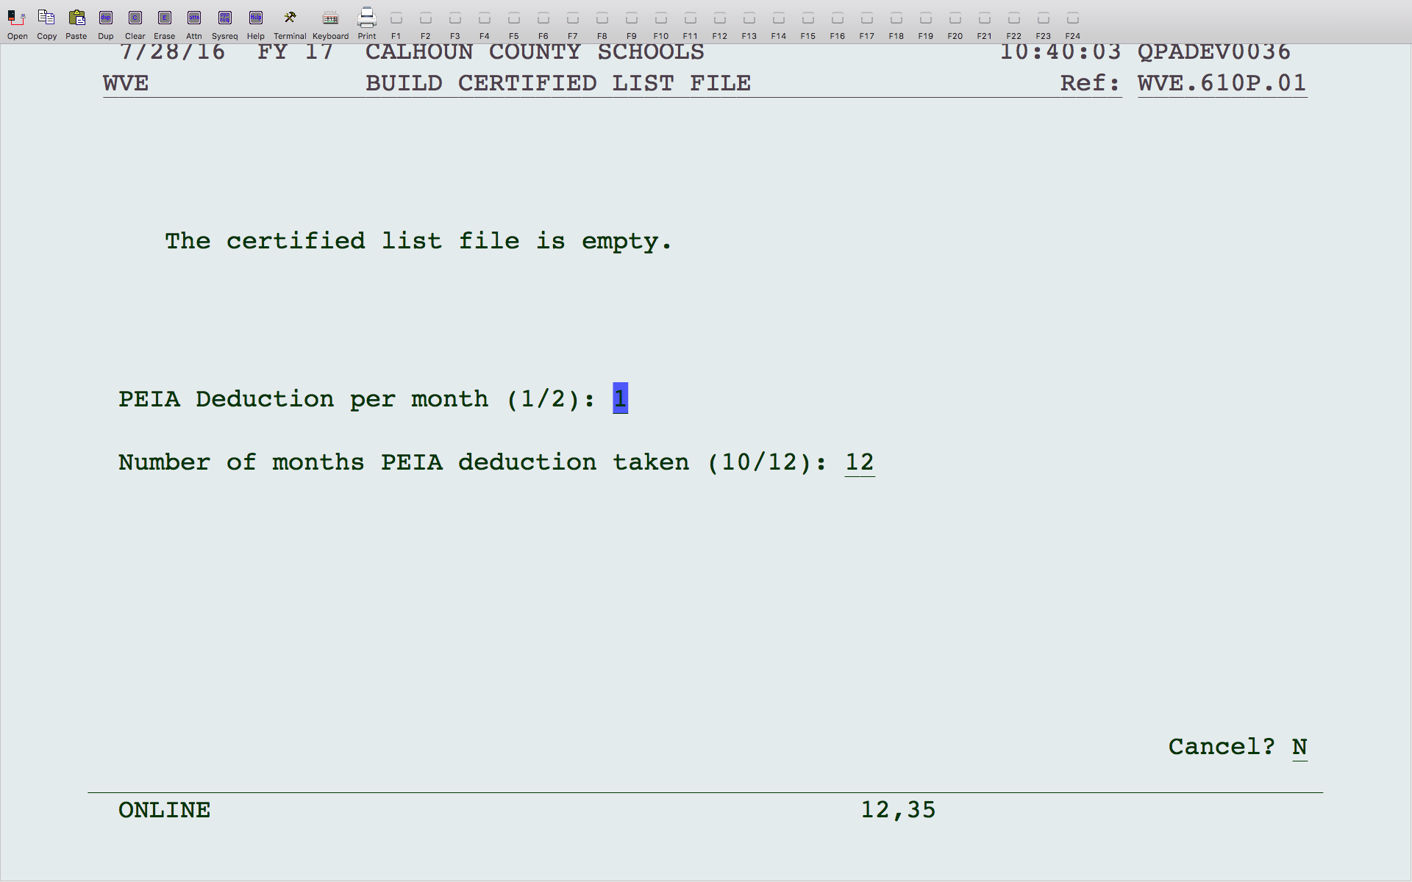
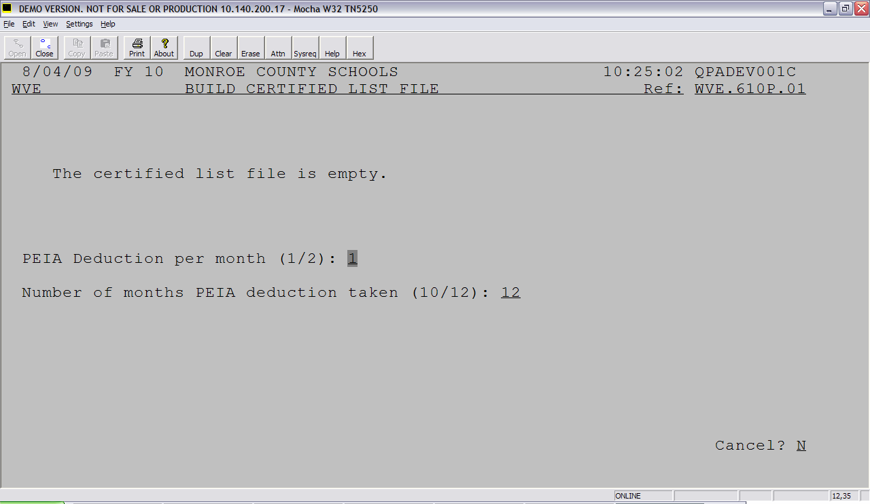
Notes:
This program will build the information from the payroll (EMS) and personnel (HMS) files. The first time you run this, the screen will state that the certified list file is empty. If you run this program again, you will get a warning message that your file already exists and running this program will wipe out your existing data. Any manual changes you had made to your certified list file will be wiped out.
The questions on the screen ask how many times a month do you take out PEIA (1 or 2) and how many months do you withhold (10 or 12). This is used to calculate the annual PEIA premium for each employee.

Slide 14
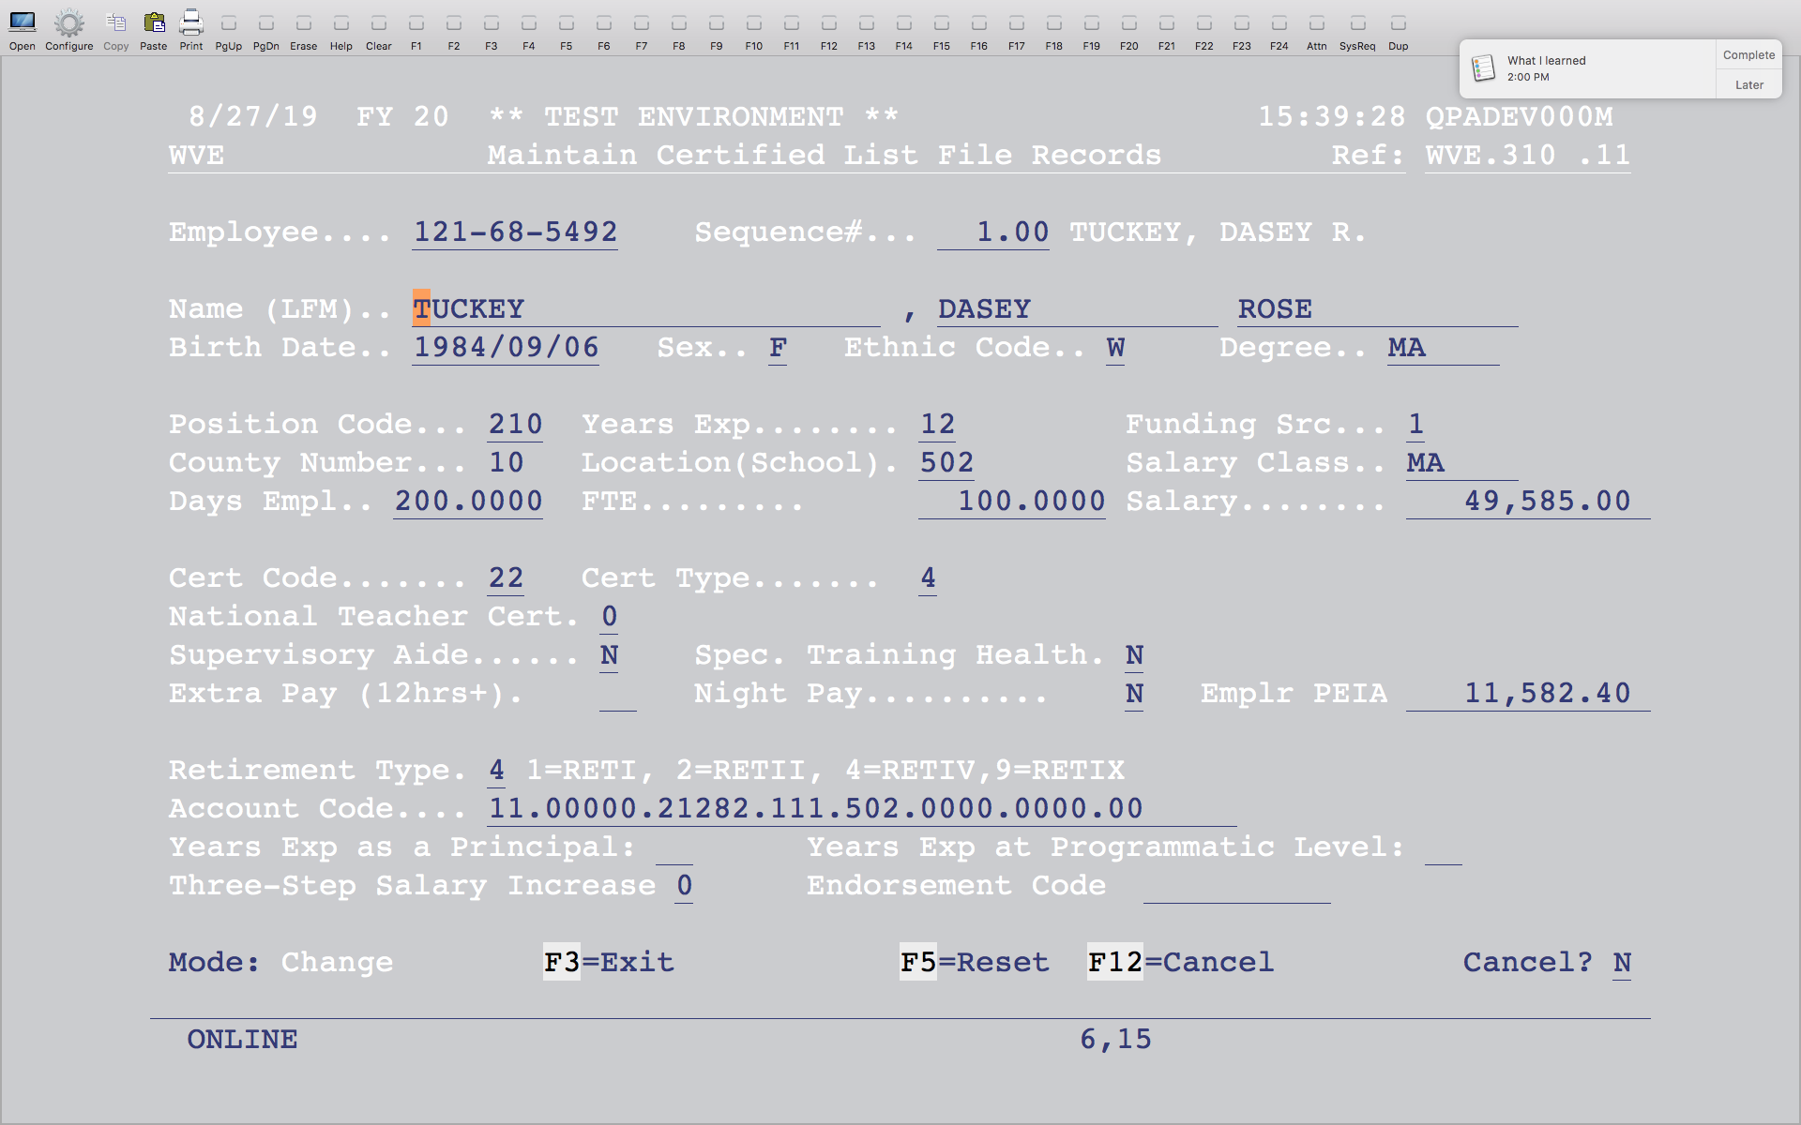
Notes:
The following fields come from the Employee Basic Record in EMS:
Employee SSN, name, birth date, sex, and ethnic code.
The following fields come from the Employee Assignment in EMS:
Degree is the first two letters of the pay grade for a professional , addenda record for a service or HS; Years Exp; Salary class is the pay grade; FTE; Salary (contract pay plus “Z” addenda pay); # Days Employed; Extra Pay from “Z” addenda for additional college hours; Night Pay, National Teacher Cert, Supervisory Aide, Spec. Training Health and Three-Step Salary Increase; Retirement Type
Remaining fields from EMS:
Cert Code and Type from the Employee Certificate Information.
PEIA comes from employee’s deduction codes and corresponding amounts.
Endorsement Code for Math or Special Ed come from Employee Certificate Information
Location, position code and account number come from HMS. Years Exp as Principal and at Programmatic Level are stored in Position Inventory and can be bumped up 1 using the program PCS.303 as described earlier in the handout. Verify that the person is still eligible. The funding source is based on the account number.

Slide 15
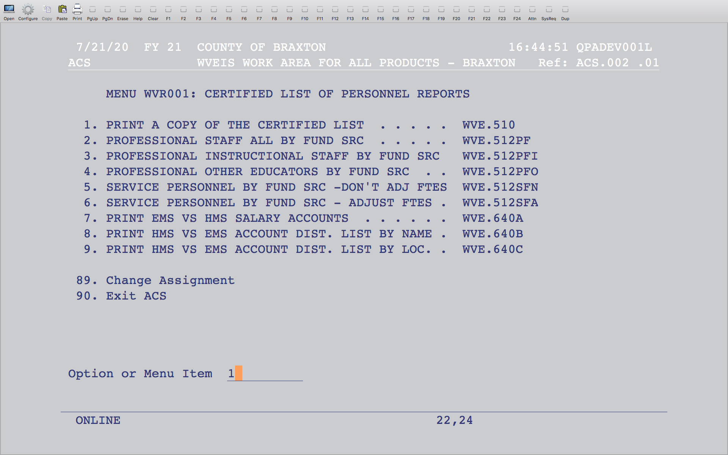
Notes:
This will print a copy of the certified list for you to verify.

Slide 16
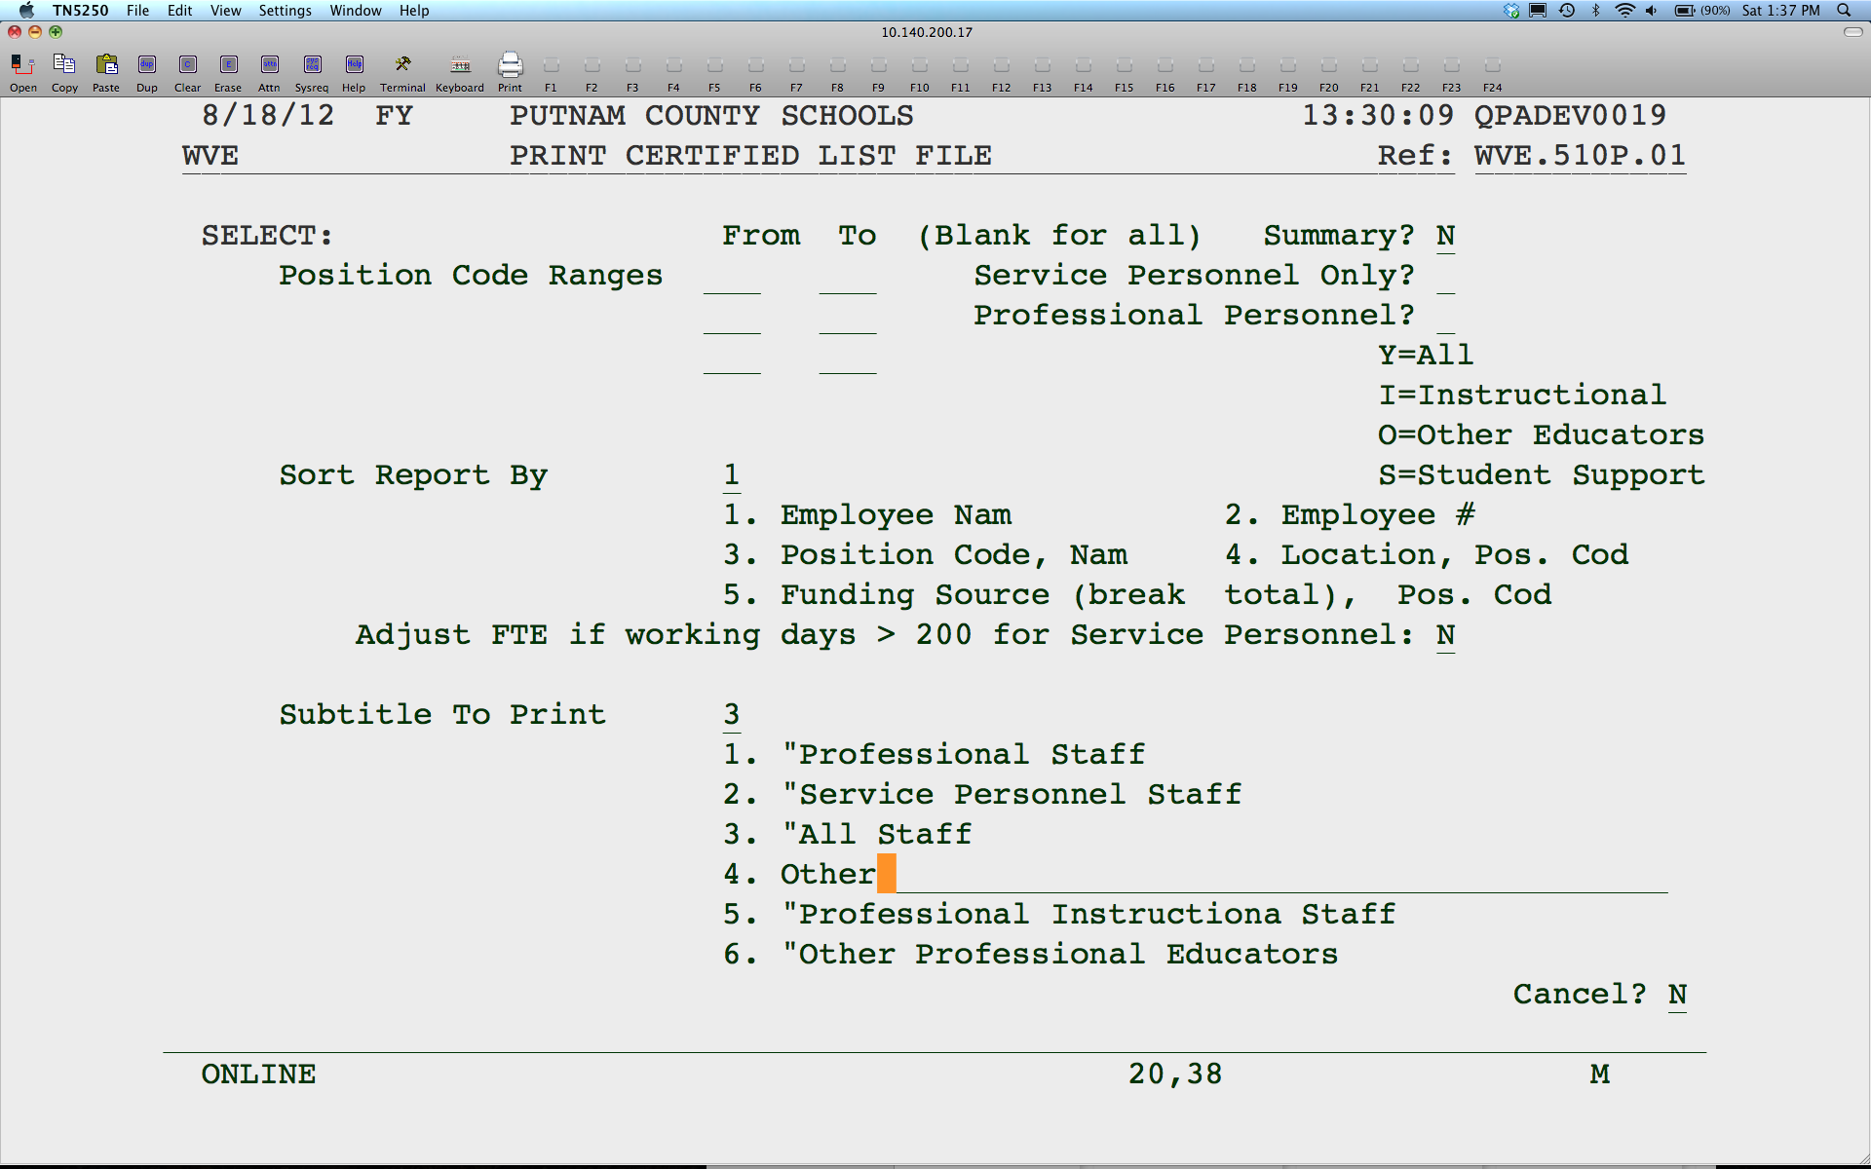
Notes:
Enter ranges of position codes or select service or professional personnel. Summary Totals Only will give you summary totals with no employee detail. You have 5 sorting options. If you want the FTE to be adjusted for Service Personnel, answer “Y”. Choose the subtitle that fits your selection or enter your own using option 4.

Slide 17
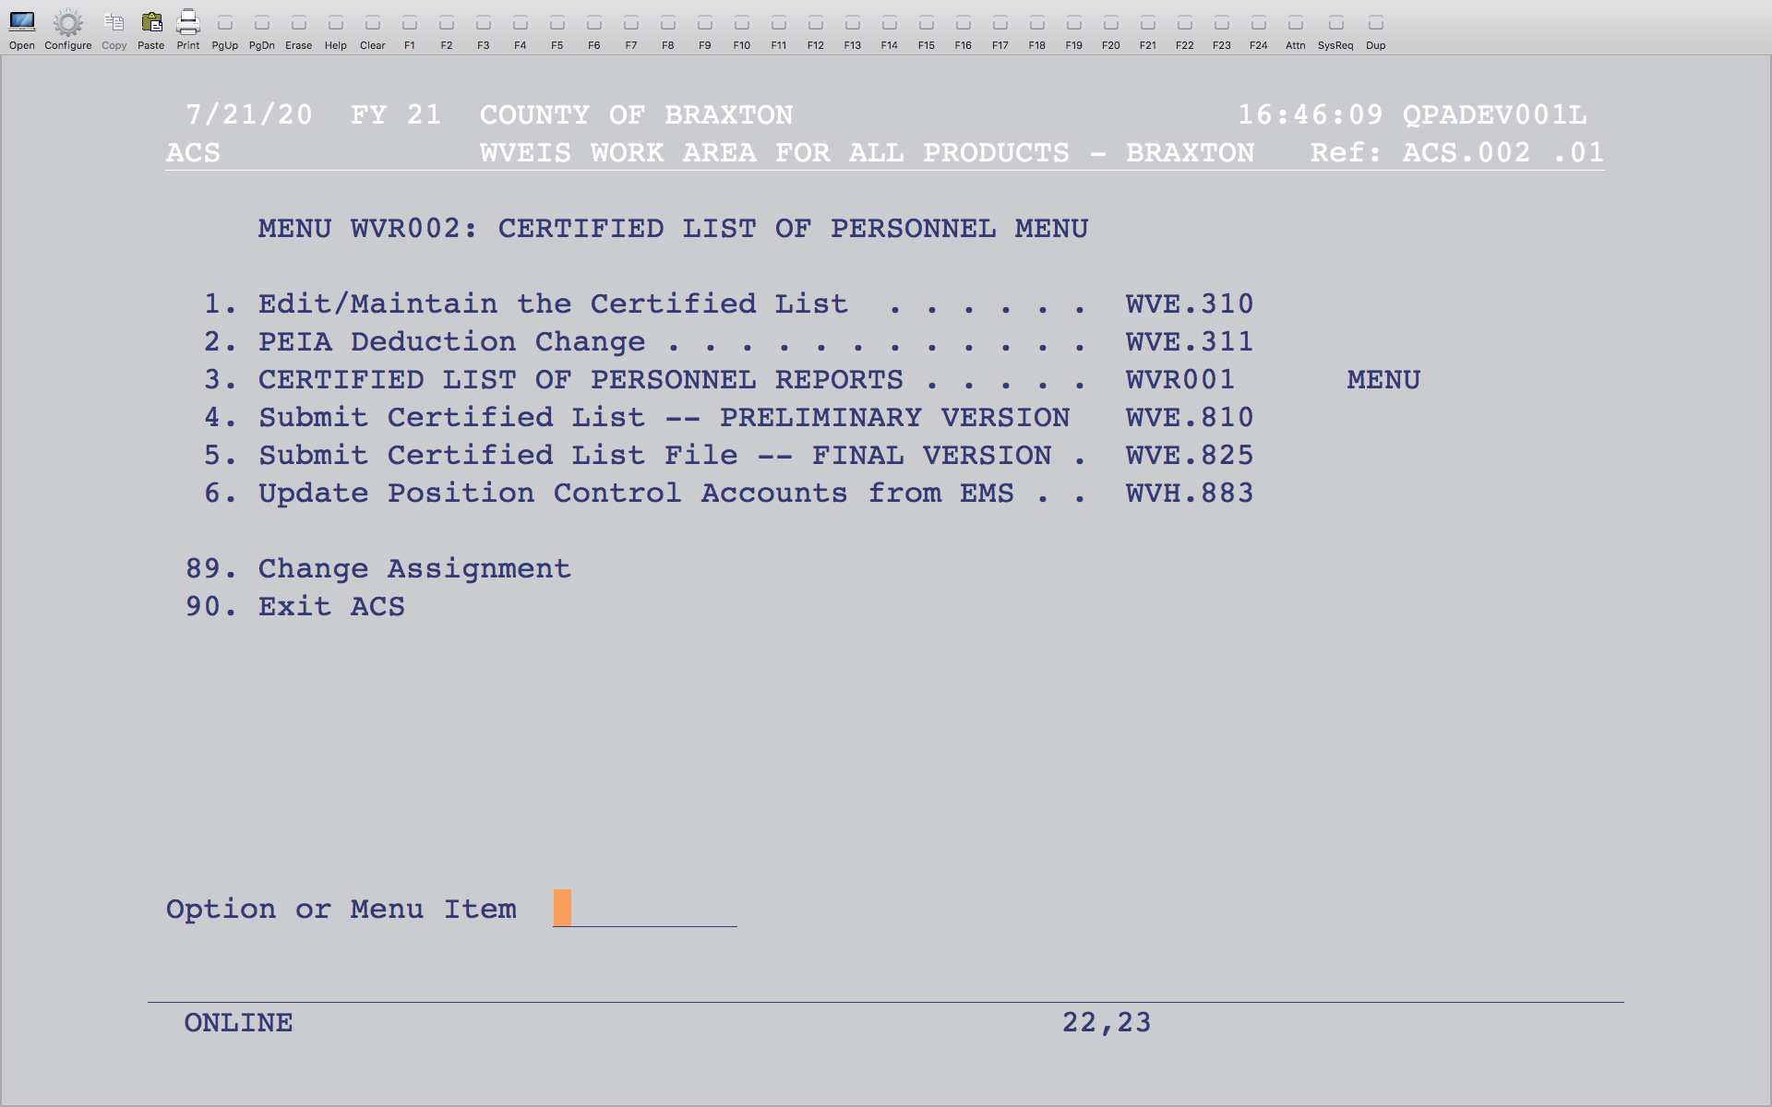
Notes:
When ready, use option 4 to submit the preliminary version. You can submit this multiple times. Once you submit the preliminary version, you can access the edits in WOW. When the final version is due, run option 5. You should only run this once.
If you have already submitted your final version, or you have critical errors, then you will receive an error message and you will not be able to submit your final. If you have critical errors, you will need to view your edit list on WOW and correct those errors by changing the information in the maintenance program (option 2 on this menu). You should not enter a comment for a critical error. If you need to re-submit your final version, you need to contact school finance to allow that submission.

