Slide 1


School finance ISSUES in west Virginia recent changes in election law, excess levies, general obligation bonds and other available financing options

Slide 2
Disclaimers
These materials are presented with the understanding that the information provided is not legal advice. Due to the rapidly changing nature of the law, information contained in this presentation may become outdated. Anyone using information contained in this presentation should always research original sources of authority, update this information to ensure accuracy when dealing with a specific matter and consult with legal counsel. No person or school board should act or rely upon the information contained in this presentation without seeking the advice of an attorney.
With respect to federal tax issues, no advice, statement or information contained in this communication is intended to be, or written for the purpose of being, (a) relied upon by a taxpayer as the exclusive basis to avoid penalties under the Internal Revenue Code, or (b) used in connection with the promotion, marketing or recommendation of any tax shelter product or tax shelter transaction.

Slide 3








Bowles Rice LLP Public Finance Team
Roger
Hunter
Elizabeth Frame
Tom
Pearcy
Cam
Siegrist
Corey
Bonasso
Our firm and our team have been recognized by the following peer-review organizations:

Slide 4
Recent Changes in election law
Excess Levies and General Obligation Bonds (“G.O. Bonds”) have one thing in common: They BOTH require voter approval – a majority vote in favor
Excess Levies are authorized under Chapter 11, Article 8 of the West Virginia Code:
  “If at least a majority of voters cast their ballot in favor of the additional levy, the county board of education may impose the additional levy . . ..” (W. Va. Code §11-8-16)
G.O. Bonds are authorized under Chapter 11, Article 8 of the West Virginia Code:
  “Provided, That a county board of education may contract indebtedness and issue bonds for public school purposes when submitted to a vote of the people of the county if the question of contracting indebtedness and issuing bonds is approved by a majority of all the votes cast for and against the same pursuant to section ten, article X of the Constitution.” (W. Va. Code §13-1-4)

Slide 5
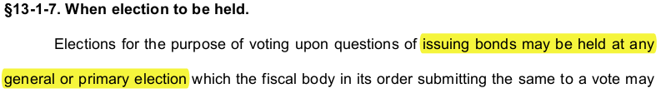
Recent Changes in election law
House Bill 4353, passed in the 2022 General Legislative Session and enacted into law, removed the ability of school boards to call for special elections in connection with Excess Levies and G.O. Bonds:
    W. Va. Code §11-8-16 (Excess Levies):
    W. Va. Code §13-1-7 (G.O. Bonds):

Slide 6
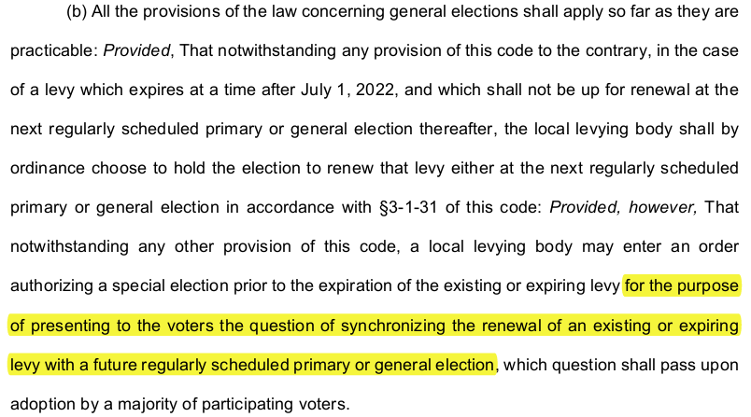
Recent Changes in election law
The attempted legislative exception in W. Va. Code 11-8-17(b) did not help:

Slide 7
Recent Changes in election law
The elimination of Special Elections presents timing and logistical challenges, especially with respect to the levy setting process related to Excess Levies.
  “The secretary of the board shall forward immediately a certified copy of the statement to the Auditor and shall publish the statement immediately. The session shall then stand adjourned until the third Tuesday in April, at which time it shall reconvene except where otherwise permitted by section nine of this article.” (W. Va. Code §11-8-12)
  “Each board of education, when it reconvenes as provided by section twelve of this article, shall proceed in a manner similar in all respects to that provided for in section ten-a of this article. The board may not finally enter any levy until it has been approved in writing by the Auditor. After receiving the approval, the board shall enter the statement as approved in its record of proceedings, together with the written approval.” (W. Va. Code §11-8-12)

Slide 8
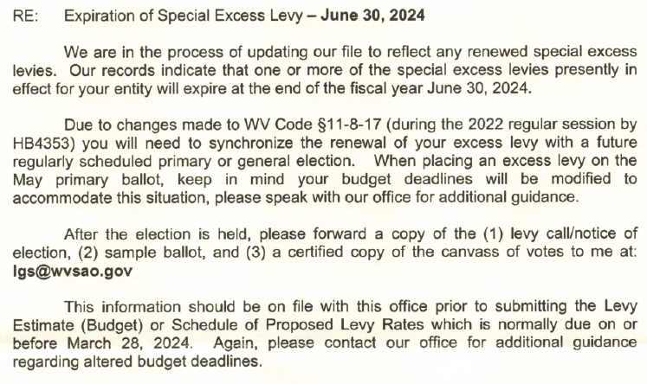
Recent Changes in election law
Recent guidance from the State Auditor’s Office provides a path forward:

Slide 9
Key election deadlines
~ 120 DAYS PRIOR
  The Board contemplates the potential date of the election, determines amount of funds needed, the purposes for which they are needed and addresses the other requirements under the applicable Order
  For G.O. Bonds, Bond Counsel, an Architect & Engineering firm and Financial Advisor should be engaged as soon as possible to assist in the process - more time is typically needed to prepare for a bond election and finalize the Bond Election Order
  That information should then be delivered to the attorney preparing the proposed order as soon as possible
~ 100 DAYS PRIOR
  The proposed Order calling the election should be placed on the agenda for the Board’s regular or special meeting

Slide 10
Key election deadlines
~ 90 DAYS PRIOR
  At a regular or special meeting, the School Board adopts the Order
~ 75 DAYS PRIOR (OR EARLIER)
  Copies of the Order should be circulated to the county clerk, the board of ballot commissioners and the county commission
  The Board contracts for ballot printing with an authorized printer
  The Board begin to inform the public about the upcoming election through news releases and general announcements
~ 60 TO 40 DAYS PRIOR
  Consult with the clerk regarding election supplies, appointing election commissioners and clerks, emergency absentee voting commissioners, appointing alternates and certain absentee ballot issues

Slide 11
Key election deadlines
26 to 20 DAYS PRIOR
  Publish the sample ballot as a Class I-O legal advertisement
14 to 8 DAYS PRIOR
  Publish notice of the election (the adopted Order) as a Class II-O legal advertisement
13 to 3 DAYS PRIOR
  Early voting takes place
8 DAYS PRIOR or 3 DAYS PRIOR TO INSPECTION
  Where an electronic voting system is used, notice of the time and place of inspection of the voting devices and ballots must be published as a Class I-0 legal advertisement.

Slide 12
Key election deadlines
3 to 2 DAYS PRIOR
  Notice of testing of automatic tabulating equipment must be published as a Class I-0 legal advertisement.
7 DAYS to 1 DAY PRIOR
  Notice of the election must be published as a Class II-0 legal advertisement
  The issue(s) to be placed on the ballot must be published as a Class I-0 legal advertisement.
REMINDER:
  These slides only include the key election deadlines and are not a fully recitation of election law requirements. Please consult with your attorney, the county clerk, the Secretary of State’s and the State Auditor’s office regarding the legal requirements and deadlines imposed by Chapter 3 and Chapter 11 of the West Virginia Code.

Slide 13
Legal Advertisements
Class I-0
  A Class I-0 Legal Advertisement shall be published one time in two qualified newspapers of opposite politics published in the publication area
Class II-0
  A Class II-0 Legal Advertisement shall be published once a week for two successive weeks in two qualified newspapers of opposite politics published in the publication area
Minimum Requirement: For all Class “-0” legal advertisements, if two qualified newspapers of opposite politics are not published in the publication area, then the legal advertisement shall be published in one qualified newspaper published in the publication area.

Slide 14
Excess levies
The process begins with the board’s adoption of an Order calling the excess levy election, and such order must include the following (W. Va. Code §11-8-16):
(1) The purpose(s) for which additional funds are needed;
(2) The amount for each purpose;
(3) The total amount needed (annually and in the aggregate);
(4) The separate and aggregate assessed valuation of each class of taxable property within its jurisdiction;
(5) The proposed additional rate of levy in cents on each class of property;
(6) The proposed number of years, not to exceed five, to which the additional levy applies; and
(7) The fact that the local levying body shall or shall not issue bonds, as provided by this section, upon approval of the proposed increased levy.

Slide 15
EXCESS LEVIES
Relevant West Virginia Supreme Court Cases:
  Under WVSCA decisions, the language of the ballot (and the order) concerning the purposes will be controlling.
  Byrd v. Board of Education of Mercer County, 467 S.E.2d 142, 196, W.Va (1995)
    The challengers claimed that the ballot was defective because it lumped multiple different purposes, which were not necessarily related in a logical way, into one big purpose with a lump sum dollar amount.
    West Virginia Supreme Court stressed that since the taxpayers’ vote in favor of an excess levy constitutes their consent to be taxed, and without such consent, no debt or tax can be imposed or any money raised, it is critically important to properly delineate the purposes (and amounts) in terms that are specific and clear so as to provide taxpayers with notice of what they are being asked to approve along with the amounts for each purpose.

Slide 16
EXCESS LEVIES
  Jarrell v. Board of Ed. of Raleigh County, 131 W.Va. 702, 50 S.E.2d 442 (1948).
    School board violated the law when order and ballot identified specific projects to be constructed, and dollar amounts, when (due to cost overruns on the first projects it pursued) the school board did not begin or spend any money at all on some of the specified projects named in the ballot.
    The West Virginia Supreme Court reasoned that provisions in the ballot/order for the excess levy, which allowed the board to set the priority of building, as determined by the board, could only be construed as authorizing the school board to determine the sequence of the projects. It could not justify failure to spend any money, or the failure to start construction on, several of the specified projects named in the ballot and order.
    Takeaway: The Ballot is a contract with the voters

Slide 17
EXCESS LEVIES
Addressing State/Federal Grants or Other Funding
Some school boards include a clause addressing how they will handle the situation where they receive federal and/or state funds (e.g., grant funding) for one or more of their excess levy purposes.
Example:
In the event The Board of Education of the County of __________ shall obtain additional money by grant or otherwise from the State or Federal government, or from any agency of either, or from any other private or public source, for the purposes aforesaid, such additional money may be used either in substitution for, or in addition to, the sums obtained from such additional levies as said The Board of Education of the County of ________ may from time to time determine.

Slide 18
EXCESS LEVIES
Sample clauses addressing a surplus scenario, where increased property valuations and/or tax collections result in levy revenue above estimates:
    Clause stating that if there is an “excess” or “surplus” above the stated amounts, the Board will reallocate it pro rata (proportionately) across all the stated purposes.
    Clause stating that if there is an “excess” or “surplus” above the stated amounts, the Board will use it for enrichment, supplementation, operation, improvement, maintenance of the schools.
    Clause stating that if there is an “excess” or “surplus” above the stated amounts, the Board will reallocate it in its discretion for any lawful school purpose.

Slide 19
EXCESS LEVIES
Sample clauses addressing a shortfall scenario, where decreased property valuations and/or tax collections result in levy revenue below estimates:
    Clause stating that if there is a revenue shortfall, then the board will pro rate the available revenue pro rata (proportionately) across all listed purposes. In effect, everything would be cut by the same percentage the shortfall bears to the total listed amounts.
    Clause stating that if there is a revenue shortfall, then certain identified purposes will be cut (meaning the other purposes/amounts will not be cut).
    Clause stating that if there is a revenue shortfall, then the board may cut any one or combination of purposes and amounts, in its discretion.

Slide 20
General obligation bonds
With some exceptions, the West Virginia Constitution prohibits the State and its subdivisions to incur indebtedness
The primary exceptions are:
    (1) Revenue Bonds (such as Lease Revenue Bonds or Special Revenue Bonds)
    (2) Lease Agreements subject to annual appropriation by the public body
    (3) General Obligation Bonds (or G.O. Bonds) approved by the voters
General Obligation Bonds are supported by the bond levies imposed on taxpayers, with levies determined by and debt service through the WV Municipal Bond Commission

Slide 21
G.O. Bonds – Pre-election PHASE
Engage Bond Counsel, Architect & Engineer and Financial Advisor
Determine the proposed date of the election (primary or general)
Begin determining project scope, sources and uses with the professional team, the board and staff.
  Uses: After the project scope is determined, A&E can provide an estimated project cost, including a contingency for inflation and costs of issuance
  Sources: The funding mix to pay for the project costs, including bond proceeds, federal and state grants (including SBA Needs Grants), private funds, lease purchase agreement proceeds, local funds on hand and/or other sources

Slide 22
G.O. Bonds – Pre-election PHASE
Threshold questions regarding School Building Authority Needs Grants:
  (1) Will the Board pursue SBA Needs Grant funding as part of Sources to pay for project costs; and
  (2) If so, will the issuance of the Bonds be contingent on the SBA’s commitment to provide such funding?
By Memo dated July 25, 2023, the SBA revised its guidance regarding the inclusion of SBA funding as part of a Bond Election Order/Ballot (see next slide)

Slide 23
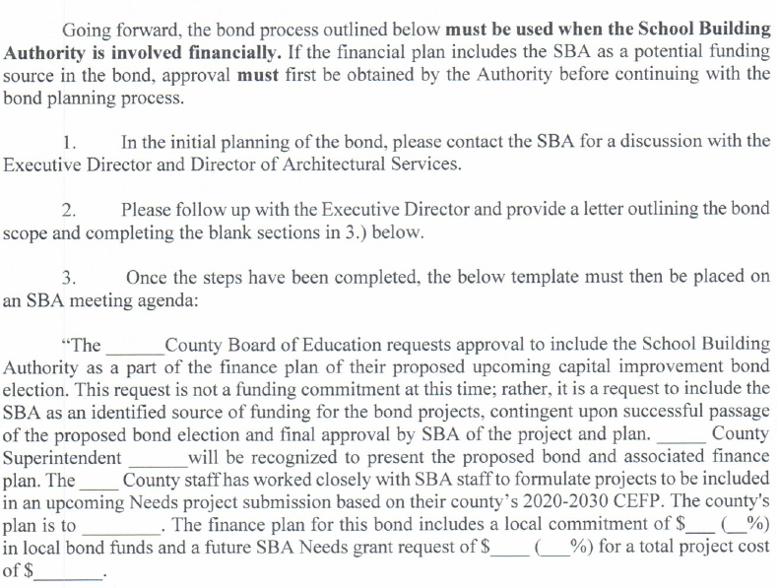
G.O. Bonds – Pre-election PHASE

Slide 24
G.O. Bonds – Pre-election PHASE
Bond Election Orders, to be considered and adopted by the Board, must state the following:
  (1) Purpose or purposes for which the proceeds of bonds are to be expended (no current or operating expenses);
  (2) Valuation of the taxable property as shown by the last assessment thereof for state and county purposes;
  (3) Indebtedness, bonded or otherwise;
  (4) Amount of the proposed bond issue (the “not to exceed” amount);
  (5) Maximum term of bonds (not to exceed 34 years);
  (6) Maximum rate of interest;
  (7) Date of election (primary of general election);
  (8) That the levying body is authorized to lay a sufficient levy annually to provide funds for the payment of the interest upon the bonds and the principal at maturity and the approximate rate of levy necessary for this purpose;
  (9) In the case of school bonds, that the bonds, together with all existing bonded indebtedness, will not exceed in the aggregate five percent of the value of the taxable property in the school district and provisions addressing other constitutional and statutory requirements

Slide 25
G.O. Bonds – Pre-election PHASE
Public engagement and advocacy leading up to the election:
  Key Takeaway: School Board employees may communicate factual information regarding the proposed general obligation bonds, but they are prohibited from using public resources (think public money, time or materials) to advocate for or against the bonds.
The same election law deadlines appearing in the prior slides will apply to the bond election process, including key legal ad publication dates.

Slide 26
G.O. Bonds – Post-election PHASE
Adoption of a Resolution Authorizing and Directing the Issuance of Bonds
  Within the parameters of what the voters approved (maximum principal amount, interest rate and term).
  Sets forth a principal repayment schedule for each maturity
  Satisfies other requirements set forth in W. Va. Code §13-1-14
A Certified Record of Proceedings is then sent to the Attorney General’s office for review and approval
  In our experience, any SBA Needs Grant contingency must be satisfied before the AG’s Office will provide approval.

Slide 27
G.O. Bonds – Post-election PHASE
After Attorney General Approval is received, the Board must publish the Approval as a Class II legal ad in the qualified newspapers.
  Citizens have the right to petition and contest the Attorney General Approval for a period of 10 days following the last publication of the legal ad.
  If no petition is filed, the Clerk of the WV Supreme Court provides certification that no petition was filed.
During this period, the professional team and the Board staff prepare the key disclosure documents, including a Preliminary Official Statement and Official Statement posted electronically to EMMA.

Slide 28
G.O. Bonds – Post-election PHASE
The Financial Advisor will assist in marketing and selling the bonds, as well as determining if an independent rating from the Rating Agencies would be beneficial.
After a competitive bid process, the Board will award the sale of the bonds to the lowest bidder, based on true interest cost.
For the next two weeks, Bond Counsel will prepare the remaining bond documents for closing and issuing the bonds.
At closing, the net proceeds of the Bonds will be deposited in a Project Fund to pay for the project costs approved by the voters.
Bond Counsel will inform the Board of its continuing disclosure obligations and post-issuance tax compliance obligations, including the 3- or 5-year temporary period requirements.

Slide 29
ISSUING LEASE REVENUE BONDS
When an issue of bonds or other obligations is structured, usually this is done by a Placement Agent, a Municipal Advisor, or an Underwriter.
  As to the sale of an issue, the Placement Agent or the Underwriter will sell the bonds or other obligations to the Purchaser(s).
  Technically, when tax-exempt bonds/obligations are sold in a public offering, the bonds/obligations are first sold to the Underwriter(s), which will in turn sell them to the ultimate initial purchasers (often their customers, which usually will include both retail and institutional customers, or other investment banking firms with which they have business relationships and which agree to take some of the bonds for resale to their customers).
    The Issuer will enter into a legally binding Bond Purchase Agreement with the Underwriter(s) whereby the Underwriter agrees to buy the entire bond issue at specified prices and yields.

Slide 30
ISSUING LEASE REVENUE BONDS
Inducement Resolution and Final Authorizing Resolution (or Final Authorizing Ordinance, as applicable)
  An Ordinance process is utilized by building commissions, as well as other political subdivisions.
  Requires three (3) separate readings, at least one week apart, as well as a public hearing.
  A Notice of Public Hearing is required to be published as a Class II legal ad in a newspaper of general circulation within the area where the project will be located. This ad typically runs after second reading, and the public hearing must be held not less than 10 days after the first publication of the notice. Third and final reading usually occurs directly after the public hearing.
Offering Circular (if private placement), or Preliminary Official Statement (if public offering). These usually reference or include copies of financial statements including audits.
Bond Purchase Agreement, Trust Indenture, and/or Lease Purchase Agreement (or similar financing agreement), in which financing terms are spelled out and the terms of the bonds or other obligations are pinned down. This is the main governing document for the issuance.

Slide 31
LEASE REVENUE BONDS
Revenue bonds (repayable from a specific source of revenue/funds, and secured by a pledge of such revenues)
  This is a very common type of obligation, used in a wide variety of contexts.
  Turnpike Toll Revenue Bonds are a good example of revenue bonds.
  Clean water and sanitary sewer system revenue bonds are another example.
  Generally, a discrete enterprise or project will generate revenue that in turn will be used to pay the revenue bonds (and pledged as part of the collateral security for the revenue bonds).
  Lease revenue bonds issued by a county or city building commission are another example of revenue bonds.

Slide 32
LEASE REVENUE BONDS
Lease revenue bonds, repayable from lease rental payments made by a governmental entity leasing the project (let’s say a public project) that is financed using the bond proceeds.
  These are often issued through a county building commission or a city building commission, but sometimes a different governmental entity.
  That building commission will actually hold title to, and own, the public project itself that will be constructed or improved using the proceeds of the lease revenue bonds (let’s call that the “Project”). It will hold record title (and is “record owner”).
  An important advantage of using a county or city building commission is that, under WV law, such building commissions have the power under the WV Code to grant a lien on the Project to secure the lease revenue bonds, whereas many other governmental entities do not have that statutory power.

Slide 33
LEASE REVENUE BONDS
  Consequently, there often will be a deed of trust providing a deed of trust lien on the Project as part of the security for the lease revenue bonds.
  Under a written Lease Agreement (the “Lease”), the building commission, as the record owner of the Project and the Lessor, will lease the Project back to the governmental entity that will use the Project and will be the Lessee
  The Lease will require the governmental Lessee to pay periodic lease rental payments to the Lessor.
  Those periodic lease rental payments (whether monthly, semi-annual, or annual) are pledged to repay the lease revenue bonds and will be in an amount, and will come due in time, to match and pay the periodic debt service (principal and interest) on the lease revenue bonds, as that debt service will come due periodically (whether monthly, semi-annual, or annual).

Slide 34
EQUIPMENT LEASE purchase FINANCING
With Equipment Lease financings, the asset is personal property rather than real property.
What constitutes “personal property” or “equipment”?
  Generally, any piece of property that can be removed, transported, and sold is considered personal property. Examples include synthetic field turf, bleachers, scoreboards, vehicles, copiers, office furniture, computers or electronic equipment, kitchen equipment, HVAC, lighting, etc.
  This delineation is usually clear, but there are some gray areas.
Schoolhouse buildings are not eligible for lease purchase financing (for now), but certain ancillary facilities (such as bus maintenance garages, etc.) may be financed through lease revenue bonds.

Slide 35
EQUIPMENT LEASE Purchase FINANCING
Equipment Lease Purchase Obligations:
  In lease purchase financings, the Purchaser/Bank (the Lessor) provides funding for specified equipment/property, and leases that back to the governmental entity which is the lessee, under a lease purchase agreement.
  The governmental lessee has an obligation to pay periodic lease payments to the Purchaser bank, which is the Lessor under the lease purchase agreement, subject to annual appropriation. Lease payments include a principal component and an interest component.
Equipment Lease Purchase financings function much the same way as Lease Revenue Bonds.
  An asset is purchased with bond proceeds, owned by one entity (typically a bank), and leased to another in exchange for lease payments equal to debt service on the lease purchase obligations (what would be called lease revenue bonds in other contexts).

Slide 36
EQUIPMENT LEASE Purchase FINANCING
While it is less common, a Bond Purchase Agreement may also be used in private placements (sometimes called a Bond Placement Agreement). Smaller issuers, such as building commissions and some school boards, may utilize private placement more frequently than a public offering.
  These are often used in lease revenue bond issues involving a county or city building commission, where the bonds are being bought by a single bank or two banks.
With Equipment Lease Purchase transactions, a Lease Purchase Agreement is typically the main governing document and will include some of the same sort of provisions and details as one might see in a typical Trust Indenture.

Slide 37
Important debt limitation exceptions
Here are some important exceptions to the “debt” prohibitions/limitations:
  Annual Appropriation Out. In lease-purchase financings, and lease revenue bonds, the leases will have to provide the governmental body an annual “out” if funds are not appropriated for the next year’s debt service.
    A board of a political subdivision that has entered into a lease-purchase agreement or issued lease revenue bonds will not have “bound” a future board because the board has the option each year to cancel the lease.
  The annual cancellation requirement and “appropriation risk” are key features (required under WV law in lease purchase agreements and other leases with governmental entities).
  The remedies provisions of an equipment lease purchase agreement, or lease, between a bank/Lessor and an Issuer/Lessee, will help mitigate appropriation risk, somewhat. If a non-appropriation event/termination occurs, most leases will allow the bank/Lessor to remove leased equipment and property, or foreclose and take possession of a leased building, as the case may be, if the Issuer/Lessee terminates by not appropriating funds for lease payments. Nationwide, the municipal leasing/finance industry addresses appropriation risk by looking at how important or essential the leased project is to the Issuer, and the Issuer’s credit history, as the most important factors mitigating appropriation risk.

Slide 38
Defining debt
Ongoing funding of an agency or department created by the legislative body.
  If the Legislature creates a State agency or department (i.e. DOT), or a county commission or city council creates an agency or department of the county or city (i.e. a building commission or land reuse agency), and gives them public duties and responsibilities, the assumption is that the body that created that agency, department, commission, etc… will fund it on annual basis with general revenue (tax) dollars. This necessarily creates an obligation on future legislatures, county commissions, or city councils, but has been deemed not to create an impermissible “debt”.

Slide 39
Defining debt
  Revenue bonds and other types of “Special Fund” obligations have long been recognized by the WV Supreme Court as types of governmental obligations that may be issued in West Virginia without running afoul of the “debt” limitations in the State Constitution.
    In these cases, a special fund is created (quite often, but not always, this will be from revenues from the project that is being financed).
    An example at the State level is turnpike toll revenue bonds issued to pay for construction of turnpike roads. There is a project (the turnpike) that will generate a special source of revenue that isn’t general revenue tax dollars. That special funding source (toll revenues) is what will pay debt service on the turnpike toll revenue bonds, not general revenue fund (tax) dollars.
    This financing arrangement is not a “debt” within the meaning of the Constitution’s “debt” limitations.

Slide 40
Defining debt
Essential Services Doctrine. This is another recognized category that does not create “debt” within the meaning of the WV Constitution’s limitations and prohibitions on “debt” without a vote of the people.
  That is, essential services must be obtained by governmental bodies over the long haul, for them to function and carry out their public missions. These necessarily require and involve long-term funding commitments.
    A city hall has to have, on a long-term basis, utilities to be able to function. Future city councils therefore will be bound to contract for and obtain and pay for essential utilities.
    Long-term contracts to obtain essential services are viewed as necessary to the operation of government, rather than long-term “debt” within the meaning of the State Constitution’s various “debt” limitations.

Slide 41
Defining debt
    Leasing essential governmental buildings and other property (e.g., copiers, motor vehicles, etc.) could be viewed in a similar way. The WV Supreme Court over the years has recognized this in carving out exceptions for leases and lease revenue bonds. If properly structured, those are not “debt”.
  The WV Supreme Court also has recognized lease purchase financings (and lease revenue bonds) as an exception to the “debt” limitations of the State Constitution. Governmental bodies need to rent office space and lease other essential property and equipment.

Slide 42
QUESTIONS?

