Slide 1


West Virginia Consolidated Public Retirement Board
2023 WVASBO Fall Conference

Slide 2
Today’s Agenda
Topic
COMPASS AND WVEIS
Discussion Topics
ACH Retirement Certifications Deferred Summer Pays System Terminated Employees Days Worked (Determination & Importance) Enrolling in Correct Plan Determining TDC to TRS Purchase Post Retirement Employment Improvements/Suggestions

Slide 3
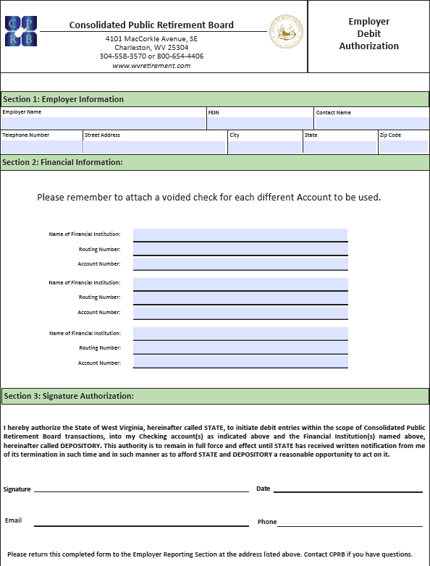
Automated Clearing House
BENEFITS OF ACH
Lower Cost
Increased Security
Convenience
Reduced Human Error
Faster Processing Time
Complete the Employer Debit Authorization form & return it to the WVCPRB with the copy of a Voided Check
- One bank account per agency code

Slide 4
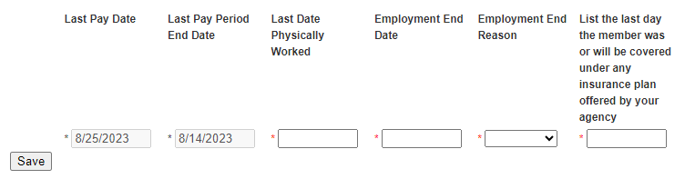
Retirement Certification
“Last Pay Date” and “Last Pay Period End Date are populated based on the last posted contribution at the time of the certification creation.
“Last Day Physically Worked” is the last day the member reported to work.
“Employment End Date” is the last day of covered employment.
Can be completed on/after the termination date.
DO NOT USE RETIREMENT DATES FOR THESE

Slide 5
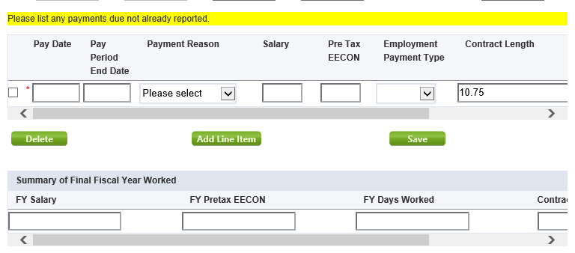
Retirement Certification
Enter any upcoming payments not already reported to CPRB.
“Summary of Final Fiscal Year Worked” is a required field. Enter totals for member’s last Fiscal Year even if it is a partial year. These are essential for the correct retirement calculation. If not completed the employer will be contacted.

Slide 6
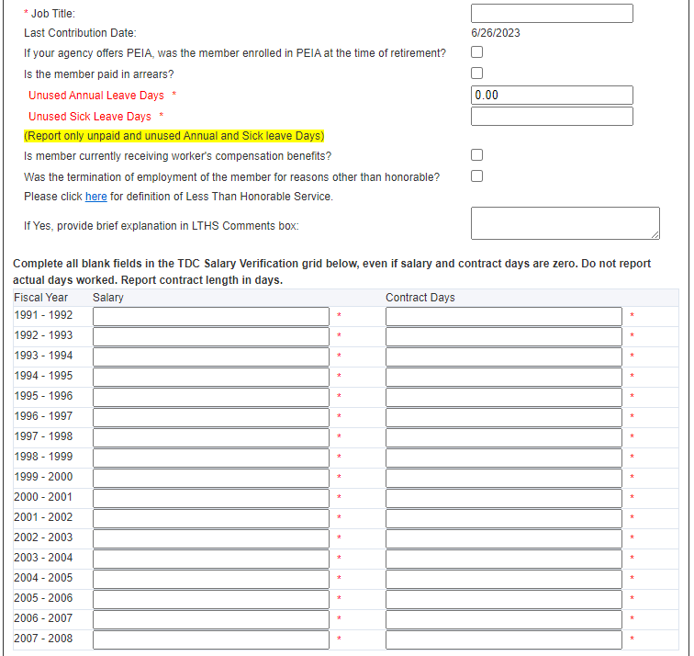
Retirement Certification
TDC Salary Verification is a required field. If not completed the certification will be returned. The Contract Days (Length) was not sent to CPRB during the transfer process. If the years listed do not apply to your agency, then enter 0’s.

Slide 7
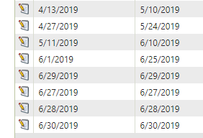
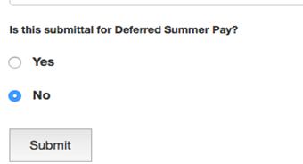
Deferred Summer Pays
All deferred summer pays are due to the CPRB by July 15^{th.}
Designated dates must be on COMPASS Payroll Schedule. If not already on the schedule, contact CPRB with the dates. Since payroll schedule dates in COMPASS should not cross fiscal year, use June Pay Dates & Pay Period End Dates.
Report each Deferred Summer Pay as a separate submission in COMPASS.
Please answer YES in WOW program so pays are identified as Deferred.

Slide 8
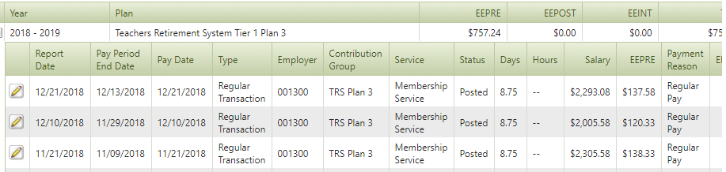
System Terminated Employees
Why is employee “System Terminated” in COMPASS?
Member does not have a contribution reported in COMPASS for 120 days since last Pay Period End Date
CPRB does not know if employee is on Leave Without Pay or Terminated

Slide 9
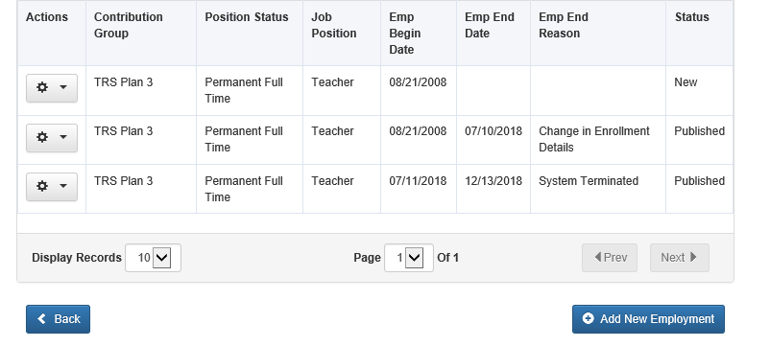
System Terminated Employees
ESS View of a System Terminated Employee

Slide 10
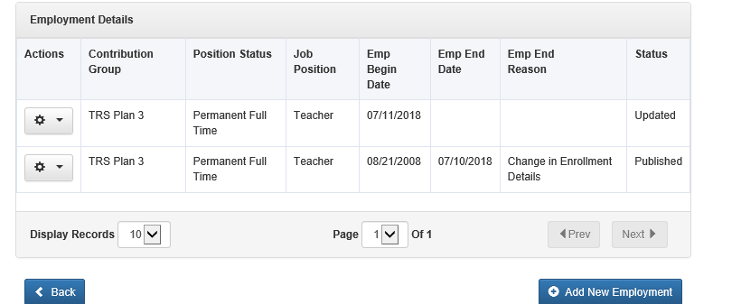
System Terminated Employees
How Should Employers Correct?
Contact CPRB when an “error” occurs for a system terminated employee
CPRB Staff can remove the date (if all other employment details remain same) and error will be fixed

Slide 11
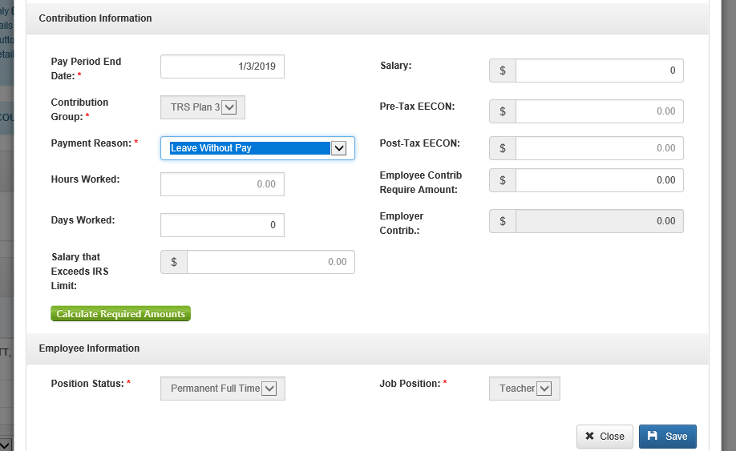
System Terminated Employees
How can this be prevented?
Every employer can manually add record for a member that is off payroll
Submitted information through ESS will prevent the “System Termination”

Slide 12
System Terminated Employees
Why is the Certification displayed twice?
Employer may receive multiple certifications for a member that has a system terminated enrollment.
It is NOT required to complete multiple certifications for the same member.
Contact the Retirement Department at CPRB if there are multiple certifications for a member and the issue can be resolved.

Slide 13
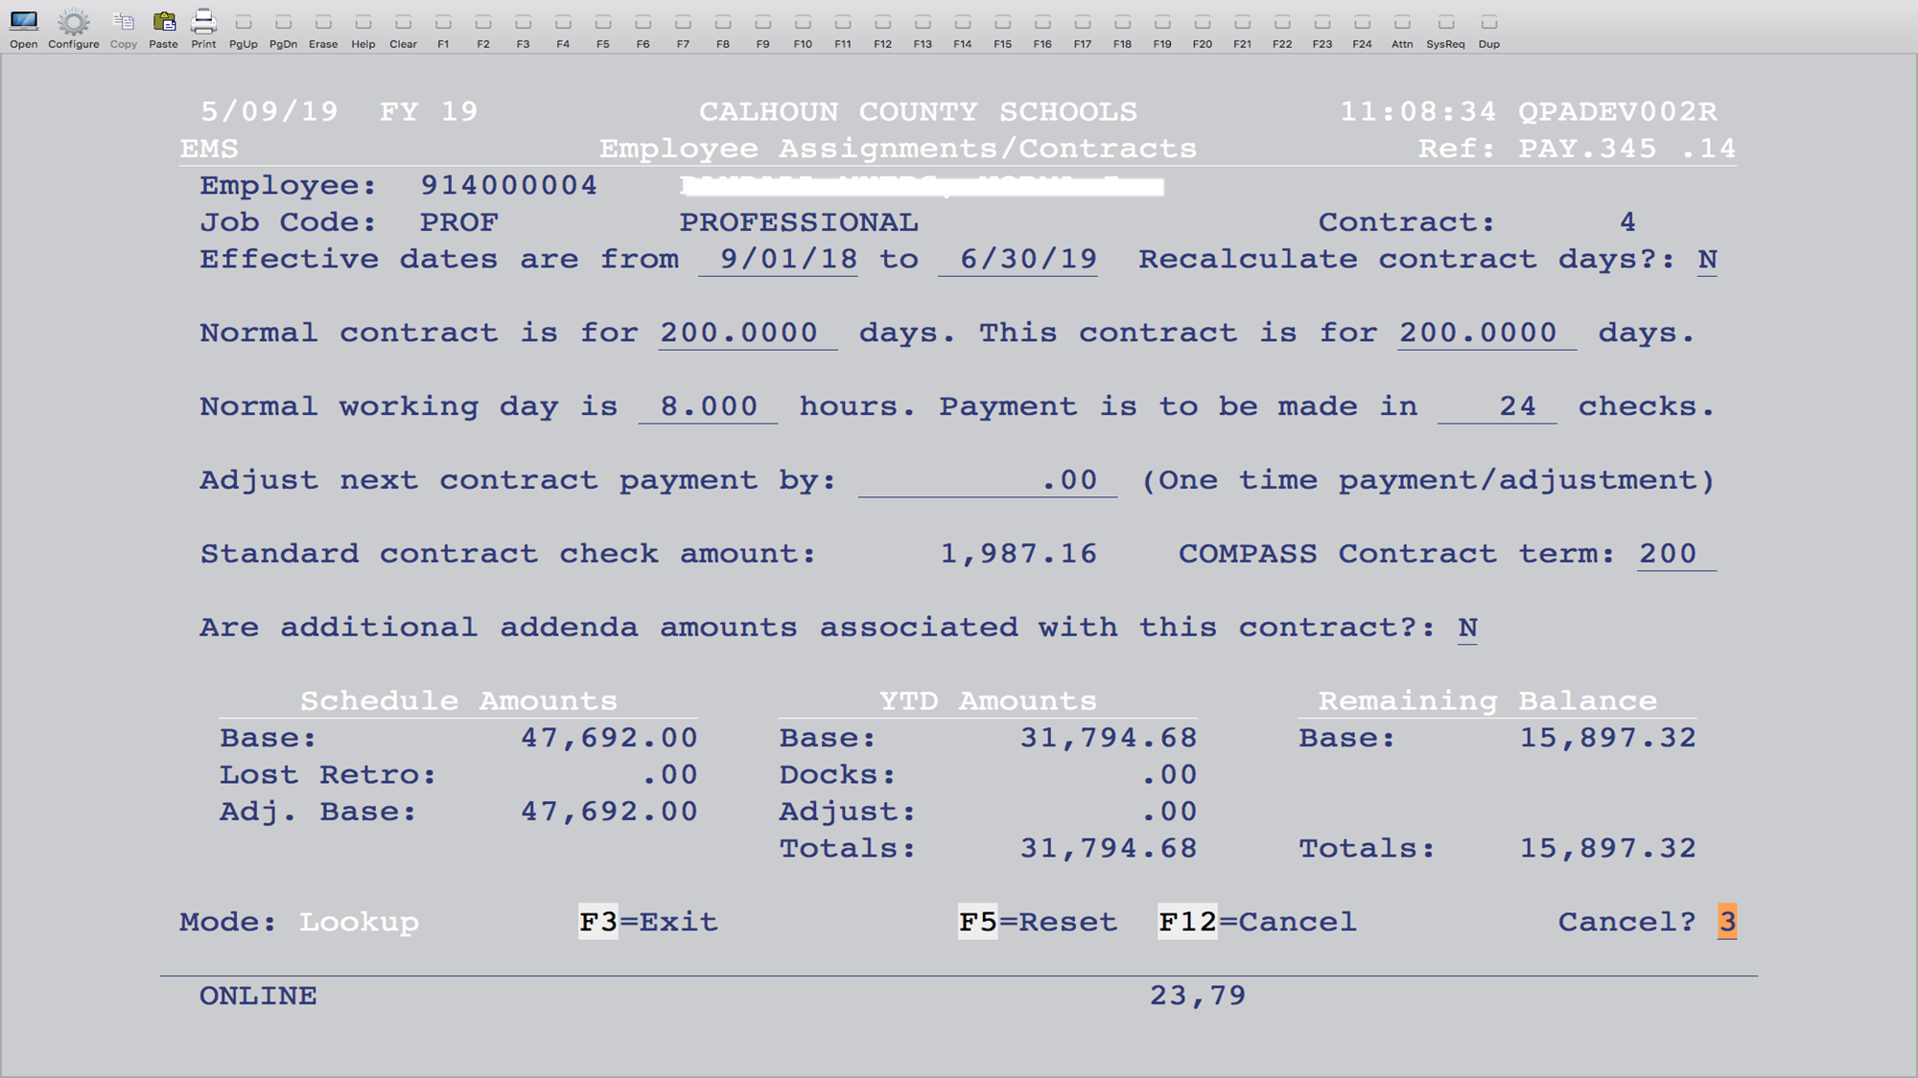
WVEIS Assignment / COMPASS
“Normal contract is for 200.0000 days” is defaulted to 200 in WVEIS based on pay table.
“This contract is for ____ days” should be how many days employee will work that year.
“COMPASS Contract term: ___” is based on the number of days in the POSITION. (This may match the “contract is for” days if they work the full year.)
“Payment is to be made in ___ checks” is total number of checks employee will receive.

Slide 14
How Days Worked are Calculated
The number of days from “This contract is for ___ days” divided by the number of checks.
Example:
Contract for 200 days / 24 checks = 8.333 days

Slide 15
Why Days Worked are Important
Days worked determines total service.
Total Service determines retirement vesting.
TRS Tier 1 (Plan 1 and Plan 3) needs 5 years for vesting
TRS Tier 2 (Plan 9) needs 10 years for vesting
§ 162-4-4.6.1 Service Credit
The Board shall give members absent from service for more than one month in a school year a fractional credit for service that year. The numerator of the fraction shall be the number of days paid and the denominator shall be the number of contract days, not to exceed two hundred and forty (240) days, minus twenty (20).
Example: Employee A worked 180 days on a 200 day contract (1.000yr service)
Employee B worked 168 days on a 200 day contract (0.933yr service)

Slide 16
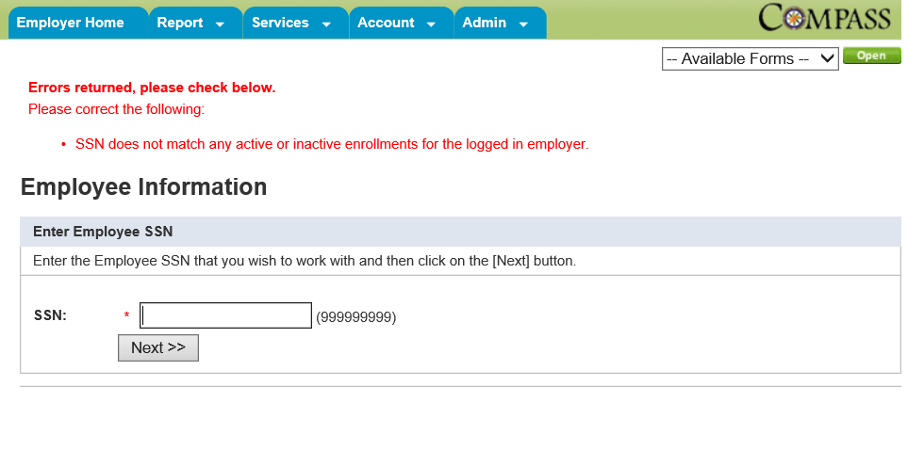
Determine Correct Plan
Services Tab – Employee Information
Enter SSN of new employee

Slide 17
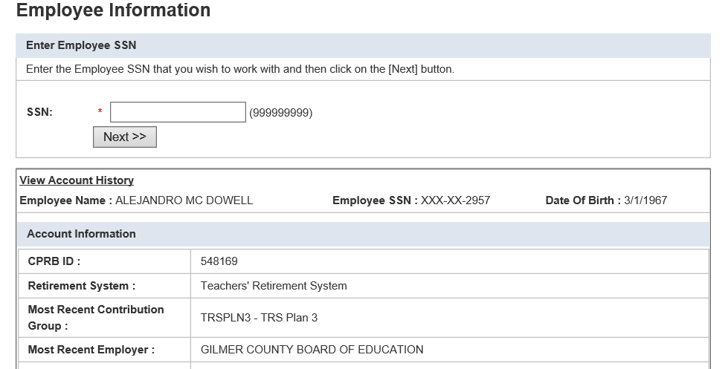
Determine Correct Plan
Services Tab – Employee Information
Enter SSN – Click Next

Slide 18


TDC to TRS Service Purchase
Services Tab – Employee Information
UNPURCHASED SERVICE
PUCHASED SERVICE

Slide 19
Post Retirement Employment
§ 162-4-6
Any retirant who accepts employment by a participating employer, other than as a college teacher, for a relatively short period (no more than a one hundred-forty (140) day contract) who is not considered in any way a permanent or regular employee is considered a temporary, part-time or substitute employee and shall continue to receive his or her normal monthly benefit during the temporary employment. The days may be consecutive.
Retirees exceeding the 140 days worked will be reduced to his or her guaranteed minimum annuity amount the month the 141st day is worked and will remain reduced each month he or she continues to work.
Annuity will be restored to full benefit the month following termination
140 Days start over each fiscal year (July 1)

Slide 20
Post Retirement Employment
Retiree and Employer Responsibilities
Track Days worked
Report to CPRB when exceeded 140 limit
Inform CPRB upon termination so benefit can be restored
Substitute “teachers” can add their hours together to equal a day worked. This is determined by Totaling the number of hours worked and dividing by the standard number of hours that a full-time teacher works per day.
All other positions count as 1 day worked no matter the hours per day
*VERY IMPORTANT*
CPRB should be notified as soon as the employment begin date has been determined by Employer or Employee.

Slide 21
Improvements/Suggestions
The CPRB is always looking for ways to improve. Please feel free to share insight into any ideas that can improve the current processes.

Slide 22
Questions?
Send questions via email to CPRBEmployerHelp@wv.gov

