Slide 1


Unclaimed Property for
WV School Business Officials
Presented by Maegan Trout
West Virginia State Treasurer’s Office

Slide 2


Identifying the Basics
What type of property to report
Where and When to report
How to report
How to claim back property

Slide 3

What is Unclaimed Property?
Financial assets owed to an individual or business entity where the owner cannot be located
Any business entity could have unclaimed property

Slide 4
Basic Terminology
Holder – The business Entity “Holding” the unclaimed funds. Your School or County would be the “Holder”
Owner – The individual or business entity that the funds belong to.
Property – The entire report record of Owner and amount information.
Claim – Process the rightful owner takes to receive payment for Unclaimed Property funds.

Slide 5

Examples of property
Accounts Payable Checks
Expense Checks
Vendor Payments
Overpayment or Refund Checks
Any Miscellaneous Outstanding Checks
Any unknown money – cleanup items

Slide 6
Where do I report?
Rules of Jurisdiction as defined by Texas v. New Jersey
Property is reportable to the state of owner’s last known address
If no address is on record – report to West Virginia
West Virginia will accept property for owners in other states – as long as it is less than 10% of your total report.

Slide 7

When to report?
Reports and payment are due before November 1st
Reporting period runs July 1st – June 30th
Only file ONE report per year
Property at least one year old on June 30th gets reported on November 1st.
Negative ($0) Reports are NOT required
All public entities have a 1-year dormancy period

Slide 8

Due Diligence
What is it?
Due Diligence is the process of a holder attempting to contact the owner of dormant property to give them a last opportunity to claim the property from the holder before it is turned over to a State Unclaimed Property Administration.
Due Diligence is mandated by state law
  W. Va. Code 36-8-7
  W. Va. Legislative Rule 112-5-6

Slide 9
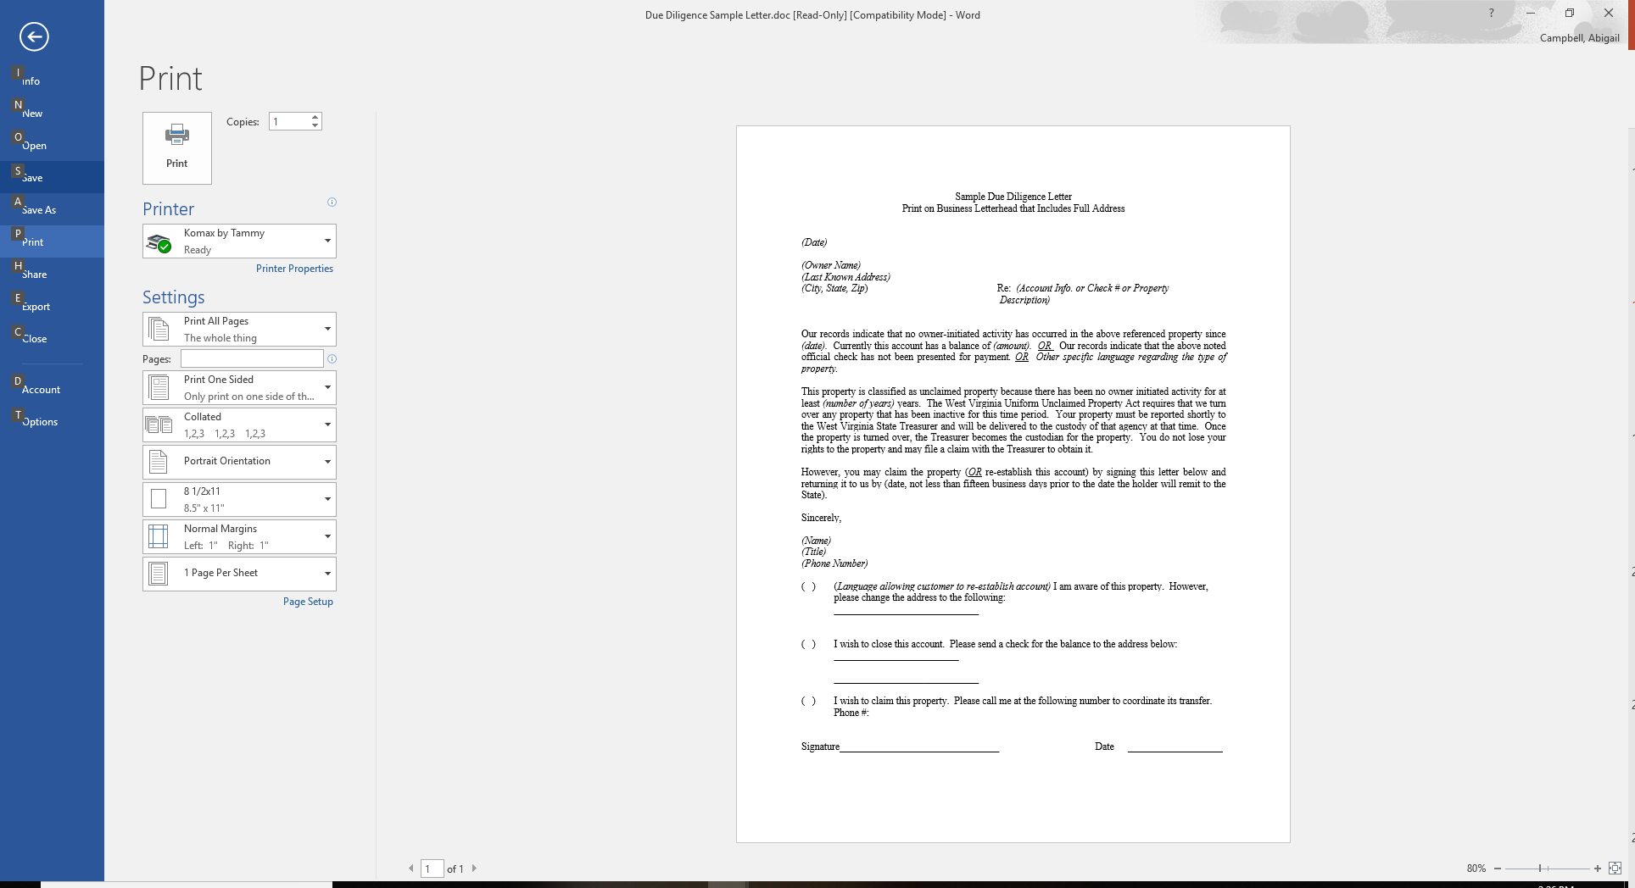
Due Diligence
Send a first class mailing to the owner of the property if:
  Amount is over $50
  Not required if known bad address.
  60 to 120 days prior to reporting.

Slide 10

Electronic Reporting
Paper reports are NO longer accepted – per WV House Bill 4290, passed 2008
If you must file a paper report, you must obtain a hardship waiver.
Electronic Reporting protects everyone

Slide 11

What info is required?
Property type code
Relationship code
Property description
Owner name and address
Date of last activity
Dollar amount
Any additional detail you may have: ss#, date of birth, email address, etc

Slide 12
Electronic Reporting Options
Upload a Report: Use a third party software to create a Naupa File. Upload the file on our website.
Manual Online Reporting: Report online for free on the Treasurer’s new website. Each property will be hand entered individually and report submitted electronically.

Slide 13

Property Type Codes
CK13 – Vendor checks
MS11 – Refunds due
MS99 – Aggregate Misc Property
Entire list can be found on our website

Slide 14
Relationship Codes
This is the Relationship of the “Owner” to the “Property”
Generally, one owner properties are the “Payee” or “Primary Owner” of the funds
Multi Owner – use “And” or “Or”
Deceased – “Estate of”

Slide 15
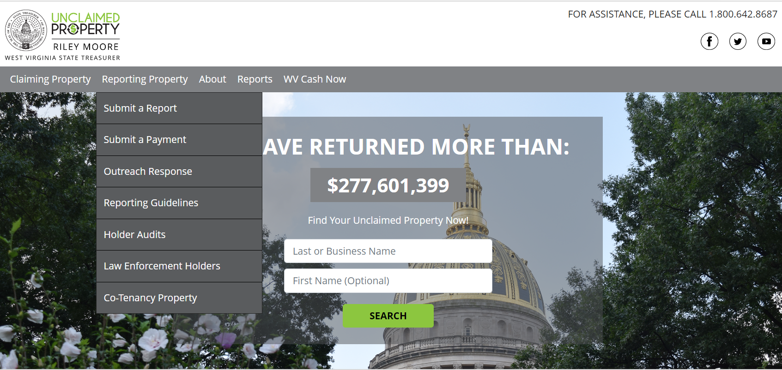
Website Walkthrough
WVUnclaimedproperty.gov
Reporting Property drop down options

Slide 16
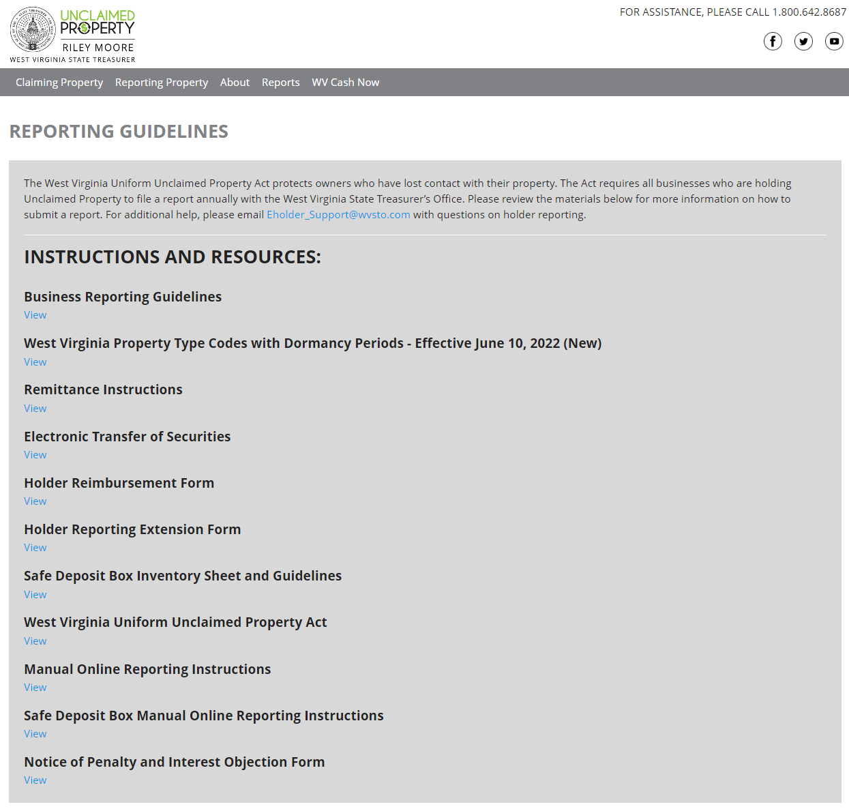
Reporting Guidelines Page
All reporting instructions will be found under the Reporting Guidelines page

Slide 17
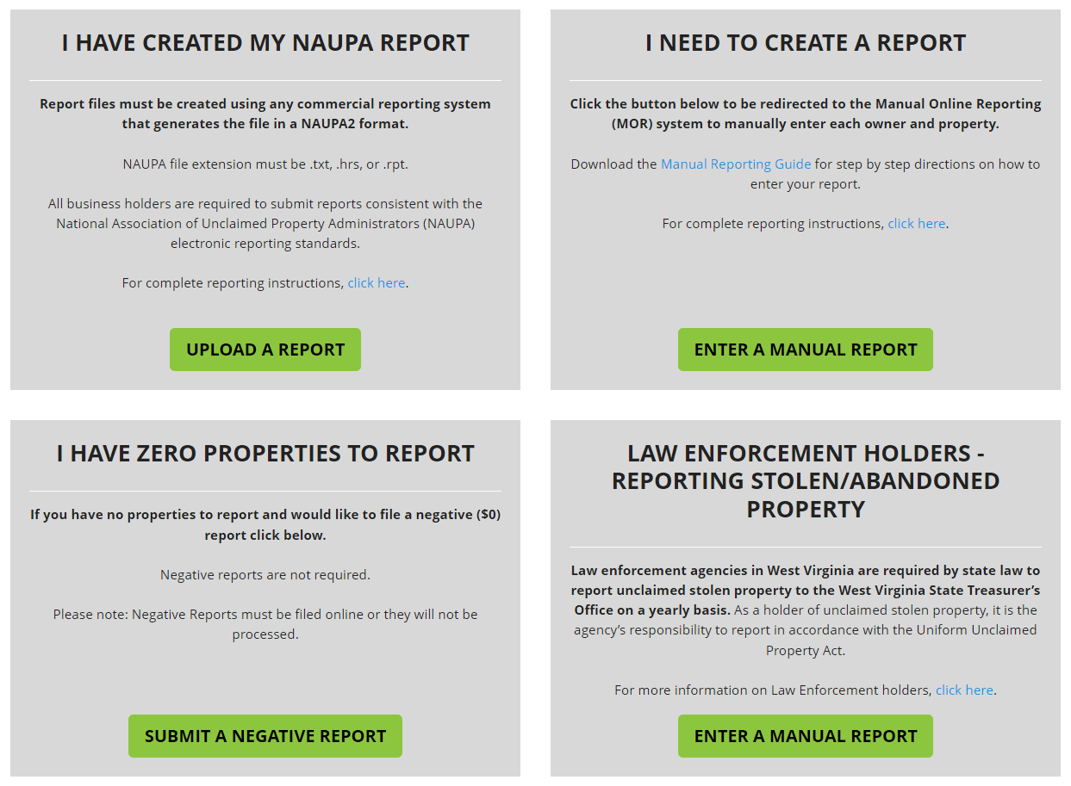
Begin to File a Report
Select “Enter a Manual Report” to hand enter each property on the website

Slide 18
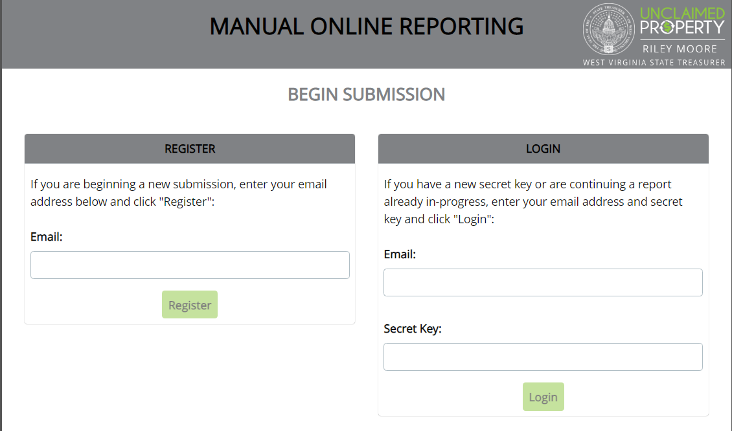
Register for an Account
Enter your Email address and select “Register” to begin your report

Slide 19
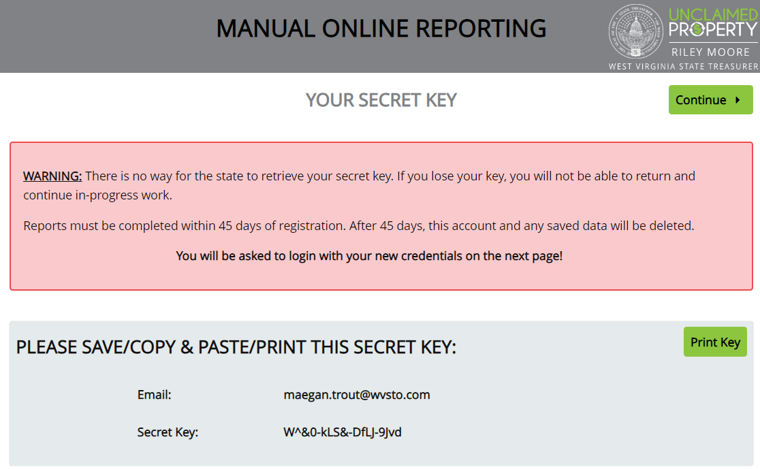

Obtain your Secret Key
You MUST remember your secret key to leave and come back to your report.

Slide 20
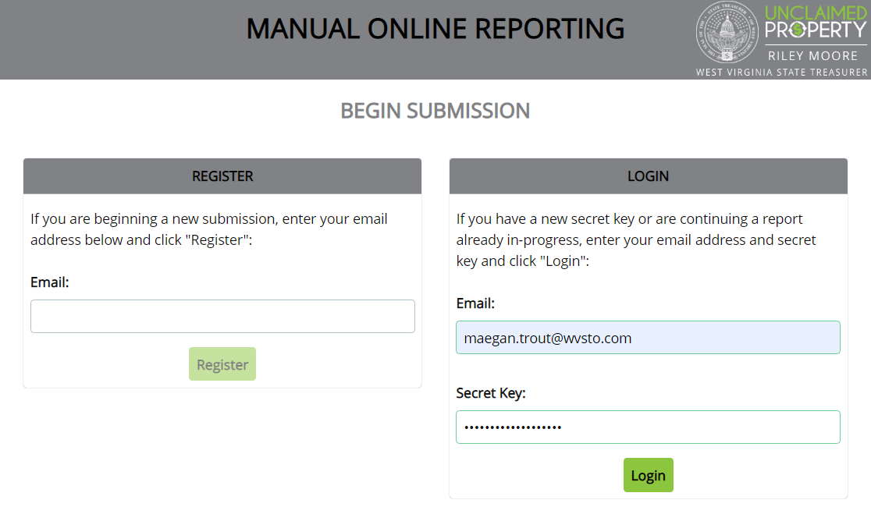
Login with your Email and Key
Enter your Email address and Secret Key to Login

Slide 21
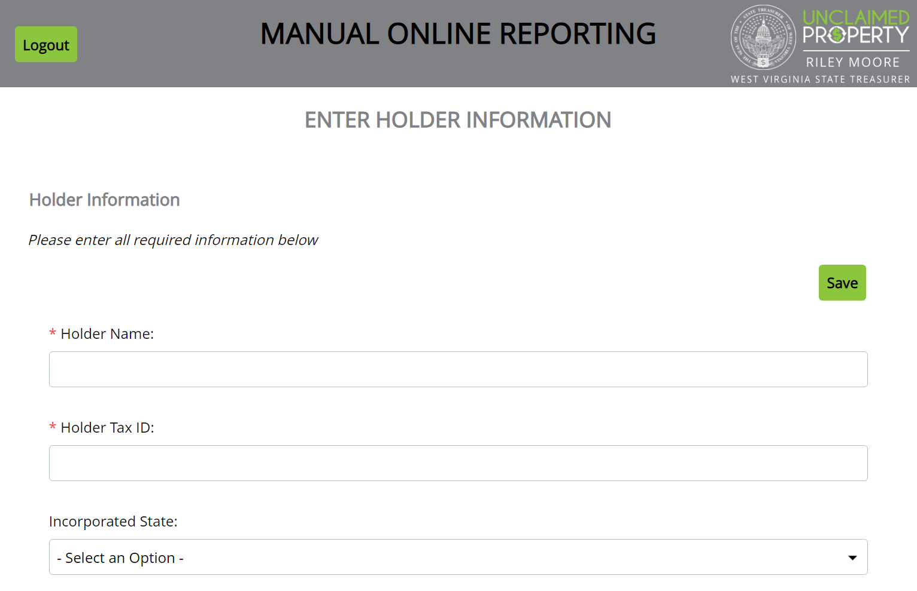
Enter Holder Information
All fields with a Red Asterisk are required fields.

Slide 22
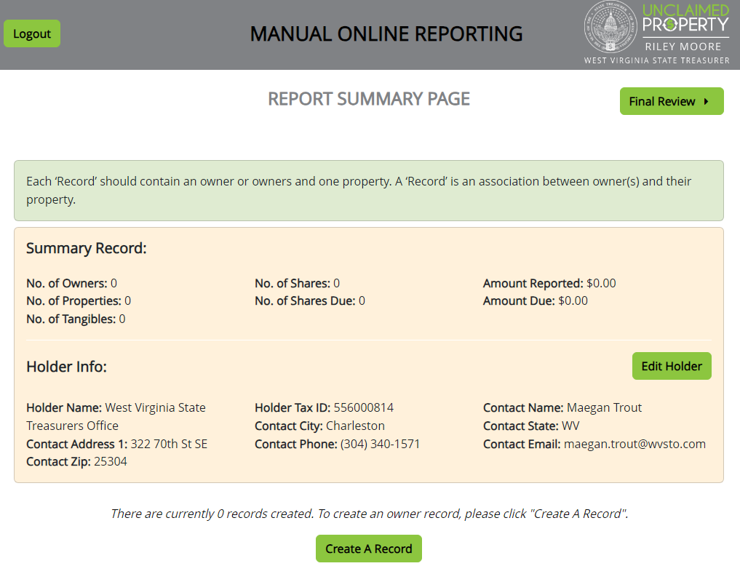
Review Holder Info / Create a Record

Slide 23
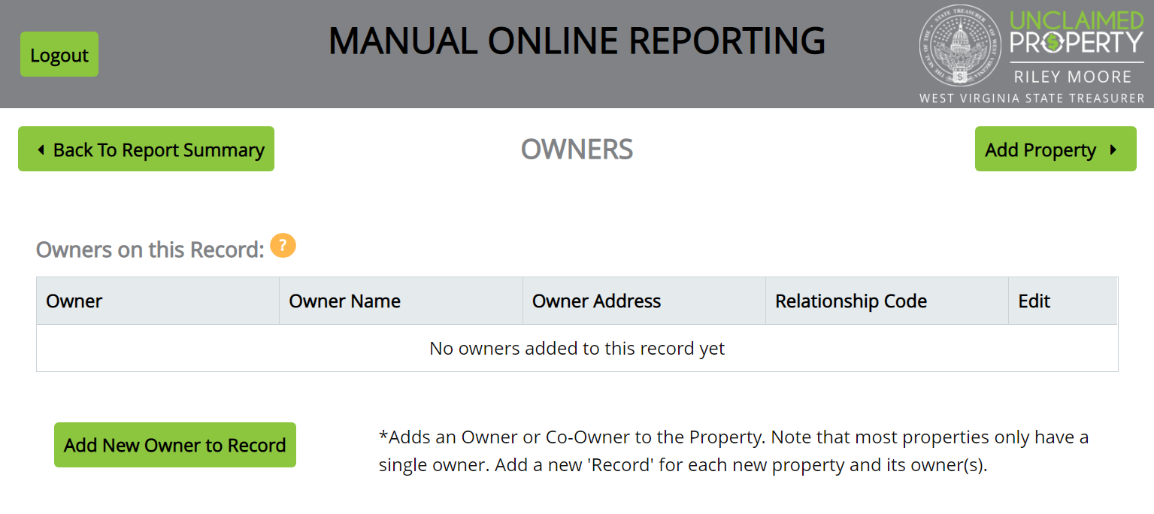
Add First Owner
Properties are added in a Two-Step Process. Each entry will have an Owner screen and a Property screen

Slide 24
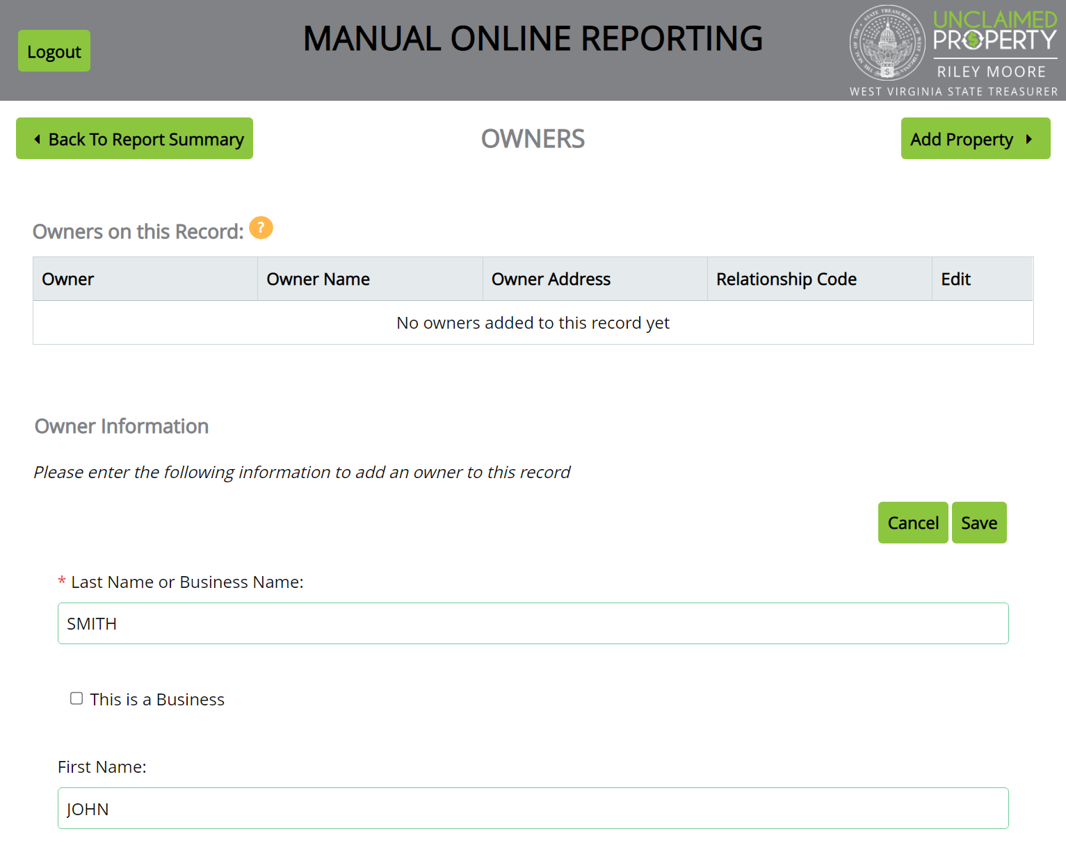
Add Owner and Save
The more information provided, the easier it is to return funds to the rightful owner.

Slide 25
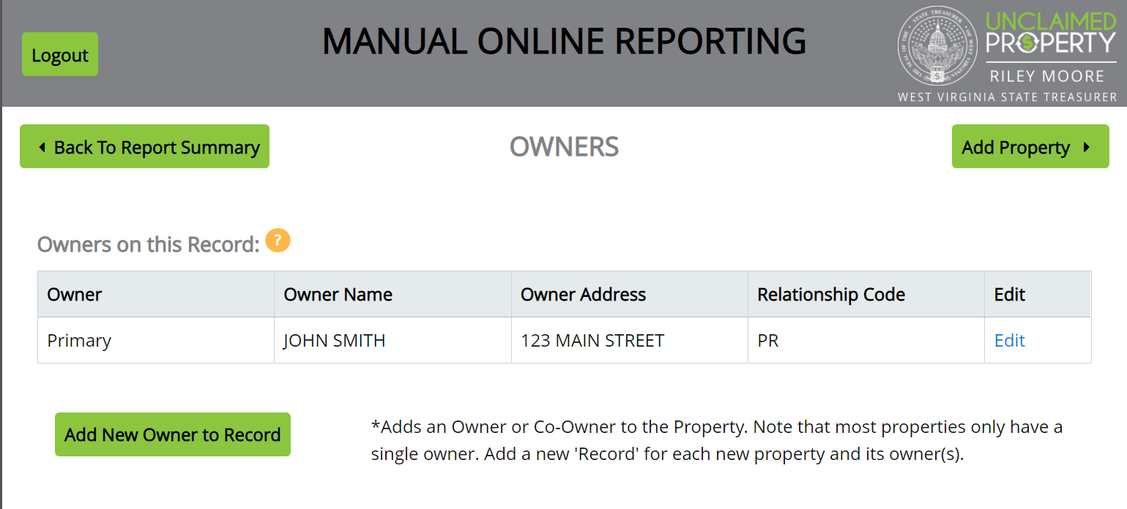
Add First Property
Verify the name and address appear correct before adding the Property information

Slide 26
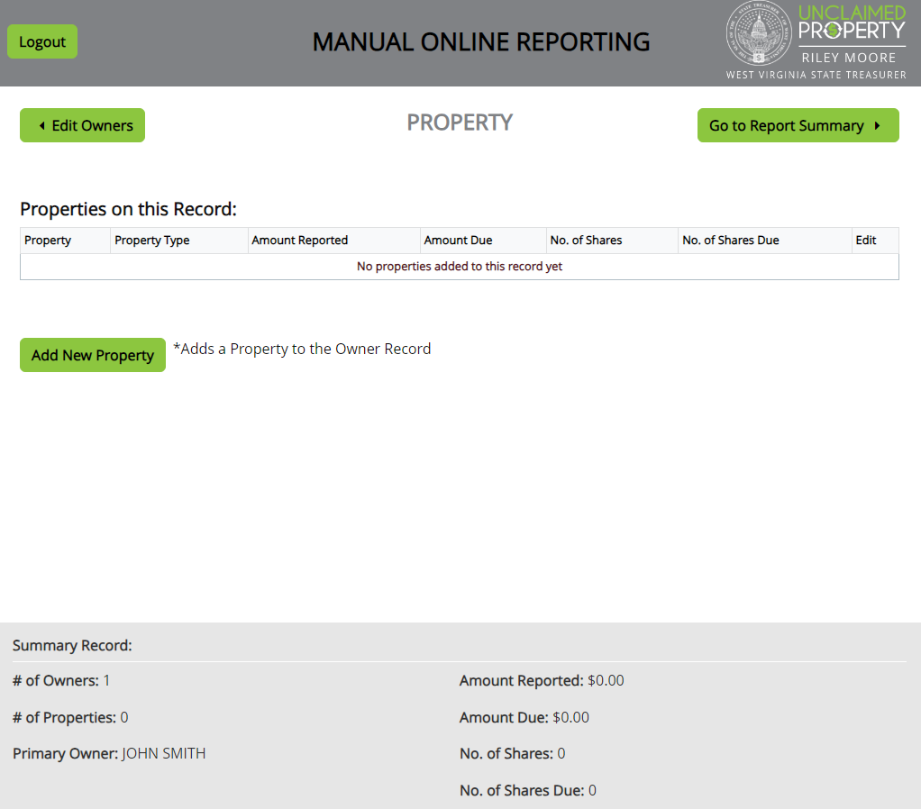
Add a new Property

Slide 27
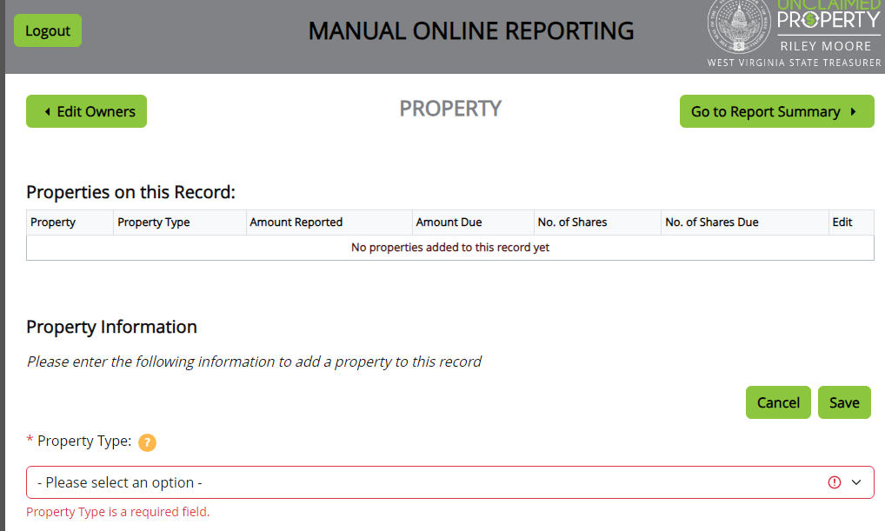
Add property information / Save
Start Date: Date of last activity (last contact) or check date

Slide 28
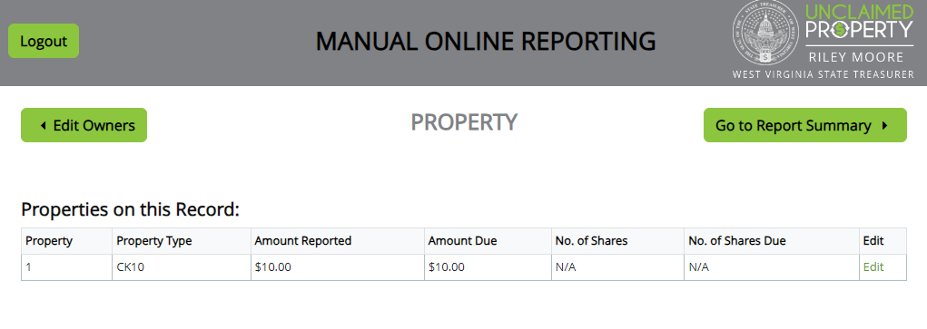
Properties will save
If property information looks correct, go to Report Summary

Slide 29
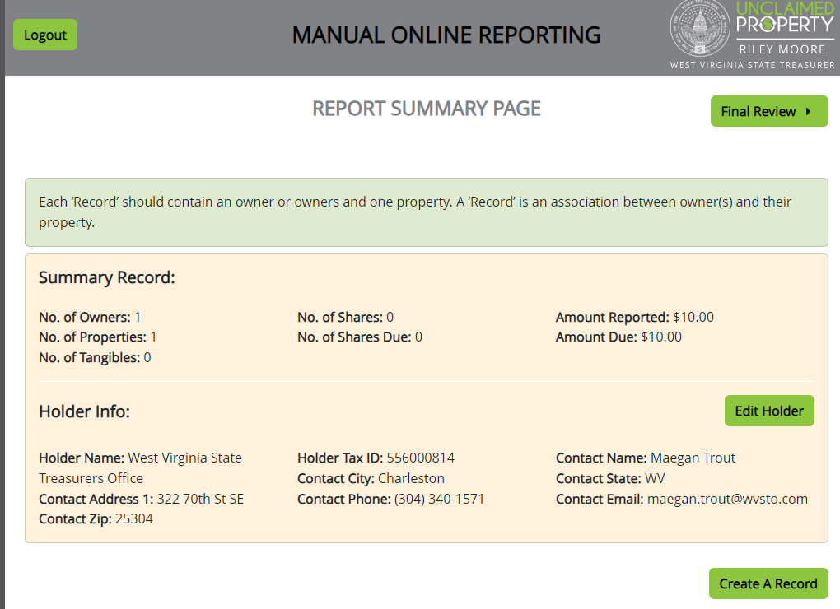
Report Summary

Slide 30
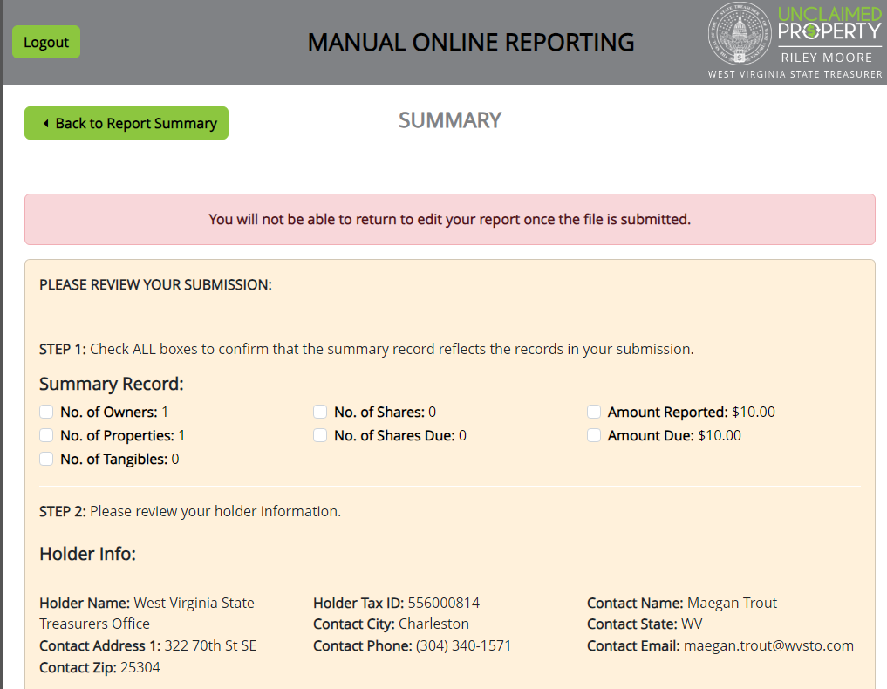
Final Review
Make sure ALL seven boxes are checked – or Submit button will not be clickable

Slide 31
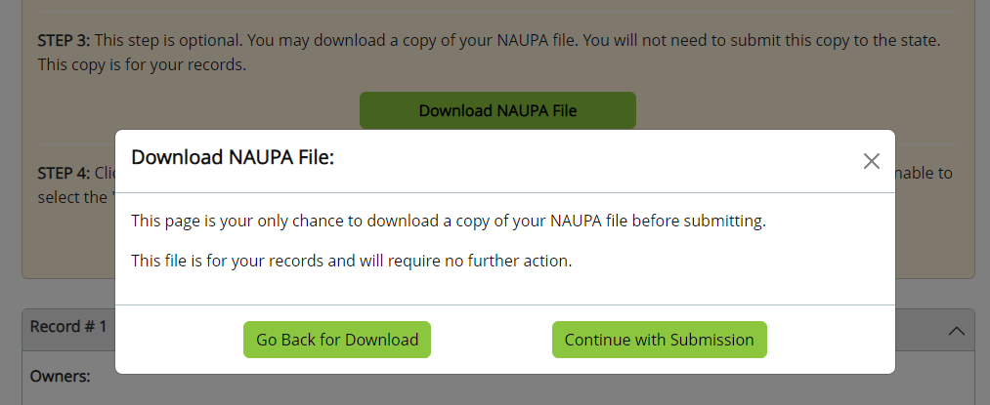
NAUPA File Pop Up
NAUPA file is a flat .txt file that is not easily readable. You do not have to download this file.

Slide 32
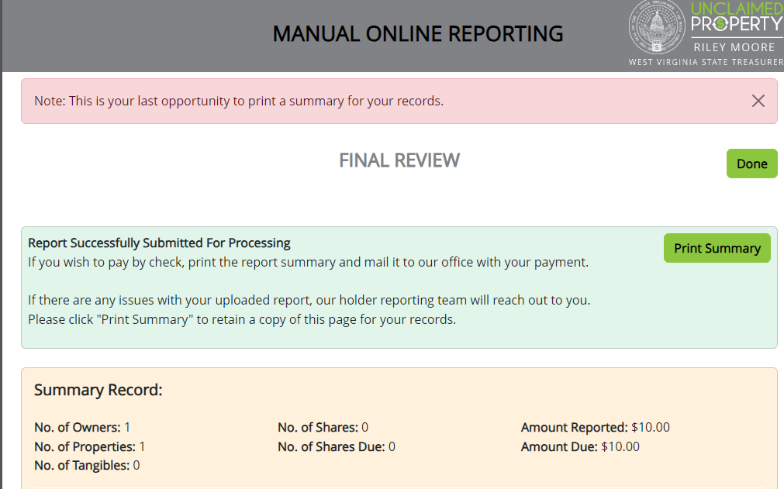
Final Review / Print
Print this summary for your records instead of the NAUPA file

Slide 33
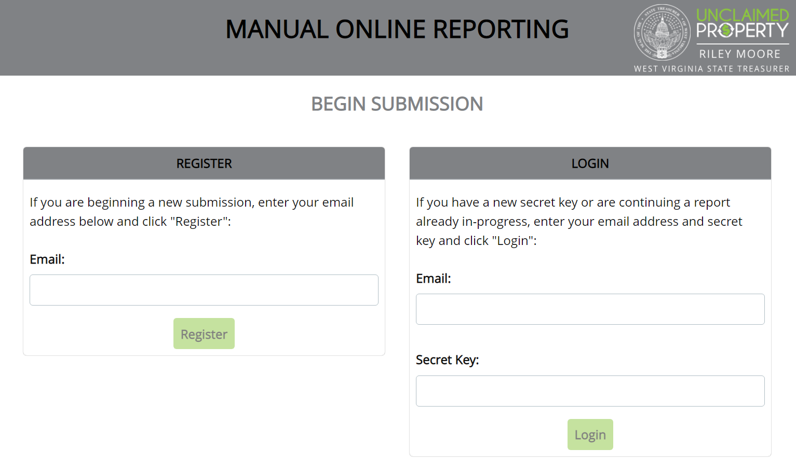
Return to Begin Submission page
Filing a new report requires starting over from the beginning and requesting a new Secret Key

Slide 34
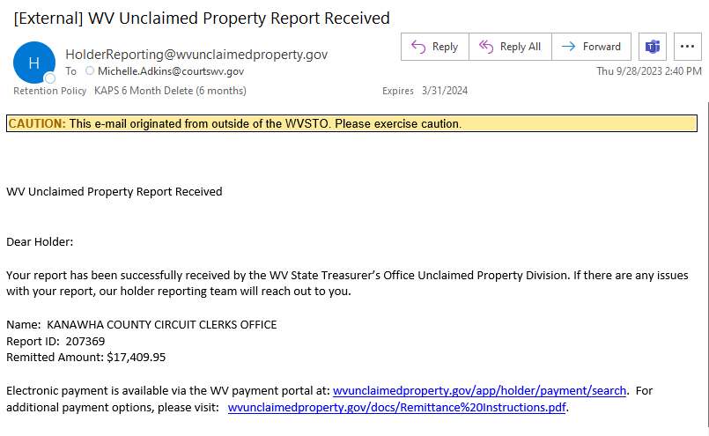
Email Confirmation
Email confirmation should be received by the following business day

Slide 35
Remit Payment
Payment is accepted via:
Online Payment portal
  Electronic Check
  Credit / Debit Card
ACH Credit
Paper Check
Debit Payments are accepted for $100,000 maximum dollar amount

Slide 36
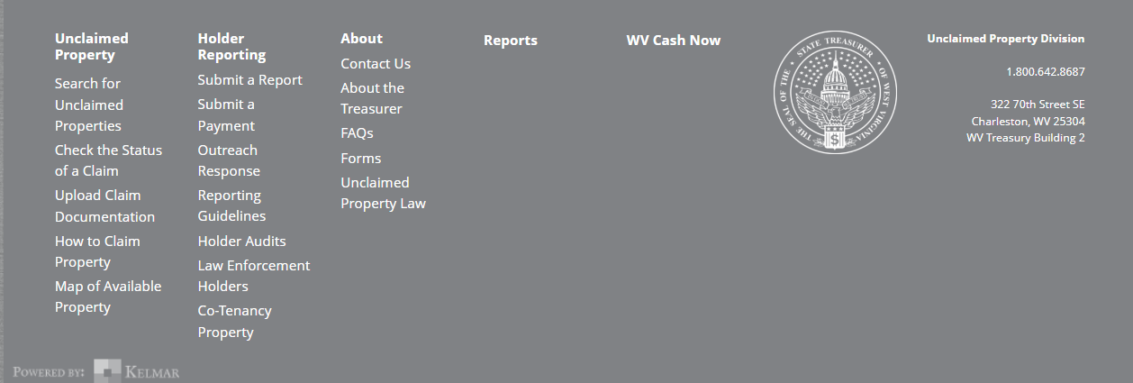
Payment Portal

Slide 37
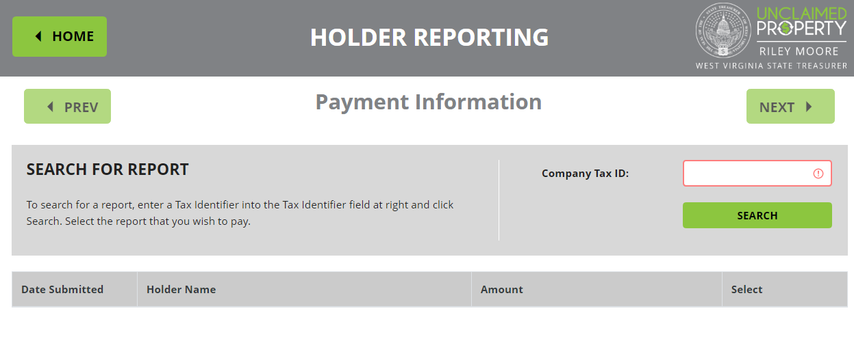
Enter FEIN to find Report

Slide 38
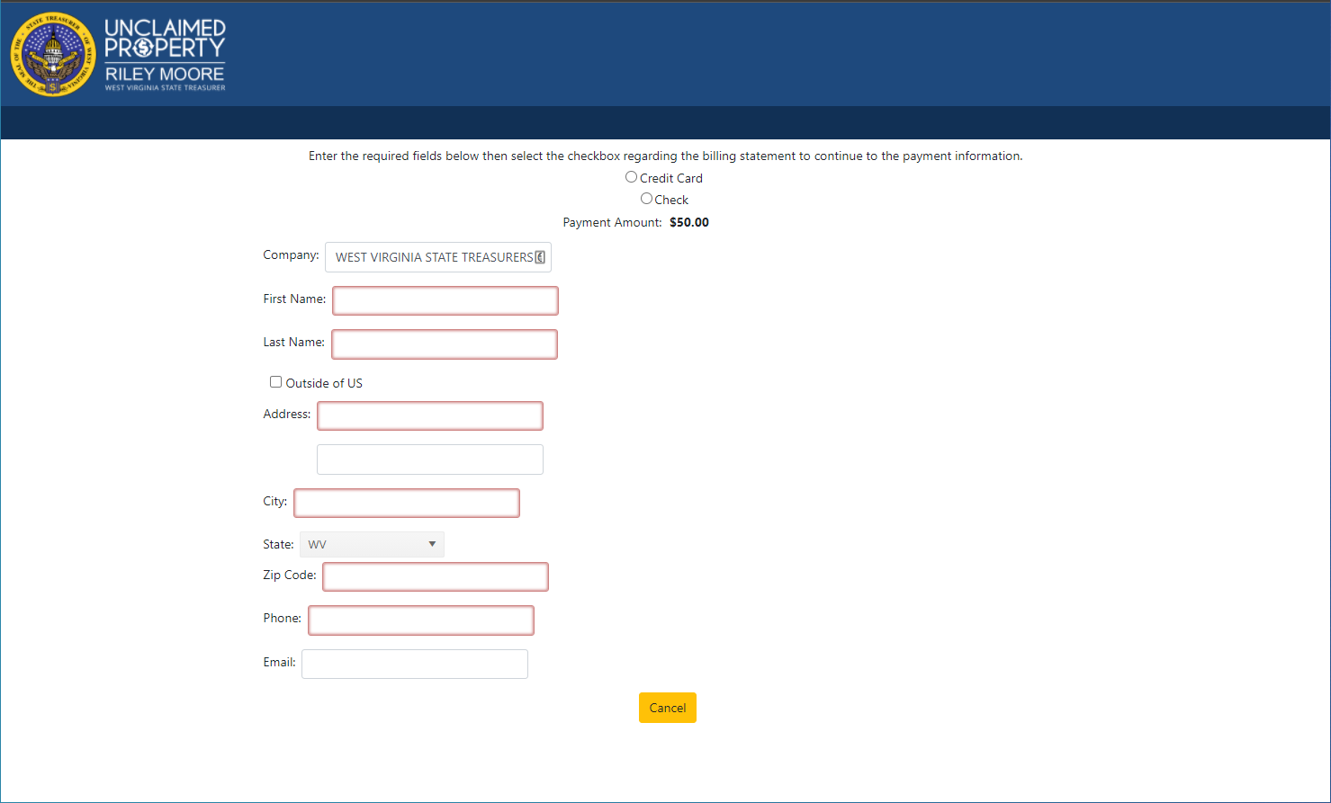
Follow steps to complete payment
You must select Credit Card or Check and enter Card number or Routing / Account number here

Slide 39

Extensions – Why & When
Ensures Compliance
Establishes “good faith”
Reduces audit risk
Must be filed 30 days before the reporting deadline

Slide 40

Reasons to Request an Extension
Technology changes or updates
Change in Personnel
Disaster: Flood, Earthquake, Pandemic
*Forgetting to complete due diligence can NOT be used to request an extension*

Slide 41
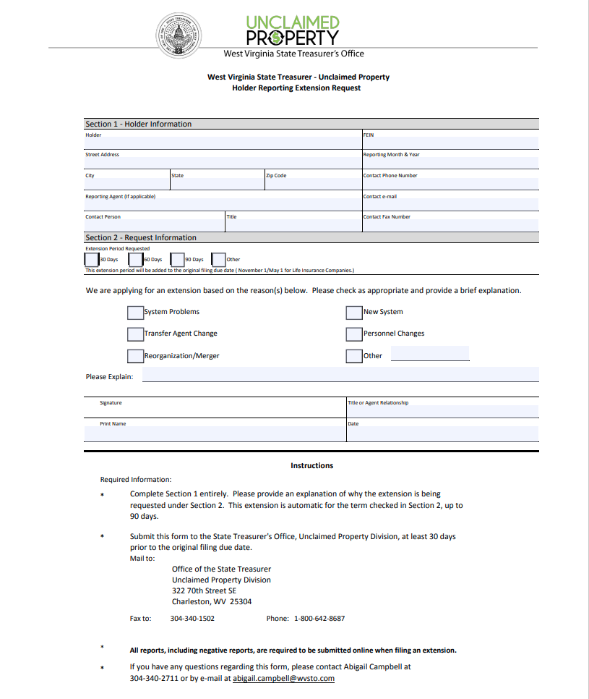
Filing the Extension
Form is on “Reporting Guidelines” website page
Fill out and email or fax to Maegan Trout
Extensions can be requested for 30, 60, or 90 days

Slide 42
Types of Claims
Customer / Owner Claims
Business Claims
Holder Reimbursements

Slide 43
Customer / Owner claims
Payee or their heirs contact you. You have already reported the property. What do you do??
Direct them to call our office at 1-800-642-8687
Direct them to our Website: wvunclaimedproperty.gov

Slide 44
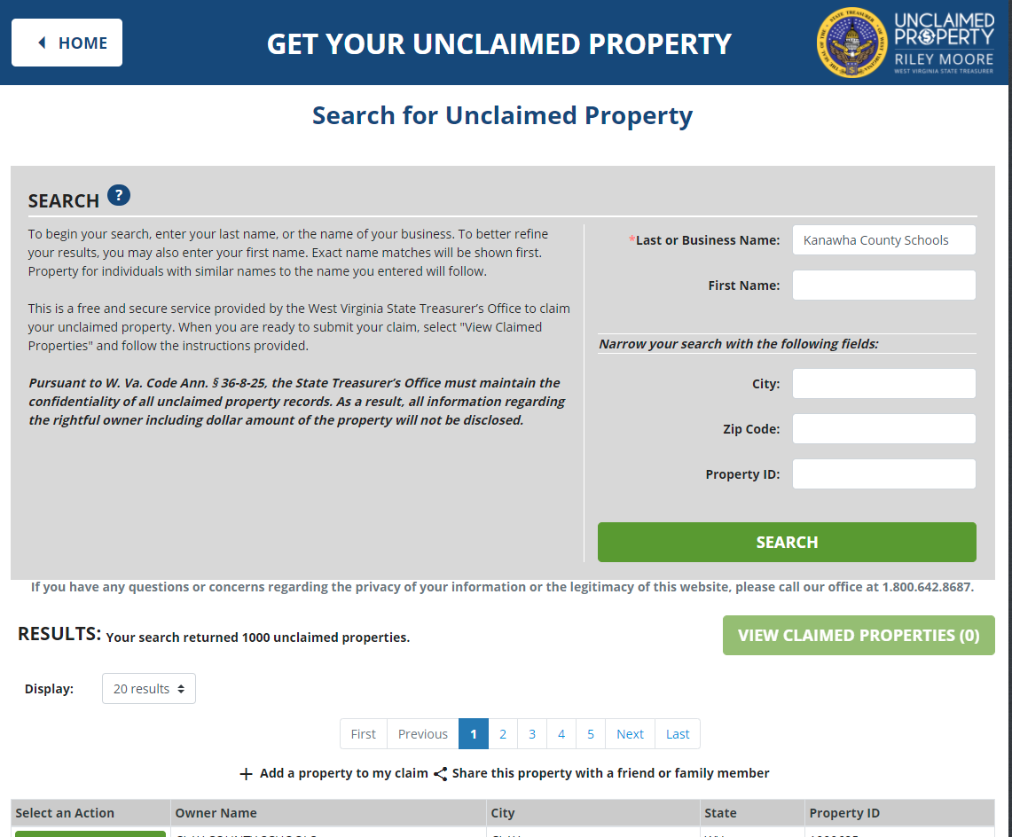
Claims for your School or County / Business Claims
Search the Website for your entity name:

Slide 45
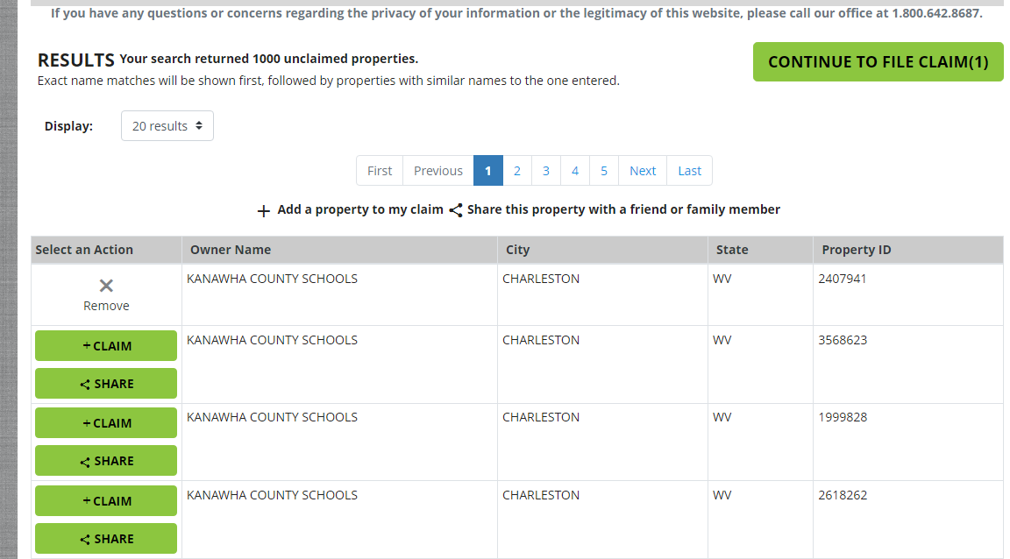
Select Property
Once you’ve found the property, select the claim box and click the green CONTINUE TO FILE CLAIM button to begin the claims process.

Slide 46
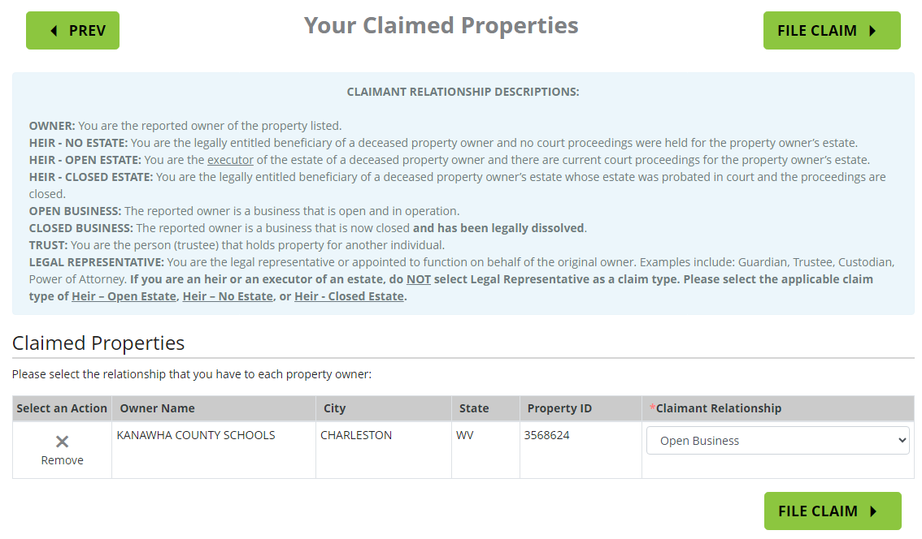
Claimant Relationship
Once you have selected the property you wish to claim, select Open Business from the Claimant Relationship dropdown menu

Slide 47
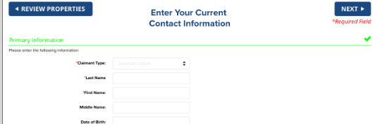
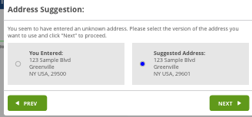
Claimant Information and Address Verification
Enter your contact information
Address Suggestion:
You may receive an additional screen that ask you to verify the address you entered.

Slide 48
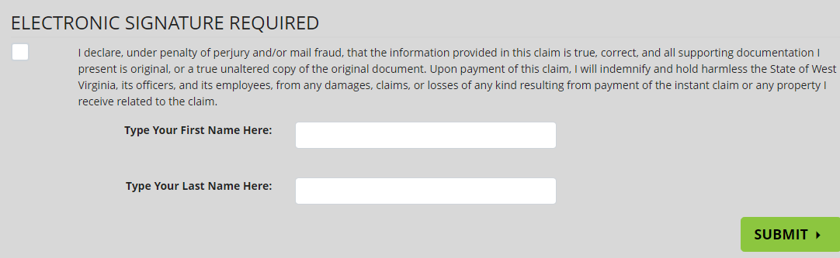
Electronic Signature/Submit Your Claim
You will preview all properties being claimed, verify your current information, and complete electronic signature. If correct, click Submit to officially create your claim and generate your claim number.

Slide 49
Business Claim Evidence Requirements
An email will be sent detailing additional evidence requirements.
  Claim Form
  Photo ID for business representative
  Legal Document of Representation –A letter on letterhead indicating the level of authority of the person filing the claim.
  Legal Document of FEIN-Acceptable documentation includes Federal or State IRS Notification or County Board document showing the tax id number.
  Additional information may be required, based on type of property.

Slide 50
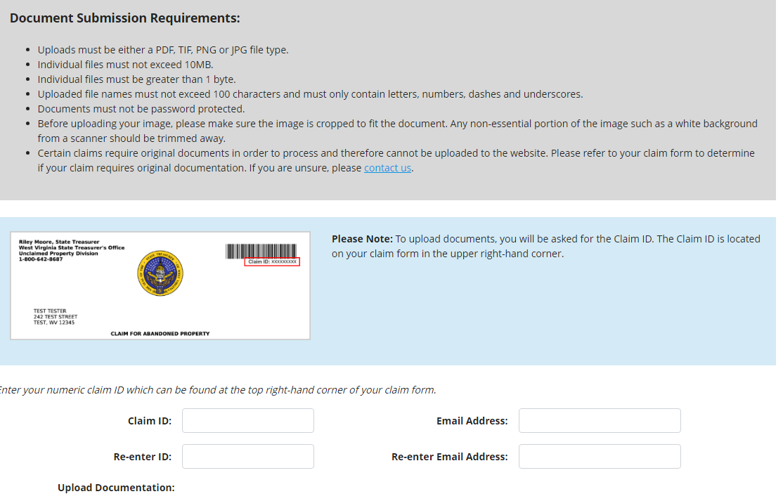
Submitting Documents to State
Documents can be uploaded to the website by our secure link in the email.

Slide 51
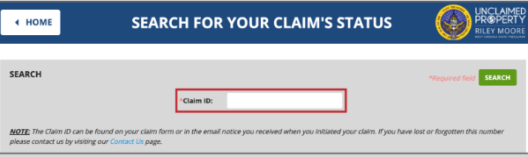
Track Your Claims Process
Your claim number can be found on your claim form and in the email you received at the time of submission. Enter the claim number at any time to check the claim status.

Slide 52

Holder Reimbursement
Item was reported in error
Check was mailed for the incorrect amount
You would like to pay the customer instead of having them claim from us

Slide 53
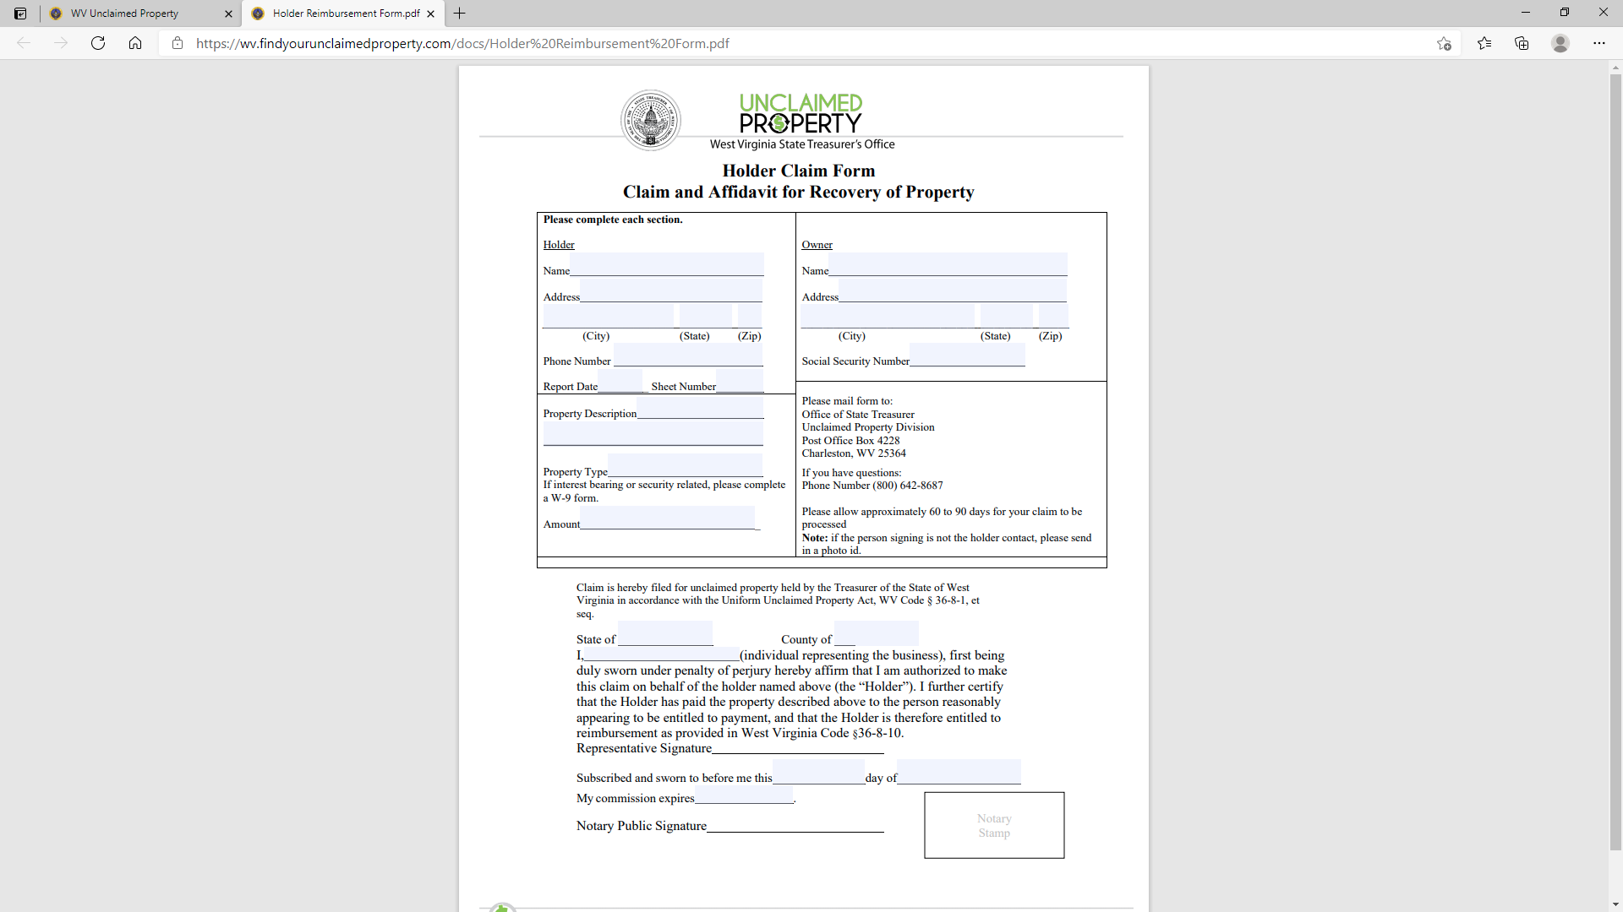
Holder Reimbursement Form
Enter Holder and Owner information – As it was entered on your report
Form must be notarized

Slide 54

Contact Information - Reports
Maegan Trout
Receipts Manager
Eholder-Support@wvsto.gov
(304) 340-1571

Slide 55
Contact Information - Claims
Tricia Sullivan
Claims Manager
Eclaims-Support@wvsto.gov
(304) 340-5029

Slide 56

Questions

