Slide 1
GASB 96 Review and e-Textbooks

Slide 2
GASB 96: Subscription-Based Information Technology Arrangements (SBITAs)
Effective for reporting periods beginning after June 15, 2022 (FY23).
This Statement provides guidance on the accounting and financial reporting for subscription-based information technology arrangements (SBITAs) for government end users (governments).
SBITA Definition:
  A contract that conveys control of the right to use another party’s IT software, alone or in combination with tangible capital assets as specified in the contract for a period of time in an exchange or exchange-like transaction.
A SBITA agreement results in an intangible right-to-use asset and a corresponding subscription liability.

Slide 3
GASB 96: SBITAs
How to determine whether a contract conveys control of the right to use the underlying IT assets.
  The entity should assess whether it has both of the following:
    The right to obtain the present service capacity from use of the underlying IT assets as specified in the contract.
    The right to determine the nature and manner of use of the underlying IT assets as specified in the contract.
Hardware that is a part of a SBITA must be accounted for in accordance with GASB 87; the corresponding subscription must be accounted for in accordance with GASB 96.

Slide 4
GASB 96: SBITAs
Does not apply to:
  Contracts that convey control of the right to use another party’s combination of IT software and tangible capital assets that meets the definition of a lease in Statement 87, in which the software component is insignificant compared to the cost of the underlying tangible capital asset.
  Governments that provide the right to use their IT software and associated tangible capital assets to other entities through SBITAs.

Slide 5
GASB 96: SBITAs
Perpetual License
One-time fee
Can use the software after the expiration date, but:
No maintenance provided No security patches and/or updates
Subscription-Based
Monthly or yearly fee
The right to use expires after a certain amount of time.
After expiration, software cannot be used until it is renewed.

Slide 6
GASB 96: SBITAs
Recognition and measurement
  Once a SBITA is identified, the county would recognize a subscription liability and a subscription asset at the commencement of the subscription term of the SBITA, which occurs when the county obtains control of the right to use the underlying IT asset.
  The subscription term is the period that the government has the noncancelable right to use the underlying IT assets, plus the following periods, if applicable:
    Periods covered by a county’s extension option if it is reasonably certain that the county WILL exercise that option.
    Periods covered by a county’s termination option if it is reasonably certain that the county WILL NOT exercise that option.
    Periods covered by a vendor’s extension option if it is reasonably certain that the SBITA vendor WILL exercise that option.
    Periods covered by a vendor’s termination option if it is reasonably certain that the vendor WILL NOT exercise that option.

Slide 7
GASB 96: SBITAs
Subscription Liability
  Like GASB 87: Leases, the initial subscription liability is measured as the present value of the total subscription payments expected to be made.
  The total future payments are discounted using either the interest rate the vendor charges the government or the implicit interest rate.
  If the implicit interest rate is not readily determinable, the government may use an estimated incremental borrowing rate.

Slide 8
GASB 96: SBITAs
Subscription Liability (continued)
  Payments that should be included in the PV calculation of the subscription liability:
    Fixed payments
    Variable payments based on an index or a rate, measured using the index or rate as of the commencement of the subscription term
    Variable payments that are fixed in substance
    Termination penalties, if the subscription term reflects the government exercising either an option to terminate the agreement or a fiscal funding or cancellation clause
    Incentives receivable from the vendor
    Other payments the government is reasonably certain will be required to be made to the vendor

Slide 9
GASB 96: SBITAs
Subscription Asset
  Measured as the initial value of the subscription liability plus:
    payments made to the vendor at the commencement of the subscription term
    capitalizable initial implementation costs
    minus any vendor incentives received at the commencement of the subscription term
  The county will then amortize the subscription asset in a systematic and rational manner over the shorter of the subscription term or the useful life of the underlying IT asset.

Slide 10
GASB 96: SBITAs
Other Outlays
  In addition to subscription payments, there may be cash outlays for other activities associated with SBITAs. The type and timing of the activity dictates the accounting treatment of these cash outlays. Other activities associated with SBITAs are grouped into three stages:
Stage | Activities | Accounting
Preliminary Project Stage | Conceptual formulation Evaluation of alternatives Selection of vendor | Expense as incurred
Initial Implementation Stage | Configuration Coding Testing Installation | Generally capitalized as an addition to the subscription asset
Operations and Additional Implementation Stage | Subsequent implementation activities Maintenance Troubleshooting | Expense as incurred, unless activity meets specific capitalization criteria

Slide 11
E-Textbooks
Do e-textbooks need to be reported as SBITAs?
  SBITA Definition:
    A contract that conveys control of the right to use another party’s IT software, alone or in combination with tangible capital assets as specified in the contract for a period of time in an exchange or exchange-like transaction.
  Does the agreement give you the right to access the information for a period of time greater than 12 months?
    Options to extend must be a written part of the agreement.
  Does the agreement give you access to IT software?
    IT software means any representation of instruction, data, sound, and image including source code and object code recorded in a machine, readable form and capable of being manipulated or providing interactivity to use by means of automatic data processing machines.

Slide 12
E-Textbooks
Your e-textbook agreements most likely qualify as SBITA agreements.
Most e-textbook agreements are 5-6 years.
  GASB 96 must be applied retroactively.
  If you determine that your e-textbook is a SBITA, and on July 1, 2022, your e-textbook agreement has a term greater than 12 months remaining, you will need to report a SBITA.
Many of these agreements are paid up front instead of in monthly/annual installments.

Slide 13
E-Textbooks
If you identify your e-textbook agreements as SBITAs, but you pay for the agreements up-front:
  You still need to enter the information into the CIVIX software.
  You will have an ROU asset that will be amortized over the shorter of the useful life or length of the agreement.
  Depending on when the agreement was entered into, you may also have a beginning SBITA liability that will be reduced to zero at year end.
  You will need to discuss with your auditors whether there is a material affect on your governmental fund statements.
    Possible prepaid expense
    Possible deferred outflow of resources

Slide 14
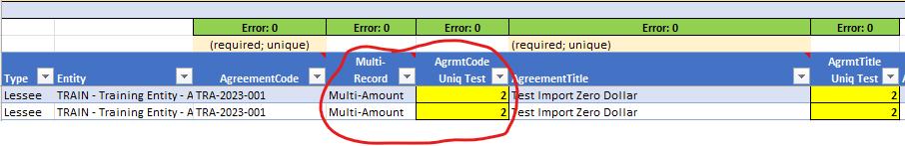
E-Textbooks
If you paid for your e-textbook SBITA agreement upfront, you would need to enter the agreement into the GASB 96 import template as a multi-line agreement.

Slide 15
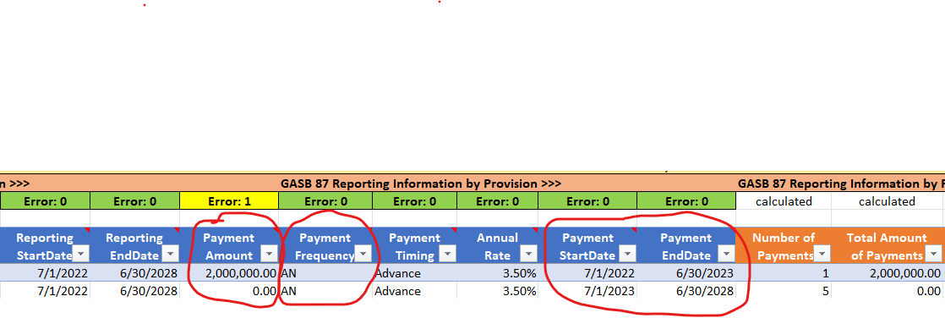
E-Textbooks
The first line “Payment Amount” column would be for the entire payment amount and the “Payment StartDate” and “Payment EndDate” would be for the first year of the agreement.
The second line “Payment Amount” column would be zero and “Payment StartDate” and “Payment EndDate” would be for the remainder of the agreement.
Please make sure the “Payment Frequency” is set to AN for Annual for both lines

Slide 16
E-Textbooks
Actual written agreements may not exist for your e-textbook subscriptions.
In the absence of a written agreement, counties should look at invoices or price quotes to determine whether a SBITA exists.
Agreements, invoices, or price quotes might be for a combination of physical textbooks and e-textbooks.
Please remember the definition of a SBITA when going through these invoices and/or price quotes.

Slide 17
E-Textbooks
If a government enters into a contract that contains both a subscription component and a nonsubscription component the government should account for the subscription and nonsubscription components as separate contracts unless:
  a contract does not include prices for individual components, or if any of those prices appear to be unreasonable
    The county board should use professional judgment to determine its best estimate for allocating the contract price to those components, maximizing the use of observable information.
    If it is not practicable to determine a best estimate for price allocation for some or all components in the contract, a government should account for those components as a single SBITA.

Slide 18
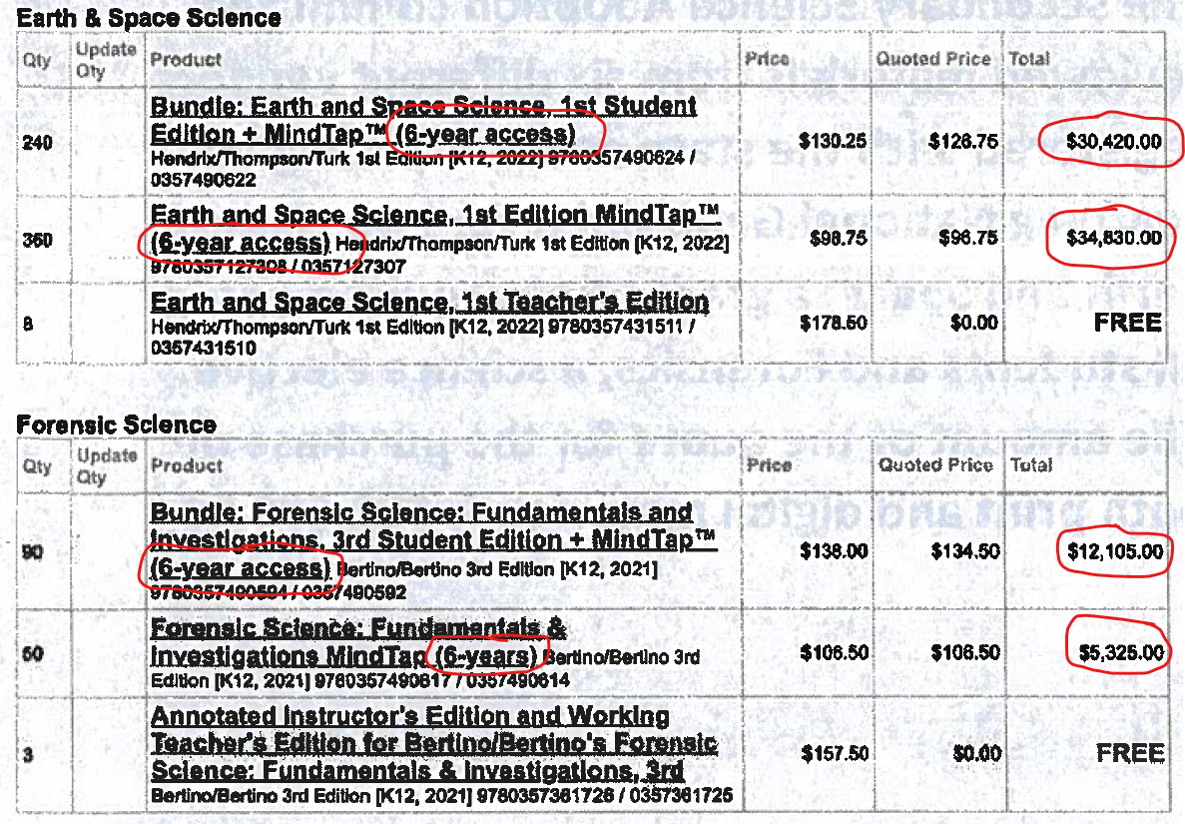
Examples
6-year access is stated
Dollar amounts clearly listed
Entire amount should be treated as a SBITA.
  $30,420
  $34,830
  $12,105
  $5,326
  $82,681 - This is the amount that would go in the first line of the import template.

Slide 19
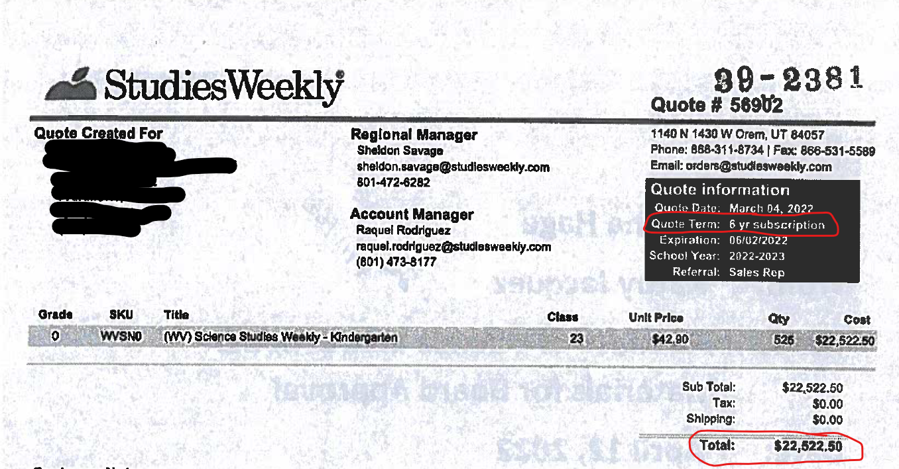
Examples
6-year access is stated
Dollar amount clearly listed
Entire $22,522.50 amount should be treated as a SBITA.
  This is the amount that would go in the first line of the import template.

Slide 20
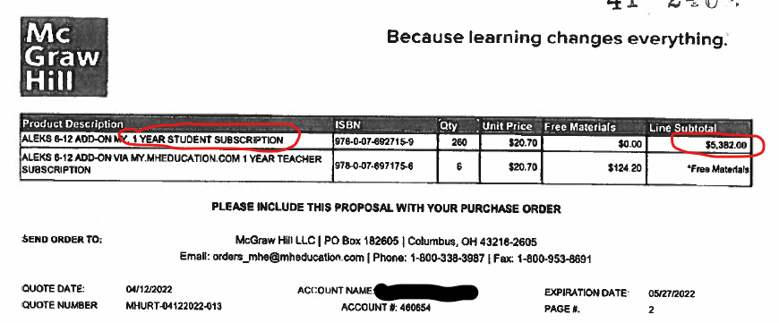
Examples
1-year access is stated
Dollar amount clearly listed
Agreement is for 1 year or less with no stated renewal option
Should be expensed and not treated as a SBITA

Slide 21
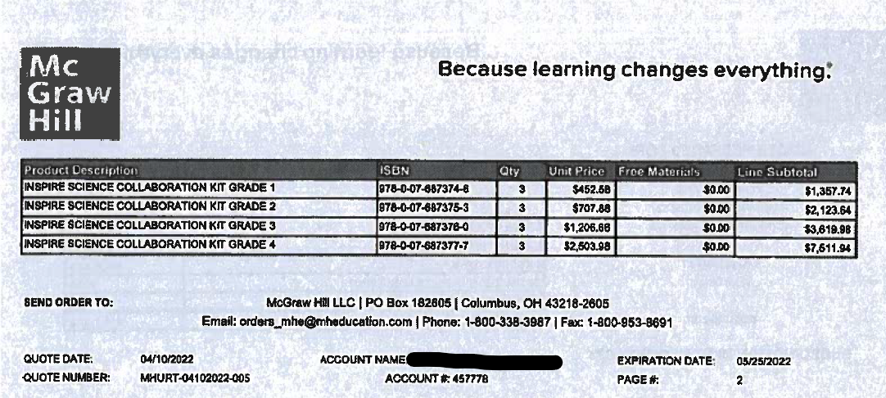
Examples
No mention of a “period of time”
Dollar amount clearly listed
Description states “Collaboration Kit”
Should be expensed and not treated as a SBITA

Slide 22
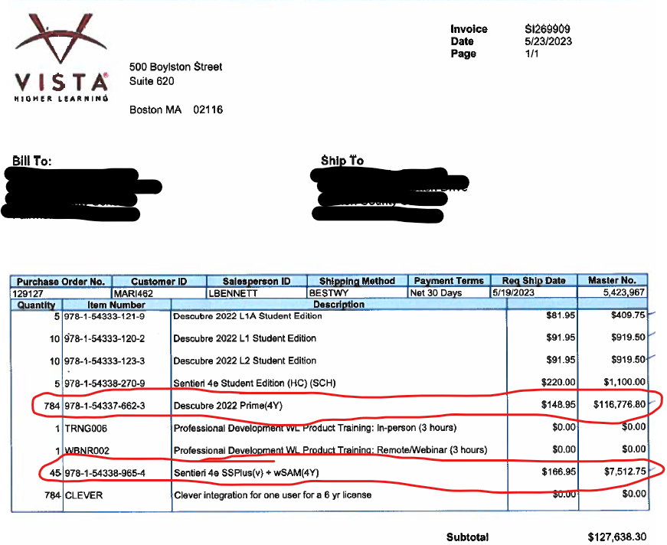
Examples
Invoice consists of multiple components
It will sometimes be necessary to go line by line to determine if you have a SBITA
Only the two circled items would qualify as SBITAs
Dollar amount clearly listed
You may also have to look at the invoice and cost proposal to help determine what an item on the invoice is

Slide 23
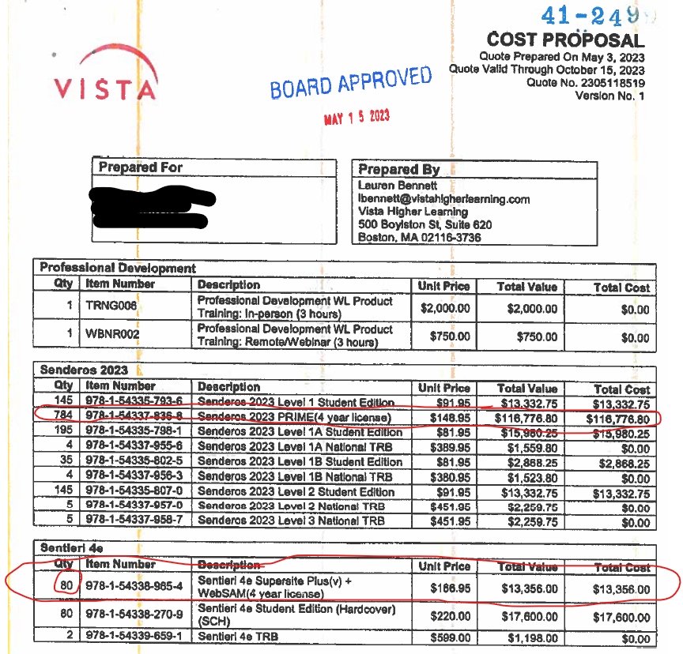
Examples
Cost Proposal for invoice on previous slide
Notice the quantity quoted was not ultimately the quantity ordered.
  Quantity is 80 on the Cost Proposal
  Quantity is 45 on the Invoice
  Make sure you use the amount for the quantity that was ordered and received.

Slide 24
Summary
GASB 96 is effective for the FY23 reporting period.
E-textbooks will most likely qualify as SBITAs.
Valuing SBITAs may be difficult.
  Invoices
  Price Quotes
  What if the agreement has multiple components that can’t be separated?
SBITAs may have an effect on your governmental funds.

Slide 25
QUESTIONS?

Slide 26
Thank You
Josh Harner, CPA
WVDE Office of School Finance
304-558-6300
Joshua.harner@k12.wv.us

