Slide 1

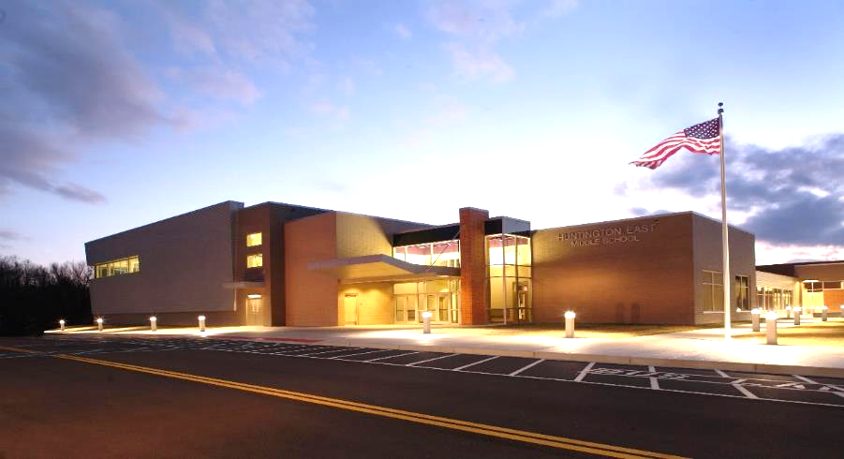

School Building Authority
of
West Virginia
School Building Authority Opportunities and Updates
WV ASSOCIATION OF SCHOOL BUSINESS OFFICIALS
October 4, 2023
10:35 AM

Slide 2
Overview
SCHOOL BUILDING AUTHORITY OF WEST VIRGINIA
SBA Mission Statement
School Building Authority Members
School Building Authority Staff
Grant Types
  NEEDS Projects
  MIP Projects
  MCS Projects
  Emergency Grant Projects
  Distressed County Projects
Items Needed for Requisition Reimbursement Processing
Fiscal Year-End Processing / Requisition Submission
Common Delays in Requisition Reimbursement Processing
Requisition Reimbursement Form Examples
SBA Requests When Providing Final Project Invoices
Grant Closeout Requirements
  SBA 502 Grant Closeout Form
  WVEIS Backup Information Example
Common Issues in Grant Closeout Processing

Slide 3
School Building Authority Mission
SCHOOL BUILDING AUTHORITY OF WEST VIRGINIA
“The (SBA) is empowered to facilitate and provide state funds
for the construction and maintenance of school facilities to meet the educational needs of the people of the state in an efficient and economical manner.”
(WV Code §18-9D)

Slide 4
School Building Authority Members
SCHOOL BUILDING AUTHORITY OF WEST VIRGINIA
Statutory President– Governor Jim Justice
Governor’s Designee/Authority Chair – Brian Abraham
Governor’s Appointee Authority Members
  Mr. Chris Morris, Vice Chair
  Mr. Don Bower
  Mr. Gregory Wooten
  Ms. Sandra Hamilton
  Mr. Thomas R. Minturn
State Board of Education Authority Members
  Michele Blatt, State Superintendent of Schools
  Ms. Nancy White, Secretary
  Mr. L. Paul Hardesty
  Dr. Daniel D. Snavely

Slide 5
School Building Authority Staff Members
SCHOOL BUILDING AUTHORITY OF WEST VIRGINIA
Executive Director – Andy Neptune
  Executive Assistant – Shannon Driver
Architecture Staff
  Director of Architectural Services – Dana Womack
  Asst. Director of Architectural Services – Tommy Young
  Asst. Director of Architectural Services – Joyce VanGilder
  Asst. Director of Architectural Services – Mark Miller
  Coordinator of Architectural Services – Angie Bradley
Finance Staff
  Chief Financial Officer – Jordan Kirk
  SBA FEMA Team Lead – Christina Dyess
  Coordinator of Financial Services – Lisa Wilkinson
  Coordinator of Administrative Services – Tamela Brewer

Slide 6
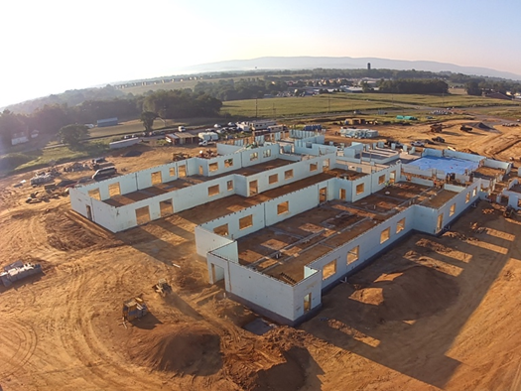
Grant Types
SCHOOL BUILDING AUTHORITY OF WEST VIRGINIA
NEEDS
MIP (Major Improvement Projects)
MCS (Multi-County Statewide)
  Formerly known as 3% Grants
Emergency
Distressed County Emergency
FEMA Grants
Jefferson County: New Ranson Elementary under construction ICF Walls – 9/6/23

Slide 7
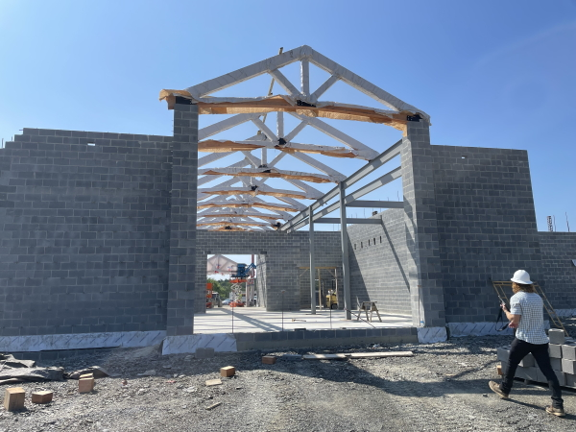
NEEDS Grant Projects
SCHOOL BUILDING AUTHORITY OF WEST VIRGINIA
New Schools & Major Renovations
  Multi-million-dollar project awards
  Must be part of 10-year CEFP
Application Process
  Application deadline is normally in September
    SBA Form 201
    Project Budget Estimates
  Superintendent Interviews are normally in November
    Provide opportunity to express project importance and student impact
    Clarify any issues/questions regarding the project
    Familiarize SBA Members with projects
  Project Awards are normally in December
Mineral County: Frankfort ES construction 7/6/23

Slide 8
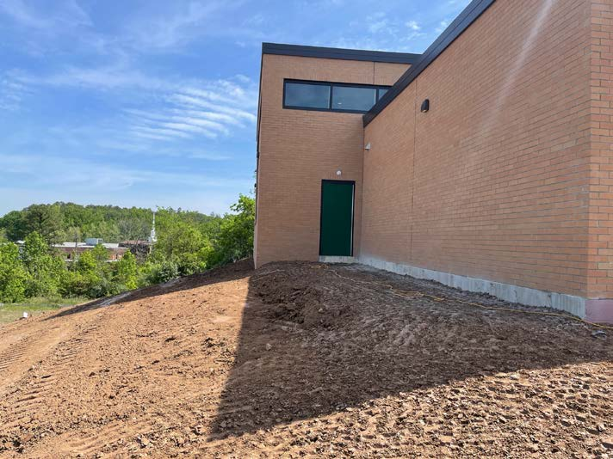
MIP (Major Improvement) Projects
SCHOOL BUILDING AUTHORITY OF WEST VIRGINIA
Grant Awards up to $1,000,000
Address problems Maintenance Budget cannot
Typically HVAC / Component renovations
Must be part of 10-year CEFP
Application Process
  Applications normally due in March – April
    SBA Form 202
    Project Budget Estimates
  Projects normally awarded in June
Kanawha County: Ruthlawn ES Addition/Renovation 5/11/23

Slide 9
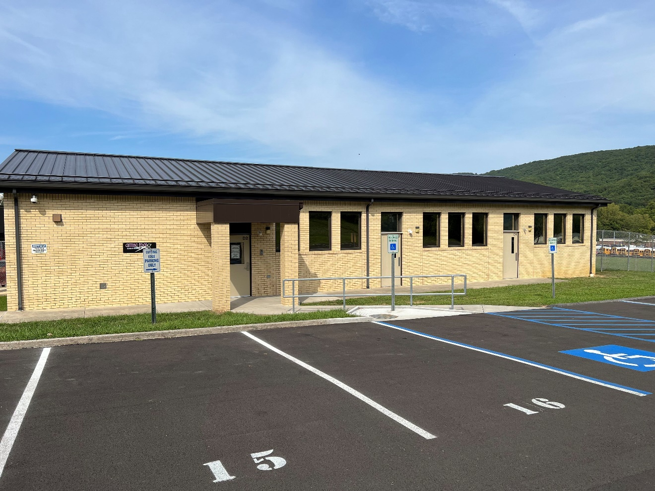
MCS (Multi-County Statewide) Projects
SCHOOL BUILDING AUTHORITY OF WEST VIRGINIA
Funding amount based on 10% of total distributable funds
For Multi-County Career & Technical Centers
Projects that have regional or statewide scopes
Application Process
  Applications normally due in March – April
    SBA Form 203
    Project Budget Estimates
  Evaluated by SBA & WVDE Staff
  Projects Awards are normally in June
Grant County: South Branch CTC Renovations with Cosmetology Entrance 9/21/23

Slide 10
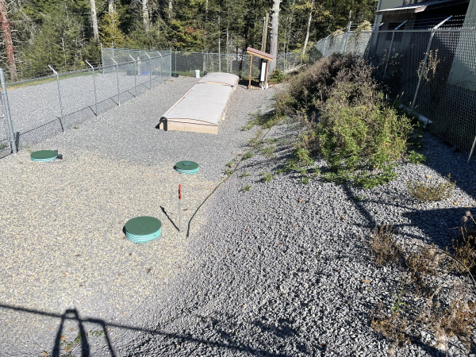
Emergency Grant Projects
SCHOOL BUILDING AUTHORITY OF WEST VIRGINIA
Subject to “Act of God”
Federal, State & Local funds for emergency repairs must be identified and exhausted
Insurance Claims and settlement amounts must be identified and exhausted
Contact SBA Staff immediately
  Please notify immediately of even the “potential” need for emergency funds so SBA Finance staff can create the entry of emergency grant in financial system to memorialize date of event
Application Process
  Immediate notification of event and potential for emergency need
  Letter from Superintendent detailing event
Pocahontas County – 2021 Wastewater Treatment Plant Emergency Request 10/1/21

Slide 11
Distressed County Emergency Grant Projects
SCHOOL BUILDING AUTHORITY OF WEST VIRGINIA
Must be a “Financially Distressed” County
  Defined by WVDE Office of School Finance
Reimbursement Program – County expends funds first
  Purpose to keep the school or major core spaces of a school open & operational
Application Process
  Contact SBA Staff immediately of even the “potential” need for this type of emergency funding so SBA Finance staff can create the entry of emergency grant in financial system to memorialize date of request
  Letter from Superintendent detailing current event and potential need

Slide 12
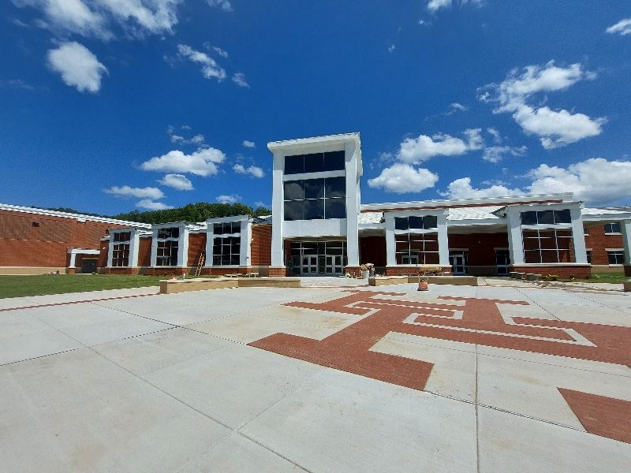
FEMA Grant Projects
SCHOOL BUILDING AUTHORITY OF WEST VIRGINIA
Grants provided through the Federal Emergency Management Authority (FEMA) for school destroyed by natural disasters where the President of the United States and the Governor have declared the areas federal disaster areas.
  Must be requested by the State and approved by FEMA before funds would be awarded.
  SBA works with Governor’s Office and WV Division of Homeland Security to award and monitor grants
Kanawha County: FEMA Project New Herbert Hoover HS 8/19/23

Slide 13
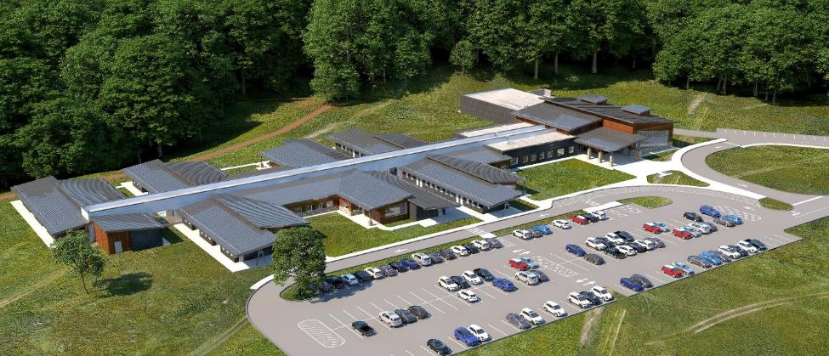
Items Needed for Requisition Reimbursement Processing
SCHOOL BUILDING AUTHORITY OF WEST VIRGINIA
Exhibit B – Requisition Form
SBA Requisition Reconciliation Summary
  Multiple Invoices/PayApps may be submitted within 1 Requisition submission if each Invoice/PayApp is reflected on the SBA Requisition Reconciliation Summary Form and all backup documentation submitted behind that.
Invoices/Pay Apps
  In order of Requisition Reconciliation Summary
  Clean Versions of Invoices (No Markups)
  Pay Apps must be completed with all appropriate signatures and backup Continuation Sheets
  Copies need to be clear and legible
Architect’s rendering of the proposed Clendenin-Bridge Elementary School – Kanawha County

Slide 14
Fiscal Year End Processing / Requisition Submission
SCHOOL BUILDING AUTHORITY OF WEST VIRGINIA
Submissions can be made to SBA at any point
  Not limited to monthly submissions as in the past
SBA Fiscal Year end is June 30
  For MIP Grants, please try to make requisition submissions that will include invoice service dates through the month of May by June 15
    This is Not a FINAL cutoff as these can be submitted afterwards, but helps with our year-end processing/budgets
    Service Dates through June 15 can be submitted as well if available at that time interval
Construction Fund (NEEDS/MCS) have 13th month ending July 31
  For NEEDS/MCS grants, please try to make requisition submissions that will include invoice service dates through June 30 by July 15.
    This is not a FINAL cutoff as these can be submitted afterwards, but helps with our year-end processing/budgets
    For 13th month transactions, ONLY invoices service dates through June 30 can be processed with 13th month funds
    Anything with dates after June 30 will be processed in the next Fiscal Year
We make Cash Flow, Budget and Forecasting reports based upon these dates and remaining balances. This is very important to ensure that we provide the best service to you.

Slide 15
Common Delays in Requisition Reimbursement Processing
SCHOOL BUILDING AUTHORITY OF WEST VIRGINIA
Note: Documentation must be approved by SBA Finance Staff and the WV State Auditor’s Office (WVSAO) before processing reimbursement
Personally Identifiable Information on backup documents
  Account Numbers
  Banking Information
  Check Numbers
  FEIN
  Other forms of PII
Incorrect Date(s) of Service
  Ensure that Requisition Dates of Service match to periods of time (i.e., PayApp from Contractor stating “through 8/31/23” should most likely be a period from 8/1/23 through 8/31/23, not just 8/31/23)
  Please try to have Contractors, etc. note dates in the margins of PayApps.
  WVSAO concerned that large dollar requisitions most likely covered a certain time period rather than one day.
Information inconsistent between Reconciliation Summary and Backup documents
Reimbursement requests outside of Grant Award period
Not providing Grant Award Numbers in correspondence

Slide 16
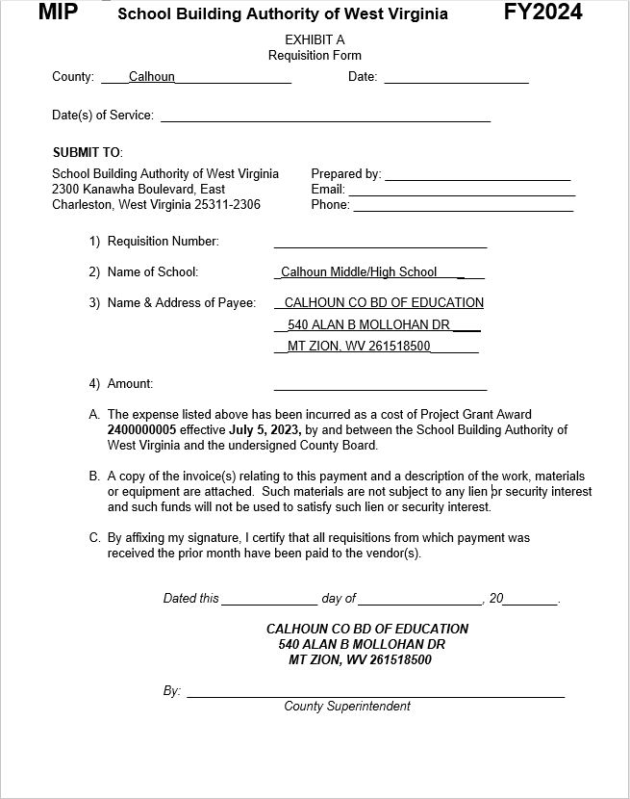
Requisition Reimbursement Form Examples
SCHOOL BUILDING AUTHORITY OF WEST VIRGINIA
16

Slide 17
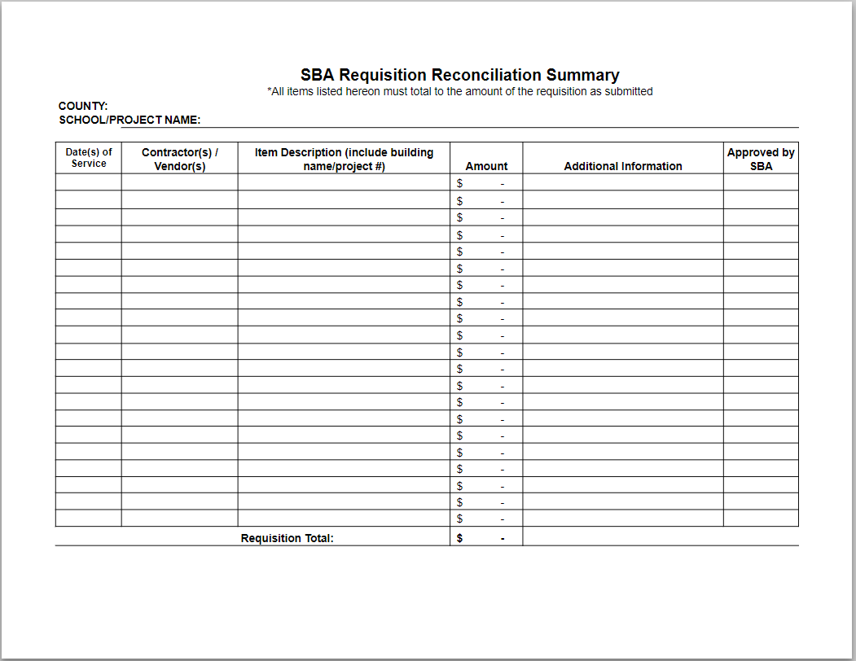
Requisition Reimbursement Form Examples (Continued)
SCHOOL BUILDING AUTHORITY OF WEST VIRGINIA
SBA Requisition Reconciliation Summary Form
17

Slide 18
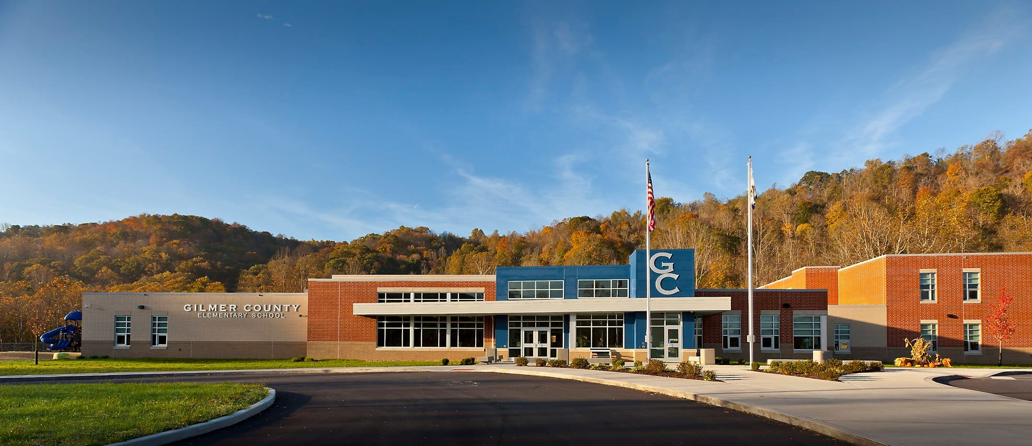
SBA Requests When Providing Final Project Invoices
SCHOOL BUILDING AUTHORITY OF WEST VIRGINIA
Sworn Statements of Expenditures and SAGA compliance no longer required (Reimbursement Grants)
Email architect or provide memorandum with final invoice
  Must state that this is final invoice and no further billing forthcoming
  This sets up Closeout Process
Please provide SBA 502 Closeout Form
  If someone other than individual preparing requisitions is responsible for closeout, please ensure that others that need to know of closeout are informed
For projects such as roofs, HVAC, etc., remember to set aside depreciation funds
Entrance of the new Gilmer Elementary School – Gilmer County
18

Slide 19
Grant Closeout Requirements
SCHOOL BUILDING AUTHORITY OF WEST VIRGINIA
As previously mentioned, email architect or provide memorandum with final invoice stating that this is final invoice, and no further invoicing is forthcoming
SBA 502 Closeout Form
WVEIS Backup Information
For projects such as roofs, HVAC, etc., remember to set aside depreciation funds over the useful life of the item.

Slide 20
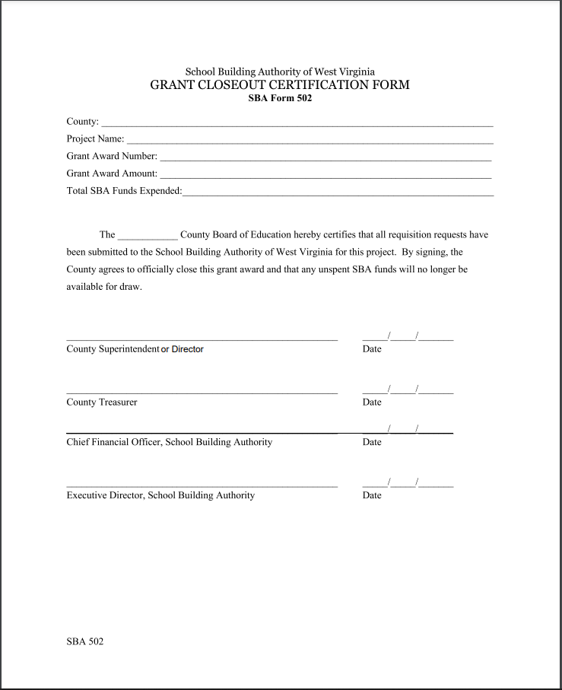
SBA 502 Grant Closeout Form
SCHOOL BUILDING AUTHORITY OF WEST VIRGINIA
20

Slide 21
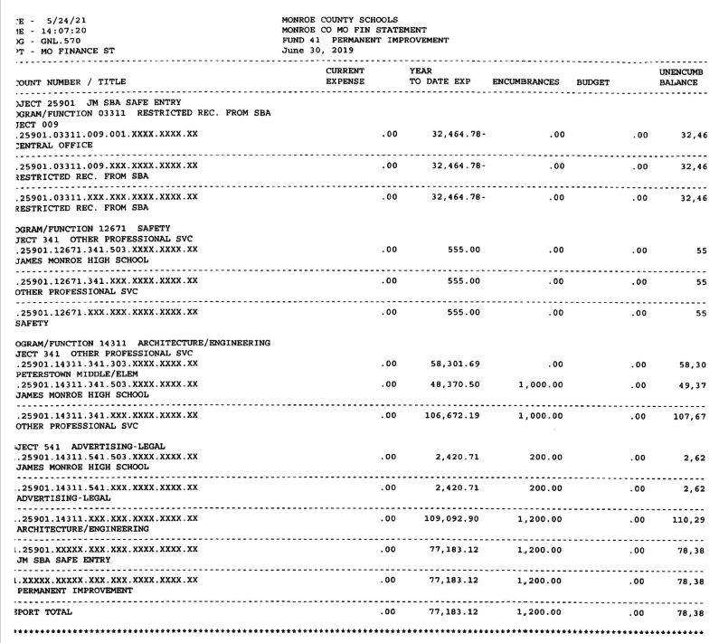
WVEIS Backup Information Example
SCHOOL BUILDING AUTHORITY OF WEST VIRGINIA
WVEIS Backup Information
21

Slide 22
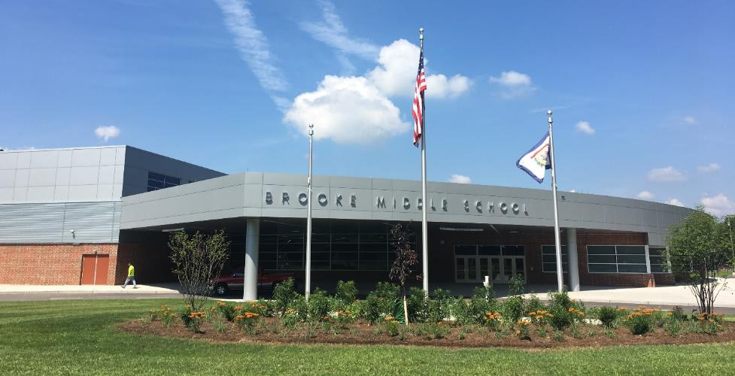
Common Issues in Grant Closeout Processing
SCHOOL BUILDING AUTHORITY OF WEST VIRGINIA
Information not provided in a timely manner
SBA 502 Form not provided with Final Invoicing
Not responding to emails requesting closeout requirements
Entrance of the new Brooke Middle School – Brooke County

Slide 23
Contact Information
SCHOOL BUILDING AUTHORITY OF WEST VIRGINIA
School Building Authority of West Virginia
2300 Kanawha Blvd., East
Charleston, WV 25311
304-558-2541
sba.wv.gov
Jordan.L.Kirk@wv.gov
23

